Slide 1
Chapter 2
Motion in One Dimension

Slide 2
Dynamics
Dynamics is the branch of physics involving the motion of an object and the relationship between that motion and other physics concepts
Kinematics is a part of dynamics
In kinematics, we are interested in the description of motion
Not concerned with the cause of the motion

Slide 3
Quantities in Motion
Any motion involves three physical concepts
Displacement
Velocity
Acceleration
These concepts can be used to study objects in motion

Slide 4
Definition of Position
Position of an object is defined in terms of a frame of reference – coordinate system
A choice of coordinate axes
Defines a starting point for measuring the motion – the origin
In this chapter, we shall concentrate on one dimensional motion, so generally the x- axis is used.

Slide 5
Displacement
Displacement is defined as the change in position
Here, f stands for the final state and i stands for the initial state
Displacement can be either “+” or “-”
Units are meters (m) in SI

Slide 6
Vector and Scalar Quantities
Vector quantities need both magnitude (size) and direction to completely describe them
In one-dimensional motion, because there are only two directions, “+” or “–” sign of the quantities is sufficient to specify the direction
Scalar quantities are completely described by magnitude only
Displacement is a vector

Slide 7
Examples of a vector quantity:
Displacement, velocity, acceleration, force, torque, momentum, angular momentum
Examples of a scalar quantity:
Mass, density, temperature, weight, volume, speed, work, kinetic energy, potential energy

Slide 8
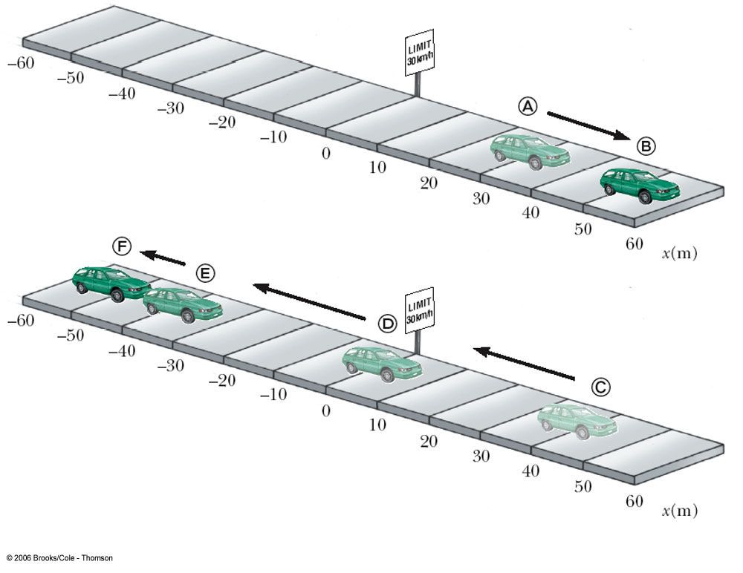
Displacement Examples
From A to B
x_{i} = 30 m
x_{f} = 52 m
Δx = 22 m
The displacement is positive, indicating the motion was in the positive x direction
From C to F
x_{i} = 38 m
x_{f} = -53 m
Δx = -91 m
The displacement is negative, indicating the motion was in the negative x direction

Slide 9
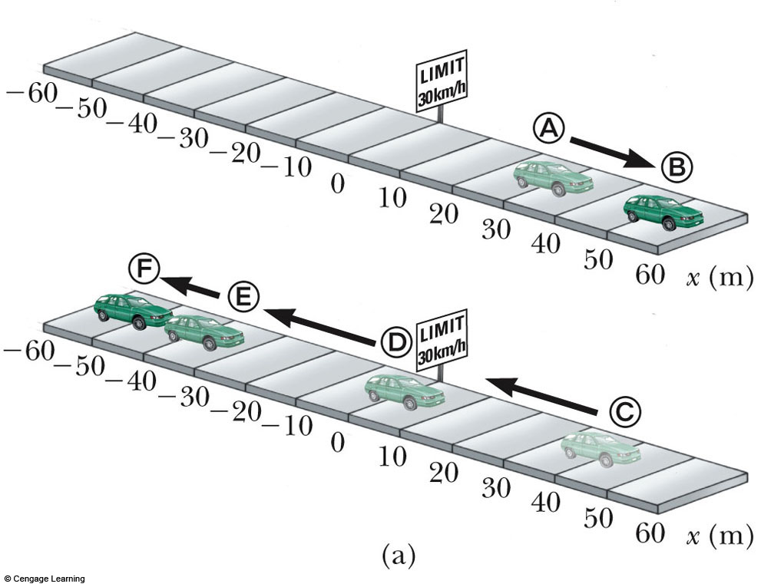
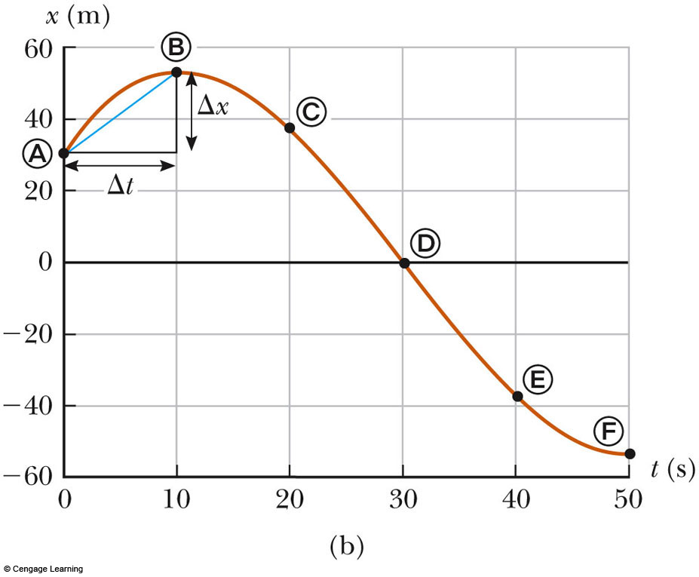
Graphical representation of Displacement

Slide 10
Displacement Isn’t Distance
The displacement of an object is not the same as the distance it travels
Example: Throw a ball straight up and then catch it at the same point as it was released
The distance is twice the height
The displacement is zero

Slide 11
Speed
The average speed of an object is defined as the total distance traveled divided by the total time elapsed
Speed is a scalar quantity

Slide 12
Speed, cont
Average speed totally ignores any variations in the object’s actual motion during the trip
The total distance and the total time are all that is important
Both the total distance and total time elapsed are positive, so speed is a positive quantity
SI units are m/s

Slide 13
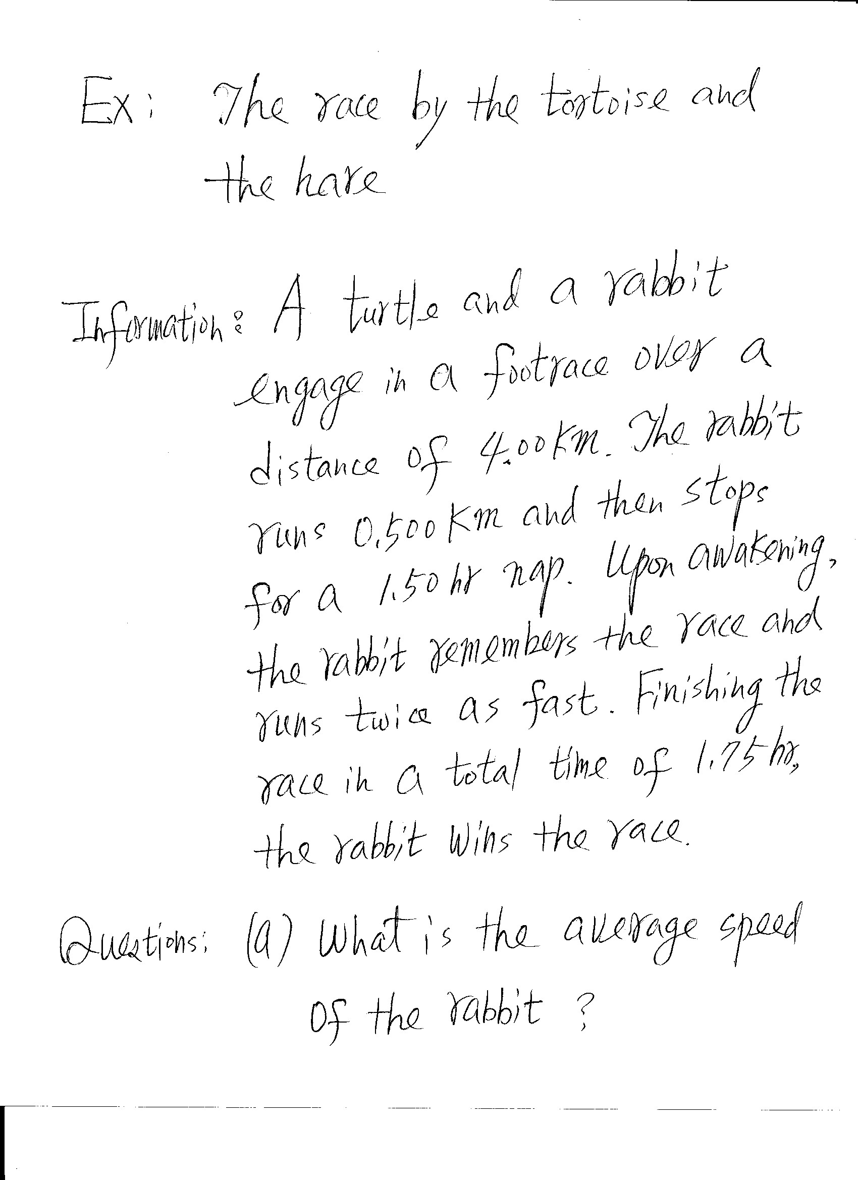

Slide 14
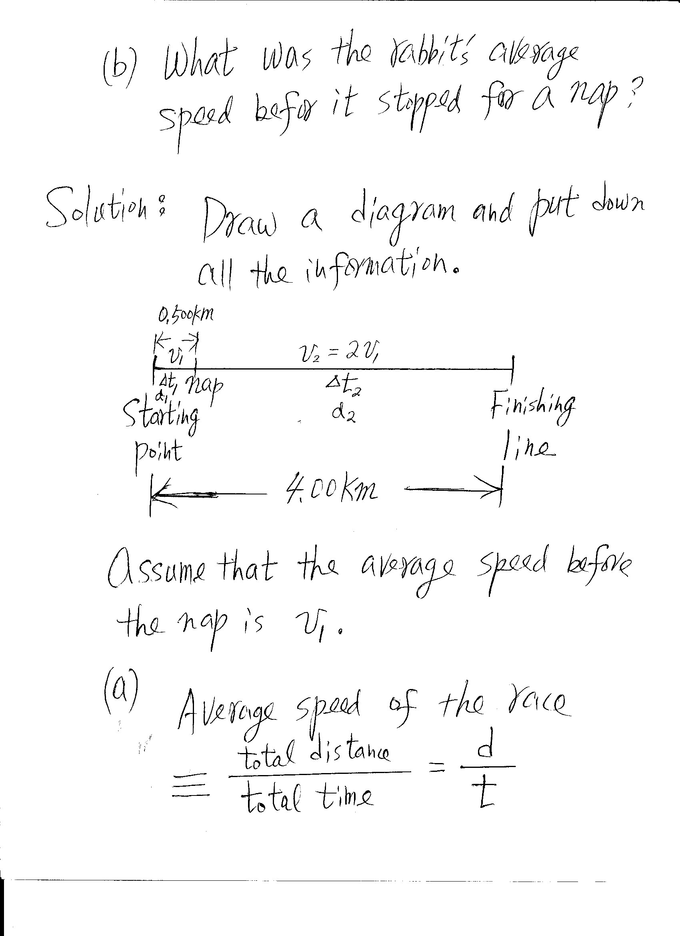

Slide 15
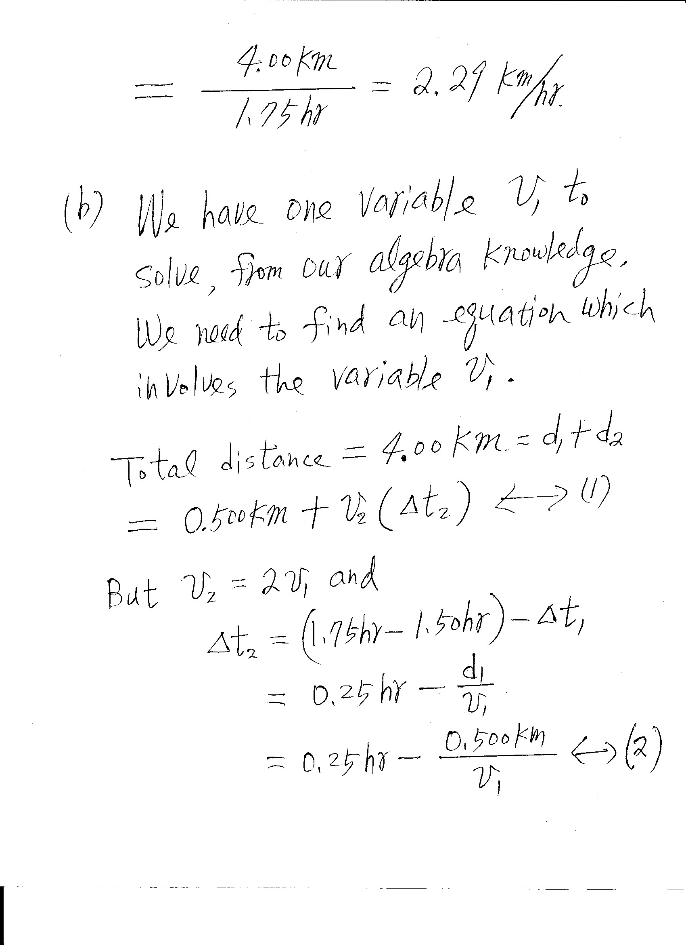

Slide 16
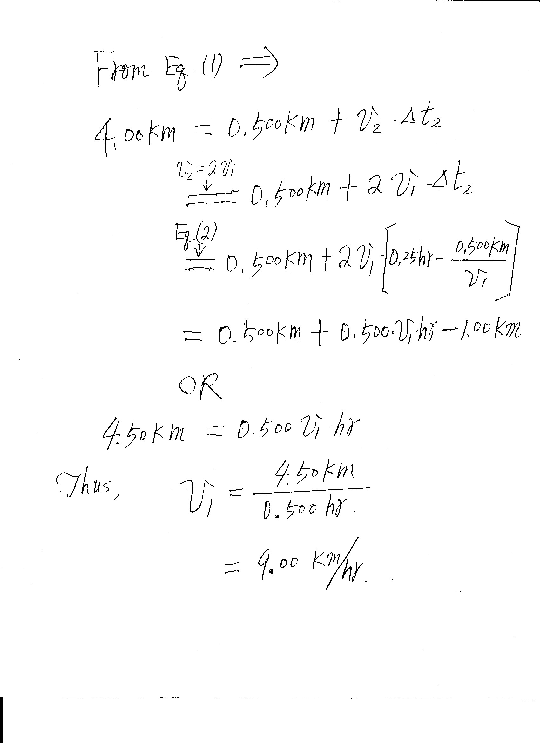

Slide 17
Velocity
It takes time for an object to undergo a displacement
The average velocity is the rate of change of displacement
Velocity is a vector quantity. It can be positive or negative, depending upon the sign of displacement
Note: Δt is always positive

Slide 18
Velocity continued
Direction will be the same as the direction of the displacement
Units of velocity are m/s (SI)

Slide 19
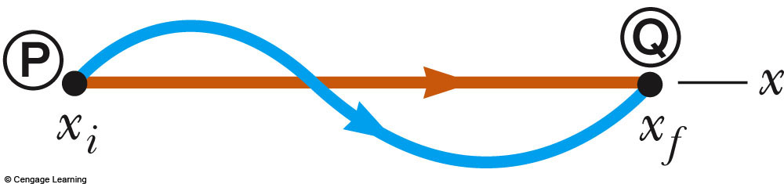
Speed vs. Velocity
Cars on both paths have the same average velocity since they had the same displacement in the same time interval, assuming that these two cars take the same time to go from P to Q
The car on the blue path will have a greater average speed since the distance it traveled is larger

Slide 20
Notes on Slopes
The general equation for the slope of any straight line is
The meaning of a specific slope will depend on the physical data being graphed
Slope carries units

Slide 21
Graphical Interpretation of Velocity
Velocity can be determined from a position-time graph
From the definitions of the average velocity and the slope, average velocity equals the slope of the line joining the initial and final positions in a position - time graph
An object moving with a constant velocity will have a graph that is a straight line in a position – time graph

Slide 22
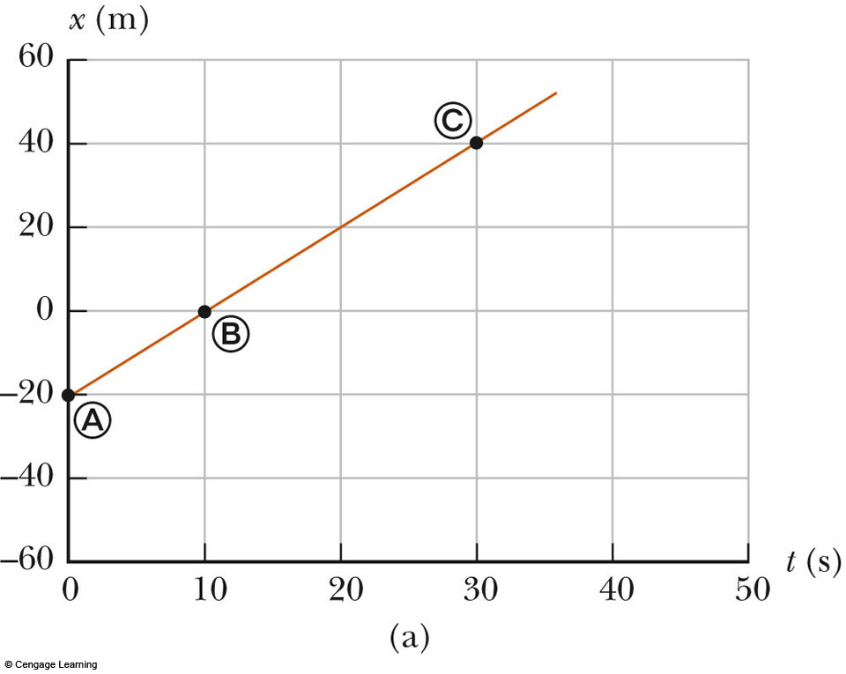
Average Velocity, Constant
The slope of the straight line is the average velocity
The straight line in the position – time graph indicates velocity is a constant

Slide 23
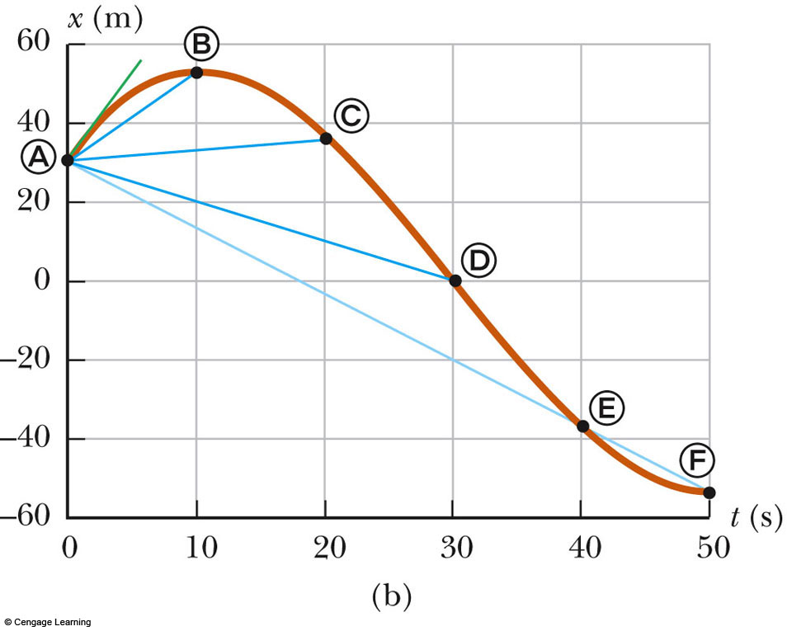
Average Velocity, Non Constant
The average velocity is the slope of the straight line joining the initial and final points
The motion is non-constant velocity

Slide 24
Instantaneous Velocity
The limit of the average velocity as the time interval becomes infinitesimally short, or as the time interval approaches zero
The instantaneous velocity indicates the velocity at a given instant of time

Slide 25
Instantaneous Velocity on a Graph
The slope of the straight line tangent to the position-vs.-time graph at a given time is defined to be the instantaneous velocity at that time
The instantaneous speed is defined as the magnitude of the instantaneous velocity

Slide 26
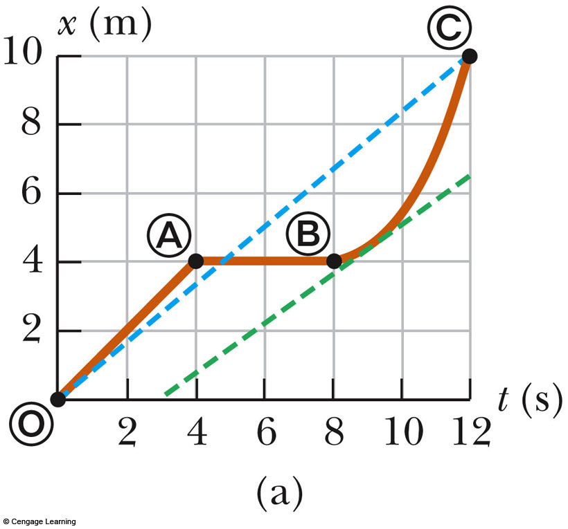

Slide 27
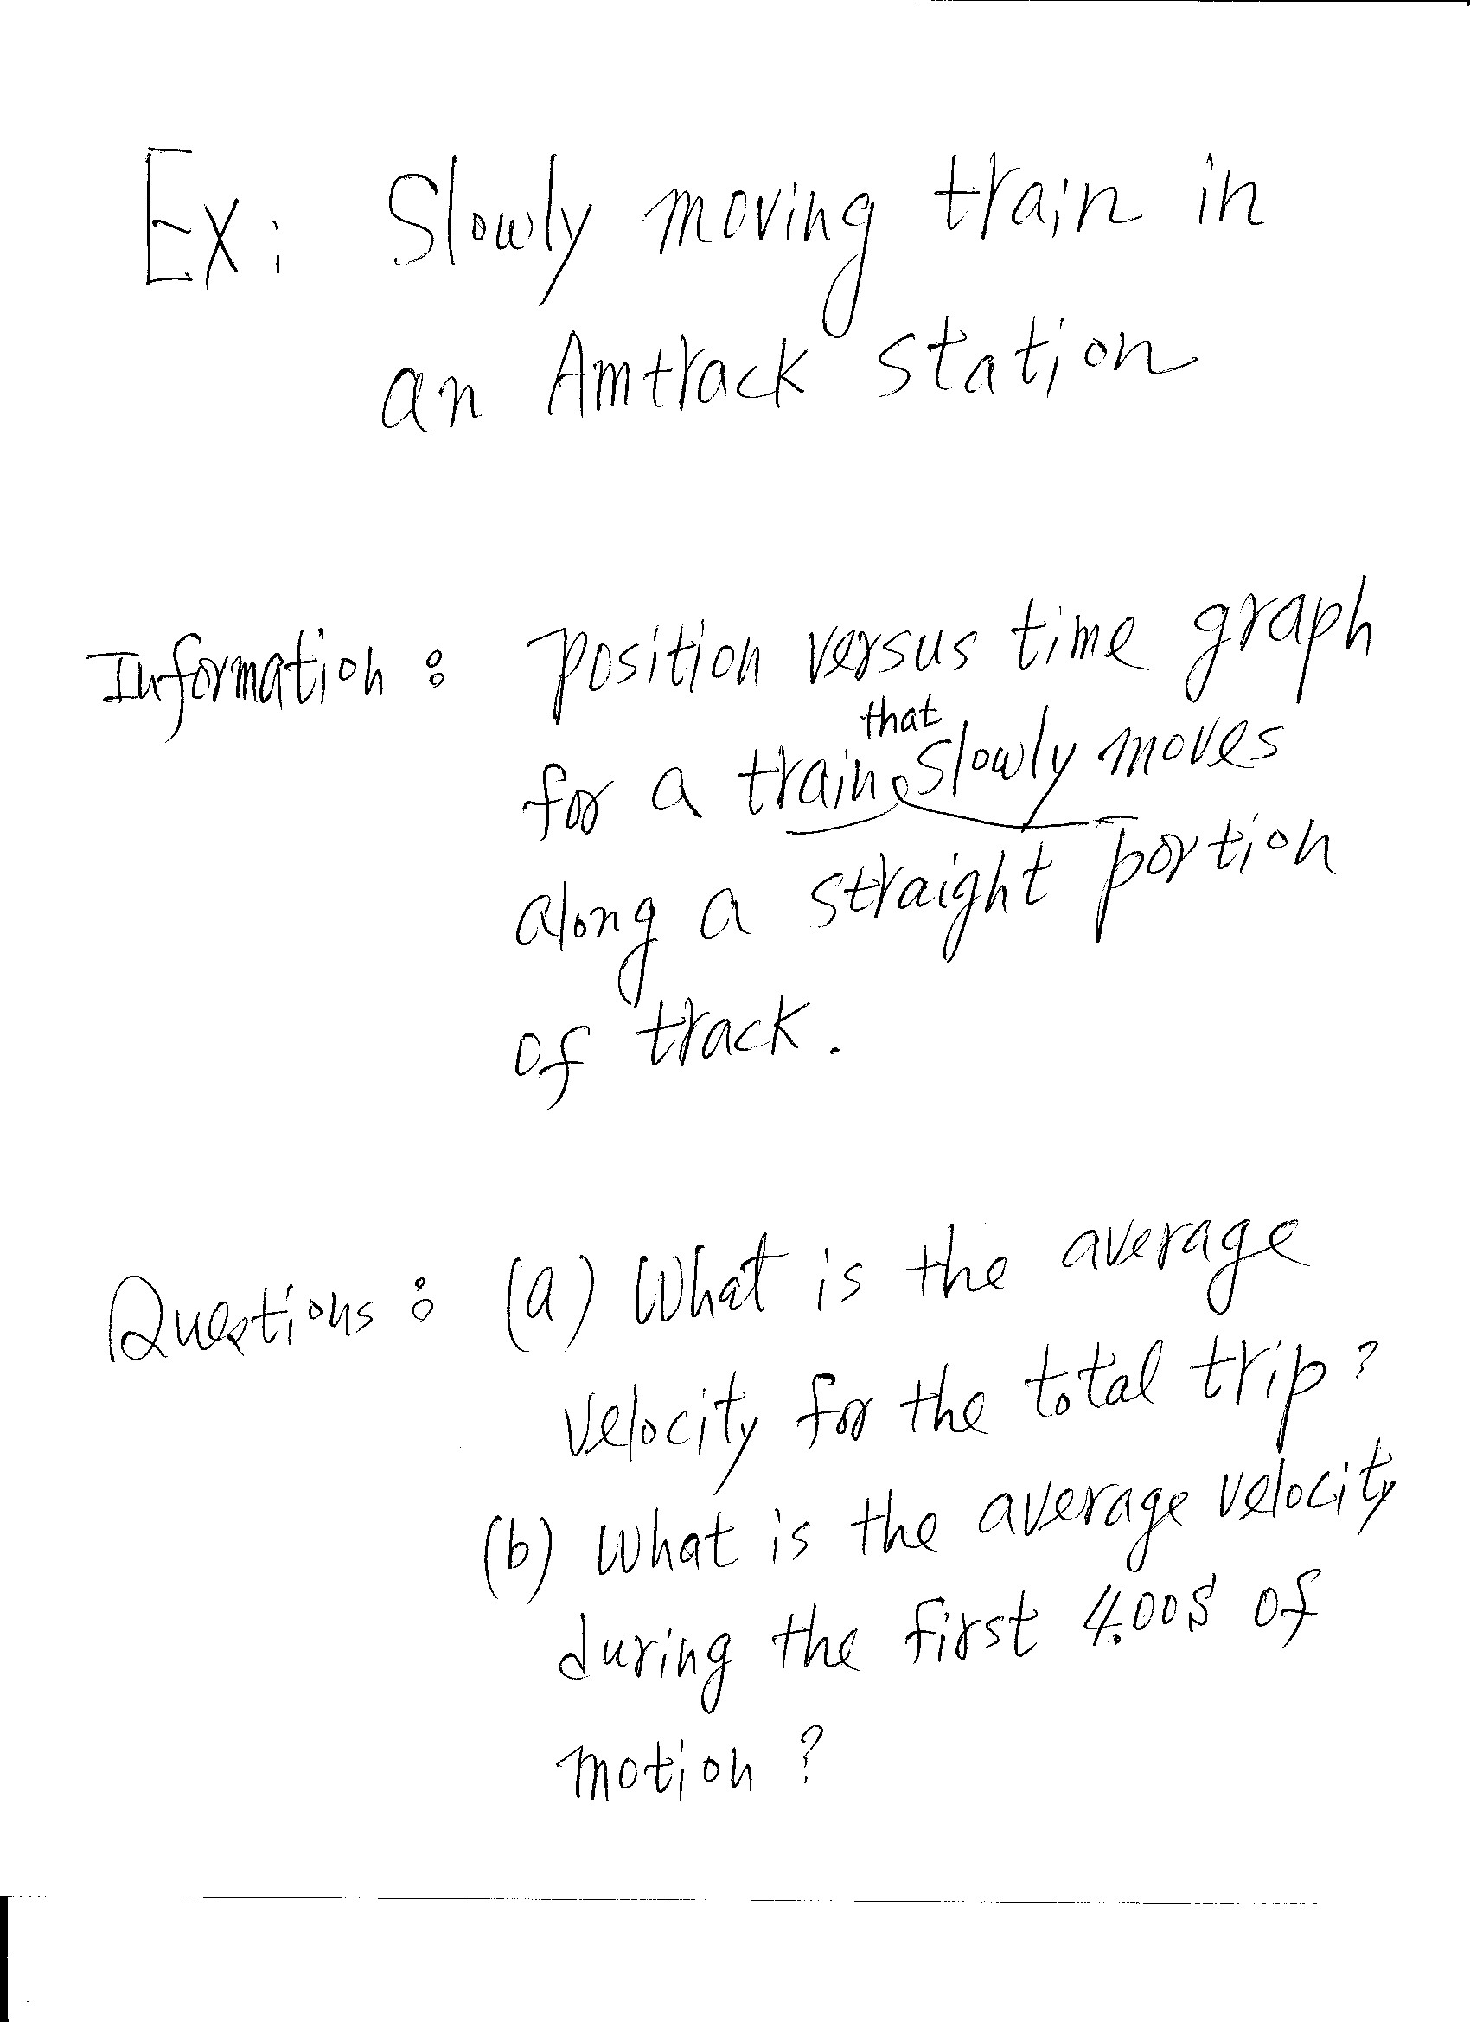

Slide 28
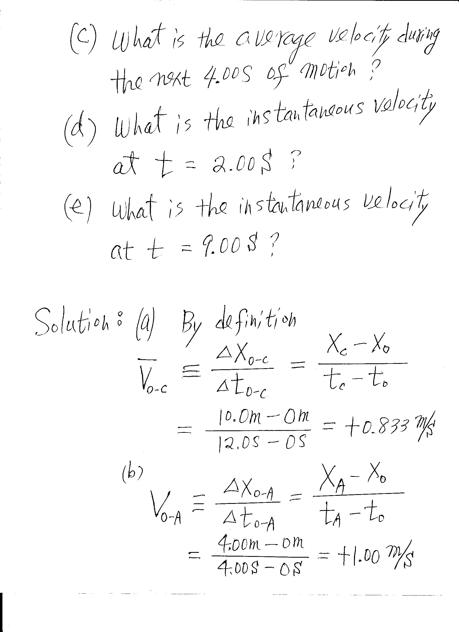

Slide 29
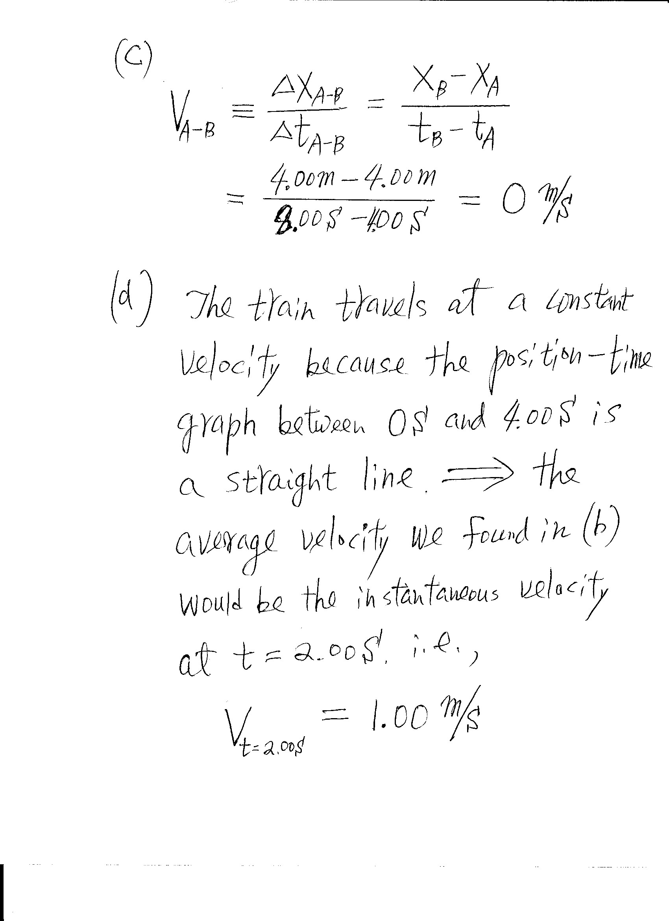

Slide 30
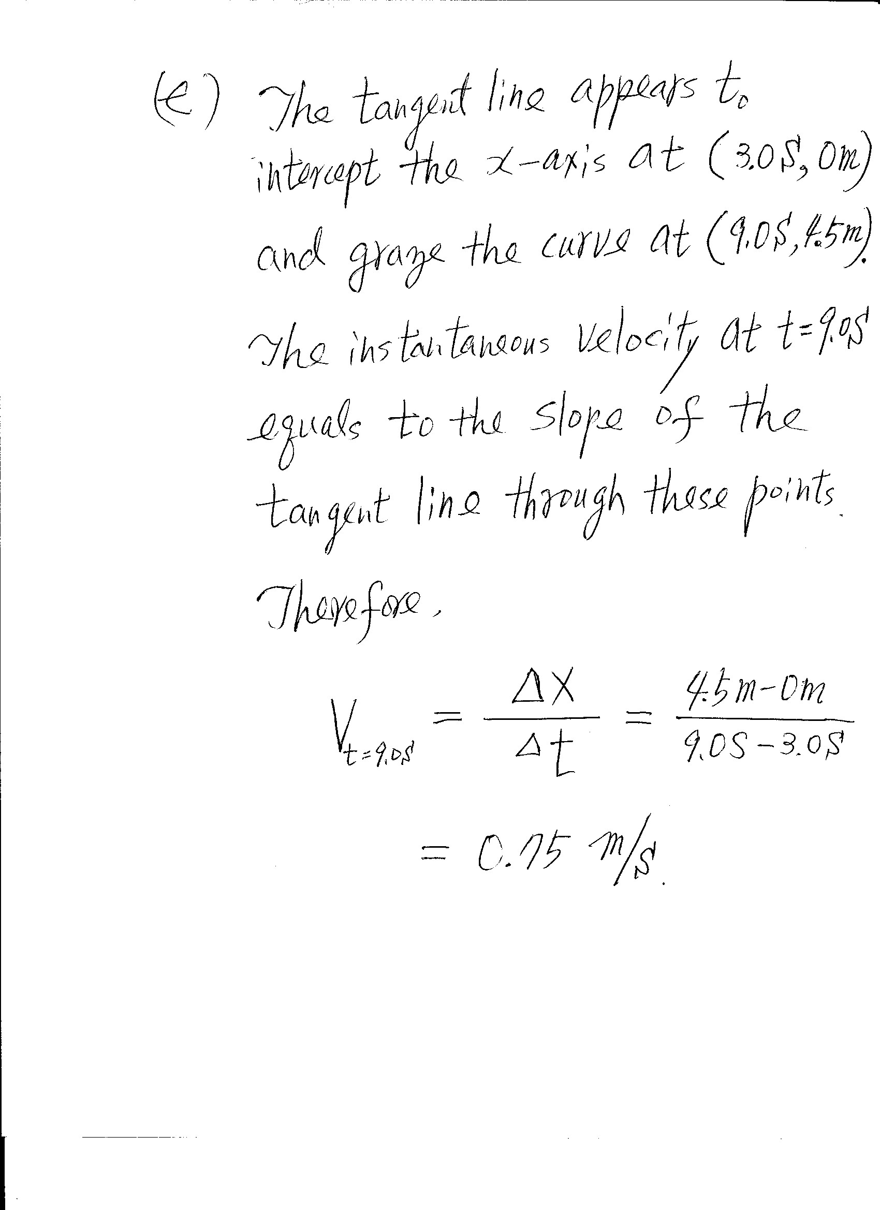

Slide 31
Average Acceleration
Changing velocity means an acceleration is present
Average acceleration is defined as the rate of change of velocity
Units are m/s² (SI)

Slide 32
Average Acceleration
Average acceleration is a vector quantity
When the sign of the velocity and the acceleration are the same (either positive or negative), then the speed is increasing
When the sign of the velocity and the acceleration are in the opposite directions, the speed is decreasing

Slide 33
Negative Acceleration
A negative acceleration does not necessarily mean the object is slowing down
If the acceleration and velocity are both negative, the object is speeding up (along the negative direction)

Slide 34
Instantaneous and Uniform Acceleration
Instantaneous acceleration is obtained by taking the limit of the average acceleration as the time interval goes to zero
When the instantaneous accelerations are always the same at any moment, the acceleration will be uniform and the instantaneous acceleration at any instant will all be equal to the average acceleration

Slide 35
Graphical Interpretation of Acceleration
From definitions of the average acceleration and the slope, average acceleration is the slope of the straight line connecting the initial and final velocities on a velocity-time graph
Instantaneous acceleration at a given time is the slope of the straight line tangent to the curve of the velocity-time graph at that instant

Slide 36
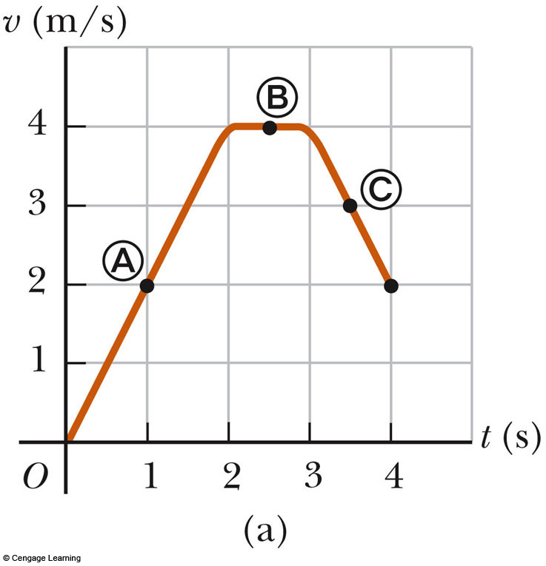

Slide 37
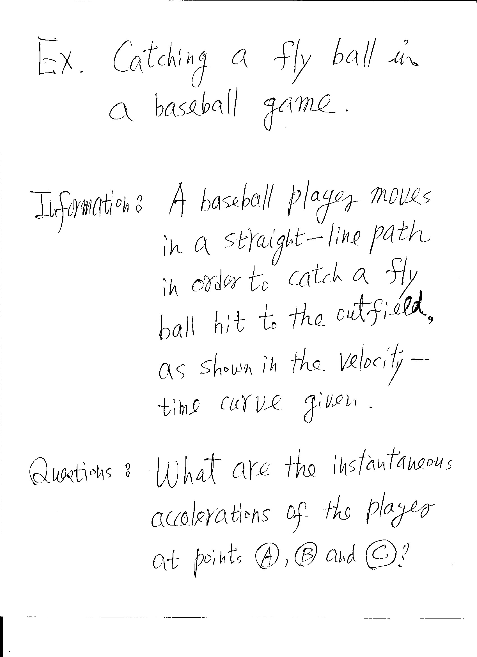

Slide 38
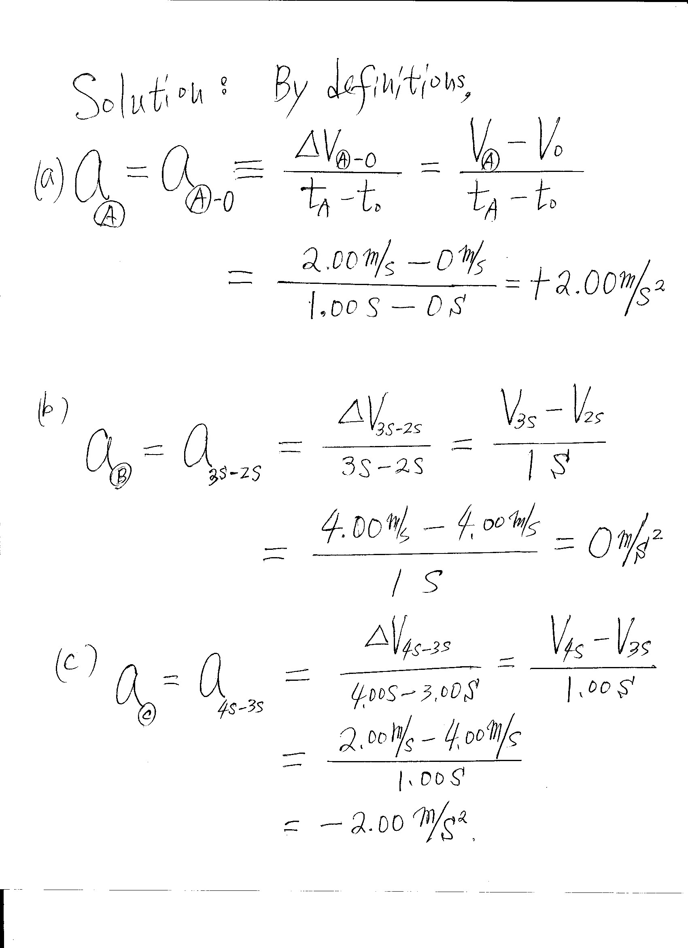

Slide 39
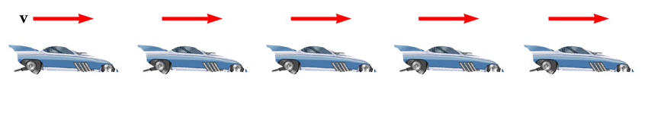
Relationship Between Acceleration and Velocity
Uniform velocity (shown by red arrows maintaining the same size)
Acceleration equals zero

Slide 40
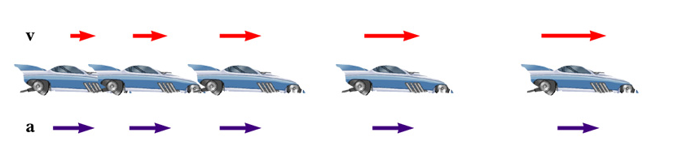
Relationship Between Velocity and Acceleration
Velocity and acceleration are in the same direction
Acceleration is uniform (blue arrows maintain the same length)
Velocity is increasing (red arrows are getting longer)
Positive velocity and positive acceleration

Slide 41
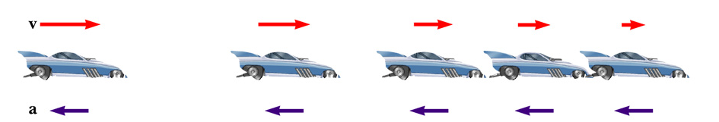
Relationship Between Velocity and Acceleration
Acceleration and velocity are in opposite directions
Acceleration is uniform (blue arrows maintain the same length)
Velocity is decreasing (red arrows are getting shorter)
Velocity is positive and acceleration is negative

Slide 42
Kinematic Equations
Used in situations with uniform (or constant) acceleration

Slide 43
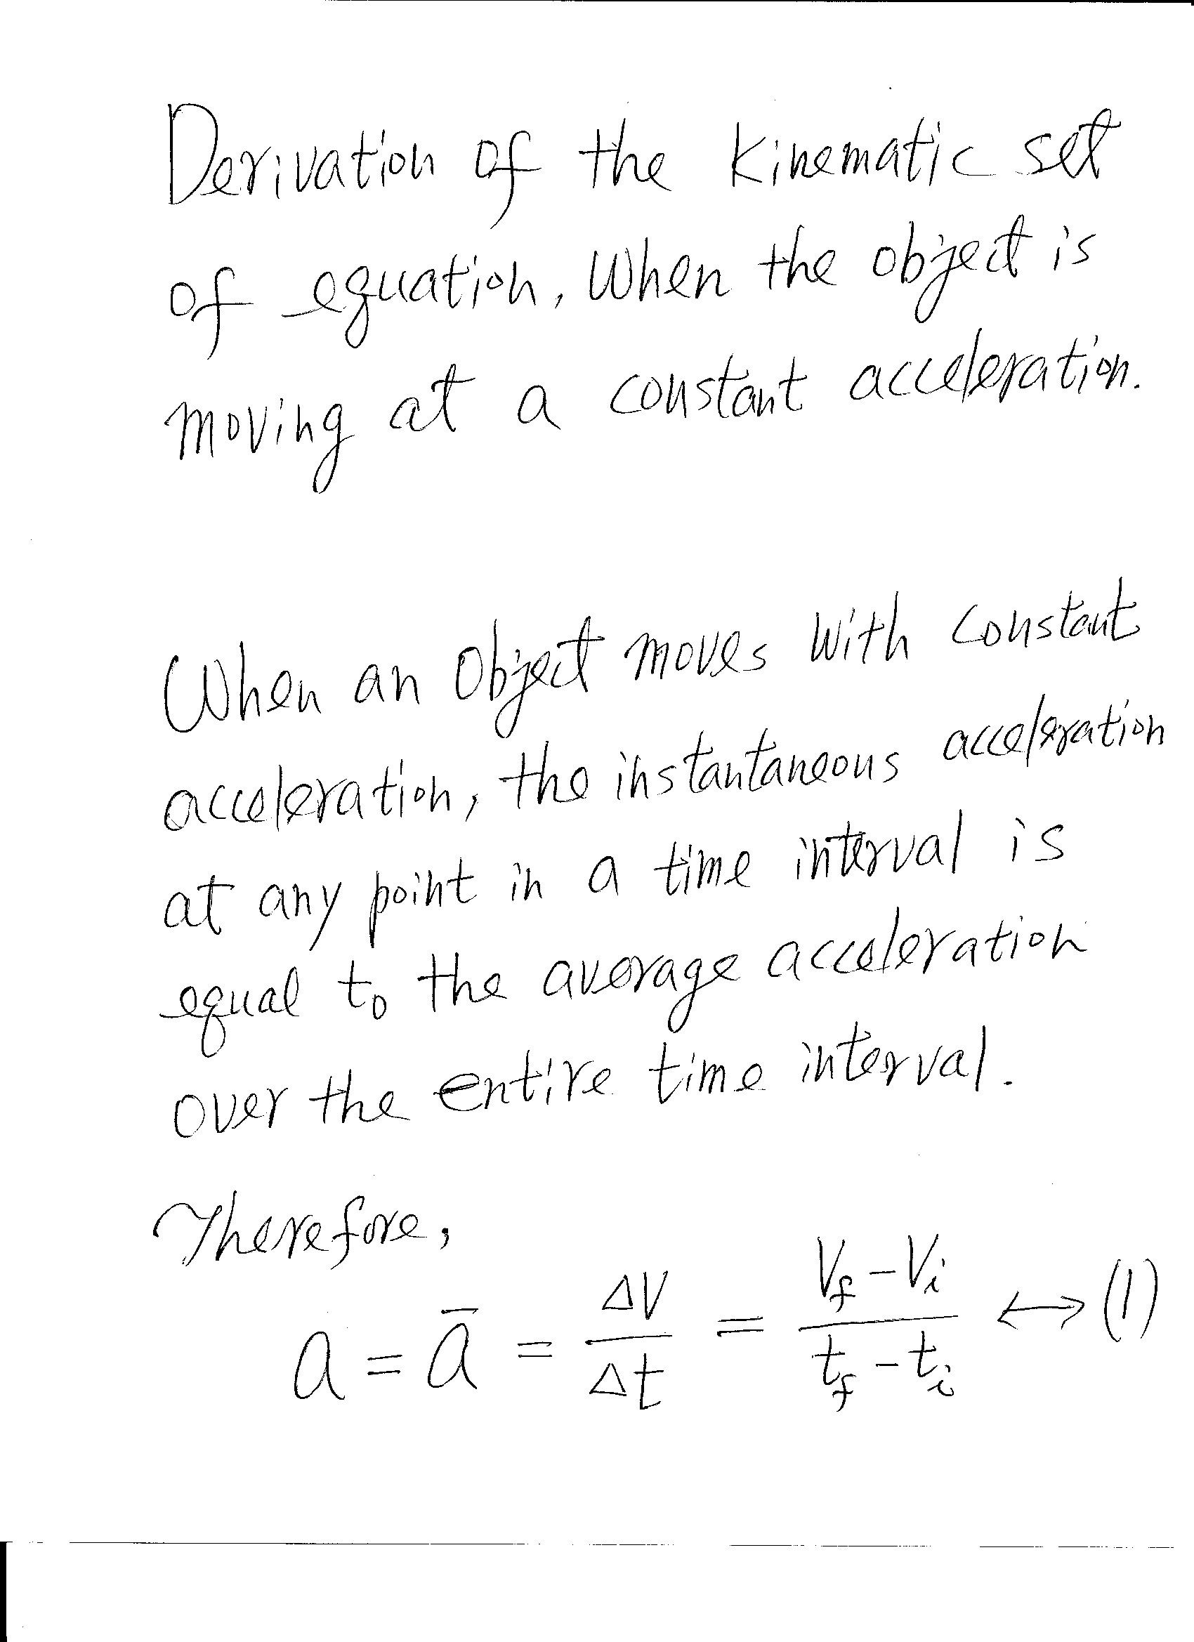

Slide 44
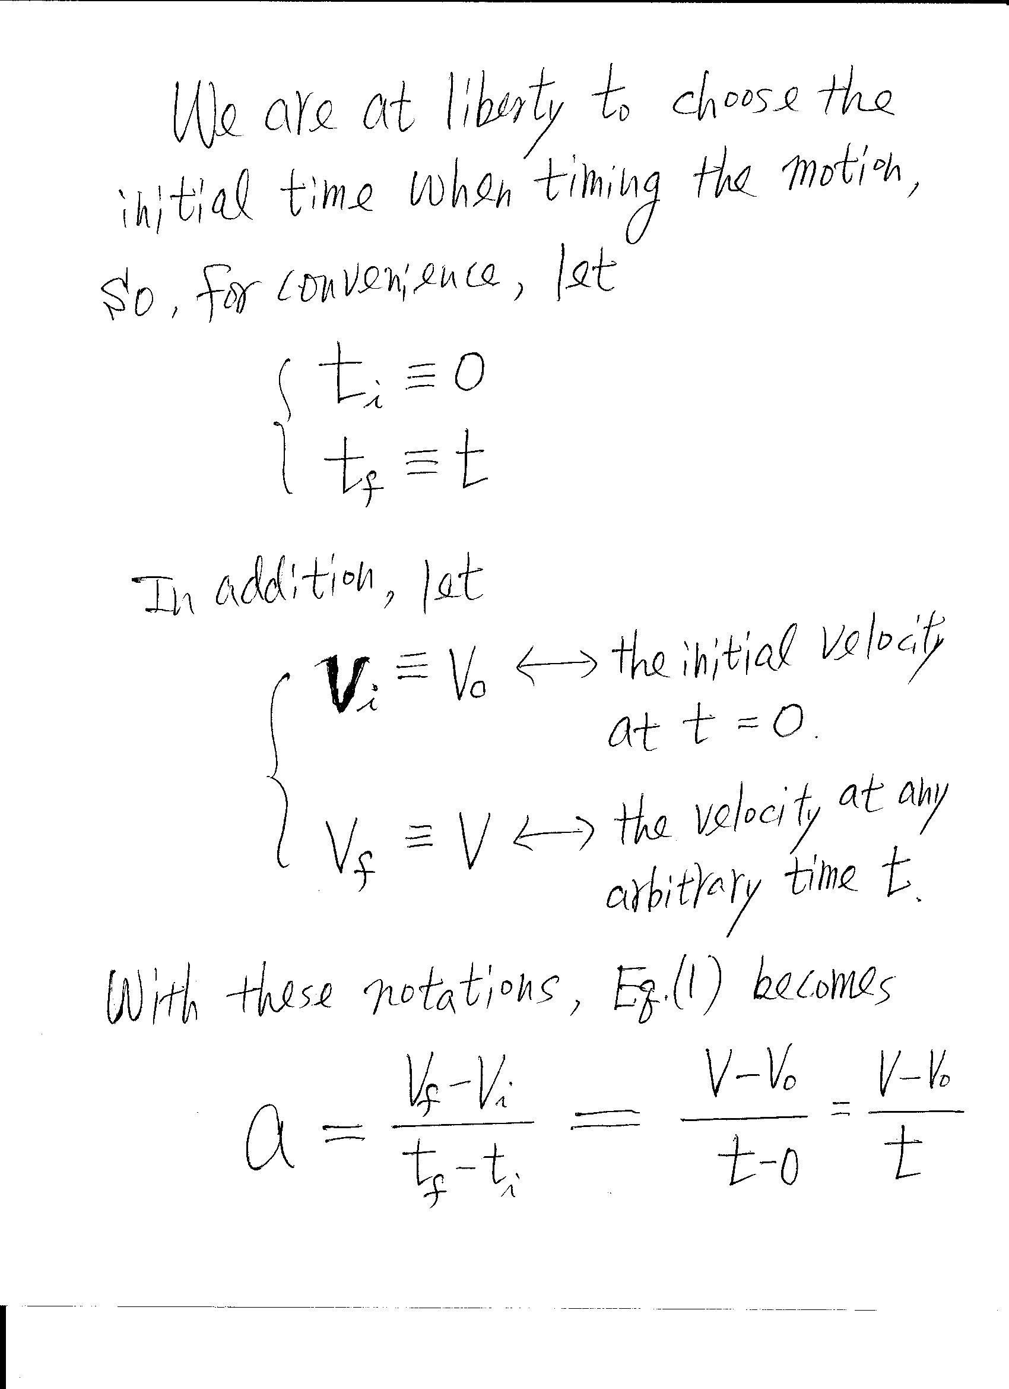

Slide 45
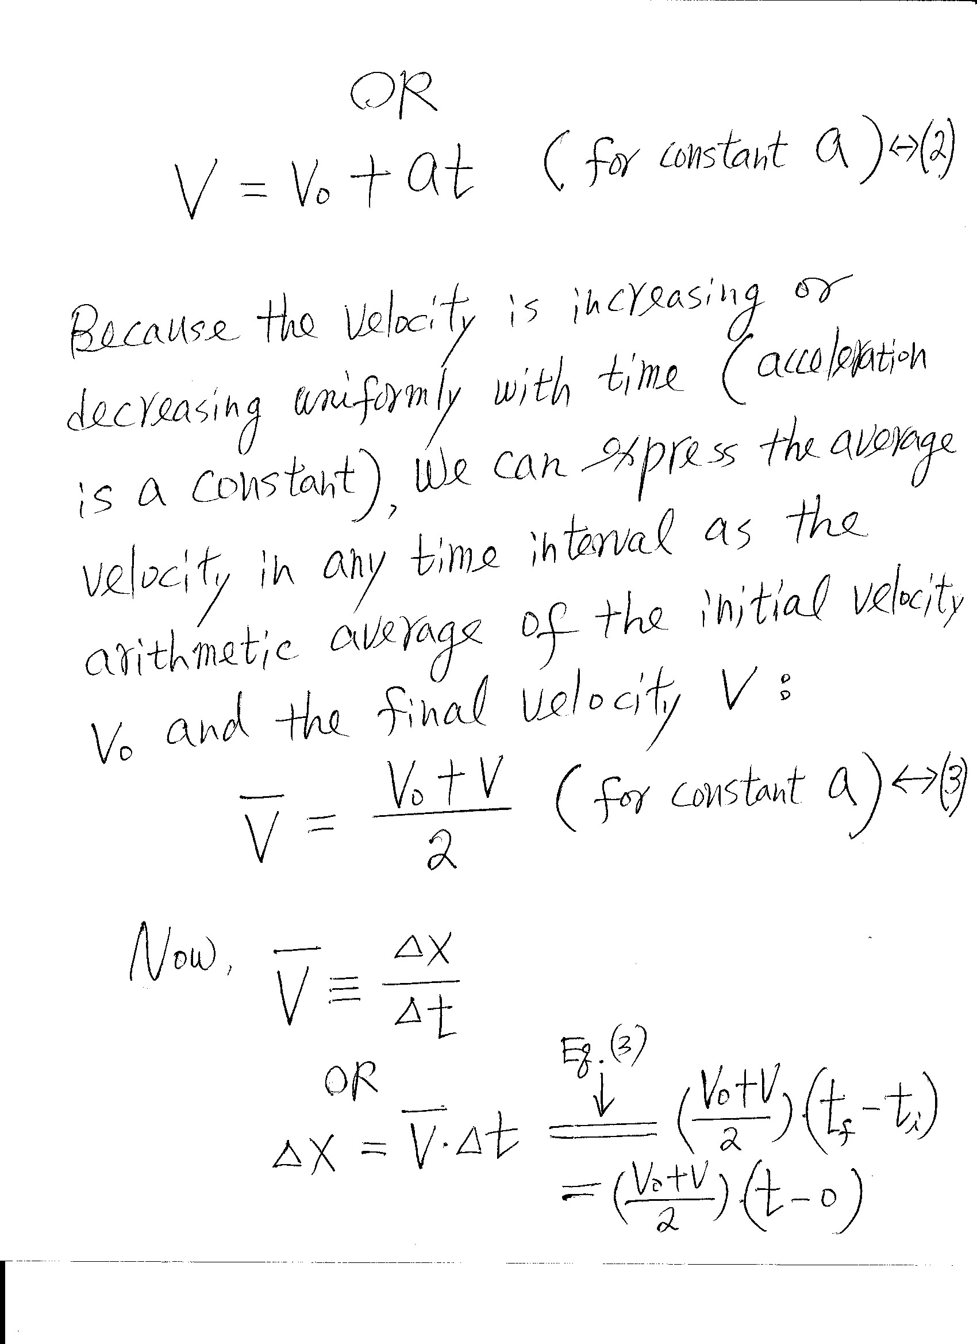

Slide 46
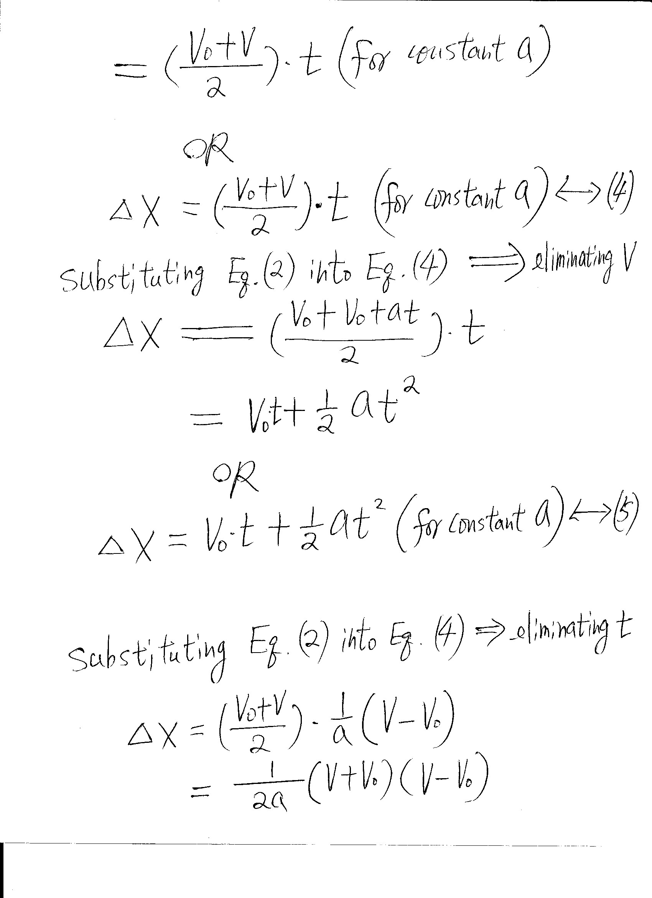

Slide 47
