Slide 1
CheapPhone Lab
Test Beyond the Flagship.
A developer testing & diagnostics platform built to uncover, prioritize and reproduce application failures under realistic Indian mobile hardware and telecom conditions.
HackFront India 2026 — Track T1.2: AI & Developer Tools
Target Track: Neo4j Graph Database Track | Prototype Demonstration

Slide 2
CHEAPPHONE LAB | HACKFRONT INDIA 2026
The Problem: The Flagship Fallacy in Indian App Development
01
Hardware Reality Gap
Flagship vs. Sub-₹8,000 Phones
• Developers test on 8GB-12GB RAM phones over 300Mbps broadband Wi-Fi.
• Over 400M Indian users use sub-₹8k phones with 1GB-2GB RAM (Android Go edition).
• Aggressive Low Memory Killers (LMK) kill app activities abruptly during transit.
02
Telecom & Storage Bottlenecks
2G/EDGE & Constrained Flash
• Commuter travel in tier-2/3 cities causes RTT latency spikes > 1500ms and 30%+ packet loss.
• Low remaining internal storage (< 500MB) causes SQLite databases to crash with SQLITE_FULL.
• Battery Saver governors throttle CPU clock down to 800MHz little cores, causing ANRs.
03
Silent User Abandonment
Catastrophic Churn
• Uncaught OOMs and frozen UIs cause users to uninstall apps immediately without sending bug reports.
• Duplicate form & order submissions occur because slow networks lag button debounce logic.
• Engineering teams lack tools to model and reproduce these stress realities locally.

Slide 3
CHEAPPHONE LAB | HACKFRONT INDIA 2026
The Solution: CheapPhone Lab Core Capabilities
⚡ Dual-Mode Testing
Mode A: Deterministic zero-device simulation engine. Mode B: Real ADB emulator & Logcat integration.
📱 Indian Budget Profiles
Pre-configured hardware profiles modeling 1GB-2GB RAM margins, Android Go editions, and tight flash storage.
🌐 Realistic Network Shaping
Presets for 2G/EDGE (128kbps), high latency (RTT > 1500ms), elevator disconnects, and packet jitter.
⚠️ 12 Failure Categories
Detects Out-of-Memory crashes, ANR looper stalls, socket timeouts, lost activity state, and double submissions.
📊 Transparent Impact Model
Quantifies affected users based on condition prevalence and target population with P0-P3 priority scoring.
🕸️ Neo4j Graph Explorer
Graph pattern matching across Application -> Feature <- Failure <- TestRun -> Condition -> UserSegment.

Slide 4
CHEAPPHONE LAB | HACKFRONT INDIA 2026
Project Workflow: From Configuration to Hotfix Recipe
STEP 1
Configure Test Lab
Select budget profile, network preset (2G/3G), storage margin, memory pressure, and battery saver.
STEP 2
Execute Scenario
Run deterministic simulation rules (instant) or launch controlled ADB Logcat on connected emulator.
STEP 3
Discover Failures
App isolates OOM stacktraces, ANRs, socket timeouts, and state loss across affected app features.
STEP 4
Impact Triage
Calculate estimated user reach: Population × Condition Prevalence × Failure Probability.
STEP 5
Neo4j Graph Analysis
Traverse cross-run patterns to identify systemic hardware constraints causing correlated crashes.
STEP 6
Export Reproduction
Download actionable step-by-step reproduction recipes in Markdown and JSON for engineering sprint hotfixes.

Slide 5
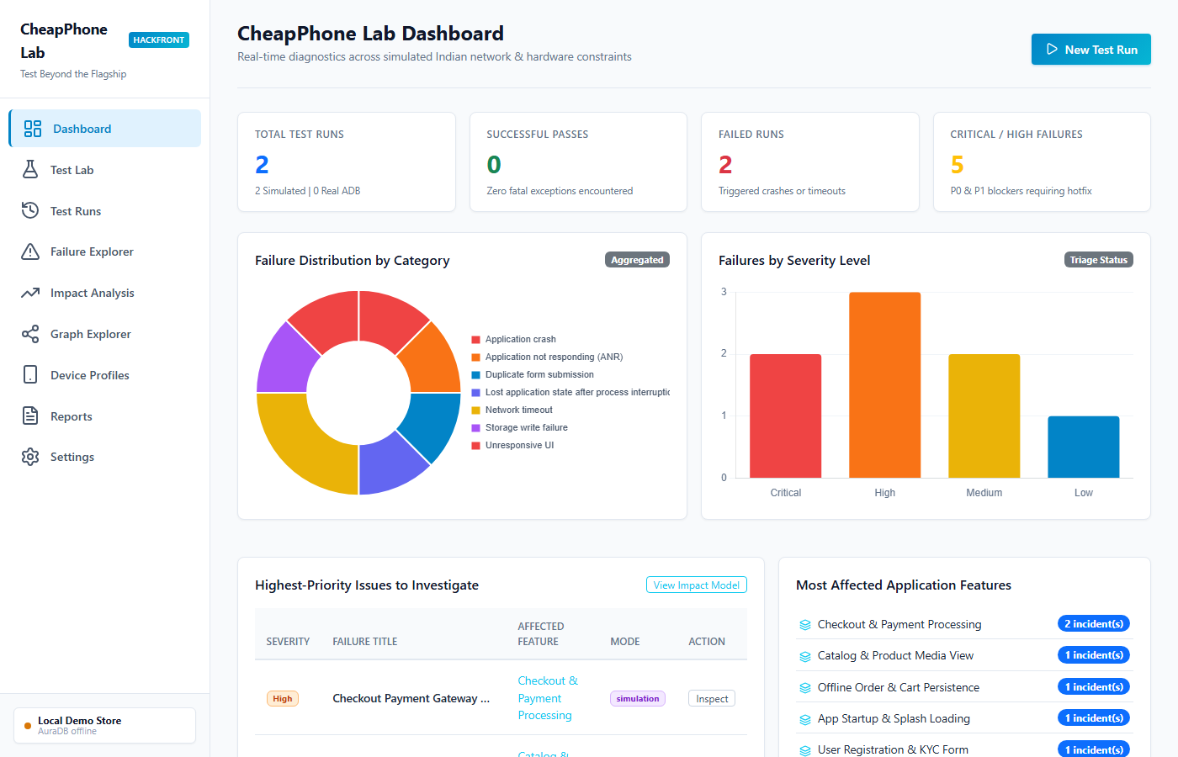
CHEAPPHONE LAB | HACKFRONT INDIA 2026
Prototype Walkthrough: Central Dashboard
Executive Diagnostics
• Live Run Metrics: Instant visibility into total test runs, pass/fail ratio, and critical P0/P1 blockers.
• Interactive Chart.js Visualizations: Failure distribution by category and severity triage breakdown.
• Priority Triage Queue: Direct highlights of top blocking failures and most vulnerable application modules.
• Recent Execution Activity: Real-time telemetry log tracking simulated and real ADB test outcomes.

Slide 6
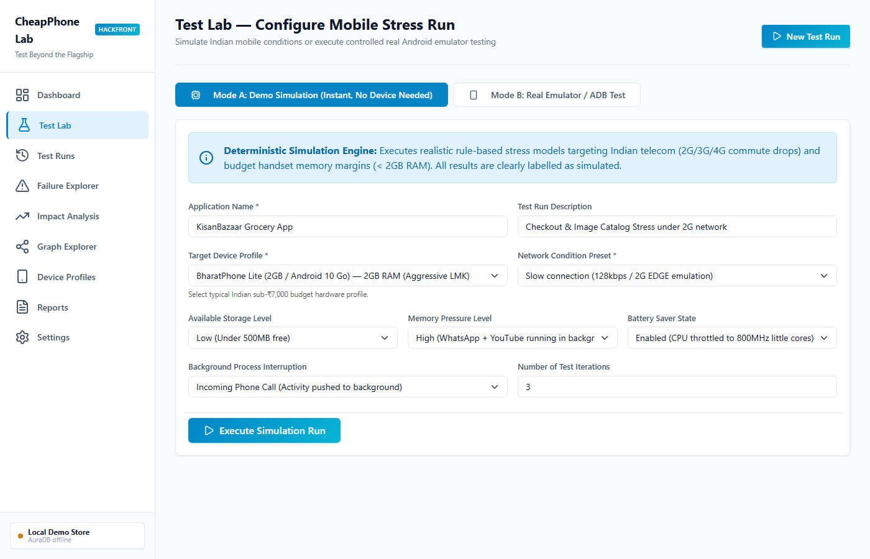
CHEAPPHONE LAB | HACKFRONT INDIA 2026
Prototype Walkthrough: Test Lab Configuration
Stress Simulation Engine
• Mode A (Zero-Device Simulation): Immediate deterministic stress modeling for rapid hackathon evaluations.
• Mode B (Real ADB / Emulator): Auto-detects connected emulators and retrieves actual device properties via getprop.
• Configurable Stress Factors: Adjust network latency (2G/EDGE), available storage (<500MB), RAM pressure, and battery saver.
• Activity Interruption: Models background phone calls and Android Go OS task evictions.

Slide 7
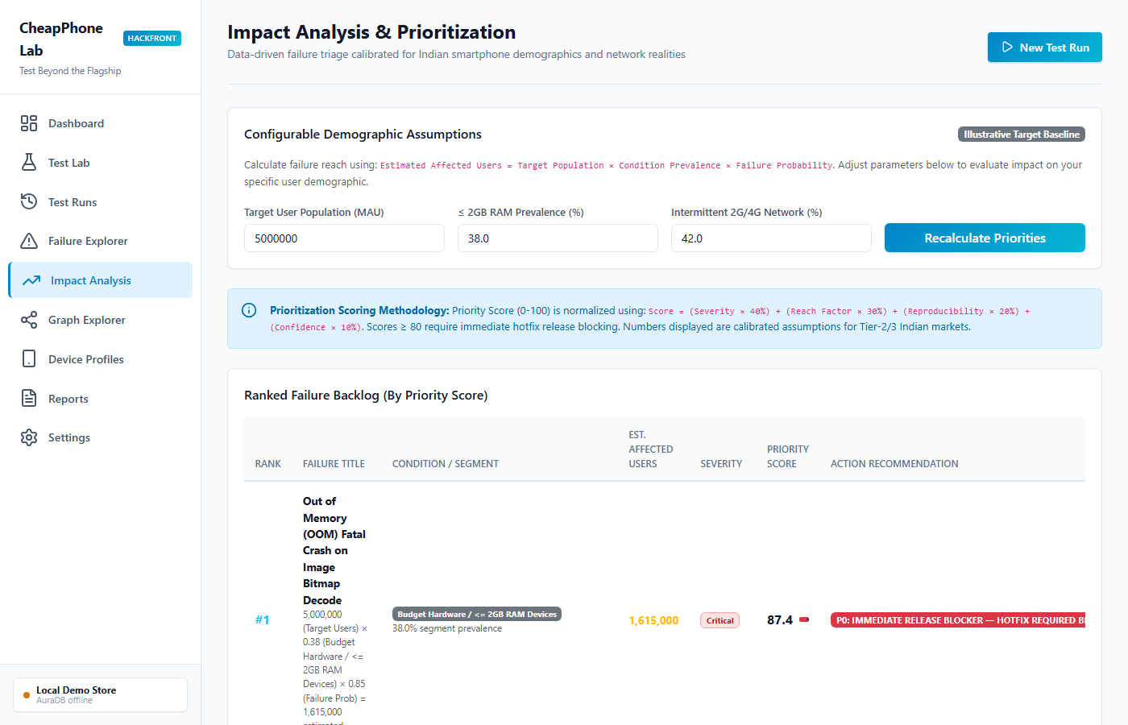
CHEAPPHONE LAB | HACKFRONT INDIA 2026
Prototype Walkthrough: Transparent Impact Analysis
Data-Driven Triage
• Transparent Mathematical Model:
Affected = Target Pop × Condition Prevalence × Failure Probability.
• Configurable Demographics: Customize MAU size, budget hardware percentage, and intermittent network coverage.
• Normalized Priority Scoring (0-100):
Severity (40%) + Reach (30%) + Repro (20%) + Confidence (10%).
• Actionable Classification: Categorizes failures into P0 Hotfix Blockers, P1 Sprint Priorities, and P2 Polish items.

Slide 8
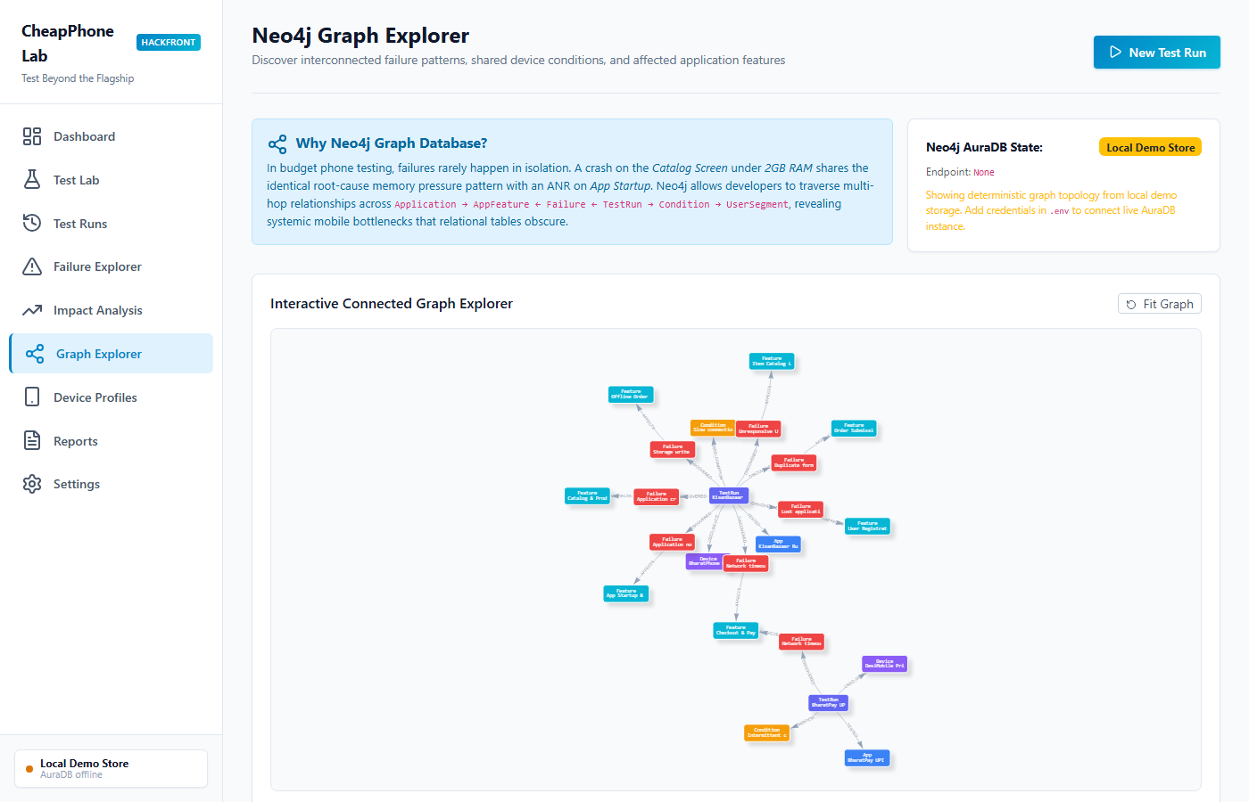
CHEAPPHONE LAB | HACKFRONT INDIA 2026
Neo4j Graph Explorer: Cross-Run Pattern Matching
Graph Traversal Value
• Multi-Hop Schema: Connects Application -> AppFeature <- Failure <- TestRun -> Condition -> UserSegment.
• Systemic Root-Cause Discovery: Uncovers how disparate failures (e.g. OOM in Catalog & ANR on Startup) share identical stress nodes (2GB RAM).
• Interactive Vis-Network UI: Real-time visual graph canvas with drag, zoom, and neighborhood exploration.
• AuraDB Live / Fallback Store: Seamless Cypher execution with disconnected local storage fallback.

Slide 9
CHEAPPHONE LAB | HACKFRONT INDIA 2026
Technical Stack & Strict Architectural Adherence
Frontend Layer — HTML5, CSS3, Vanilla JS, Bootstrap 5
Clean light developer dashboard, responsive layouts, zero heavy node frameworks, Chart.js for charts, Vis-network for graph visualization.
Backend & Core — Python 3.11, Flask, python-dotenv
Modular architecture: core/test_runner.py, impact_analyzer.py, demo_scenarios.py, failure_detector.py with full REST API endpoints.
Graph Database — Neo4j AuraDB & Official Python Driver
Real parameterized Cypher MERGE queries, schema constraints, subgraph extraction, and graceful disconnected demo store fallback.
Diagnostics & Testing — ADB Subprocess, Logcat, pytest
Safe argument-list ADB runner (no shell injection), Logcat regex parsing for fatal crashes & ANRs, 5 automated pytest suites passing.

Slide 10
CheapPhone Lab: Test Beyond the Flagship
Empowering engineering teams to build software that thrives across India's next 500 million mobile users.
✔ Discovers hidden failure modes before they reach play store reviews and cause user churn.
✔ Provides reproducible, step-by-step engineering hotfix recipes with Logcat stack traces.
✔ Demonstrates real Neo4j graph traversal value in debugging complex mobile system constraints.
✔ Works out of the box with zero configuration for hackathon evaluations and developer CI/CD.

