Slide 1

Docker Storage
Shreyas Dhareshwar
System Architect, Micro Focus
23rd November 2019

Slide 2
Agenda
Brush-up on Docker basics
Linux Volumes
Union File SYstem
Types of Docker mount
Volumes
Bind mounts
Tempfs
Hands-on

Slide 3
Brush-up on Docker basics
Try using https://labs.play-with-docker.com/
docker run hello-world
docker ps
docker images
docker run ubuntu bash
docker run -it ubuntu bash
docker exec –it «container_id»
docker run --name web -d -p 3000:80 nginx
docker rm -f $(docker ps -qa)

Slide 4

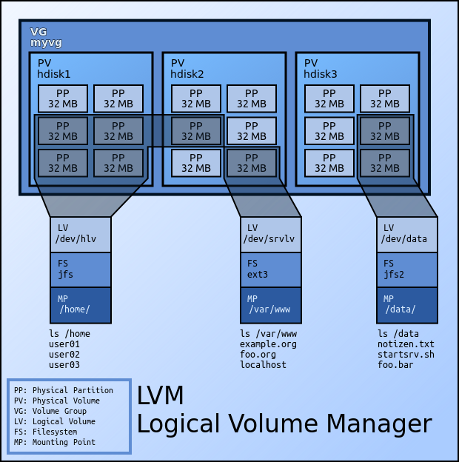
Linux Volumes

Slide 5
Need for Storage
Create a container: docker run --name web -d -p 3000:80 nginx
Connect to container and explore file system (/usr/share/nginx/html)
Check physical file system on host (/var/lib/docker/)
Create file on container
Find the file on the host
Check volume diff of the container
Kill and remove the container
What happens to the container’s file system?
Notes:
Can try using https://labs.play-with-docker.com/
docker run --name web -d -p 3000:80 nginx
docker exec -it web bash
cd /usr/share/nginx/html/
cp index.html msrit.html
Ctrl + p +q
cd /var/lib/docker
find . -name *msrit*
docker diff web
docker rm -f web
find . -name *msrit*

Slide 6
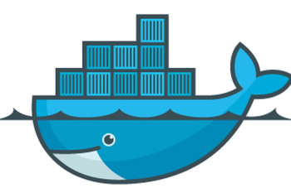
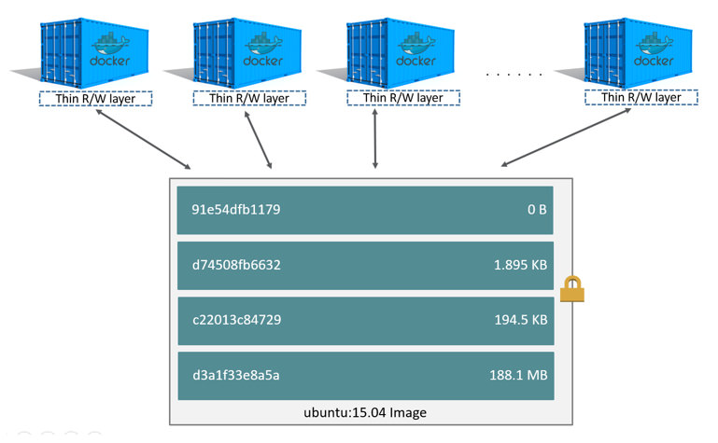
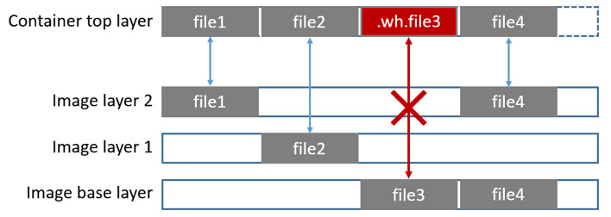
Union File Systems

Slide 7
Union File Systems
“Writable container layer”
No static path from outside the container
No container, no data
Tightly coupled with host machine
Union FS - slower performance

Slide 8
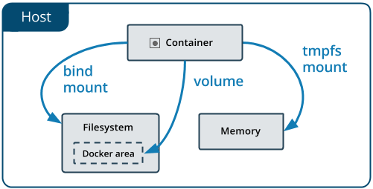
Types of Docker mount

Slide 9
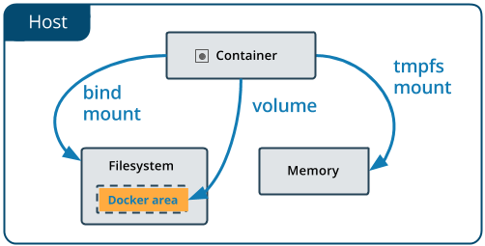
Volumes
Created and managed by Docker
Explicitly (docker volume create)
Implicitly (during container creation)
Can be Named or Anonymous
Supports volume drivers
Cleanup possible (docker volume prune)
Notes:
1. docker volume create web-server-vol
2. docker run -d --name webserver1 -p 3000:80 --mount source=web-server-vol,target=/usr/share/nginx/html nginx:latest
3. docker exec -it webserver1 bash
4. cp /usr/share/nginx/html/index.html /usr/share/nginx/html/msrit.html
5. From host: vi /var/lib/docker/volumes/web-server-vol/_data/msrit.html
6. docker run -d --name webserver2 -p 3001:80 --mount source=web-server-vol,target=/usr/share/nginx/html nginx:latest
7. Check UI
--mount syntax is more verbose than -v or --volume, but the order of the keys is not significant, and the value of the flag is easier to understand.
The type of the mount, which can be bind, volume, or tmpfs. This topic discusses volumes, so the type is always volume.
The source of the mount. For named volumes, this is the name of the volume. For anonymous volumes, this field is omitted. May be specified as source or src.
The destination takes as its value the path where the file or directory is mounted in the container. May be specified as destination, dst, or target.
The readonly option, if present, causes the bind mount to be mounted into the container as read-only.
The volume-opt option, which can be specified more than once, takes a key-value pair consisting of the option name and its value.

Slide 10
Volumes – Use cases
Persistency across container lifecycle
Sharing data across containers (say across 2 nginx’s)
Decoupled host-container file system architecture
Storing data outside the host (central storage or cloud)
Backup and restore

Slide 11
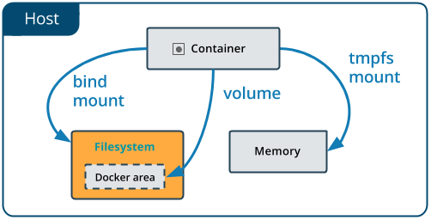
Bind mounts
Created by docker if needed
Maintained by host
Can have security implications
Performant
Needs specific dir structure on host
Notes:
1. mkdir /root/web-server-dir
2. docker run -d --name webserver1 -p 3000:80 --mount type=bind,source=/root/web-server-dir,target=/usr/share/nginx/html nginx:latest
3. ls /usr/share/nginx/html/
4. From host: vi /root/Desktop/web-server-dir/msrit.html
<html>
<title>Demo</title>
<body>Hello from MSRIT!</body>
</html>
5. docker run -d --name webserver2 -p 3001:80 --mount type=bind,source=/root/Desktop/web-server-dir,target=/usr/share/nginx/html nginx:latest
6. Check UI
--mount syntax is more verbose than -v or --volume, but the order of the keys is not significant, and the value of the flag is easier to understand.
The type of the mount, which can be bind, volume, or tmpfs. This topic discusses volumes, so the type is always volume.
The source of the mount. NA
The destination takes as its value the path where the file or directory is mounted in the container. May be specified as destination, dst, or target.
The readonly option, if present, causes the bind mount to be mounted into the container as read-only.
The volume-opt option, which can be specified more than once, takes a key-value pair consisting of the option name and its value.

Slide 12
Bind mounts – Use cases
Sharing config from host
DevOps build lifecycle – target folder into container
Persistency across container lifecycle
Sharing data across containers (say across 2 nginx’s)

Slide 13
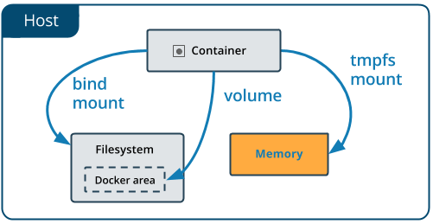
Tmpfs
Only in memory!
Great for storing sensitive data
Extremely fast
No cleanup needed
Notes:
1. docker run -it --name webserver1 -p 3000:80 --mount type=tmpfs,target=/usr/share/nginx/html nginx:latest bash
2. cd /usr/share/nginx/html/
echo '<html><title>Demo</title><body>Hello from MSRIT!</body></html>' > index.html
3. docker run -d --name webserver2 -p 3001:80 --mount type=tmpfs,target=/usr/share/nginx/html nginx:latest
4. Check UI
--mount syntax is more verbose than -v or --volume, but the order of the keys is not significant, and the value of the flag is easier to understand.
The type of the mount, which can be bind, volume, or tmpfs. This topic discusses volumes, so the type is always volume.
The source of the mount. NA
The destination takes as its value the path where the file or directory is mounted in the container. May be specified as destination, dst, or target.
The readonly option, if present, causes the bind mount to be mounted into the container as read-only.
The volume-opt option, which can be specified more than once, takes a key-value pair consisting of the option name and its value.

Slide 14
Tempfs – Use cases
I/O sensitive projects
Standalone containers with need to store runtime info

Slide 15
Reference material
https://docs.docker.com/storage/

Slide 16
Thank You.

