Slide 1
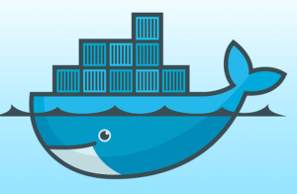
Docker Compose
Shreyas Dhareshwar
System Architect, Micro Focus
23rd November 2019

Slide 2
Agenda
What is Docker Compose?
Installing Docker Compose
Building an app with Compose yaml
Managing apps with Docker Compose
Hands-on

Slide 3

What is Docker Compose?
Tool for orchestrating multi-container apps
Use a single command to bring up you deployment
Uses YAML
Popular during development and testing

Slide 4

Installing Docker Compose
Easy - https://docs.docker.com/compose/install/
Notes:
curl -L "https://github.com/docker/compose/releases/download/1.22.0/docker-compose-$(uname -s)-$(uname -m)" -o /usr/local/bin/docker-compose
chmod +x /usr/local/bin/docker-compose
docker-compose --version

Slide 5
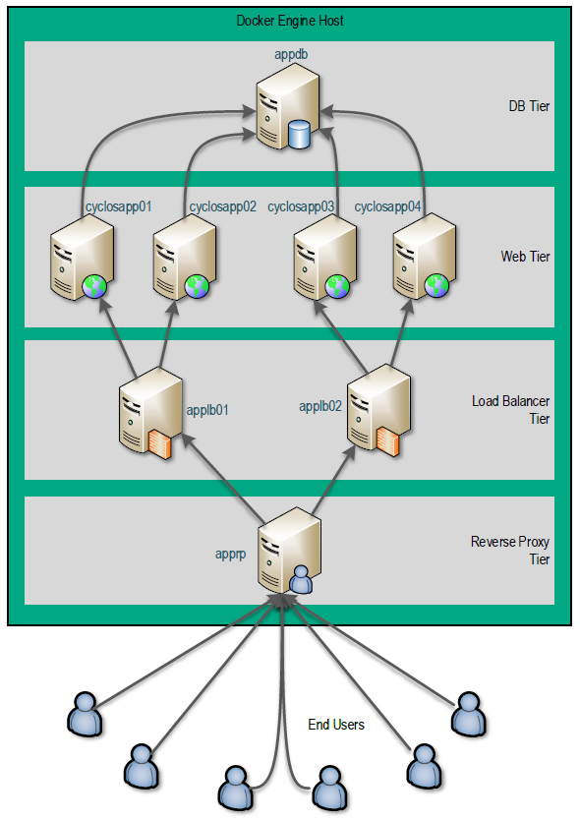
Building an app - requirements
Images
apprp01: docker.io/httpd:latest
applb*: docker.io/httpd:latest
cyclosapp*: tomcat:7-jre7
appdb: mysql:5.5
Notes:
apprp01
image: docker.io/httpd:latest
applb*
image: docker.io/httpd:latest
cyclosapp01 to cyclosapp06
image: tomcat:7-jre7
appdb
image: mysql:5.5

Slide 6
Building an app - requirements
Network hierarchy
For apprp01
links:
- applb01:applb01
- applb02:applb02
...
Notes:
apprp01
links:
- applb01:applb01
- applb02:applb02
applb01
links:
- cyclosapp01:cyclosapp01
- cyclosapp02:cyclosapp02
- cyclosapp03:cyclosapp03
applb02
links:
- cyclosapp04:cyclosapp04
- cyclosapp05:cyclosapp05
- cyclosapp06:cyclosapp06
cyclosapp01 to cyclosapp06
links:
- appdb:appdb

Slide 7
Building an app - requirements
Ports to expose
apprp01: "8080:9090"
Notes:
apprp01
ports:
- "8080:9090"

Slide 8
Building an app - requirements
Storage
apprp01:
volumes:
/var/myapp/apprp01/modified_httpd.conf:/usr/local/apache2/conf/httpd.conf
...
Notes:
apprp01
volumes:
- /var/myapp/apprp01/modified_httpd.conf:/usr/local/apache2/conf/httpd.conf
applb01
volumes:
- /var/myapp/applb01/modified_httpd.conf:/usr/local/apache2/conf/httpd.conf
applb02
volumes:
- /var/myapp/apprp02/modified_httpd.conf:/usr/local/apache2/conf/httpd.conf
cyclosapp01 to cyclosapp06
volumes:
- /var/myapp/cyclosapp/cyclos:/usr/local/tomcat/webapps/cyclos
appdb
volumes:
- /var/myapp/appdb:/var/lib/mysql

Slide 9
Managing apps with Docker Compose
Check for bound storage
Manage app lifecycle:
docker-compose up -d
docker-compose logs
docker-compose stop
docker-compose up
docker-compose kill
docker-compose rm
Notes:
http://localhost:8080/cyclos

Slide 10
Reference
https://docs.docker.com/compose/

Slide 11
Thank You.

