Slide 1
Deep learning for image search
Prepared by:-Shrey Malvi(16bce099)
Guided by :-Dr. Zunnun Narmawala

Slide 2
Contents
Introduction
Neural Network
Deep Learning Basics
Deep Learning Architectures
Deep Learning Frameworks
Optical Image Recognition
Siamese Network
Autoencoders
CNNs Architectures
Implementation
References

Slide 3
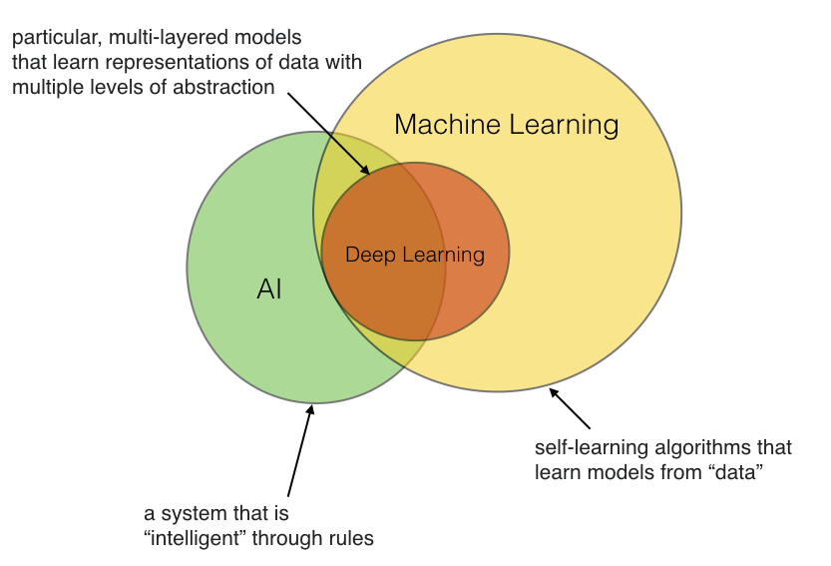
Introduction
1. Image Search.
2. Artificial Intelligence.
3. Machine Learning.
4.Deep Learning.

Slide 4
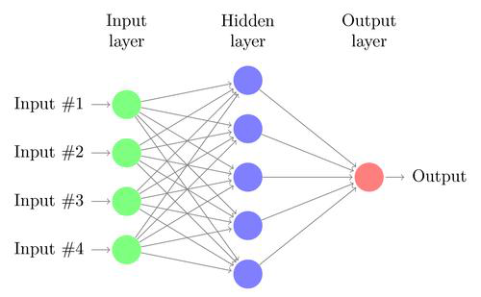
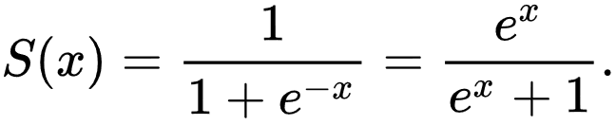
Neural Network:
Artificial Intelligence mainly works using neural networks which is inspired by the neurons
in the brain.
The delta rule is often utilized by the most common class of ANNs called backpropagational neural networks (BPNNs).
The function which calculates the values at each neuron is called Sigmoid function.

Slide 5
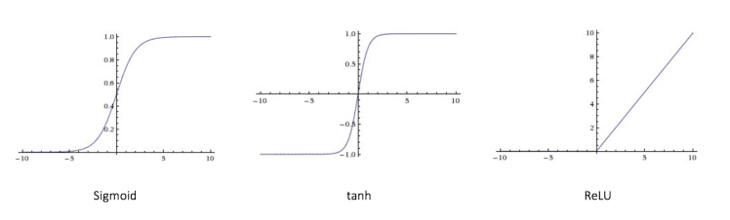
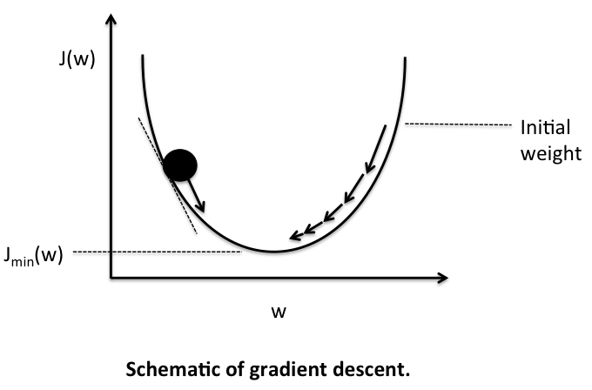
Sigmoid: Output is between 0 and 1.
Tanh :Output is between -1 and 1.
ReLU:Output is between 0 and 1.

Slide 6
DEEP learning
Deep learning is a subset of machine learning – a field that examines computer
algorithms that learn and improve on their own.
Deep learning is the implementation of neural networks with more than a single hidden layer of
neurons.
In other words, deep learning is a way to automate predictive analytics.

Slide 7
DEEP learning Architectures
• Recurrent neural networks(RNN)- Speech recognition, handwriting recognition
• Convolution neural networks(CNN)- Image recognition, video analysis, natural language
processing
• LSTM-Natural language text compression, handwriting recognition, speech recognition,
gesture recognition, image captioning
• Deep beliefs networks(DBN)- Image recognition, information retrieval, natural language
understanding, failure prediction
• Deep stacking networks(DSN)- Information retrieval, continuous speech recognition

Slide 8
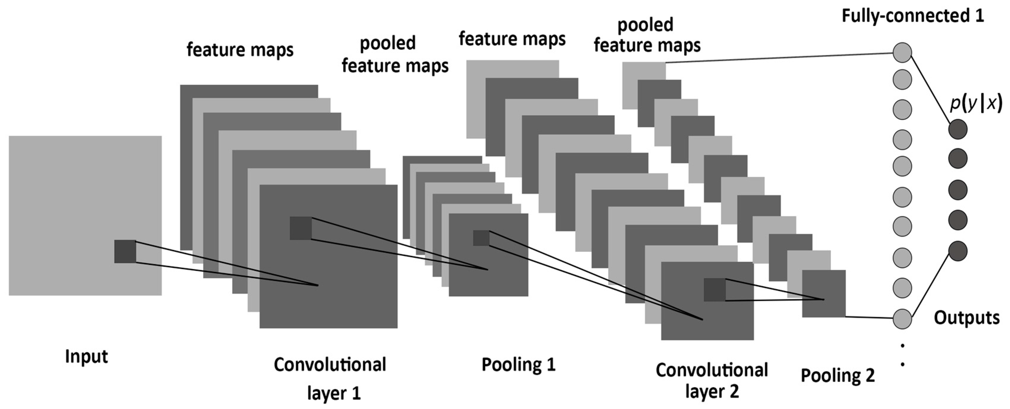
CNN
A CNN consists of an input and an output layer, as well as multiple hidden layers.
Filters
Padding
Pooling
Multiple Filters

Slide 9
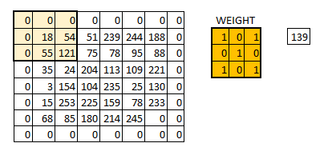
Filters
Padding
Pooling
The weight extends to the entire depth of the input image. Therefore, convolution with a single weight matrix would result into a convolved output with a single depth dimension.

Slide 10
RNN A recurrent neural network (RNN) is a class of artificial neural network where connections between units form a directed cycle. Unlike feedforward neural networks, RNNs can use their internal memory to process arbitrary sequences of inputs Difference between CNN and RNN?

Slide 11
LSTM
prediction + memories
forgetting
memory
prediction
New Information

Slide 12
DEEP learning Frameworks
Every framework is different, built for a different purpose and offering a unique range of features.
Most Popular Frameworks are as follow:
1.TensorFlow
2. Caffe
3. Keras
4. DeepLearning4j

Slide 13
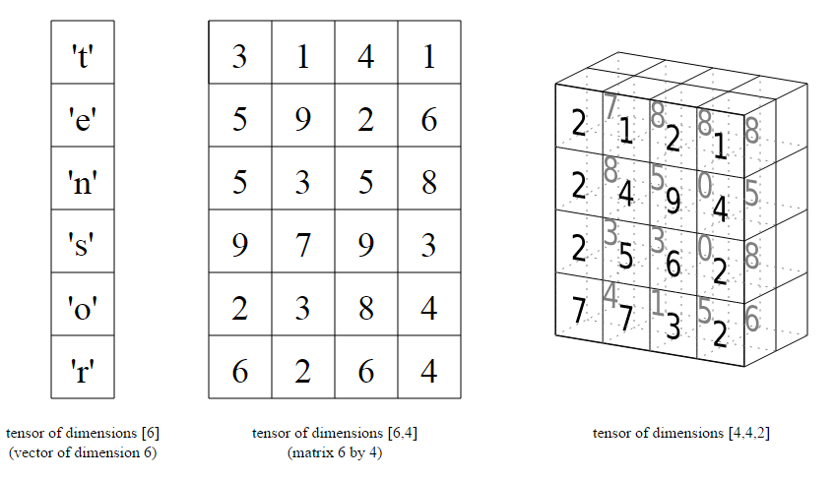
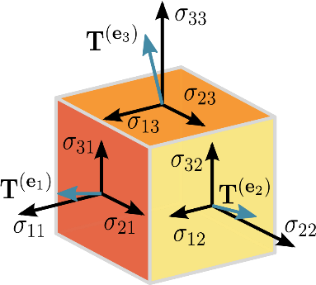
1.Tensorflow
Mathematically a Tensor is a N-dimensional vector, means a Tensor can be used to represent N-
dimensional datasets.
Tensors of different dimensions.

Slide 14
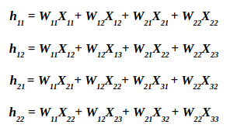
Tensors
The entire purpose of TensorFlow is to have a so-called computational graph that can be executed much more efficiently than if the same calculations were to be performed directly in Python.
TensorFlow can also automatically calculate the gradients that are needed to optimize the variables of the graph so as to make the model perform better.
Computational Graph makes use of chain rule to calculate derivative which helps in reducing the time.

Slide 15
2. Caffe
It is a C++ library which also has a Python interface and finds its primary application in modeling Convolutional Neural Networks.
3. Keras
Keras is a simplified interface for building efficient neural networks.
4. DeepLearning4j
Deeplearning4j is a popular deep learning framework that is focused on Java technology.

Slide 16
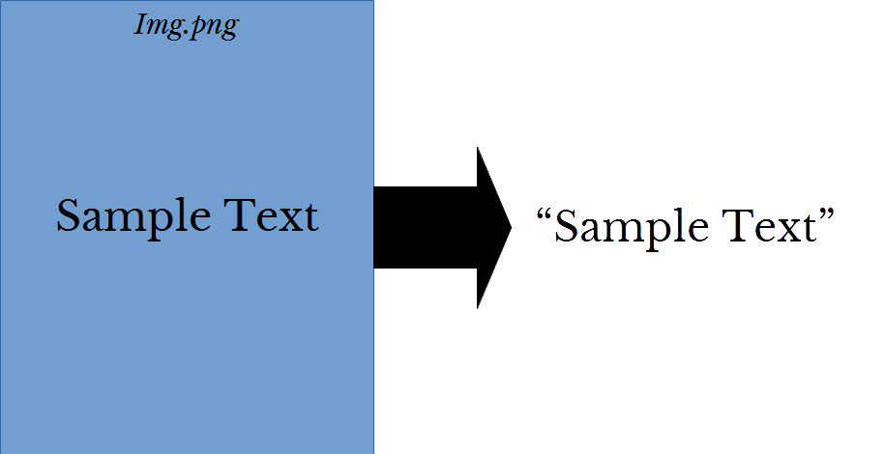
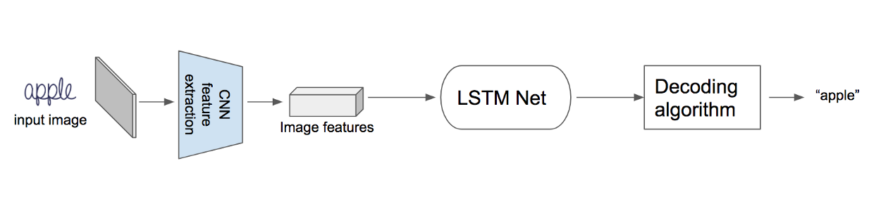
OPTICAL CHARACTER RECOGNITION
Optical Character Recognition is a process when images of handwritten, printed, or typed text are converted into machine-encoded text.
OCR techniques are typically multi-stage processes.

Slide 17
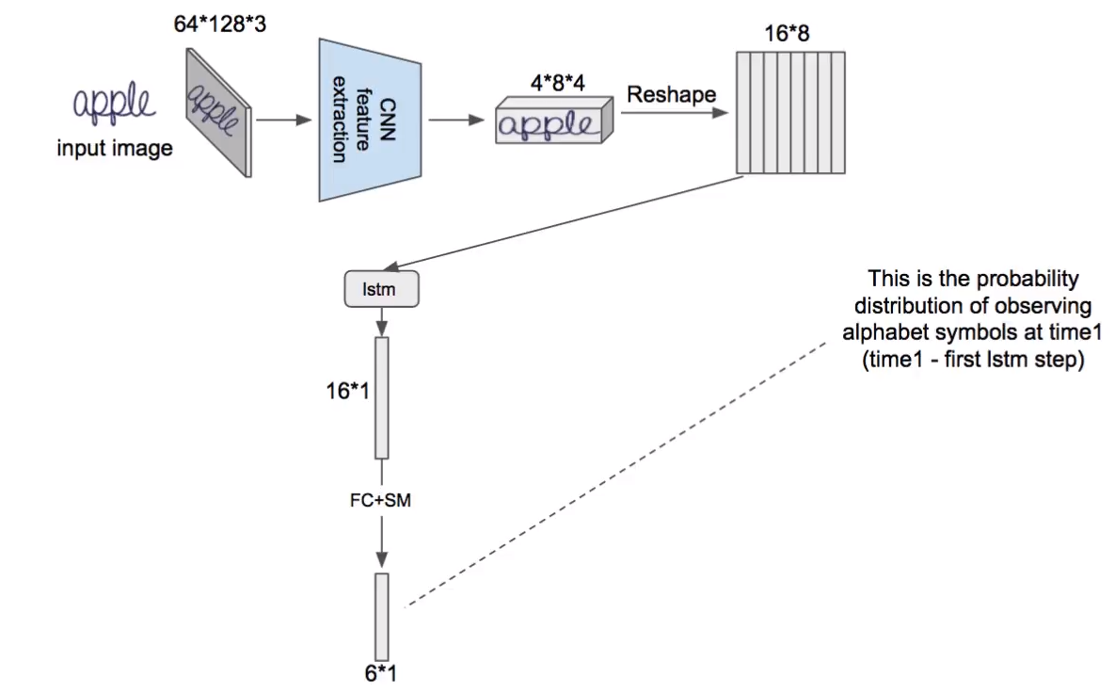
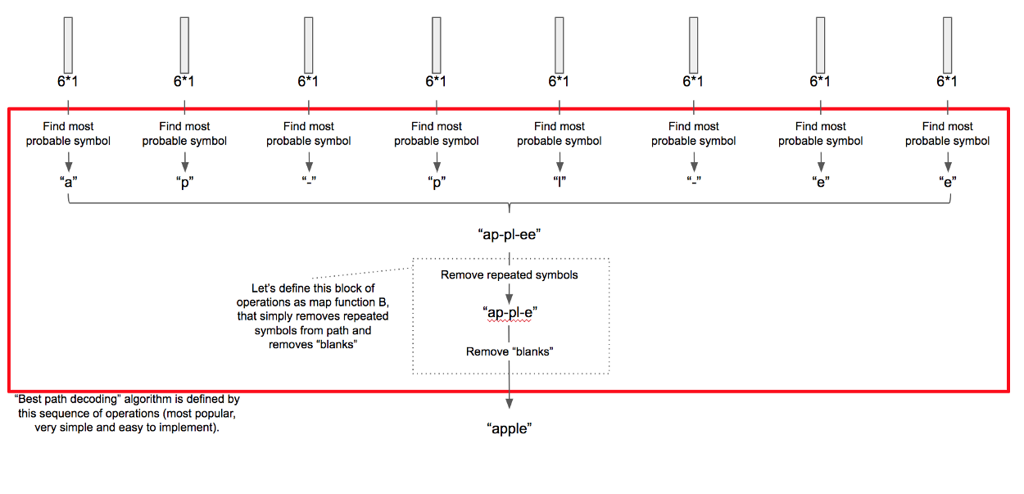
Working of OCR

Slide 18
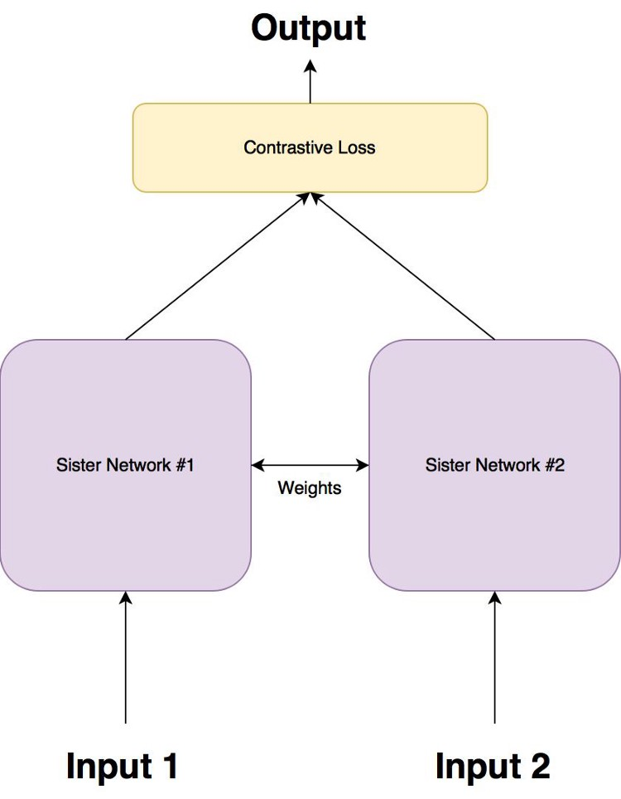
SIAMESE ARCHITECTURE
Siamese networks are a special type of neural network architecture. Instead of a model learning to classify its inputs, the neural networks learns to differentiate between two inputs. It learns the similarity between them.
This architecture utilizes pre-extracted features from Convolutional Neural Networks (CNNs) and learns a new distance representation based on the user’s relevance feedback.

Slide 19
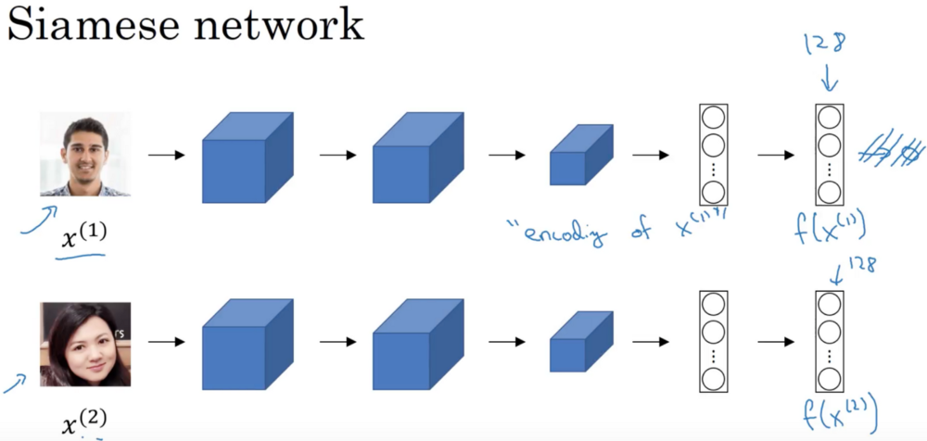
SIAMESE ARCHITECTURE
To compare the two images x1 and x2, we compute the distance d between their encoding f(x1) and f(x2). If it is less than a threshold (a hyperparameter), it means that the two pictures are the same person, if not, they are two different persons.

Slide 20
COMPARISON
SAIMESE | NORMAL CLASSIFIER
Time Efficient | Requires more time to train
Requires less data for training | Relatively large dataset is required
User’s feedback is needed | No feedback needed
Mainly used for image and signature verification | Mainly used for feature Extraction and OCR

Slide 21
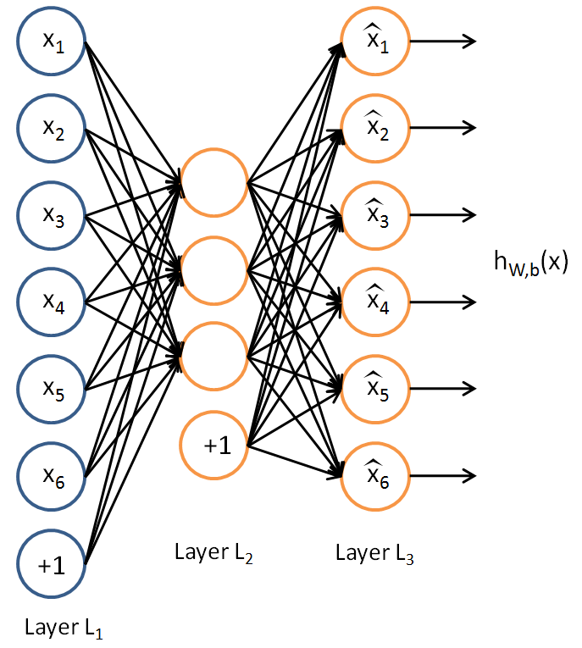
AUTOENCODERS
Autoencoders are neural networks that are comprised of an encoder and a decoder. The goal is to compress your input data with the encoder, then decompress this encoded data with the decoder such that the output is a good/perfect reconstruction of your original input data.
Instead of operating in such huge and hard-to-work-with space of RGB pixels, we use the trained encoder to embed the image of your face in a lower-dimensional encoding vector space with hopefully more meaningful dimensions such as “image brightness”, “head shape”, “location of eyes”, “colour of hair”, etc.

Slide 22
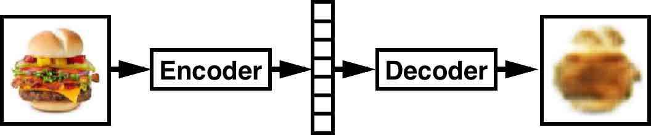
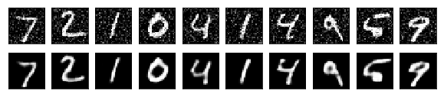
AUTOENCODERS
The practical applications of autoencoders were pretty rare some time back, today data denoising and dimensionality reduction for data visualization are considered as two main interesting practical applications of autoencoders.

Slide 23
CNN ARCHITECTURES
1.GoogLeNet
The network used a CNN inspired by LeNet but implemented a novel element which is dubbed an inception module. This module is based on several very small convolutions in order to drastically reduce the number of parameters. Their architecture consisted of a 22 layer deep CNN but reduced the number of parameters from 60 million (AlexNet) to 4 million.
2.AlexNet
In 2012, AlexNet significantly outperformed all the prior competitors and won the challenge by reducing the top-5 error to 15.3%.
3.ZFNet
The network was mostly an achievement by tweaking the hyper-parameters of AlexNet while maintaining the same structure with additional Deep Learning elements

Slide 24
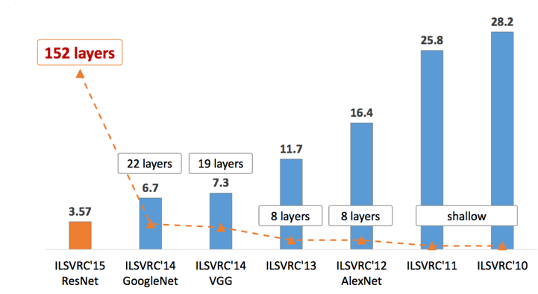

Slide 25
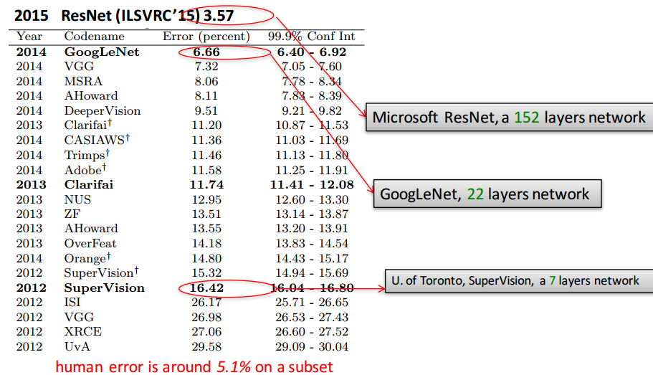
ILSVRC

Slide 26
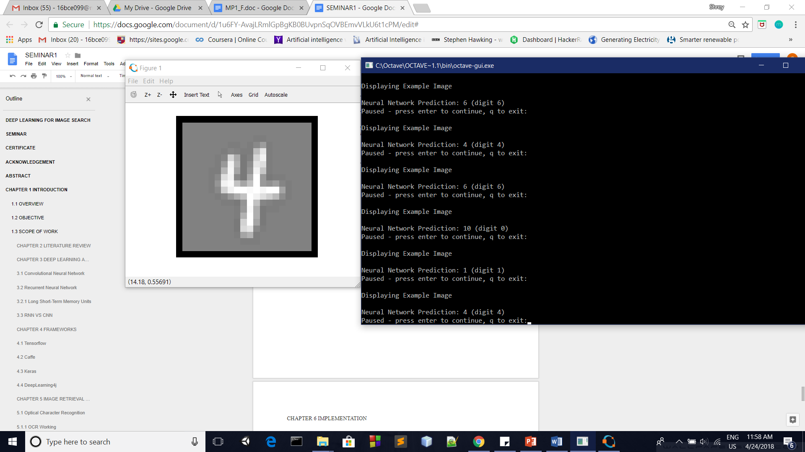
IMPLENTATION

Slide 27
REFERENCES
https://www.analyticsvidhya.com/blog/2017/05/25-must-know-terms-concepts-for-beginners-in-deep-learning/
https://www.kdnuggets.com/2017/08/deep-learning-neural-networks-primer-basic-concepts-beginners.html
https://devblogs.nvidia.com/deep-learning-nutshell-core-concepts/
https://towardsdatascience.com/a-beginner-introduction-to-tensorflow-part-1-6d139e038278
https://www.ibm.com/developerworks/library/cc-machine-learning-deep-learning-architectures/index.html
https://datahub.packtpub.com/deep-learning/top-10-deep-learning-frameworks/
http://www.ritchieng.com/machine-learning-photo-ocr/
https://dzone.com/articles/using-ocr-for-receipt-recognition

Slide 28
THANK YOU

