Slide 1
Predictive Memory Paging System with Workload Awareness
OPERATING SYSTEMS PROJECT · FINAL REVIEW
A trace-driven paging simulator that predicts which memory pages a program needs next, prefetches them only when that helps, and is evaluated against seven baselines on 22 real programs.
G.K Shreyas Bharadwaj 24BCE2256
Vaastav Bajanthri 24BCE2223
P. Giphy Bershan 24BCE2201
RAM as page frames: amber pages were prefetched before the program asked for them
Guide: [Guide name]
Department: [Department]
Institution: [Institution]
Academic year: [2026-27]
Notes:
Introduce the team and the project in one sentence: we built a simulator of operating-system paging that tests whether predicting future page requests and loading them early (prefetching) reduces page faults, and when it is safe to do so.
Fill in the guide, department, institution and academic year before presenting (amber placeholders).
The graphic: RAM is a small set of page frames; amber squares are pages loaded early by our system.
Transition: first, why page faults matter and why prefetching is risky.
Likely question: "Is this a real operating system?" Answer: no, it is a trace-driven simulator that replays real programs' memory requests; this is standard for comparing policies fairly because every method sees identical input and the optimal policy (OPT) can be computed.

Slide 2
Page faults stall programs, and prefetching can backfire
1
Page faults are expensive
A request for a page not in RAM waits for the disk, thousands of times slower than RAM.
Objectives
Build a correct, reproducible paging simulator with 6 eviction policies including OPT
Build lightweight predictors: Markov, delta-Markov, stride, Linux-style readahead
Build a decision engine that prefetches only when it measurably helps
Find which feedback signal works, and make it cheap enough to deploy
Evaluate on real programs without tuning on test data, in faults and in time
2
Classical paging only reacts
FIFO, LRU and Clock act after the fault. Even the optimal policy (OPT) pays for every first visit to a page.
3
Prefetching is a bet
With RAM full, every prefetched page evicts another. A wrong guess can create a fault, so existing prefetchers can make things worse.
55.0%
1.43×
1 of 44
fewer page faults than LRU (mean, 44 configurations)
estimated speed-up over LRU on an NVMe SSD
configurations where it is worse than LRU
Notes:
Problem: a page fault makes the program wait for the disk. Classical policies (FIFO, LRU, Clock) only decide what to evict after a fault; even Belady's OPT, the best possible eviction, still pays for each page's first access.
Motivation: predicting and prefetching pages can avoid faults, including first-access faults. The risk: when RAM is full, each prefetch evicts a page, so a wrong guess can create a fault. Our earlier always-prefetch control made some workloads up to 1.5% worse, and readahead alone up to 19.3% worse.
Objectives: read them briefly. Point to the bottom row as the demonstrated outcome (all from our result files): 55.0% fewer faults than LRU on average over 44 configurations, about 1.43 times faster on an SSD model, worse than LRU in only one configuration.
Transition: how existing approaches handle this and what we do differently.
Likely question: "Why is 55% fewer faults not 55% faster?" Prefetching adds disk reads; slide 8 shows the time results.

Slide 3
Existing approaches leave a gap that our design fills
Approach | How it works | Gap (measured on our 22 traces)
FIFO / LRU / Clock | Evict after a fault | Reactive; cannot avoid first-visit faults
OPT (Belady) | Evict page needed furthest ahead | Needs the future; still pays first-visit faults
ARC / LRU-2 | Smarter eviction (recency + frequency) | No gain here: ARC −0.5% vs LRU
Linux readahead | Fetch next pages of a sequential run | Blind to non-sequential patterns; worst −19.3%
Markov prefetching [Joseph & Grunwald 1997] | Learn page-to-page transitions | Cannot predict unseen pages: +7.7%
Proposed system | Readahead + delta-Markov, gated by measured fault delta | +55.0% mean, worst −3.3%
What is new (with evidence)
1
Which feedback signal works
Confidence is never below 0.5 (structural); precision of 81–86% coexisted with rising faults. Measured fault delta halved the worst case.
2
Exact, cheap feedback
Shadow directory stores page IDs only (~0.2% of RAM); 1/8 sampling gave identical faults on 9 of 10 traces.
Building blocks are known (Markov prefetching, readahead, fault-rate feedback, ghost lists); the contribution is their combination and evaluation.
3
Time-aware evaluation
Fewer faults ≠ faster: timeliness and disk type decide (slide 8).
Notes:
Walk the table top to bottom: classical policies are reactive; OPT is a bound, not a solution; ARC and LRU-2 improve eviction but gave no gain on our traces (ARC averaged −0.5%); Linux readahead helps sequential reading but its worst case was −19.3%; Markov prefetching cannot predict pages it has never seen, so it averaged only +7.7%.
Proposed: readahead covers new pages in runs, delta-Markov covers repeating gap patterns, and a decision engine driven by the measured fault delta limits harm.
Novelty, stated honestly: the components exist in literature; what is ours is (1) showing which feedback signal works and why confidence and precision fail, (2) obtaining that signal exactly and cheaply with a page-ID-only shadow directory, and (3) evaluating in time, not just faults.
Likely question: "Isn't the shadow directory just the oracle again?" Same idea, but it stores page IDs only, no data, and can be sampled to 1/8 of its size.

Slide 4
Architecture: predict, decide, prefetch, measure, adapt
Input trace
page numbers of a real program
Predictor
readahead + delta-Markov
Decision engine
confidence ≥ threshold?
Memory engine
RAM frames + LRU eviction
Output
faults, prefetches, used, wasted
new threshold
same requests
event log
Data
22 real traces: ML-DPC LoadTraces (SPEC CPU 2006 + GAP graphs), 200,000 requests each; addresses → 4 KB pages
6 synthetic traces with known answers (correctness tests)
RAM = 1% or 5% of each program’s working set
Feedback controller
every 1,000 requests
Shadow directory
no-prefetch copy, page IDs only
Time model
event log → estimated time
fault delta
Implemented as paging.final.run_final. Prefetched pages enter RAM only through the same install path as demand faults.
Notes:
Explain the implemented architecture left to right. Input: a recorded list of page numbers from a real program. For each request: the memory engine reports hit or fault and evicts with LRU when full; the predictor learns and proposes candidate pages (readahead window first, then the delta-Markov guess); the decision engine accepts a candidate only if its confidence passes a threshold; accepted pages are loaded through the normal install path, so a bad predictor can slow the system but never corrupt it.
Feedback (amber arrows): a shadow directory replays the same requests without prefetching, storing page IDs only. Every 1,000 requests the controller compares faults: if prefetching saved faults the threshold drops (bolder), if it caused faults the threshold rises.
The time model replays the recorded events on a simulated disk.
Likely question: "Where does the data come from?" Public ML-DPC LoadTraces (cache-level traces of SPEC CPU 2006 and GAP benchmarks), mapped to 4 KB pages; this approximates OS paging, which we state as a limitation.

Slide 5
Core logic: three rules decide every prefetch
Per request
Decision rule
Free frame available
prefetch if confidence ≥ 0.15
RAM full
prefetch if confidence ≥ threshold (0.15–0.95)
Feedback rule
delta rate = (no-prefetch faults − real faults) / 1,000
> +0.002
threshold − 0.1 (bolder)
< −0.002
threshold + 0.1 (more careful)
Predictors
Readahead
window 4 → 8 → 16 pages (cap RAM/4); confidence = run/(run+1)
Delta-Markov
learns gaps: +1, +3, +1 … predicts pages never seen
1
Access page; on a fault, LRU evicts if RAM is full
2
Predictor learns the transition just seen
3
Every 1,000 requests: update the threshold
4
Predictor proposes candidate pages
5
Skip candidates already in RAM
Why this approach: the predictor runs on every request, so it must be O(1) and tiny (256-entry tables); the feedback measures the outcome itself, which confidence and precision failed to do. All settings were chosen on the first 25% of each trace only.
6
Decision rule: prefetch or not
Method: trace-driven simulation · identical input for every method · RAM = 1% and 5% of each working set · judged by page faults and estimated time
Notes:
Methodology: trace-driven simulation; every method sees identical requests; memory sized at 1% and 5% of each program's working set; every parameter chosen on the first 25% of each trace (warm-up) and then frozen, so we never tune on test data.
Per request (left): access, learn, every 1,000 requests update the threshold, predict, skip resident candidates, decide.
Decision rule: with a free frame a wrong prefetch evicts nothing, so be generous (≥0.15); with RAM full require confidence ≥ the adaptive threshold.
Feedback rule (the key mechanism): delta rate = (faults the no-prefetch shadow had − faults we had) / 1,000. Above +0.002 prefetching is helping, lower the threshold by 0.1; below −0.002 it is hurting, raise it; in between do nothing (avoids reacting to noise). These values (epoch 1,000, step 0.1) were tuned on warm-up data only.
Predictors: readahead fetches a doubling window when it sees consecutive pages; delta-Markov learns gaps between pages, so a pattern like +1,+3 predicts pages never seen before.
Likely question: "Why not deep learning?" It runs on every memory request; our tables are O(1) and kilobytes. A learned model is fair future work.

Slide 6
Implementation: a Python simulator in eight modules
Technology stack
Module | Responsibility | Status
traces.py | generate, convert and load traces | Done
engine.py | RAM model; FIFO, LRU, Clock, OPT, ARC, LRU-2 | Done
predictors.py | stride, Markov, hybrid, delta-Markov, readahead | Done
deciders.py | 9 decision engines, shared feedback controller | Done
simulate.py | per-request loops; ghost list; shadow directory | Done
timing.py | I/O time model | Done
final.py | frozen final system (run_final) | Done
scripts 01–17 | experiments, HTML report | Done
Prediction-aware eviction | evict unused prefetches early | Tried, no gain
Kernel integration | run inside a real OS | Future work
Python 3.14
all code (3.9+ compatible)
NumPy · pandas
traces, result tables
matplotlib
figures
pytest
24 automated tests
Python stdlib
lzma, urllib, heapq, bisect, OrderedDict
Git · GitHub
version control
Google Colab
first stages (Stages 1–5)
ML-DPC LoadTraces
SPEC CPU 2006 + GAP traces
Key decisions: one install path for all pages · predictor and decider never see each other’s internals · RAM sized as % of working set · warm-up-only tuning
Notes:
Only technologies actually used are listed. Everything is Python (developed on 3.14, compatible with 3.9+); NumPy and pandas for arrays and tables; matplotlib for figures; pytest for 24 automated tests; standard-library modules for decompression, download and data structures (OrderedDict gives O(1) LRU; heapq for LRU-2 and disk channels; bisect for OPT). Early stages ran on Google Colab; later work locally on Windows with Git and GitHub.
Modules (right): all core modules are complete. Be explicit: prediction-aware eviction was implemented and tested but gave no gain, so it was not adopted; kernel integration is future work, not done.
Key implementation decisions: one install path (safety); predictor and decision engine separated so nine engines can be compared on identical predictions; memory sized as a percentage of each program's working set (with large fixed memory every policy looks the same); settings chosen on warm-up data only.
Likely question: "How long does a run take?" About 1–4 seconds per 200,000-request configuration on a laptop.

Slide 7
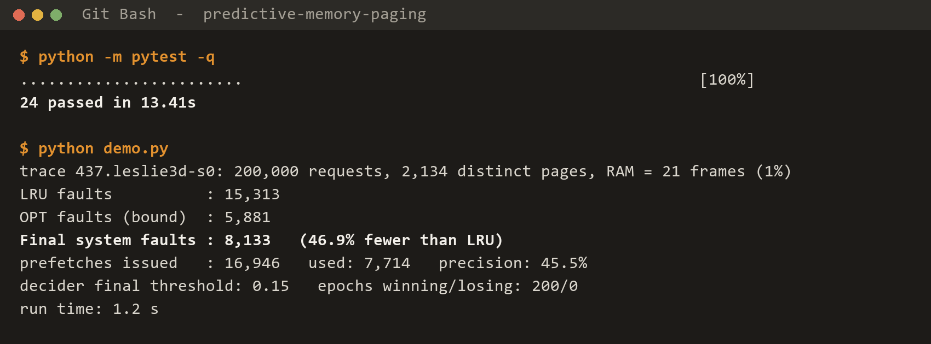
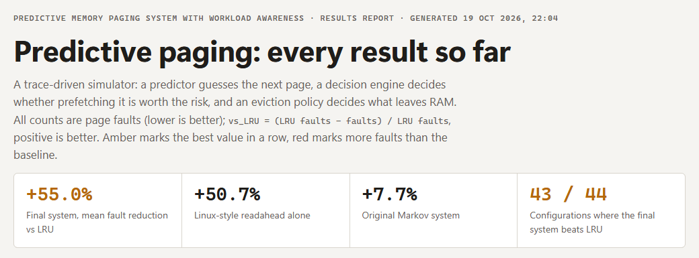
Working system: real runs, real output
Proves: one command regenerates every result into a self-contained report (16 sections, read from the result files).
Proves: all 24 tests pass; on the real leslie3d trace (21 frames) the final system cuts faults from 15,313 (LRU) to 8,133, 46.9% fewer, in 1.2 s.
End-to-end example (computed by the real code): a loop of 5 pages repeated 3 times, 4 frames of RAM
Plain LRU 15 faults
loop is one page larger than RAM, so LRU always evicts the page needed next
With prediction 5 faults
stride spots +1,+1,+1 and prefetches page 5; the Markov table then learns the loop and every request hits
A wrong guess page 6
predicted but never used: it evicted page 2 (brought back later), showing why a decision engine is needed
Notes:
All evidence here is genuine. Left: actual terminal output captured from our laptop: the 24 automated tests pass, then the final system runs on the real leslie3d trace with 21 frames: LRU 15,313 faults, optimal bound 5,881, final system 8,133 (46.9% fewer than LRU), 16,946 prefetches with 45.5% precision, run time 1.2 seconds.
Right: a real browser screenshot of results/report.html, generated by scripts/13_report.py from the result CSV files.
Bottom: a worked example produced by running our classes: a loop of five pages with four frames. LRU faults on every one of 15 requests; with prediction only 5. It also contains a wrong guess (page 6), which wastes a read and evicts a page: exactly the risk the decision engine manages.
If a live demo is allowed: run "python -m pytest -q" and the demo script; both finish in seconds.
Likely question: "Why only 45% precision but 47% fewer faults?" Readahead fetches whole windows; many pages are not used, but the ones that are used remove faults. That extra I/O is why slide 8 measures time too.

Slide 8
Results: fewest page faults; in time it ties readahead
Testing
24 / 24
automated tests pass
48 / 48
rows of the original Colab results reproduced exactly
0
mismatches vs independent LRU/FIFO/OPT on 40 traces
Fewer faults: fewer than readahead in 34 of 44, below OPT in 30 of 44 (prefetching avoids first visits); worst case −3.3% vs readahead −19.3%
Time: faster than LRU on an SSD (1.43×, level with readahead); slower on a single-channel hard disk. Model estimates, not hardware measurements
Notes:
Left chart: mean share of LRU's page faults removed over 44 configurations (22 real programs × 2 memory sizes). ARC alone −0.5%; original Markov +7.7%; Linux readahead +50.7%; final system +55.0%, the highest. It is worse than LRU in only 1 of 44 configurations (bwaves-s2, 8 frames, −3.3%), versus readahead's worst −19.3%.
Middle chart (time model): on an NVMe SSD that can serve 8 reads at once, the final system is about 1.43 times faster than LRU, the same as readahead (1.44); on a single-channel hard disk every prefetcher is slower than LRU. Say clearly these are model estimates with stated latencies (80 µs SSD read, 5 ms HDD read), not hardware measurements.
Right: testing evidence: 24 automated tests (invariants such as "nothing beats OPT", equivalence checks, pinned numbers), exact reproduction of the original Colab ablation, independent re-implementations.
Objectives: met for correctness, prediction, decision engine, deployable feedback and evaluation; "faster" is achieved only on parallel storage and does not beat readahead in time. That is an honest, reportable finding.
Likely question: "Why is Markov alone not faster despite 35–37% fewer faults on leslie3d and bwaves?" It prefetches only one request ahead, so pages arrive late.

Slide 9
Contributions, limitations and future scope
Demonstrated contributions
Limitations
Future scope
Evidence that measured fault delta is the right feedback; confidence and precision mislead
Shadow directory: exact feedback at ~0.2% of RAM, samplable to 1/8
Readahead + delta-Markov: +55.0% mean, most of any system tested
Time model showing when fewer faults mean faster programs
Reproducible open repository with 24 tests and a full report
Cache-level traces mapped to pages approximate OS paging
Time results are model estimates, not hardware measurements
Predictor sees every request; a kernel sees only faults
Slower than LRU on hard disks; only ties readahead in time
200,000 requests per trace; one run per configuration
Evaluate on OS page-fault traces or inside a kernel
Demand-read priority and prefetch-distance control
Compare with a learned (LSTM / attention) predictor
Validate directory sampling at real memory sizes
Possible student or regional-conference paper (draft written; acceptance not assumed)
Notes:
Separate clearly what is demonstrated from what is future work.
Contributions (left, all demonstrated with results): the feedback-signal finding; the shadow directory as a deployable exact feedback; the readahead + delta-Markov combination with the largest fault reduction; the time model; and a reproducible repository.
Limitations (middle): be upfront. The traces are processor-cache traces treated as pages, so they approximate operating-system paging; the predictor sees every request, which is optimistic; time numbers are from a model; on hard disks prefetching is slower than LRU; in time we only match readahead.
Future scope (right): kernel or OS-trace evaluation; demand priority; a learned-predictor comparison; sampling at real memory sizes. A paper draft exists for a student or regional conference; do not claim acceptance or patentability.
Likely question: "What would you do with six more months?" Measure on real hardware with OS-level traces, and add prefetch-distance control to fix late prefetches.

Slide 10
CONCLUSION
Problem
page faults stall programs; prefetching can backfire
Solution
readahead + delta-Markov prediction, gated by measured fault delta
Thank You
Key achievement
exact, cheap feedback via a page-ID shadow directory
Questions & Answers
Key result
55.0% fewer faults than LRU on 22 real programs; 1.43× on SSD (model)
Status
simulator, final system and evaluation complete; hardware validation is future work
github.com/shrey1-1/Predictive-memory-paging-system-
Notes:
Summarise in about 30 seconds: we addressed page faults and the risk that prefetching causes harm; we built a predictor combining readahead and delta-Markov, steered by the measured fault delta, which a page-ID shadow directory provides cheaply and exactly; the system removes 55.0% of LRU's faults on 22 real programs and is about 1.43 times faster on an SSD model, level with readahead; the simulator, final system and evaluation are complete, and hardware or kernel validation is future work.
Then thank the panel and invite questions. The separate viva Q&A file has prepared answers.

