Slide 1
B.TECH FINAL-YEAR PROJECT · FINAL REVIEW
CNN-LSTM Based Network Traffic Forecasting
STTL
CHIN
DNVR
NYCM
Forecasting backbone router-to-router traffic 5–60 minutes ahead and mapping it onto network links to flag congestion before it happens
IPLS
SNVA
KSCY
WASH
Student(s)
[Name – Register No.] · [Name – Register No.]
LOSA
ATLA (+M5)
Department
[Department of ...]
Institution
[Institution name]
HSTN
Guide
[Guide name, designation]
Abilene (Internet2) backbone: 12 routers → 144 origin–destination flows. Positions from the dataset’s topology file. Highlighted: LOSA→CHIN path, source of most congestion events.
Academic year
[20XX – 20XX]
144 + 529
2
5–60 min
73
OD flows forecast (Abilene, GÉANT)
real backbone networks
forecast horizons
trained models saved
Notes:
WHAT TO SAY
- Good morning. Our project forecasts traffic on a real backbone computer network (not road traffic) so that link congestion can be flagged before it happens.
- The map is the Abilene research network in the US: 12 routers, so 12 x 12 = 144 router-to-router (origin-destination) flows, measured every 5 minutes for 24 weeks in 2004. We later repeated everything on the European GEANT network (23 routers, 529 flows, 15-minute data).
- The highlighted path (LA to Chicago) matters later: one bursty flow on it causes almost all congestion events.
EMPHASISE: real measured data, two networks, about 70 trained models, everything reproducible.
TRANSITION: "Let me start with why forecasting this traffic matters."
LIKELY QUESTIONS
- Is this road traffic? No - bytes between routers.
- Why Abilene? It is the standard public dataset with measured OD flows plus the routing matrix needed to compute link loads.
(Fill in the bracketed names, register numbers, department, institution, guide and year before presenting.)

Slide 2
Problem, Motivation and Objectives
THE PROBLEM
OBJECTIVES
1
Congestion is handled reactively
1. Prepare real backbone data without leaking the future
Done
Operators reroute only after a link overloads — users already see delay and packet loss.
2. Measure strong baselines: persistence and ARIMA
Done
2
Traffic is volatile
3. Build and tune LSTM, CNN and CNN-LSTM models
Done
Abilene’s daily peak is about 1.5× its low; one flow bursts from ~100 to over 6,000 Mbit/s.
4. Forecast 30 and 60 min ahead; ablation study
Done
5. Turn flow forecasts into link loads and warnings
Done
3
Deep forecasters are often judged loosely
6. Verify on a second network (GÉANT)
Done
Results are frequently reported on scaled data or against other complex models, not against the simple rule “next = now”.
7. Analyse where and why the model gains or loses
Done
8. Final report
Pending
WHY FORECAST? — THE PROACTIVE CHAIN THIS PROJECT BUILDS
dashed = not implemented
Historical flow traffic
CNN-LSTM flow forecast
Future link load
Early congestion warning
Proactive rerouting
Notes:
WHAT TO SAY
- Today congestion is handled after the fact: monitoring shows a link is overloaded, then operators act. Users have already suffered.
- Traffic changes all the time: the whole network peaks around 1.5x its quiet point each day, and individual flows burst - one LA-to-Chicago flow jumps from about 100 Mbit/s to over 6 Gbit/s.
- If we could forecast each flow 5-60 minutes ahead, we could add up the forecasts on each link (using the routing matrix) and warn before the link is overloaded.
- A gap we noticed: many deep-learning forecasters are judged on scaled numbers or against other complex models. We always compare against persistence ("next value = current value"), which is very hard to beat at 5-minute steps.
OBJECTIVES: seven technical objectives are complete; the final written report is pending. The last box of the chain (actually rerouting) is not implemented - we stop at warnings.
EXPECTED vs DEMONSTRATED BENEFIT: expected - minutes of warning before congestion. Demonstrated - flow forecasts beat persistence slightly; warnings were not earlier (slide 8). Be upfront about this.
TRANSITION: "Next, how this is done today and what we did differently."
LIKELY QUESTIONS
- Why not forecast link loads directly? Flows are what the dataset measures, and a flow forecast can be mapped onto any routing (load = A x flows).
- What is persistence? Forecast = last observed value.

Slide 3
Existing Approaches, Proposed Solution and Novelty
Approach | How it forecasts | Gap — measured in this project
Reactive monitoring | Acts on the current link load | Warns only after overload has begun
Persistence (“next = now”) | Repeats the last value | Strong at 5 min (MAE 3.212 Mbit/s) but cannot anticipate a burst
ARIMA, per flow | Linear model of recent values | 2.8% worse than persistence on the 5 busiest flows; smooths spikes
Plain LSTM / CNN | Predict each flow’s level from scratch | 2.8× / 3.4× worse than persistence: pulled to typical values
Proposed: residual CNN-LSTM | Last value + learned correction, trained on error in Mbit/s | Beats persistence on both networks: +0.4% (5 min) to +2.7% (60 min)
WHAT IS NEW
Not a new architecture — CNN-LSTM hybrids already exist. The contribution is in how it is built, evaluated and explained:
1
Leak-free evaluation against persistence at every horizon, on 2 networks, with 3 seeds
2
Evidence that output form and loss matter more than architecture
3
End-to-end test: flow forecasts → link loads → warnings
4
Diagnosis of why gains stay small
Persistence is the bar every model must clear; all errors are in Mbit/s on the held-out test period.
Notes:
WHAT TO SAY
- Four ways the problem is handled today, each with a gap we measured ourselves on Abilene's test period:
* Reactive monitoring - acts after overload.
* Persistence - excellent at 5 minutes (3.212 Mbit/s mean error) but by definition it cannot see a burst coming.
* ARIMA, one model per flow - on the 5 busiest flows it was 2.8% WORSE than persistence; its forecasts are smoothed and react late to spikes.
* Plain LSTM or CNN that predict each flow's level from scratch - 2.8x and 3.4x worse than persistence, because they pull forecasts towards typical values.
- Our solution: a residual CNN-LSTM. It predicts "last value + a correction", so before training it IS persistence and training can only improve on it. And it is trained on the error in real units (Mbit/s), the same metric we report.
- Novelty, honestly stated: we did not invent the CNN-LSTM. What is distinctive is the strict evaluation, the evidence about output form and loss, the end-to-end link-level test, and the diagnosis.
TRANSITION: "Here is how the whole system fits together."
LIKELY QUESTIONS
- Why is persistence so strong? At 5-minute steps traffic changes little; the last value is already a very good guess.
- Then what is the point of the CNN-LSTM? To learn the small systematic part of the change. It does - slightly - and the gain grows with horizon.

Slide 4
System Architecture and Workflow
1 DATA PIPELINE (01_data.py, 03e_geant.py)
Raw measurements
Cleaning rules
Segments + windows
Split + scale
Abilene: 24 weekly files, 5-min, 144 flows · GÉANT: 10,772 XML matrices, 15-min, 529 flows
Duplicates, outages, impossible values removed — never filled. 84.4% / 94.4% kept
12-step input window, target h steps ahead; no window crosses a data gap
Chronological 60/20/20; log1p + per-flow min–max fitted on train only
2 FORECASTING (02_baselines.py, 03*.py)
Flow forecasts
Predict
Residual CNN-LSTM
Training
144 / 529 values per step at h = 1, 6, 12 (Abilene) and 1, 4 (GÉANT)
Clip to 0 … fastest link capacity, then undo the scaling
Last value + learned correction; best checkpoint saved (.keras)
Adam, MAE-in-Mbit/s loss, early stopping, LR halving, 3 seeds
3 APPLICATION + EVALUATION (04_analysis.py, 05_errors.py)
Link loads
Congestion warnings
Evaluation
Outputs
Utilisation = (A · flows) / capacity; A = 54 links × 144 flows
Warn when forecast utilisation ≥ 50% (40%, 60% as checks)
MAE, RMSE, MAPE vs persistence + ARIMA; precision, recall, F1, onsets
metrics.csv log, 21 figures, single results page report.html
Implemented and run end to end on both networks. Not implemented: acting on warnings (rerouting), live streaming input. GÉANT link loads use approximate min-hop routing (no capacities published).
Notes:
WHAT TO SAY (follow the arrows)
Lane 1 - data:
- Abilene: 24 weekly files, each 2,016 rows x 144 flows; we use the measured "realOD" column. GEANT: 10,772 traffic-matrix XML files.
- Cleaning is rule-based: duplicated days, day-long flow outages, router outages and one physically impossible value are REMOVED, never filled in. 84.4% of Abilene time steps are kept.
- The kept data is cut into gap-free segments (9 on Abilene) and 1-hour windows are made inside each segment only.
- Split by time 60/20/20, scaler fitted on training data only - so nothing about the test period leaks into training.
Lane 2 - forecasting (right to left):
- Train the residual CNN-LSTM; predict; clip the forecast to the physically possible range; undo the scaling to get Mbit/s.
Lane 3 - application:
- Multiply flow forecasts by the routing matrix A to get the load on each of the 30 backbone links, divide by capacity, warn at 50%.
- Evaluate everything against persistence; log every run; one HTML results page.
EMPHASISE: this is the implemented architecture, not an idealised design. Rerouting itself is not implemented.
TRANSITION: "Now the model inside lane 2."
LIKELY QUESTIONS
- Why remove rather than fill missing data? Filling would mean training and scoring on numbers that were never measured.
- Why 50% and not 80%? No Abilene link ever reaches 80% (max 75%), so 80% gives zero events. 50% was fixed before seeing any warning result and is documented as a deviation from the plan.

Slide 5
Methodology, Model and Core Logic
Input window 12 × 144
last hour, scaled
Residual output
ŷₜ₊ₕ = xₜ + fθ(xₜ₋₁₁ … xₜ)
Conv1D 64 filters, k = 3, causal
short patterns
An untrained model equals persistence; training only moves away where that lowers the error.
Conv1D 64 filters, k = 3, causal
Loss in real units
L = mean | g(y) − g(ŷ) | / ref, g(z) = exp(z·range + min) − 1
MaxPooling1D(2) → 6 × 64
skip: last value xₜ
Undoes the scaling inside TensorFlow, so the model optimises MAE in Mbit/s — what is reported.
LSTM 100 units
how patterns evolve
Leak-free by design
z = (log(1 + x) − min) / (max − min), fitted on train only
LSTM 50 units
one summary vector
Chronological split; causal convolutions see only the past; forecasts clipped to 0 … link capacity.
Dropout 0.2
WHY THIS DESIGN — VALIDATION MAE, ABILENE, 5 MIN AHEAD
Dense 144 “correction”
weights start at 0
CNN-LSTM variant | Mbit/s | vs persistence 2.742
Plain output, MSE loss (as planned) | 5.833 | 2.1× worse
Residual, MSE on scaled data* | 2.777 | 1.3% worse
Residual, MAE in Mbit/s (final) | 2.693 | 1.8% better
Add → forecast, 144 flows
143,608 parameters (Abilene) · 237,163 (GÉANT) · laptop CPU
*with forecast clipping. One-at-a-time tuning (filters, kernel, units, dropout, learning rate) found no change better by >0.5%, so the planned settings were kept.
Notes:
WHAT TO SAY
- Input: the last 12 readings (one hour) of all 144 flows, scaled.
- Two causal 1-D convolutions (64 filters, width 3) pick up short patterns such as a rise over three readings, across all flows. "Causal" means each output only sees the current and earlier steps - no peeking at the future.
- Max pooling halves the sequence to 6 steps; two LSTM layers (100 then 50 units) model how those patterns evolve and summarise the hour into 50 numbers; dropout 0.2 limits memorising.
- The key design: the final Dense layer outputs a CORRECTION, initialised to zero, which is ADDED to the last observed value (orange skip path). So an untrained model is exactly persistence.
- Loss: we undo the log + min-max scaling inside TensorFlow and train on mean absolute error in Mbit/s. On the log scale every flow counts equally, so the model was optimising flows that hardly matter in Mbit/s.
- Evidence table: the planned (plain) CNN-LSTM was 2.1x worse than persistence; residual with MSE still lost by 1.3%; residual with the real-unit loss was the first to WIN (1.8% better on validation).
- Training: Adam, learning rate 0.001, batch 128, early stopping with best-weight restore, learning-rate halving on plateaus, 3 random seeds.
SIMPLE ANALOGY: the model is a weather forecaster who starts from "tomorrow = today" and only learns small adjustments.
TRANSITION: "How this is implemented in code."
LIKELY QUESTIONS
- Why causal padding? Otherwise convolution outputs mix in later steps of the window.
- Why tuning changed nothing? Differences between settings (about 0.5-1.5%) were inside the seed-to-seed noise, so we kept the planned settings rather than over-fit validation.
- What was the forecast "blow-up"? One validation input exceeded the training range; the model extrapolated and exp() turned it into ~25 million Mbit/s. Fixed by clipping forecasts to 0..fastest link capacity.

Slide 6
Implementation, Technology Stack and Modules
Python
TensorFlow / Keras
NumPy
pandas
statsmodels
matplotlib
3.13.5
2.21.0
2.5.3
3.0.6
0.15.0 · ARIMA
3.11.2
VS Code with # %% cells + ipykernel · CPU only, no GPU · Data: Abilene TM (Y. Zhang, UT Austin) and GÉANT (TOTEM project)
Module | Responsibility | Status
common.py | Shared logic: scaler, windows, split, models, loss, metrics, report page | Done
01_data.py | Parse Abilene, apply cleaning rules, window, split, scale | Done
02_baselines.py | Persistence and ARIMA baselines | Done
03_models.py | LSTM-only and CNN-only, plain and residual | Done
03b / 03c | CNN-LSTM, loss comparison, tuning, 3 seeds | Done
03d_horizons.py | 30 and 60 min horizons, ablations | Done
03e_geant.py | GÉANT data, retraining, link-level check | Done
04_analysis.py | Link loads and congestion warnings | Done
05_errors.py | Error analysis: move size, damping, peaks | Done
KEY IMPLEMENTATION DECISIONS
Remove bad data, never fill it
Scaler fitted on the training split only
Forecasts clipped to 0 … link capacity
Fixed seeds; trained models cached and reused
Every run logged to metrics.csv and one HTML page
How modules interact: scripts share code only through common.py and exchange files with a fixed contract (.npy, scaler.npz, .keras, metrics.csv).
Notes:
WHAT TO SAY
- Stack: Python 3.13 (TensorFlow does not support 3.14 yet), TensorFlow 2.21 with Keras for the networks, NumPy for all data handling, statsmodels only for ARIMA, pandas for the results table, matplotlib for the 21 figures. Everything runs on a laptop CPU.
- Code organisation: all reusable code lives once in common.py; each phase is one script, split into "# %%" cells that run in VS Code's Interactive Window.
- All modules are complete. Only the final written report is pending.
- Decisions worth highlighting:
* removing bad data instead of inventing values,
* scaler on training data only (no leakage),
* clipping forecasts to the physically possible range - this fixed a real bug where one out-of-range input produced ~25 million Mbit/s,
* fixed seeds + cached models so every number can be regenerated,
* every run is appended to metrics.csv and the results page is rebuilt automatically.
TRANSITION: "Here is the system actually running."
LIKELY QUESTIONS
- How did you test the code? self_test() runs the whole data pipeline on synthetic data with assertions; 00_setup checks the model builds with exactly 143,608 parameters; 01_data checks that undoing the scaling gives back the raw data exactly.
- Why .py with cells instead of notebooks? Plain text: easy to diff, runnable from a terminal; outputs are saved to the report anyway.

Slide 7
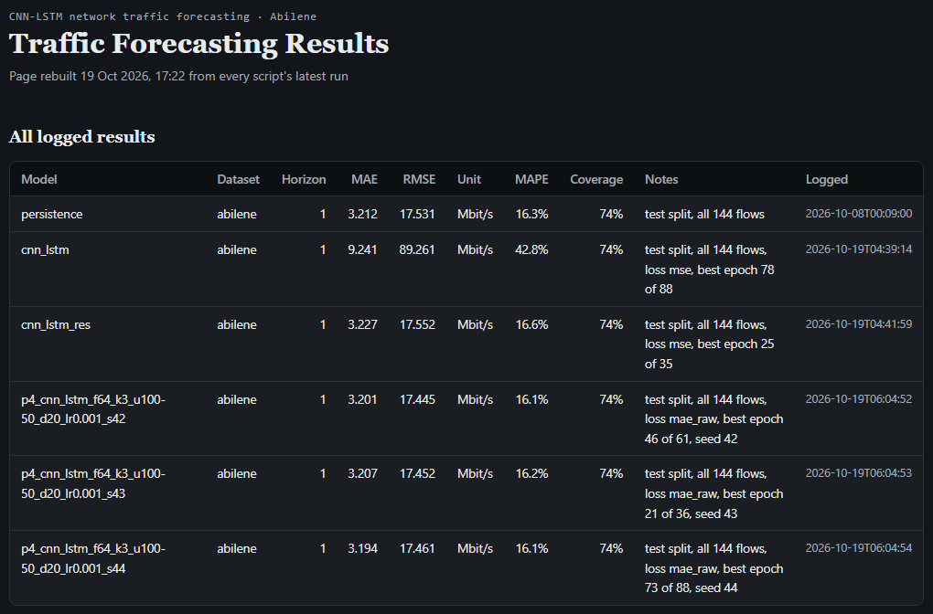
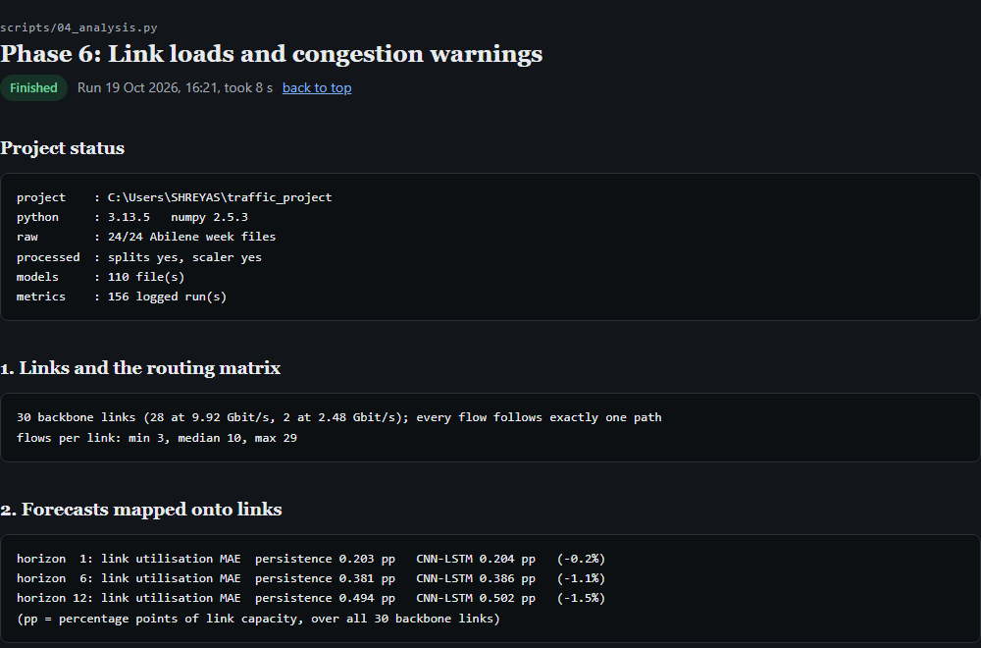
Actual Working: Evidence from the Running System
READING A
persistence 3.212
plain CNN-LSTM 9.241
residual, MSE 3.227
final, 3 seeds
3.201 3.207 3.194
MAE, Mbit/s
A results/report.html — excerpt: Abilene 5-min test rows. Proves: every final CNN-LSTM seed beats persistence.
B 04_analysis.py output — forecasts mapped onto 30 backbone links. Proves: flow → link pipeline runs end to end.
C ONE REAL FORECAST, END TO END (test sample #3691, flow WASH→WASH, 5 min ahead)
INPUT — last hour, Mbit/s
PROCESSING
OUTPUT vs TRUE 286.7
292 413 330 387 368 290 274 298 273 281 273 335
Scale → CNN-LSTM → correction −0.0037 added to last value 0.9397 → clip check → undo scaling
CNN-LSTM 311.6 (error 24.8) · persistence 334.9 (error 48.2)
Sample chosen to show a gain; typical corrections are far smaller (median 0.0012 in scaled units). Output = mean of 3 seeds.
Notes:
WHAT TO SAY
A - An excerpt of the results page (results/report.html), which every script rebuilds automatically. These are the Abilene 5-minute test rows: persistence 3.212 Mbit/s; the CNN-LSTM as originally planned 9.241 (about 3x worse); the residual version trained with MSE 3.227 (still slightly worse); and the final residual CNN-LSTM trained on MAE in Mbit/s, three seeds: 3.201, 3.207, 3.194 - every seed beats persistence. The full page lists all 156 logged runs; only these rows are shown so the comparison is readable.
B - Real console output from the link-level script: the routing matrix has 30 backbone links (28 at 9.92 Gbit/s, 2 at 2.48 Gbit/s); forecasts are mapped onto them and link-utilisation errors computed for 5, 30 and 60 minutes ahead.
C - One real forecast traced through the system: busiest flow (Washington to Washington), test sample 3691. The last reading (335) jumped up from ~273-281. The model added a small negative correction, forecasting 311.6 Mbit/s. The truth was 286.7: error 24.8 vs persistence's 48.2.
BE HONEST: this sample was picked to illustrate a gain. Most corrections are much smaller; on average the model is only about 1% better.
LIVE DEMO OPTION: open results/report.html in a browser, or run ".venv\Scripts\python scripts\04_analysis.py" (about 8 seconds, uses saved models).
TRANSITION: "Now the overall numbers."
LIKELY QUESTIONS
- Why did the model lower the forecast? A plausible reading is that it learned single-step spikes on this flow are often partly reversed - an interpretation, not tested for this sample.
- Why do seeds differ? Seed 43 barely moved (334.3); seeds 42 and 44 corrected more. That is why we report 3 seeds.

Slide 8
Results, Testing and Performance Evaluation
Test split (MAE in Mbit/s) | Persistence | Model
Plain LSTM / CNN, Abilene 5 min | 3.212 | 9.076 / 10.821
Residual CNN-LSTM, Abilene 5 min | 3.212 | 3.200 ± 0.005
Residual CNN-LSTM, GÉANT 60 min | 2.377 | 2.313
Link warning F1, 5 / 30 / 60 min | 0.97 / 0.93 / 0.90 | 0.97 / 0.94 / 0.91
Onsets warned 30 min ahead (of 35) | 5 | 5
Share of each real change forecast | 0 | 1–5%
HOW IT WAS TESTED
WERE THE OBJECTIVES MET?
self_test(): whole data pipeline on synthetic data, with assertions
Scaling round trip reproduces the raw test data exactly
Untrained residual model = persistence (checked in code)
3 seeds per final model; no choice ever made on the test split
MET
Beats persistence on both networks, all seeds; gain grows with horizon
NOT MET
No earlier congestion warning than reacting to current load
FINDING
LSTM-only failed at 30/60 min (−12%) — caused by one bursty flow, LOSA→CHIN
Notes:
WHAT TO SAY
- Chart: after the fixes, the CNN-LSTM beats persistence everywhere - but by small margins: 0.4% at 5 minutes on Abilene, rising to 1.1% at 60 minutes; on GEANT 0.3% at 15 minutes and 2.7% at 60 minutes, where it beats persistence on 459 of 529 flows. All 3 seeds beat persistence in every case. The gain grows with horizon on both networks - that is the stable finding.
- Table: plain models were 2.8x / 3.4x worse; the residual CNN-LSTM is 3.200 +/- 0.005 vs 3.212.
- Link level: F1 is almost identical (0.97/0.94/0.91 vs 0.97/0.93/0.90) and the number of congestion onsets warned 30 minutes in advance is the same, 5 of 35. So the objective of EARLIER warnings was not met.
- Why: the model forecasts only 1-5% of each real change ("damping" 0.01-0.05). It is persistence plus a small nudge, because short-term bursts are mostly unpredictable from the last hour.
- LSTM-only looked best on validation but lost 12% on test at 30/60 min. That entire loss is one flow (LOSA to CHIN) whose test bursts exceed anything in training. Without that flow LSTM-only is as good as the CNN-LSTM. So the CNN's value here is robustness to out-of-range bursts.
TRANSITION: "What we contribute, and what is left."
LIKELY QUESTIONS
- Isn't 0.4% just noise? Seed spread at 5 min is +/-0.005 Mbit/s on 3.2 and all seeds beat persistence - consistent but tiny. The 60-minute GEANT gain (+2.7%) is clearer.
- Why is persistence F1 so high? Congestion episodes last many steps; persistence is right on every step except the first and last.
- Why can persistence never warn of an onset 5 minutes ahead? An onset means the previous step was below threshold, and that is exactly persistence's forecast.

Slide 9
Contributions, Limitations and Future Scope
1
DEMONSTRATED CONTRIBUTIONS
2
LIMITATIONS
3
FUTURE SCOPE
Reproducible, leak-free forecasting pipeline on two real backbone networks
Showed residual output + real-unit loss are what let a CNN-LSTM beat persistence
End-to-end evaluation from flow forecasts to link congestion warnings
Diagnosis: gains come from large moves; peaks under-forecast; one flow causes 96% of Abilene congestion events
Gains are small: 0.3–1% at 5–15 min, 1–3% at 60 min
No early-warning advantage on either network
Input is only the last hour; no time-of-day features
2004–05 data; 3 seeds, one split; GÉANT routing approximate
Offline only — no live deployment or rerouting
Seasonal baseline (“same time yesterday”) and time-of-day inputs
Probabilistic forecasts: warn on the chance of exceeding 50%
Link-aware loss or graph neural network over the topology
Third dataset, e.g. CESNET-TimeSeries24
Simulate rerouting to measure operational benefit
Remaining work: final written report. Opportunity: the evaluation findings could form a short research paper after adding more seeds and significance tests. No patent claim — the architecture is not new.
Notes:
WHAT TO SAY
Contributions (all demonstrated, with evidence on earlier slides):
1. A clean, leak-free, reproducible pipeline on Abilene and GEANT.
2. Evidence that the output form (residual) and the loss (MAE in real units) matter more than the architecture.
3. An end-to-end check that goes beyond flow accuracy to the warnings an operator would actually use.
4. A diagnosis of why gains stay small: the model loses slightly on small moves, gains 4-7% on large moves at 60 min, under-forecasts peaks (bias -21% vs -15% for persistence at 60 min on Abilene), and setting the LOSA-CHIN flow to zero cuts congested link-steps from 1,091 to 43.
We also corrected our own earlier hypothesis: we thought the model "over-smoothed" everywhere; the data showed the opposite on ordinary moves - over-smoothing is only a peak effect.
Limitations - state plainly. Future work is separate and NOT implemented.
Publication: possible, not guaranteed; it would need more seeds and confidence intervals. No patent claim.
TRANSITION: "To conclude."
LIKELY QUESTIONS
- What would you do first next? Add a seasonal baseline and time-of-day inputs (low effort, uses the daily cycle the model cannot currently see).
- Would a GNN help? It could use which flows share links; untested here.
- Why not deploy? Data is 2004-05 and offline; a live system needs streaming input, drift monitoring and input integrity checks.

Slide 10
Conclusion
Problem
Backbone congestion is handled only after links overload.
Solution
Residual CNN-LSTM forecasting all OD flows 5–60 min ahead, mapped to link loads and warnings.
Thank You
Key achievement
Complete, leak-free pipeline on two real networks; every result reproducible from logs.
Questions & Answers
Key findings
Beats persistence by 0.3–2.7%, growing with horizon; no earlier congestion warnings — short-term bursts are largely unpredictable from the last hour.
[Presenter names]
Status
All seven technical objectives complete; final report pending.
Notes:
WHAT TO SAY (about 1 minute)
- Problem: congestion is handled reactively.
- Solution: we forecast all router-to-router flows with a residual CNN-LSTM, map them onto links with the routing matrix and raise warnings.
- Achievement: a complete, leak-free, reproducible pipeline evaluated on two real backbone networks.
- Findings: it beats the strong persistence baseline on both networks, by 0.3% at the shortest horizon up to 2.7% at an hour, but better flow forecasts did not give earlier congestion warnings. Our error analysis explains why.
- Status: all technical work done; final report being written.
"Thank you. We are happy to take questions."
QUICK ANSWERS TO KEEP READY
- "Your gain is tiny" -> consistent across all seeds and both networks; grows with horizon; we report it honestly rather than on scaled data.
- "What did the model learn?" -> small systematic corrections; it forecasts 1-5% of each real change.
- "What is novel?" -> not the architecture; the strict evaluation, the residual + real-unit-loss evidence, the link-level test and the diagnosis.
See Final_Review_Viva_QA.md for the full list.

