Slide 1
Team Rishitha Bandi Shreya Goyal Shashank Raghuvanshi Praveen Kumar
Detection of Phishing email
\

Slide 2
Problem Statement
In today’s world where everything is online from shopping clothes to buying a house. Online transactions are increasing day by day with that phishing activities are also increasing.
Phishing is a cyber attack that uses email as a weapon.

Slide 3
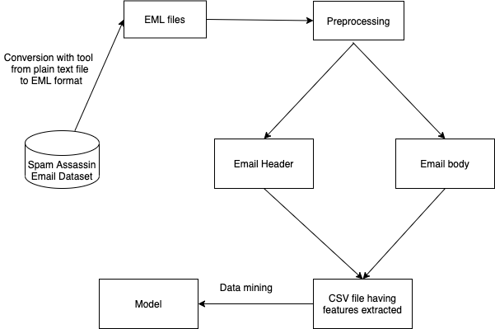
High level Architecture Diagram

Slide 4
Dataset
SpamAssassin Dataset
Ham Emails: 2428
Spam Emails: 1276
Dataset Link: https://www.kaggle.com/beatoa/spamassassin-public-corpus

Slide 5
Extracted Features
Email Header:
Number of recipients from attributes need to be considered.
Email content type from the header.
i) Check if email is HTML type.
ii) Check if email has multipart.
Check if there is a difference between sender and reply email address.
Email Body:
Check if the email body contains the URL. The features to be extracted from the URL section will be set ‘False’ if email doesn’t contain any URL.
Number of inline attachments..
Number of attachments.
URL:
If the email body has URLs these features need to be extracted otherwise default values are stored.
Check if the URL has @.
Check if the IP address is used as a domain name in any of the URLs.
if any of the URLs has // as this is used for redirection.
if any of the URL has ‘mailto’ as this can be used to send information using email.
if any URL domain has ‘-’
Length of the URL. Calculated for each URL and returns maximum number.
Check if the domain of the URL is getting resolved.
Subject:
Check the subject length
Check if subject contains any non-ascii character
Check if the subject contains any numbers

Slide 6
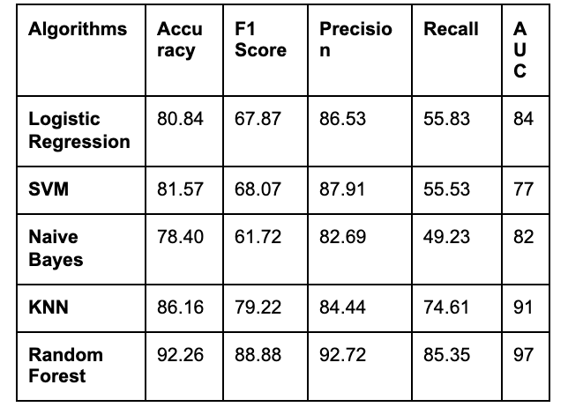
Analysis of Data mining algorithms

Slide 7
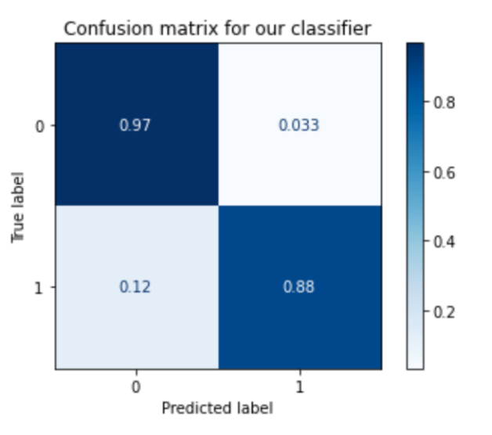
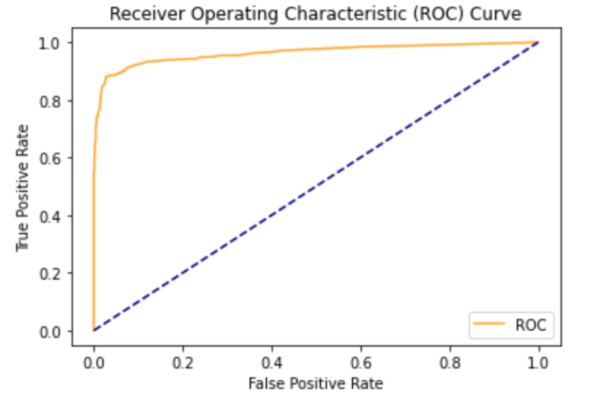
Random Forest
Confusion matrix
ROC Curve

Slide 8
Code
Github: https://github.com/shrey1234/project_255
Google Colab: https://colab.research.google.com/drive/1ckV7zTkhM8PxZXlCVVauv9FBaM_aH5sT?usp=sharing

Slide 9
Conclusion
This study focuses on the classification of phishing and legitimate emails using 15 features derived from the email content. Different classification algorithms are compared with these datasets to get the best classifier for ham and spam detection. Algorithms showing the best results are Random Forest with 92.26% accuracy followed by KNN with 86.16% accuracy.

Slide 10
Rubrics
Data Collection: Using SpamAssassin dataset as it is the only available approved dataset and has been used previously in other literatures. Collected 2428 ham emails from easy_ham and hard_ham folder, 1276 spam emails from spam_2 folder.
Variety: Downloaded dataset has text files for each email. Each email has attachments, URLs, HTML contents, Javascript and plain text content. In the preprocessing step, processed all types to extract features from an email.
Visualization: Feature analysis, Comparison of classification algorithms is done using figures that are attached here.
Significance to the real world: In today’s world when everything is online from shopping clothes to buying a house. Online transactions are increasing day by day and with that phishing activities are also increasing. Phishing can be done via email or website anything and there are other ways also. Detection of phishing email is of great importance nowadays.
Data reduction: Extracted 20 features into csv but after drawing the correlation matrix and feature analysis graph, removed 5 features.
Veracity: Analysing total of 3704 records having quality data for a better model creation. This can be observed from the feature analysis graph showing the importance of each one.
Tools usage: Online tool ‘mbx2mel’ used to convert each text file into eml file.

Slide 11
Thank you

