Slide 1
Team
Rishitha Bandi
Shreya Goyal
Shashank Raghuvanshi
Praveen Kumar
Significant Paper Presentation
\

Slide 2
Significant Paper
Detection of Phishing Emails using Data Mining Algorithm
By, Sami Smadi, Nauman Aslam, Li Zhang, Rafe Alasem and M A Hossain
Published in 2015 9th International Conference on Software, Knowledge, Information Management and Applications (SKIMA), IEEE
source url : https://ieeexplore.ieee.org/document/7399985

Slide 3
Phishing?
Phishing employs social engineering methods to gain access to user’s sensitive information for malicious purpose.
Phishing is usually done through mediums such as emails, SMS (smishing), voice calls (vishing) and instant messages.
Phishing tactics in emails and other message based mediums usually involve convincing user to click on a link of a fraudulent website.
Emails are the most common medium used for phishing.*
* source cited: Anti-Phishing Work Group (APWG) report from 4th quarter of 2012

Slide 4
Phishing detection in emails
vs fraudulent websites
Average lifespan of phishing websites is short (2.25 days)*, which makes it harder to analyse.
Detection of phishing at email level can be more secure as it doesn’t require any action on user’s part.
An average user spends very less time to check for security indicators of websites.**
Detecting phishing in emails early on results in better user experience overall.
*source cited : Intelligent phishing detection system for e-banking
**source cited : Why phishing still works: User strategies for combating phishing attacks

Slide 5
Proposed Technique
Key emphasis is on feature extraction from content and headers of emails, and then selecting/deriving hybrid features from extracted features.

Slide 6
Dataset
Apache Spamassassin Public Corpus*
4559 legitimate emails were selected from ham and hard ham folders.
Nazario**
4559 phishing emails were selected, the whole dataset is a single large text file.
*source : https://spamassassin.apache.org/publiccorpus/
**source : Nigerian fraudulent email corpus (recent link from kaggle, cited link is no longer active)

Slide 7
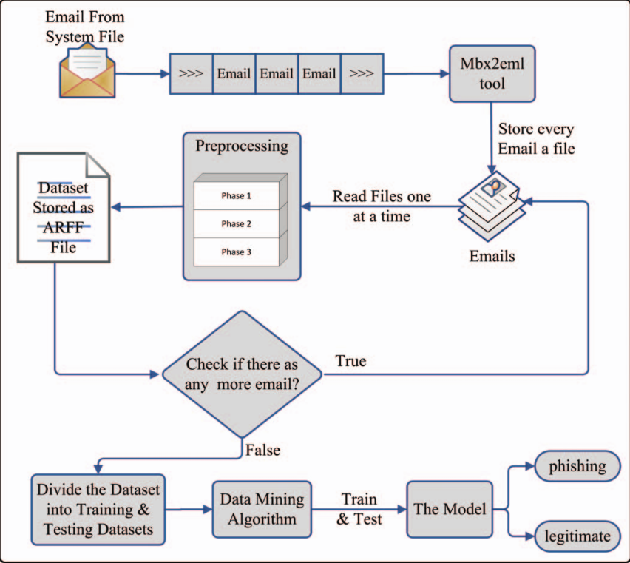
Proposed System Model
Image Source: Directly taken from Research Paper

Slide 8
Extracted Features
The authors extracted 23 hybrid features from emails, which are listed below
Sender domain name from email id matches the domain name of message ID (binary feature).
Email is Html (binary feature)
Email is multipart (binary feature)
Email contains Html form (binary feature)
Number of hyperlinks in email
Number of different domains from hyperlinks
Hyperlink target different from hyperlink text
Number of hyperlinks that have domain different from sender domain
Number of dots in hyperlink
Number of urls that contain ip address
Number of urls that contain hexadecimal
Number of links that contain @ character
Number of links in msg body containing non-standard port (instead of 80 and 443)
Use of javascript (Binary feature)
Number of images used as hyperlink
Number of pictures with Image Map (images containing clickable areas with hyperlinks)
Url containing Non-Ascii character
Number of urls pointing to websites containing self signed certificate
Message size in bytes
Check if all domain names have DnS and Reverse DNS entry (binary feature false if numbers do not match)
Text email (binary feature if content type is text/plain)
Number of attachments
Number of receivers

Slide 9
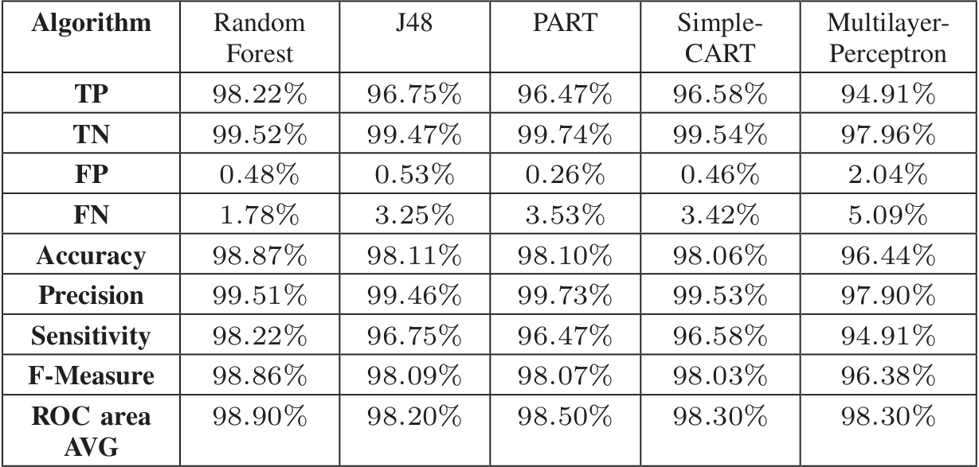
Results
Average classification results for Random Forest, J48, PART, Simple CART and Multilayer Perceptron algorithms

Slide 10
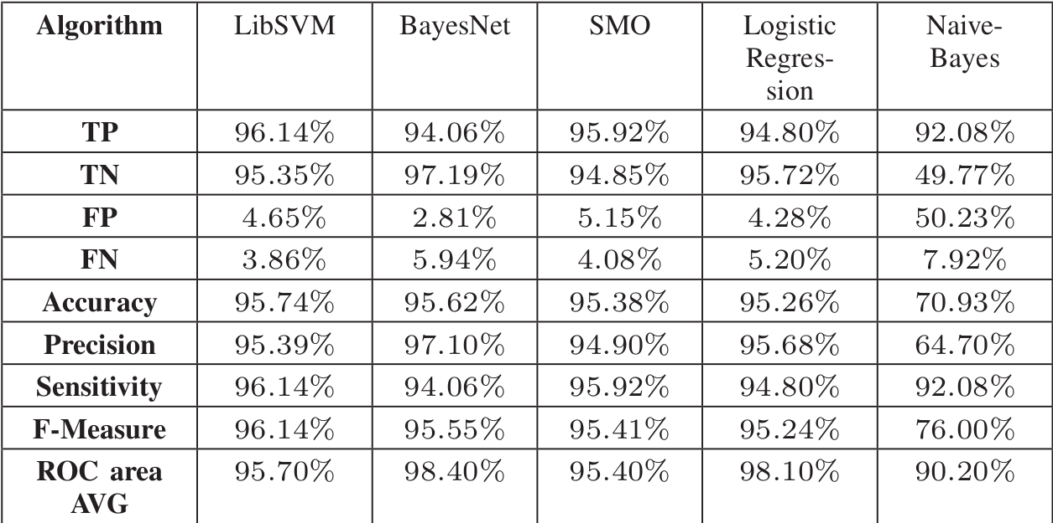
Results
Average classification results for LibSVM, BayesNet, SMO, Logistic Regression and Naive Bayes algorithms

Slide 11
Key Learnings
Data Preprocessing and Feature extraction can have significant impact on the final model.
Random Forest algorithm seems to be most suitable for this task.
Even simple features from emails can prove to be effective in detection of phishing emails.
Since this method of detection does not rely on text analysis, so it also has no adverse impact from some of the techniques used by phishers to confuse text mining methods like hidden salting.

Slide 12
Suggested Improvements
The authors didn’t use any features from text analysis, considering that there are many NLP based approaches that classify emails solely based on text analysis, so it seems, that analysis of text combined with mentioned features can improve the effectiveness of the approach.
Dataset used in research is old, so the effectiveness of model on recent techniques used by phishers can’t be quantified.

