Slide 1

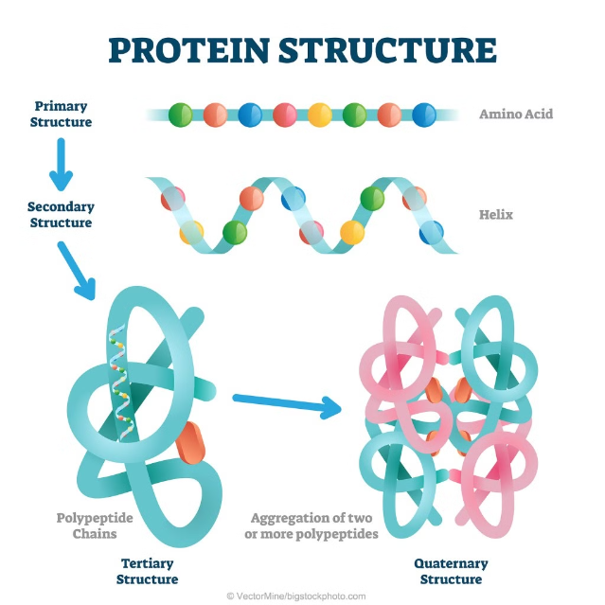
Protein Superfamily Classification Using CNN
PROJECT TEAM MEMBERS
PROJECT GUIDE
Shreeharsh Joshi
Shreyas C
Sinchana Poojary
Sreevalli R
Dr. Suresh Y
Professor & Asst. HOD
Dept. of CSE

Slide 2
Abstract
This study presents a CNN-based approach for protein superfamily classification, integrating sequence and structural data to improve accuracy and efficiency, thus advancing bioinformatics and healthcare.

Slide 3


Vision and Mission
Vision
Our vision is to revolutionize protein superfamily classification through advanced Convolutional Neural Networks (CNNs), eliminating the limitations of traditional methods by seamlessly integrating sequence and structural data.
Mission
To develop a CNN-based classification model that integrates sequence and structural data to address the labour-intensive nature and limited capture of protein structures and functions in current methods, enhancing accuracy, efficiency, and automation in bioinformatics and healthcare research.

Slide 4
Introduction
Existing Systems
Proposed Idea
Current methods for protein superfamily classification are labor-intensive and limited in their ability to capture the full scope of protein structures and functions.
We propose using CNNs for protein superfamily classification, automating feature extraction and surpassing traditional methods, to enhance our understanding of biological functions and evolution.

Slide 5


Scope of the Project
1
Dataset
This project uses an 80,000 protein sequence dataset to develop a CNN-based classification model.
2
Focus
The project focuses on accuracy and recall in protein superfamily classification.
3
Future Goals
Future goals include scaling and integrating advanced machine learning techniques.

Slide 6
Literature Survey
Paper No. | Title | Description | Implementation | Accuracy Level (%) | Remarks
1 | DeepLoc | Predicts subcellular localization of proteins using deep neural networks. | Implemented using a deep neural network trained on large protein datasets. | ~89% | Requires large datasets for training; computationally intensive.
2 | Fuzzy Rule-Based Classification | Utilizes fuzzy rule-based systems to classify protein sequences into superfamilies. | Implemented with a fuzzy rule-based system, compared with non-fuzzy decision tree-based classifier. | ~76-81% | Fuzzy rules are human-readable but system complexity increases with exchange n-grams.
3 | PCA and Neural Networks | Applies PCA and a two-dimensional neural network to classify human protein sequences. | Uses PCA for dimensionality reduction followed by a neural network for classification. | ~68-80% (inertia explained) | Time-consuming training process; classification accuracy varies with neuron map configuration.
4 | Support Vector Machines | Uses SVMs for protein secondary structure prediction. | Implemented with SVM, relies on physicochemical properties of amino acids. | ~83% | High computational cost for large datasets; limited interpretability.

Slide 7
Problem Statement
To develop a Convolutional Neural Network (CNN)-based model that integrates sequence and structural data to address the labour-intensive nature and limited capture of protein structures and functions in current methods for protein superfamily classification.

Slide 8
Functional Requirements
Data Selection
Data Cleaning and Pre-processing
Selecting the appropriate dataset for model development.
Cleaning and preparing the data for model input.
Transformation
Model Development
Transforming the data into a format suitable for the CNN model.
Designing and implementing the CNN-based classification model.
Model Training and Validation
Evaluation
Training the model and validating its performance.
Evaluating the model's accuracy, efficiency, and robustness.
Deployment and Integration
Monitoring
Deploying the model and integrating it into the bioinformatics workflow.
Continuously monitoring the model's performance.

Slide 9






Non-Functional Requirements
Performance
Scalability
Security
The model must deliver high accuracy and efficiency in protein superfamily classification.
The system must be able to handle large-scale protein datasets and future growth in data volume.
The system must ensure the confidentiality and integrity of sensitive biological data.
Usability
Reliability
The system must be user-friendly and accessible to bioinformatics researchers and healthcare professionals.
Ensure consistent and accurate classification results across different datasets and usage scenarios.

Slide 10
System Requirements
Software Requirements
Hardware Requirements
OS: Linux (Ubuntu, CentOS) or Windows 10
Computer with a multi-core processor
Frameworks: TensorFlow, PyTorch, or Keras
8 GB or more of RAM
Tools: Biopython, scikit-bio, NumPy, Pandas, Matplotlib, Seaborn
512 GB or more of storage
High-performance storage (e.g., SSD)
IDE: Jupyter Notebook, Visual Studio Code

Slide 11



Conclusion
Advancing Bioinformatics
Computational Techniques
Future Innovations
This paves the way for future innovations in molecular biology and medicine.
This project advances protein superfamily classification, enhancing bioinformatics research and biomedical applications.
Utilizing advanced computational techniques, it provides insights into protein behaviors and interactions.

Slide 12
References
https://www.sciencedirect.com/science/article/abs/pii/S1476927102000981
https://ieeexplore.ieee.org/abstract/document/4803770
https://journals.plos.org/plosone/article?id=10.1371/journal.pone.0258625

Slide 13
THANK YOU

