Slide 1

Yelp Spam/Review Detection
Presented By
Kunj Parikh -012532065
Neha Bindle - 013763126
Shrey Patel - 012430652

Slide 2

Introduction
Reviews have great importance e-commerce.
Untruthful review is a fake review or opinion spam
Positive reviews attract sales, negative reviews leads to lower sales

Slide 3

Filtering
Supervised
Unmonitored
Characteristics
Linguistic
Behavioral

Slide 4
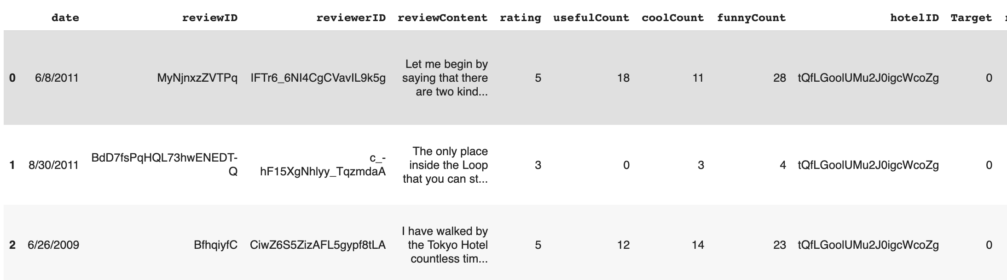

Dataset
6,88,328 reviews and associated features
Highly imbalanced: 25% labeled as Fake, 75% real reviews.

Slide 5
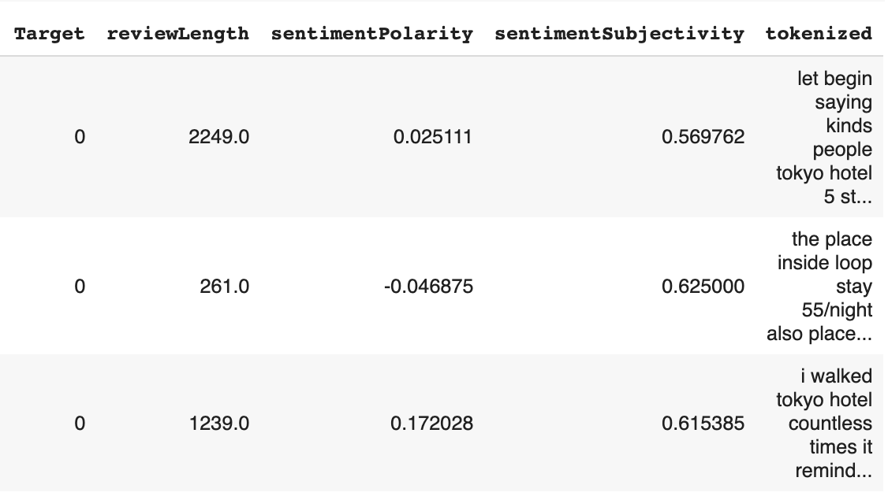
Dataset
Preprocessing: Tokenize reviews (200000 dim feature vector)
Feature Extraction from reviews: sentiment polarity and subjectivity
Used Over sampling to balance the classes

Slide 6
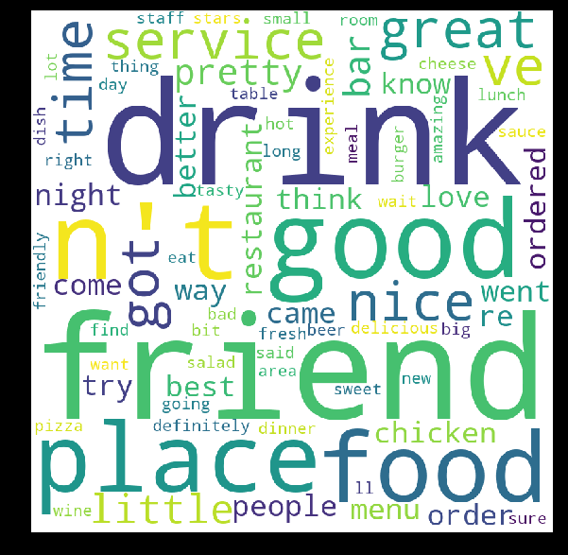
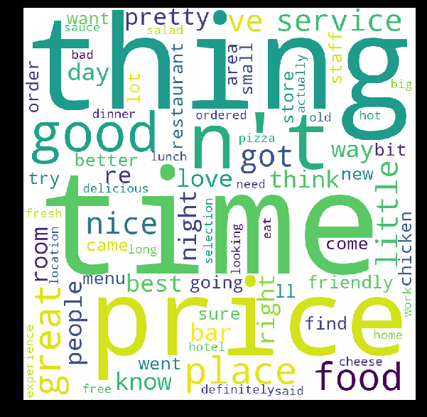
System Design and Implementation
Structural Features - Review Length, Average and standard deviation of review length
Semantic Features – Sentiment Polarity
N-Gram - Unigram, Bigram and Trigram

Slide 7
Preprocess the data, replace the missing values, Oversampling
Train the data using different algorithms
Check for accuracy by tuning various parameters and cross validation
Test on unseen data
Compare the accuracy
Save the model, so that it can be directly used next time
Choose the best model

Slide 8
Data Preprocessing and Feature Engineering
Oversampling
Train – Test Split 80-20 percent with 3 fold cross validation
Tokenize using spacy and Keras
Removal of punctuations , convert to lowercase
Removal of stopwords
Vectorizer and TF-IDF
Word Frequency and Word cloud
Sentiment Polarity and Sentiment Subjectivity

Slide 9
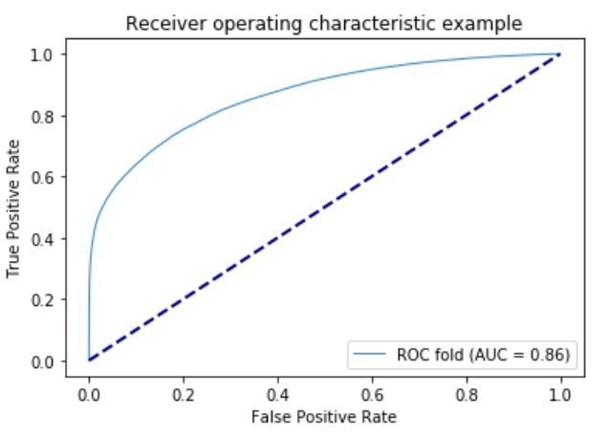
Multinomial Naïve Bayes
Label is generated using Bernoulli Distribution
Trained on Review Content initially
Performed Grid Search with following parameters-'vect__ngram_range': [(1, 1), (1, 2)], 'tfidf__use_idf': (True, False), 'clf__alpha': (1e-2, 1e-3)}
Best Parameters obtained : ngram_range':, (1, 2),
Tfidf__use_idf : True, clf_alpha : .0001.
3 – fold cross validation

Slide 10
Neural Networks
Neural Network with LSTM | Neural Network with extra 1D CNN on top of LSTM layer | Neural network with Bidirectional recurrent layers | Neural network using RNN
Embedding layer, LSTM layer, and output of LSTM Layer was fed into hidden fully connected layer | Combination of recurrent neural network with LSTM and Convolutional layer | Frequently used for NLP for richer data representations | Trained with padded sequence
10,000 most common words were used as features | Dropout layer was added after embedding layer and convolutional layer | Bidirectional recurrent layer after embedding layer | Need to change weight matrices so recurrent unit provides output for input sequence
20 percent dropout, 0.2 Validation split | 20 percent dropout, 0.2 Validation split | Separate instance of this layer for chronological processing and reversed order processing | 5 percent validation split

Slide 11
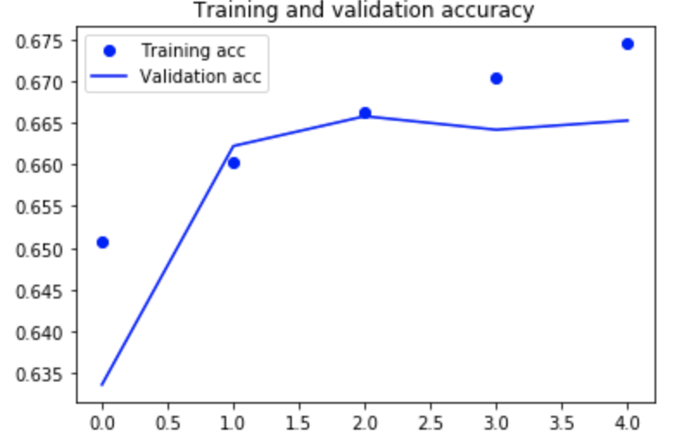
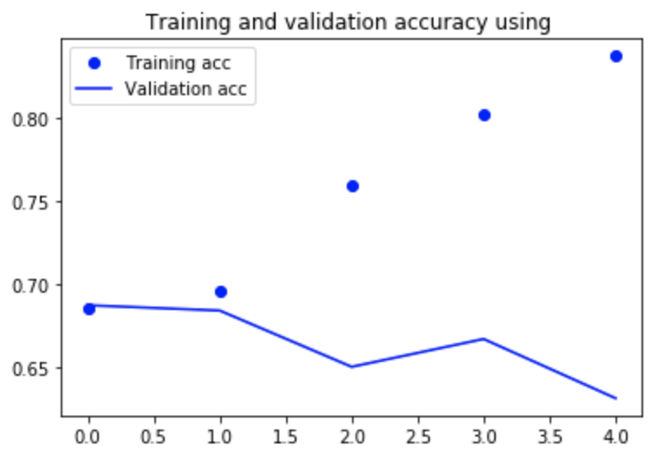
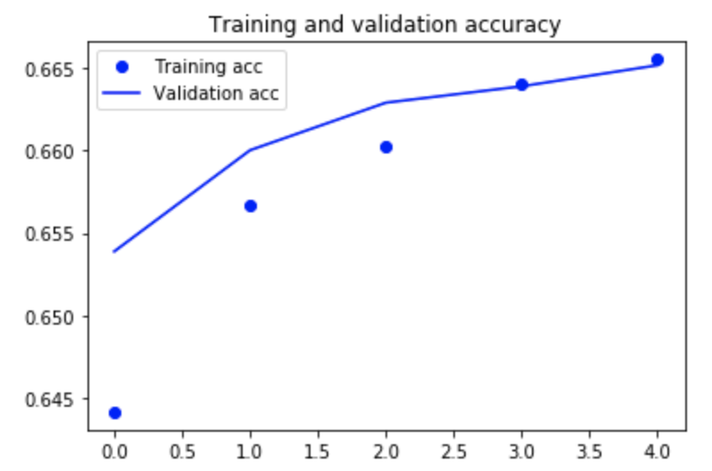
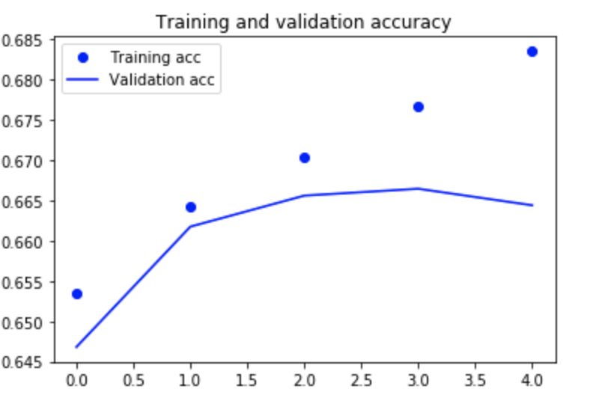
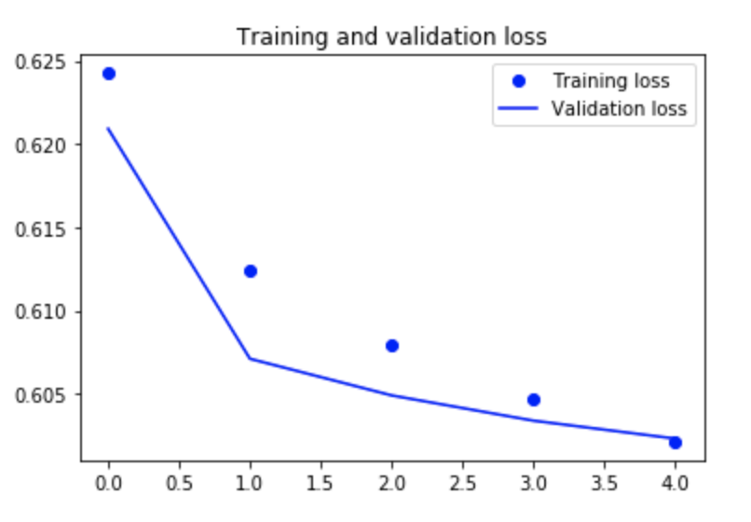
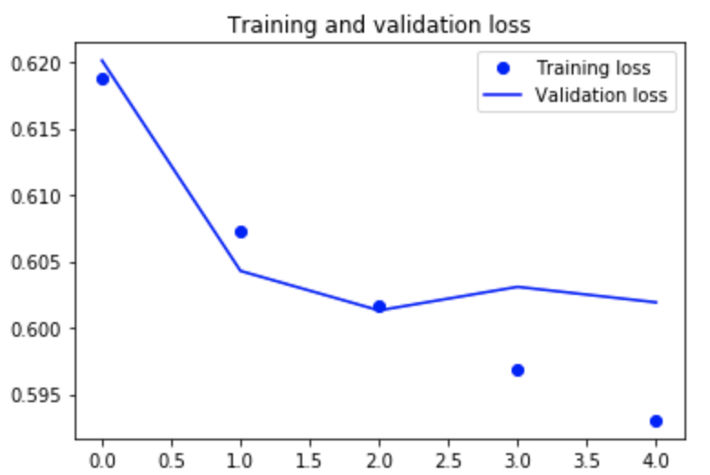
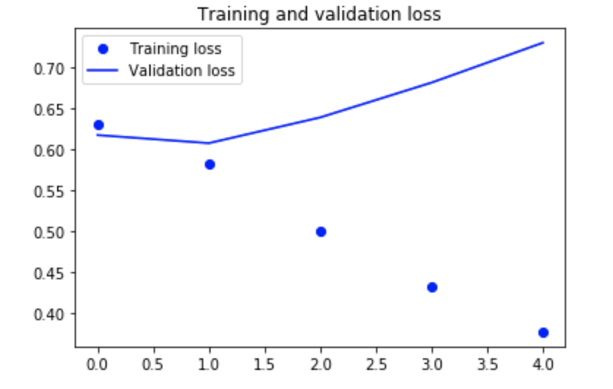
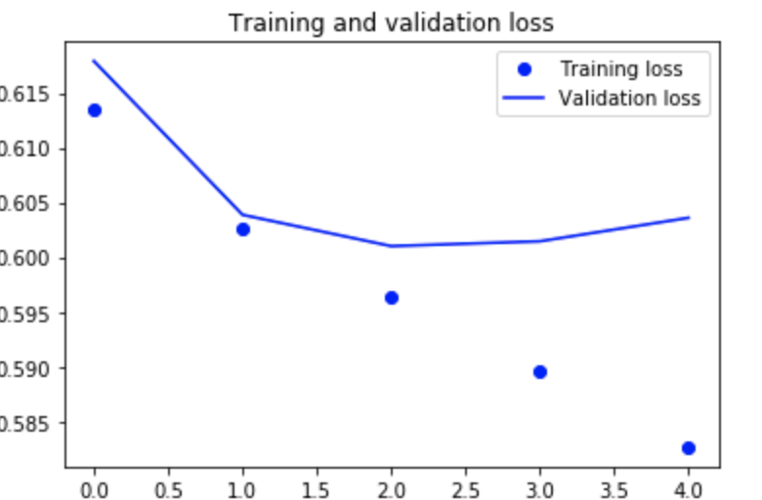
Neural Network with LSTM | Neural Network with extra 1D CNN on top of LSTM layer | Neural network with Bidirectional recurrent layers | Neural network using RNN

Slide 12
SGD Classifier
Model-A trained on text data, and model-B trained on other features.
Model using xa + yb + c, where a and b are predictions of modelA and modelB resp. x and y are the weights to be learnt
Split dataset into 64 - 16 - 20 (individual_train, combine_train, test)
Train on 16% data - Use SGD Classifier and use predictions of modelA and B as input.
Predict on 16% data - Use the learned modelA and modelB.
Train on 64% data - Use NaiveBayes (A) on review text, XGBoost (B) on non-text feature

Slide 13
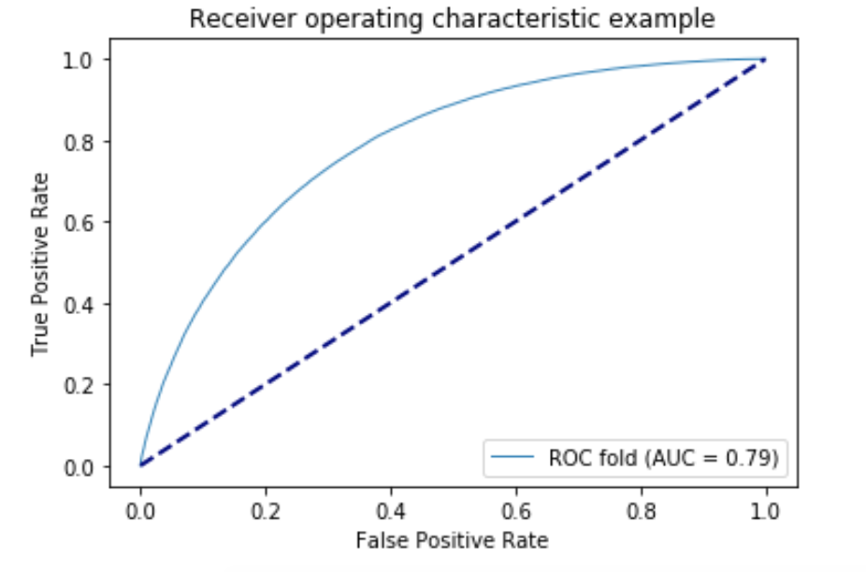
SVM with linear kernel
Applied on tf- idf sparse review matrix, got weighted-avg F1 score : 72%
Also applied to sentiment polarity, subjectivity, but got: 65%
Performed Grid Search with following parameters-'vect__ngram_range': [(1, 1), (1, 2)], 'tfidf__use_idf': (True, False)}
Best Parameters obtained : ngram_range':, (1, 2), Tfidf__use_idf : True}

Slide 14
Evaluation of Results
 | Classifier | F1 Score
1 | Support Vector Machine – Linear Kernel | 72 % (Text), 65%(other
2 | Stochastic Gradient Descent | 55.56 %
3 | Naive Bayes Classifier | 63.52 %
4 | Naive Bayes Classifier (With Grid search and ngram) | 77.00 %
5 | Random Forest | 65.93 %
6 | Neural Network with LSTM | 66.23 %
7 | Neural Network with 1D CNN on top of LSTM layer | 66.38 %
8 | Neural Network using Bidirectional recurrent layer | 66.45 %
9 | Recurrent Neural Network with GRU | 68.23%
10 | XGBoost | 64% (Text), 57%(Other)
11 | Logistic Regression | 56.27 %

Slide 15
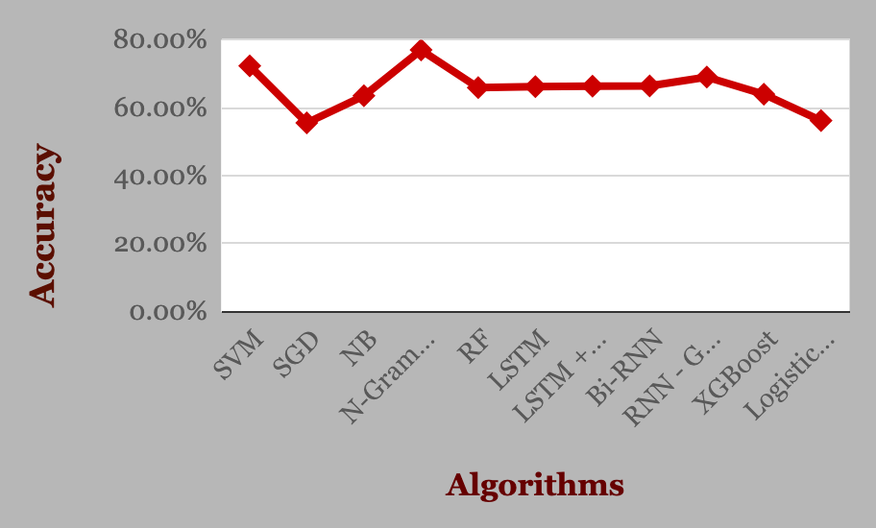
Conclusion
No major improvement with reviewer centered features
Using simple approach works best
Multinomial Naïve Bayes gave the best accuracy of 77 percent with Grid search.
Comparison of different Models

Slide 16

Live Demo…

