Slide 1


Name Of Students
Roll Numbers
Shrey Raj
Mayank Kumar Tiwari
Mayuri Singh
2102840100161 2102840100099 2102840100100
Under Supervision
Dr. Amit Tiwari

Slide 2
Introduction
Objective
Data Flow Diagram
ER Diagram
Relevance to Real World Problems
Summary of Research Papers

Slide 3
INTROOUCTION
Theme: Robotics and Drones
Micro—Doppler based target classification is crucial in distinguishing drones from birds in radar surveillance systems. The increasing prevalence of drones in sensitive airspace necessitates robust and accurate differentiation. This project leverages radar micro—Doppler signatures for real—time, high—accuracy classification.

Slide 4
OBJECTIVE
Develop a robust system to distinguish drones from birds using radar data.
Ensure real—time processing for security and surveillance applications.
Employ advanced signal processing and machine learning techniques for scalability and adaptability.

Slide 5
Software Development Life Cycle (SDLC)
The Software Development Life Cycle (SDLC) is a structured process used to develop software applications. SDLC is a structured process that outlines the entire procedure of software development, from planning to maintenance.

Slide 6
Model of SDLC
Here are some common models of the Software Development Life Cycle(SDLC):
Waterfall Model
V-Model(Verification and Validation Model)
Incremental Model
Spiral Model
Iterative Model
Each model has its own approach to development and is suited for different types of projects and requirements

Slide 7
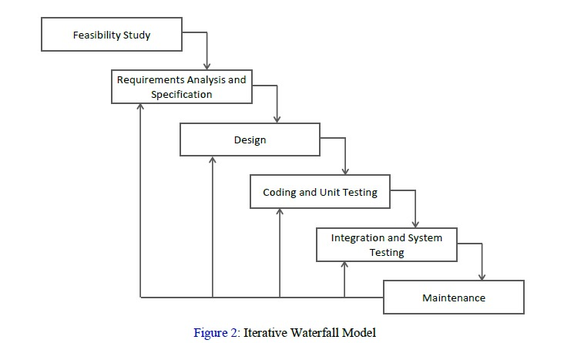
Iterative Waterfall Model
The Iterative Waterfall Model combines elements of the traditional Waterfall Model with iterative processes.
DRAWBACK:
Late Testing: Issues may not be discovered until late in the cycle, which can lead to costly fixes.
Rigidity: While it allows for iteration, it may still be too structured to adapt quickly to significant changes in requirements.

Slide 8
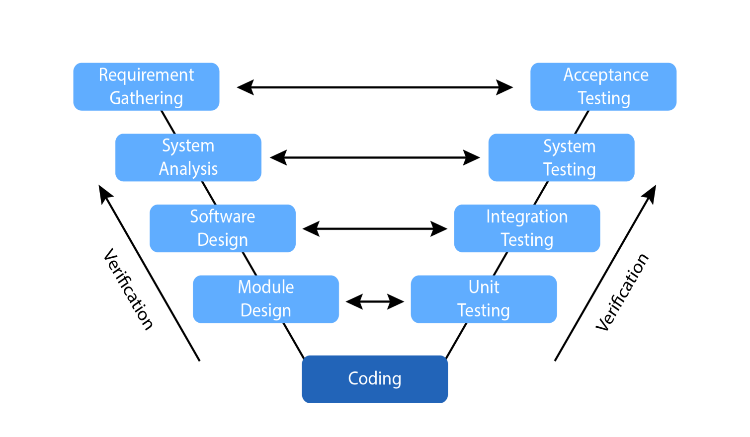
Verifications &Validation Model
The Verification and Validation (V&V)Model is a process used to ensure that a software system meets its specifications and fulfills its intended purpose.
DRAWBACKS:
Time-Consuming
Resource Intensive
Complexity
Late Issue Discovery
User Involvement challenges

Slide 9
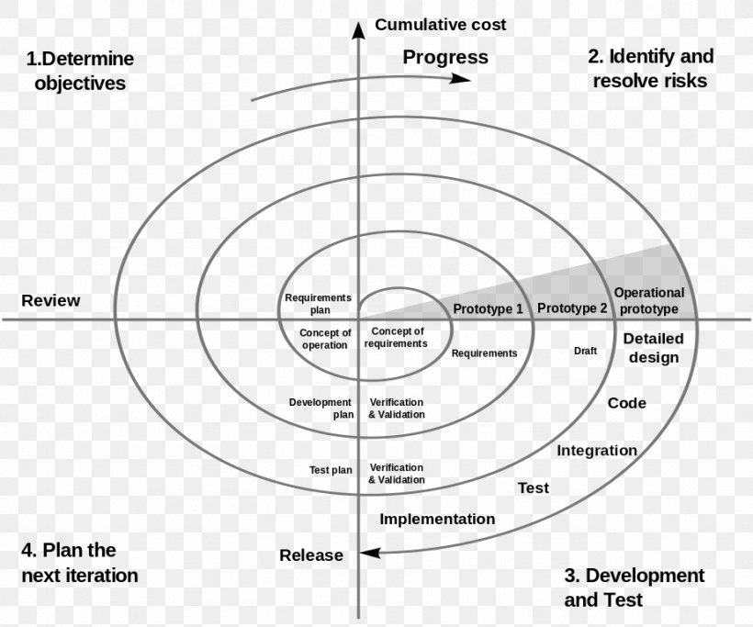
Spiral Model
The Spiral Model is a software development life cycle (SDLC) model that emphasizes iterative development and risk management. It consists of a series of repeated cycles, or "spirals," each encompassing four main phases :
planning, Risk Analysis, Engineering and Evaluation.
Benefits:-
Risk management
Iterative development
Customer feedback
Improved product
Efficient resource management
Enhanced project visibility

Slide 10
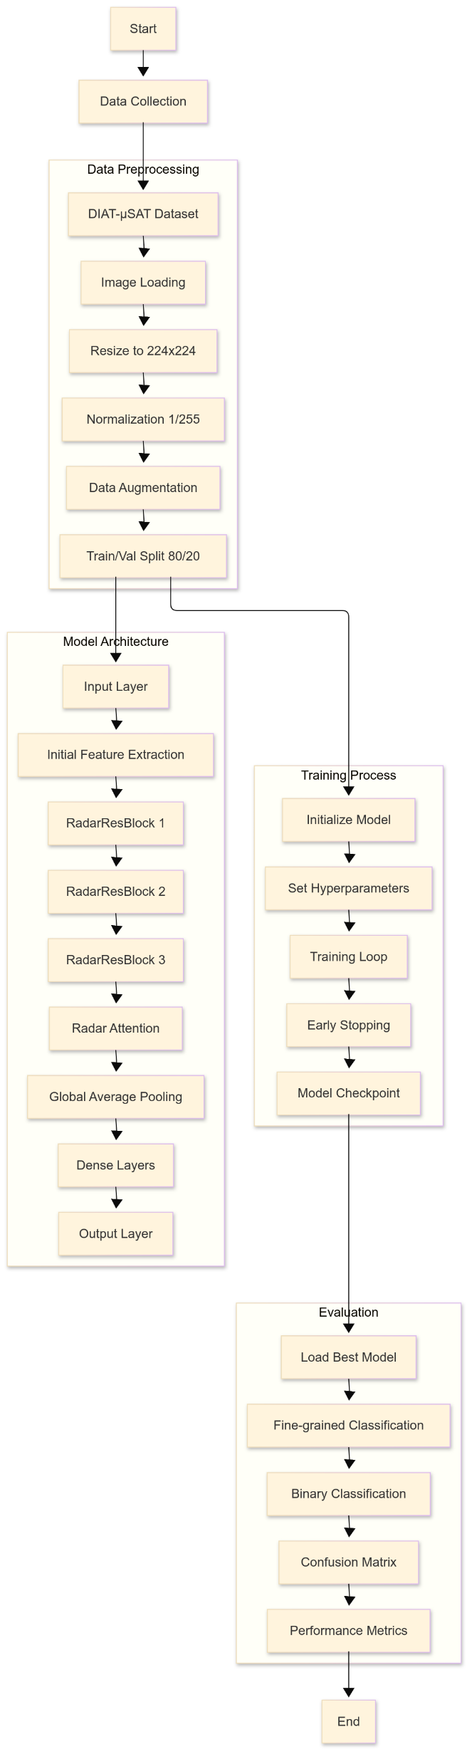
Model Flow Chart

Slide 11
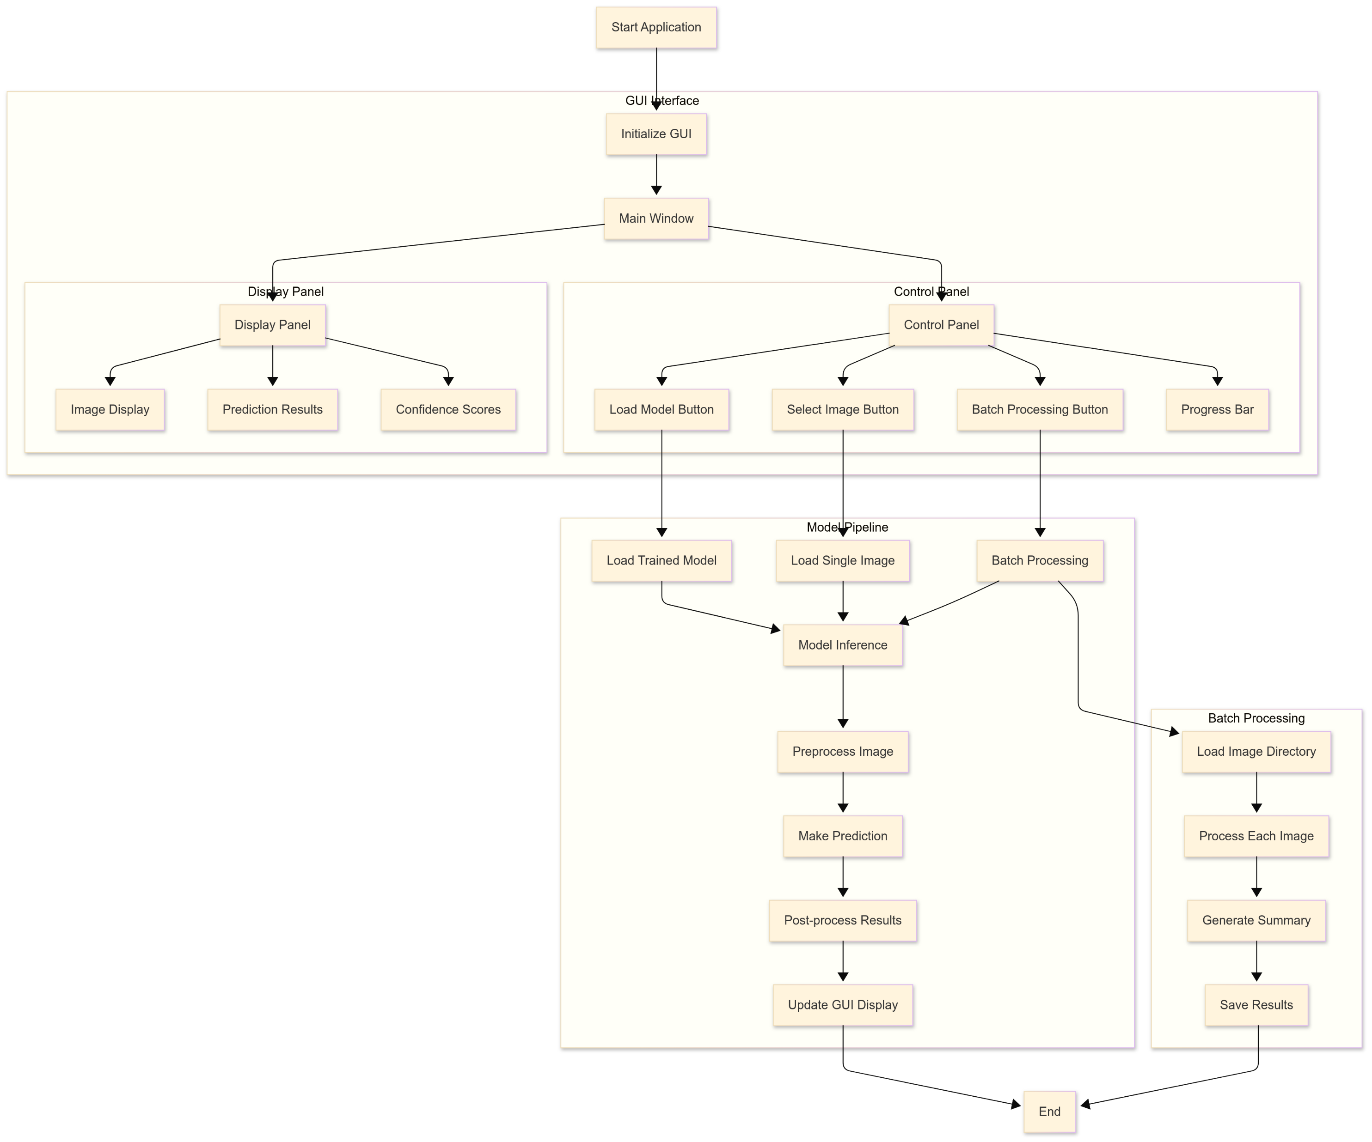
Workflow Diagram

Slide 12
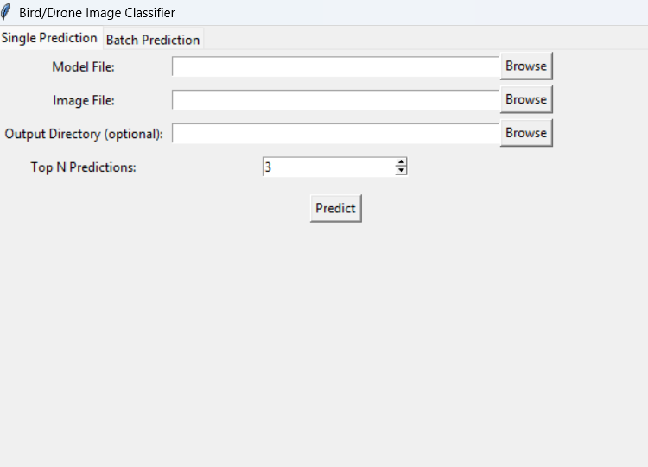
GUI

Slide 13
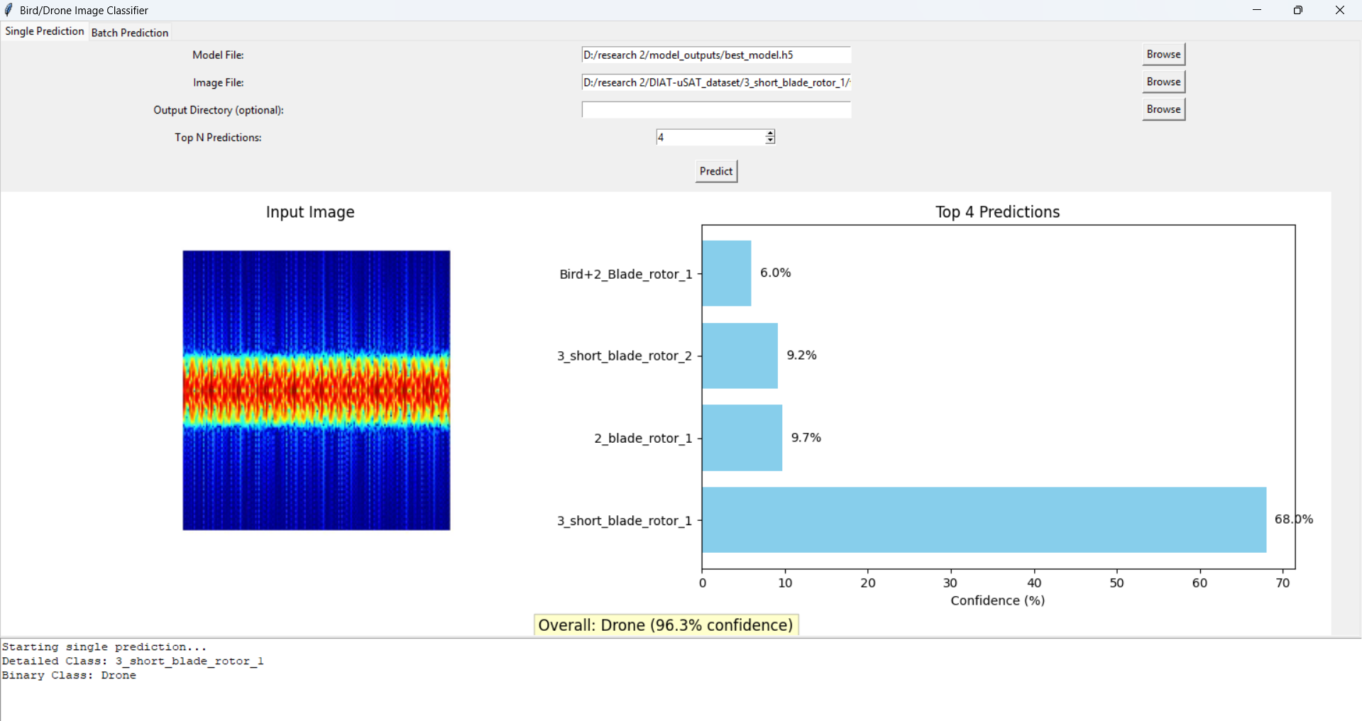

Slide 14
RELEVANCE TO REAL WORLD PROBLEMS
Addresses the need for accurate differentiation of drones and birds in sensitive airspaces.
Enhances safety and security through robust surveillance systems.
Scalable solution adaptable to diverse environmental conditions.

Slide 15
SUMMARY OF RESEARCH PAPERS
Reviewed Micro—Doppler based target classification techniques.
Analyzed methods such as STFT, CWT, PCA, and machine Iearning models.
Proposed improvements for real—time deployment and scalability

Slide 16
THANK YOU

