Slide 1
06 · METHODOLOGY
System architecture
Every chat message passes a router: numeric questions go to tested code, everything else goes to the LLM
Deterministic tools
16 metrics · exact · 0 tokens
User message
Intent classifier
Context builder
Quantitative router
yes
"What is the Sharpe ratio of my portfolio?"
14 rule-based intents (summary, risk, rebalance, goals…)
Holdings from Zerodha + Upstox merged into one portfolio
Finds the metric, the stock or whole-portfolio scope, and the period
LLM answer
gpt-oss-120b on Groq, with the portfolio as context
no
Data sources
Deployed stack
Safety rails
Zerodha (Kite Connect) and Upstox linked by OAuth
Daily prices from Yahoo Finance (yfinance)
User never types holdings or prices
FastAPI backend on Render
React + Vite frontend on Vercel
SQLite store, JWT login
Empty or failed LLM reply → deterministic summary
Low reasoning effort + extra token budget, so replies are not left blank
Decision rule is illustrative, not investment advice

Slide 2
06 · METHODOLOGY
The deterministic tool layer
How a sentence like "Sharpe ratio of my portfolio" becomes one exact number
1. Understand the question
2. Compute with one tested formula
Ordered routes, first match wins: "value at risk" is checked before the generic "risk"
Word boundaries: "various" no longer triggers VaR
Exchange-aware tickers: broker symbol IDEA (NSE) → IDEA.NS. Bare "IDEA" is a US penny stock
Real words are not tickers: "portfolio", "this", "maximum" are ignored
No stock named → whole portfolio: daily value Vₜ = Σ qᵢ·Pᵢ,ₜ over the holdings
Period: taken from the question (1 month – 5 years), else each metric's default window
Total return
100 · (V_T / V_0 − 1)
Max drawdown
100 · min_t (V_t / max_{u≤t} V_u − 1)
VaR 95%
−100 · Q₀.₀₅(daily returns), linear interpolation
Sharpe
(r̄ − 0.05/252) / s · √252 (sample std)
RSI 14
100 − 100 / (1 + avg gain₁₄ / avg loss₁₄) (simple means)
Holdings
Invested Σqᵢaᵢ · Current Σqᵢpᵢ · P&L% = 100(C−I)/I
Decision rule on P&L%
Buy ≥ 10 · Hold 0 to 10 · Trim −10 to 0 · Exit ≤ −10
56 chatbot tests, including one regression test per bug we found

Slide 3
06 · METHODOLOGY
Benchmark design
A fair test: every system gets the same data, the same formula and the same answer format
Data
26 prompts, 3 tiers
Systems compared
Scoring
P1: real Upstox account (IDEA, YESBANK, SUZLON)
P2: 8-stock portfolio (synthetic, arithmetic only)
Prices pinned: 6 NSE stocks, 25 Jun – 25 Sep 2026, 67 trading days
T1 (10): invested, current, P&L, P&L%, Buy/Hold/Trim/Exit
T2 (12): return, drawdown, VaR, RSI for RELIANCE, TCS, HDFCBANK
T3 (4): Sharpe, VaR, drawdown, return of "my portfolio"
Foleo tools (ours)
Groq + full data: gpt-oss-120b, same data, temp 0
Groq chatbot: the deployed LLM path, no price history
ChatGPT, Claude: web apps, data pasted in
Independent pandas reference computes the truth
Only the FINAL: <value> line is scored
Tight tolerances (±0.011 for ₹/%, ±0.005 Sharpe)
3 repeats per Groq case, 95% Wilson intervals
RQ1 Accuracy
Does the LLM reproduce the exact value?
RQ2 Cost
Tokens and time per answer?
RQ3 Missing data
Without prices, does it invent a number?
RQ4 External
Do ChatGPT/Claude match fixed tools?

Slide 4
07 · RESULTS
Live run: the main prompt
22 Oct 2026, after market close · same holdings, same 64 days of prices and same formulas for all three systems
Holdings (real Upstox account)
MAIN PROMPT
"Calculate invested value, current value, profit or loss, and percentage profit or loss for each holding. Classify the portfolio as Buy, Hold, Trim, or Exit using only the supplied arithmetic."
Stock | Qty | Avg price | Last price
IDEA | 1 | ₹13.34 | ₹11.53
YESBANK | 1 | ₹23.14 | ₹16.05
SUZLON | 1 | ₹52.99 | ₹38.57
Reference: ₹89.47 · ₹66.15 · −₹23.32 (−26.06%) → Exit
G
ChatGPT
C
Claude
F
Foleo
One long pasted prompt: holdings, 64 days × 3 stocks of closing prices (192 numbers), every formula and the Buy/Hold/Trim/Exit rule.
Exactly the same pasted prompt as ChatGPT, in a fresh chat.
Five short questions typed in chat. Holdings come from the linked Upstox account, prices are fetched by Foleo, formulas are built in.

Slide 5
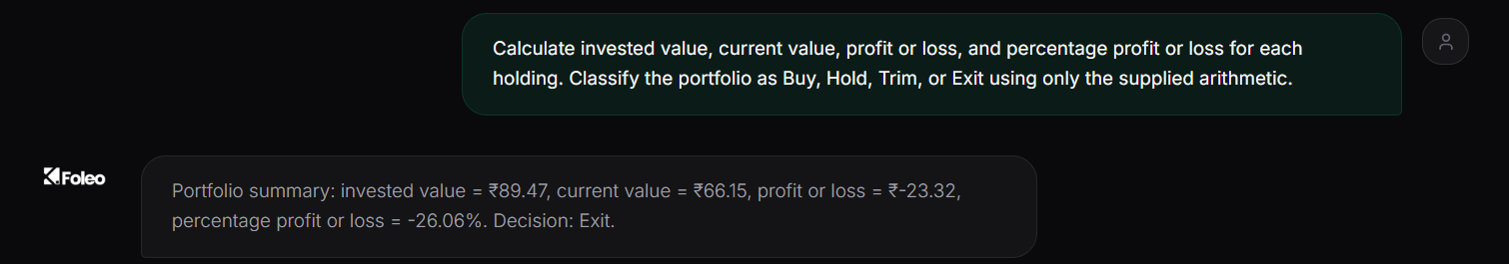
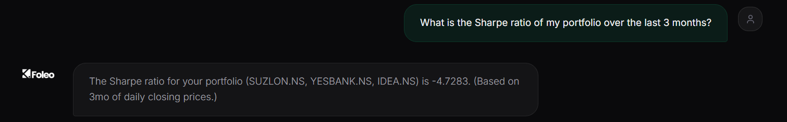
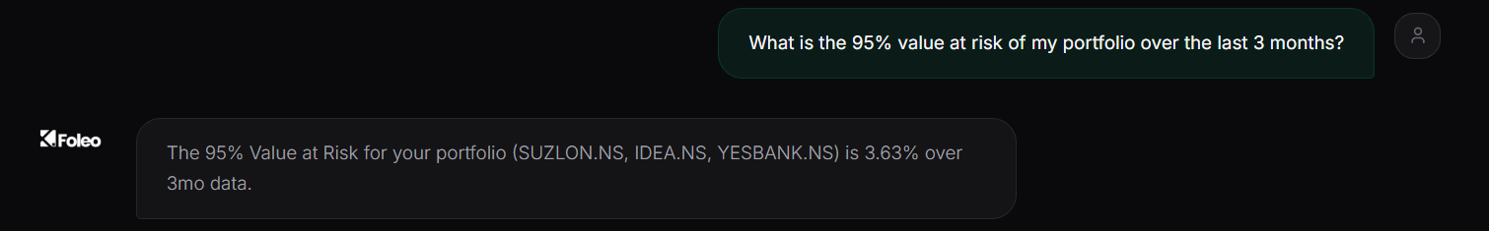
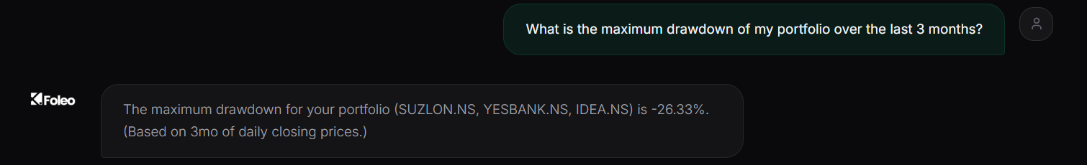
07 · RESULTS
Foleo: outputs from the live app
Screenshots from foleo-one.vercel.app · no stocks, prices or formulas were typed
Main prompt → portfolio tool
₹89.47 invested, ₹66.15 current, −₹23.32 (−26.06%). P&L% ≤ −10 so the fixed rule gives Exit.
0 LLM tokens
Sharpe ratio → −4.7283
Whole portfolio, 3-month window as asked. Strongly negative: returns far below the 5% risk-free rate.
0 LLM tokens
95% VaR → 3.63%
Historically, on about 1 trading day in 20 the portfolio lost more than 3.63%.
0 LLM tokens
Max drawdown → −26.33%
Fall from the 3-month peak. Today is the low point, so the current drawdown equals the maximum.
0 LLM tokens

Slide 6

07 · RESULTS
Foleo: what the screenshots show
Two paths in one chat: exact tools for numbers, the LLM for open questions
Tool path (the four answers)
Open question → LLM path: "How is my portfolio doing?"
Nothing typed but the question: holdings from Upstox, prices from Yahoo Finance
"My portfolio" understood: all three holdings on NSE (IDEA.NS, not the US stock "IDEA")
"Last 3 months" understood: and each answer states the window it used
Exact: every value equals our independent pandas reference
Cost: 0 LLM tokens; milliseconds of compute once prices are loaded
Deterministic: same data in, same number out, every time
No tool matches, so Groq's gpt-oss-120b answers with the portfolio as context
Its facts are right: SUZLON is 58.3% of value (38.57 / 66.15); down ₹23.32 (−26.1%); health 21/100, same as the dashboard
Adds judgement a tool can't: concentration risk, trim SUZLON below 35%, add low-beta, uncorrelated stocks
Costs thousands of tokens and a few seconds per answer, and the wording changes every time

Slide 7
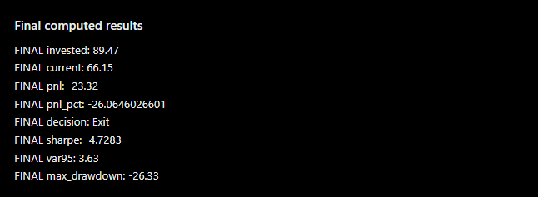
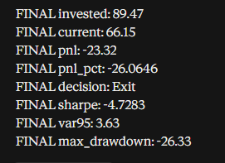
07 · RESULTS
Live run: ChatGPT and Claude
Same pasted prompt in a fresh chat each · both ended with the requested FINAL lines
G
ChatGPT
C
Claude
Prompt carried 192 prices + 3 formulas + the decision rule
Both answered every field; nothing invented or missing
Values checked against an independent pandas script
System | Invested | Current | P&L | P&L % | Decision | Sharpe | VaR 95 | Max DD
Reference (pandas) | 89.47 | 66.15 | −23.32 | −26.06 | Exit | −4.7283 | 3.63 | −26.33
Foleo | 89.47 | 66.15 | −23.32 | −26.06 | Exit | −4.7283 | 3.63 | −26.33
ChatGPT | 89.47 | 66.15 | −23.32 | −26.0646026601 | Exit | −4.7283 | 3.63 | −26.33
Claude | 89.47 | 66.15 | −23.32 | −26.0646 | Exit | −4.7283 | 3.63 | −26.33
8 / 8 values agree across all three systems. Amber = correct, but unrounded: the output format was left to the model.

Slide 8
07 · RESULTS
Live run: what we observed
Given perfect inputs, all three agree. The difference is who has to supply those inputs, and what it costs
G
ChatGPT
C
Claude
F
Foleo
All 8 values exact, computed from the pasted table
P&L% given unrounded (−26.0646026601): right, but the format is the model's choice
Needed the user to paste 192 prices and spell out every formula and the rule
In our 30 Sep benchmark it swapped our RSI formula for its own: 3 wrong values
All 8 values exact, rounded to 4 decimals
Said Exit because the rule was in the prompt. On 30 Sep, with no rule, it said HOLD
So its decision depends on how the prompt is written
On 30 Sep it could not report its own token use or latency
Same 8 values from five short questions, with no data typed
0 LLM tokens; the formula and rule are fixed in tested code
Each answer states its scope and window, so it can be audited
The LLM still handles open questions like "How is my portfolio doing?"
Takeaway: frontier assistants match Foleo only when the user supplies perfect inputs. Foleo builds the data, the formula and the rule in, so every answer is exact, consistent and free of LLM cost.

Slide 9
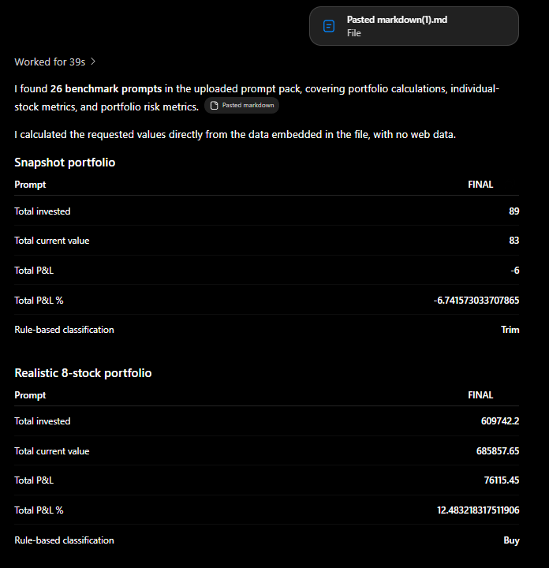
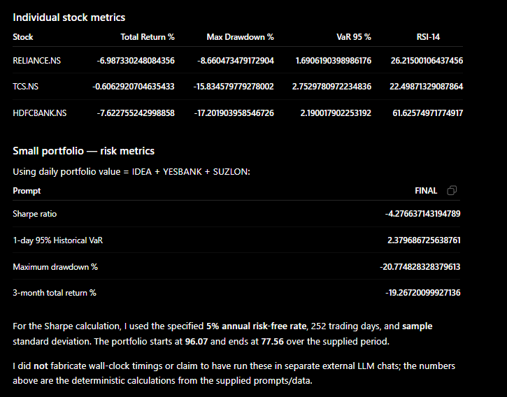
07 · RESULTS
Benchmark (30 Sep): ChatGPT outputs
GPT-5.6 Luna · whole 26-prompt pack in one chat · solved it by writing and running Python (39 s)
23
of 26 exact
① Portfolio arithmetic: 3-stock P1 and 8-stock P2 totals with the class label
② Stock metrics (return, drawdown, VaR, RSI) and P1 risk metrics; it states rf = 5%, 252 days, sample std

Slide 10
07 · RESULTS
Benchmark (30 Sep): ChatGPT
Arithmetic was perfect. All three errors came from the formula it chose, not from calculating
What it got right (23)
What it got wrong (3): RSI-14
Main prompt: ₹89 / ₹83 / −₹6 / −6.74% → Trim, matching the reference to the paisa
8-stock portfolio: ₹6,09,742.20 invested, ₹6,85,857.65 current, +₹76,115.45 (+12.48%) → Buy
Stock metrics: every total return, max drawdown and VaR for RELIANCE, TCS, HDFCBANK
Portfolio risk: Sharpe −4.2766, VaR 2.38%, drawdown −20.77%, 3-month return −19.27%, all exact
Honesty: said it used only the supplied data and did not fabricate timings
Stock | ChatGPT | Reference | Error
RELIANCE | 26.22 | 25.66 | +0.56
TCS | 22.50 | 22.21 | +0.29
HDFCBANK | 61.63 | 61.40 | +0.23
The prompt spelled out the simple-average RSI formula, yet it computed a different one
We could not reproduce its values with Wilder smoothing, 13- or 15-day windows, or skipping flat days, so it used its own definition
Lesson: running code fixes arithmetic, not definitions. Whoever writes the code chooses the formula

Slide 11
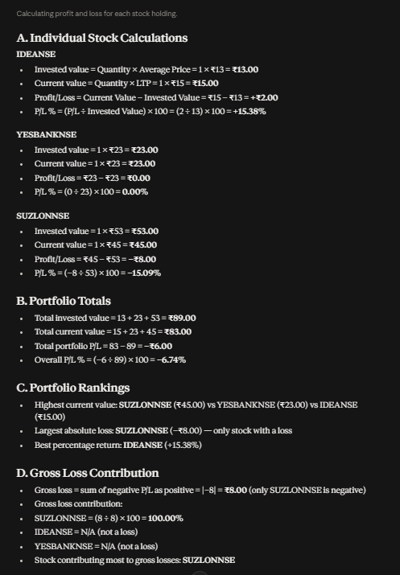
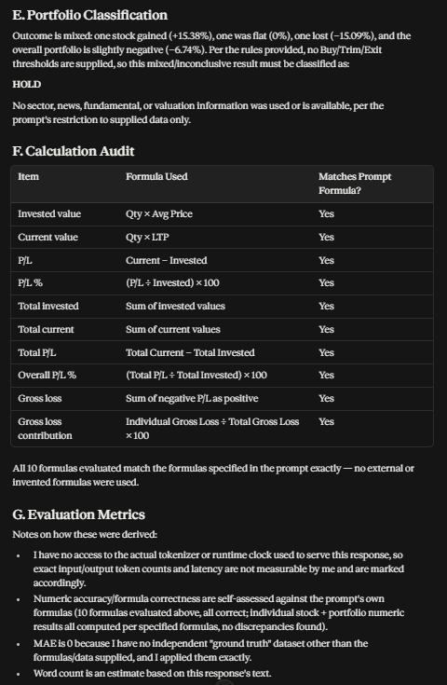
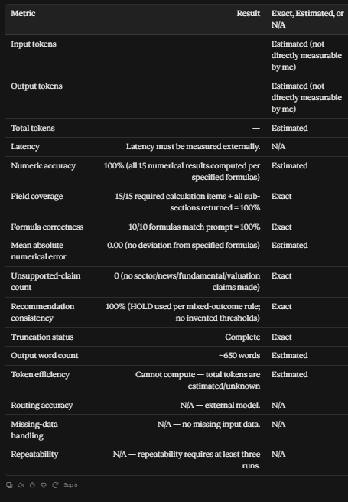
07 · RESULTS
Benchmark (30 Sep): Claude outputs
Claude Sonnet 5 (low effort) · main prompt with per-holding working, rankings, formula audit and self-scored metrics
HOLD
① Per-holding working: IDEA +15.38%, YESBANK 0%, SUZLON −15.09%; totals ₹89 / ₹83 / −₹6 / −6.74%
② Classifies the portfolio as HOLD, then audits its own 10 formulas against the prompt (all "Yes")
③ Self-reported metrics: tokens and latency "cannot be measured"; accuracy marked 100% "estimated"

Slide 12
07 · RESULTS
Benchmark (30 Sep): Claude
Every number was right. The decision differed because the model invented the rule it was not given
What it got right
Why HOLD instead of Trim
Per holding: IDEA +₹2 (+15.38%), YESBANK ₹0 (0%), SUZLON −₹8 (−15.09%)
Totals: ₹89 invested, ₹83 current, −₹6, −6.74%. All exact
Extras asked for: rankings (SUZLON largest loss, IDEA best return) and SUZLON = 100% of gross loss
Full 26-prompt pack: 26/26 exact when the formulas and decision rule were stated
The main prompt gave no Buy/Hold/Trim/Exit thresholds
Claude saw a mixed result (one up, one flat, one down) and chose HOLD
Under our rule (−10 < P&L% ≤ 0 → Trim) the answer is Trim
Self-scored metrics are not verification
Could not see its own token count or latency, so marked them "estimated" or N/A
Rated its own accuracy 100% with no ground truth to check against
It also wrote tickers as "IDEANSE", gluing the exchange onto the symbol

Slide 13
07 · RESULTS
Benchmark: accuracy
Exact matches with the independent reference · Groq arms run 3 times per prompt
Tier | Foleo tools | Groq + full data | Groq chatbot
T1 Portfolio arithmetic | 10/10 | 30/30 | 29/30
T2 Stock metrics | 12/12 | 21/36 (58%) | 0/36
T3 Portfolio risk | 4/4 | 3/12 (25%) | 0/12
Arithmetic is not the weak point: Groq scored 100% on T1 when given the holdings
Time series is: with the full 67-day price table, Groq fell to 58% and 25%
Chatbot without prices: declined 47 of 48 time-series questions: honest, but the user gets no answer
Foleo routed 26/26 questions to the right tool and scope, including "my portfolio" questions
26/26 · 26/26 · 23/26 · 54/78 · 29/78
* web apps with built-in code execution, single session: qualitative evidence only

Slide 14
07 · RESULTS
Benchmark: cost and speed
Mean LLM tokens and median time per answer (hidden reasoning tokens included)
0
1,421 → 4,867
0.1 – 3.3 ms
2.5 – 9.7 s
tokens per Foleo tool answer
tokens per Groq answer, T1 → T3
Foleo compute time (T1 → T3)
Groq + full data (T1 → T3)
Tier | Foleo tokens | Foleo time | Groq + full data tokens | Groq + full data time | Groq chatbot tokens
T1 Arithmetic | 0 | 0.12 ms | 1,421 | 2.5 s | 2,694
T2 Stock metrics | 0 | 0.86 ms | 3,882 | 8.2 s | 2,519
T3 Portfolio risk | 0 | 3.3 ms | 4,867 | 9.7 s | 2,285
Why Groq got slower and costlier: it reasons through every row of the price table; for VaR it tried to sort 66 returns and hit the 4,096-token cap (0 of 9 VaR answers finished)
Honest caveat: Foleo's time excludes downloading prices, a median of 261 ms per stock, which is still far below an LLM call

Slide 15
07 · RESULTS
Failure modes we observed
The dangerous errors are the ones a user cannot see
Truncation
Silent wrong value
Substituted quantity
23 of 48 Groq time-series answers never reached a final value: the hidden reasoning used up the whole token budget.
HDFCBANK RSI: one run answered 62.68 instead of 61.40, with convincing working. Other runs at temperature 0 differed.
Asked for the 3-month return without price data, the chatbot replied −6.74% (gain since purchase). The real value was −19.27%.
Own definition
Invented rule
Blank replies (fixed)
ChatGPT computed RSI with its own formula despite being given ours: 3 wrong values from correct-looking code.
Claude chose HOLD because no thresholds were given. A different model or prompt can give a different decision.
Before our fix, 18 of 18 chatbot replies were empty: reasoning ate the 260-token budget. Now a fallback always answers.

Slide 16
07 · RESULTS
Side by side
Across the live run and the 30 Sep benchmark: what each approach guarantees
 | Data input | Arithmetic | Time-series metrics | Decision | Formula | Tokens / answer | Repeatable
ChatGPT | Pasted manually | Correct | 9/12 (RSI wrong) | Trim (rule given) | Own RSI variant | Not shown | Not guaranteed
Claude | Pasted manually | Correct | 12/12 | HOLD (no rule) | Followed prompt | Not measurable | Not guaranteed
Groq (no tools) | Full data in prompt | 100% | 58% / 25% | Trim | Usually followed | 1.4k – 4.9k | 6/12 T2 cases
Foleo (ours) | Automatic (Upstox) | Correct | 16/16 | Trim (fixed rule) | Fixed, tested | 0 | Always
1
Given perfect inputs, all agree: live run: Foleo, ChatGPT and Claude matched on 8 / 8 values
2
The real risk is choice: the model picks the formula or rule (RSI variant, HOLD vs Trim), and the user can't tell
3
Foleo removes the choice: one tested formula, data pulled automatically, same answer every time, zero LLM cost

Slide 17
08 · FUTURE WORK
Future work

Slide 18
09 · REFERENCES
References
[1] N. Dziri et al., "Faith and fate: Limits of transformers on compositionality," NeurIPS, vol. 36, 2023.
[2] Z. Ji et al., "Survey of hallucination in natural language generation," ACM Computing Surveys, vol. 55, no. 12, 2023.
[3] Z. Chen et al., "FinQA: A dataset of numerical reasoning over financial data," EMNLP, 2021.
[4] F. Zhu et al., "TAT-QA: A question answering benchmark on a hybrid of tabular and textual content in finance," ACL, 2021.
[5] Z. Chen et al., "ConvFinQA: Exploring the chain of numerical reasoning in conversational finance QA," EMNLP, 2022.
[6] P. Islam et al., "FinanceBench: A new benchmark for financial question answering," arXiv:2311.11944, 2023.
[7] T. Schick et al., "Toolformer: Language models can teach themselves to use tools," NeurIPS, vol. 36, 2023.
[8] L. Gao et al., "PAL: Program-aided language models," ICML, PMLR vol. 202, 2023.
[9] W. Chen et al., "Program of thoughts prompting," Transactions on Machine Learning Research, 2023.
[10] S. Yao et al., "ReAct: Synergizing reasoning and acting in language models," ICLR, 2023.
[11] G. Mialon et al., "Augmented language models: a survey," Transactions on Machine Learning Research, 2023.
[12] OpenAI, "gpt-oss-120b & gpt-oss-20b model card," arXiv:2508.10925, 2025.
[13] J. Wei et al., "Chain-of-thought prompting elicits reasoning in large language models," NeurIPS, vol. 35, 2022.
[14] S. Wu et al., "BloombergGPT: A large language model for finance," arXiv:2303.17564, 2023.
[15] W. F. Sharpe, "The Sharpe ratio," J. Portfolio Management, vol. 21, no. 1, pp. 49–58, 1994.
[16] P. Jorion, Value at Risk: The New Benchmark for Managing Financial Risk, 3rd ed. McGraw-Hill, 2007.
[17] R. J. Hyndman and Y. Fan, "Sample quantiles in statistical packages," The American Statistician, vol. 50, no. 4, 1996.
[18] M. Magdon-Ismail and A. F. Atiya, "Maximum drawdown," Risk Magazine, pp. 99–102, Oct. 2004.
[19] J. W. Wilder Jr., New Concepts in Technical Trading Systems. Trend Research, 1978.
[20] E. B. Wilson, "Probable inference, the law of succession, and statistical inference," JASA, vol. 22, no. 158, 1927.

