Slide 1
ect-Oriented Systems Development:
Using the Unified Modeling Language
Chapter 14:
System Usability and Measuring User Satisfaction
Object-Oriented Systems Development Bahrami © Irwin/ McGraw-Hill

Slide 2

Goals
Usability testing.
User satisfaction testing.
Object-Oriented Systems Development Bahrami © Irwin/ McGraw-Hill

Slide 3

Ninety percent of product development efforts fail. About thirty percent fail to produce anything at all, but most of the failures don’t have that problem. They do produce a product, but people don’t like it. They do not use it at all, or if they do, they may grumble endlessly.
Donald C. Gauge and
Gerald Weinberg
Object-Oriented Systems Development Bahrami © Irwin/ McGraw-Hill

Slide 4

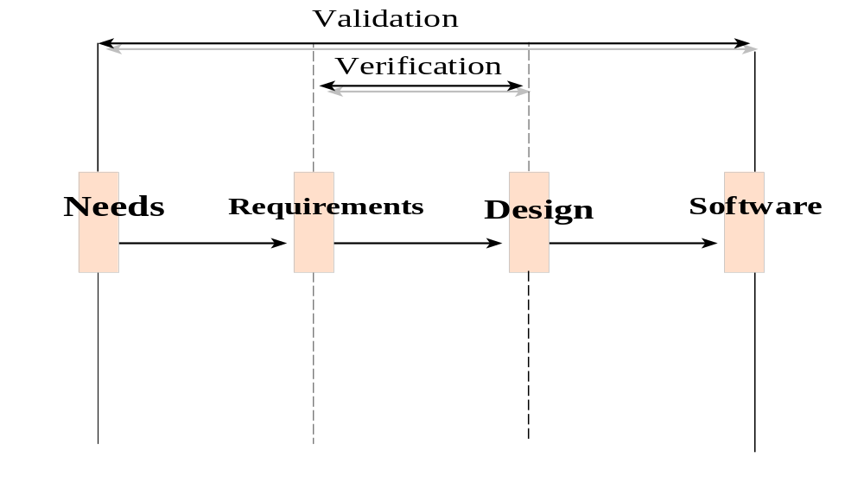
Quality Measures
Verification - "Am I building the product right?"
Validation - "Am I building the right product?"
Object-Oriented Systems Development Bahrami © Irwin/ McGraw-Hill

Slide 5

Quality Measures (Con’t)
Two main issues in software quality are validation or user satisfaction and verification or quality assurance.
Object-Oriented Systems Development Bahrami © Irwin/ McGraw-Hill

Slide 6
Recall from Chapter 12
The process of designing view layer classes consists of the following steps:
  1. In the macro-level user interface (UI) design process, identify view layer objects.
  2. In the micro-level UI, apply design rules and GUI guidelines.
  3. Test usability and user satisfaction.
  4. Refine and iterate the design.
Object-Oriented Systems Development Bahrami © Irwin/ McGraw-Hill

Slide 7
Usability and User Satisfaction Testing
Two issues will be discussed:
1. Usability Testing, and how to develop a plan for usability testing.
2. User Satisfaction Test, and guidelines for developing a plan for user satisfaction testing.
Object-Oriented Systems Development Bahrami © Irwin/ McGraw-Hill

Slide 8

Usability
The International Organization for Standardization (ISO) defines usability as the effectiveness, efficiency, and satisfaction with which a specified set of users can achieve a specified set of tasks in particular environments.
Object-Oriented Systems Development Bahrami © Irwin/ McGraw-Hill

Slide 9
Usability (Con’t)
Defining tasks. What are the tasks?
Defining users. Who are the users?
A means for measuring effectiveness, efficiency, and satisfaction.
The phrase two sides of the same coin is helpful for describing the relationship between the usability and functionality of a system.
Object-Oriented Systems Development Bahrami © Irwin/ McGraw-Hill

Slide 10

Usability Testing
Usability testing measures the ease of use as well as the degree of comfort and satisfaction users have with the software.
Usability testing must begin with defining the target audience and test goals.
Object-Oriented Systems Development Bahrami © Irwin/ McGraw-Hill
Notes:
Products with poor usability can be difficult to learn, complicated to operate, and misused or not used at all. Therefore, low product usability leads to high costs for users and a bad reputation for the developers.

Slide 11
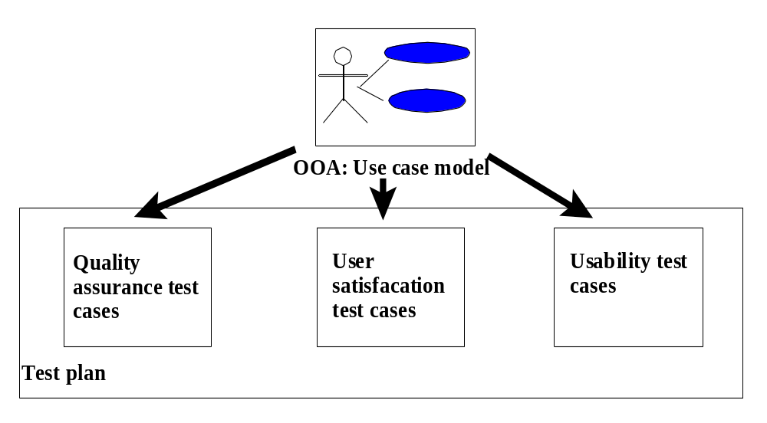
Usability Testing (Con’t)
Usability testing should begin in the early stages of product development, when developing use cases.
The findings from usability testing can be incorporated into the usability test plan and test cases.
Usability testing must be a key part of the UI design process.
Object-Oriented Systems Development Bahrami © Irwin/ McGraw-Hill
Notes:
Usability is one of the most crucial factors in the design and development of a product, especially the user interface. Therefore, usability testing must be a key part of the UI design process. Usability testing should begin in the early stages of product development, when you can use it to gather information about how users do their work and find out their tasks, which in essence is the function of the use cases. You can incorporate your findings into the usability test plan and test cases. As the design progresses, usability testing continues to provide valuable input for analyzing initial design concepts and, in the later stages of product development, can be used to test specific product tasks, especially the UI.

Slide 12

Usability Testing (Con’t)
Run a pilot test to work out the bugs of the tasks to be tested.
Make certain the task scenarios, prototype, and test equipment work smoothly.
Object-Oriented Systems Development Bahrami © Irwin/ McGraw-Hill

Slide 13

Guidelines For Developing Usability Testing (Con’t)
Tests need not involve many subjects.
More typically, quick, iterative tests with a small, well-targeted sample of 6 to 10 participants can identify 80–90 percent of most design problems.
Object-Oriented Systems Development Bahrami © Irwin/ McGraw-Hill

Slide 14
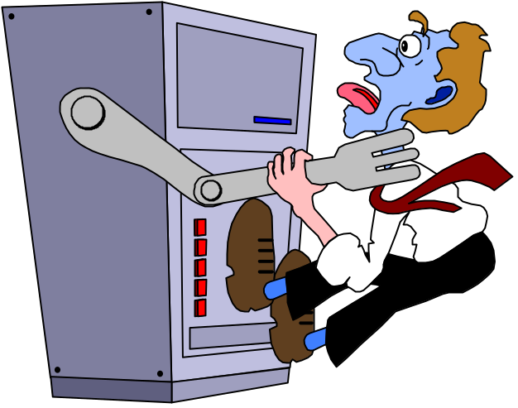
Recording the Usability Test
Make participants feel comfortable by explaining the testing process.
Emphasize that you are testing the software, not the participants.
If they become confused or frustrated, it is not a reflection on them.
Object-Oriented Systems Development Bahrami © Irwin/ McGraw-Hill

Slide 15

Recording the Usability Test (Con’t)
Record the test results using a portable tape recorder, or better, a video camera.
You may also want to follow up the session with the user satisfaction test.
Object-Oriented Systems Development Bahrami © Irwin/ McGraw-Hill

Slide 16

User Satisfaction Test
User satisfaction test is the process of quantifying the usability test with some measurable attributes of the test, such as functionality, cost, or ease of use.
Object-Oriented Systems Development Bahrami © Irwin/ McGraw-Hill
Notes:
Such as:
95 percent of users should be able to find how to withdraw money from the ATM machine without error and with no formal training.
70 percent of all users should experience the new function as "a clear improvement over the previous one."
90 percent of consumers should be able to operate the VCR within 30 minutes.

Slide 17

User Satisfaction Test (Con’t)
To enable pinpointing specific areas of dissatisfaction for remedy.
To provide a clear understanding of just how the completed design is to be evaluated.
Object-Oriented Systems Development Bahrami © Irwin/ McGraw-Hill

Slide 18

User Satisfaction Test (Con’t)
The test is inexpensive, easy to use and it is educational to those who administer it and those who fill it out.
Even if the results may never be summarized, or filled out, the process of creating the test itself will provide us with useful information.
Object-Oriented Systems Development Bahrami © Irwin/ McGraw-Hill

Slide 19
Guidelines for Developing a User Satisfaction Test
The format of every user satisfaction test is basically the same, but its content is different for each project.
Use cases and users can provide us with the attributes that should be included in the test.
Object-Oriented Systems Development Bahrami © Irwin/ McGraw-Hill

Slide 20
Guidelines for Developing a User Satisfaction Test (Con’t)
Ask the users to select a limited number (5 to 10) of attributes by which the final product can be evaluated.
Once these attributes have been identified, they can play a crucial role in the evaluation of the final product.
Object-Oriented Systems Development Bahrami © Irwin/ McGraw-Hill

Slide 21
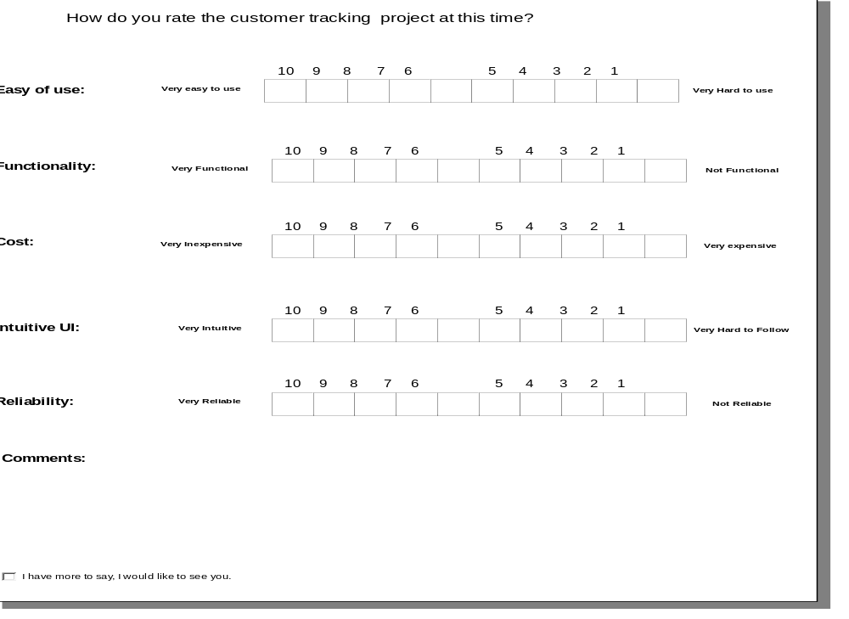
Custom Form for User Satisfaction Test
Object-Oriented Systems Development Bahrami © Irwin/ McGraw-Hill

Slide 22
Guidelines for Developing a User Satisfaction Test (Con’t)
Gause and Weinberg raise the following important point in conducting user satisfaction test:
"When the design of the test has been drafted, show it to the clients and ask, 'If you fill this out monthly (or whatever interval), will it enable you to express what you like and don't like?' if they answer negatively then find out what attributes would enable them to express themselves and revise the test."
Object-Oriented Systems Development Bahrami © Irwin/ McGraw-Hill

Slide 23
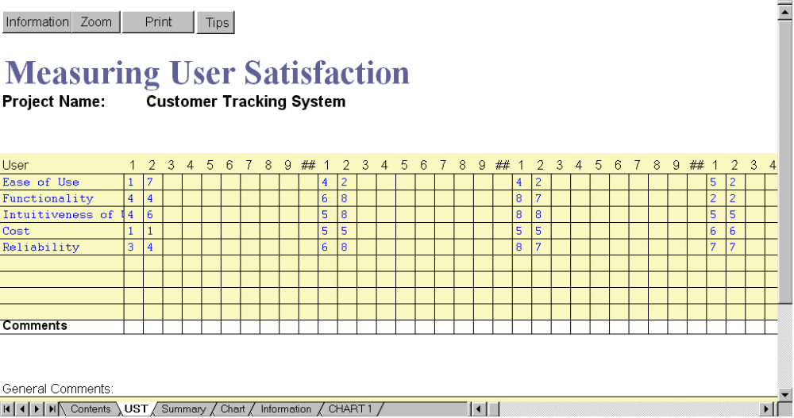
User Satisfaction Test (Con’t)
A user satisfaction test for a customer tracking system.
Object-Oriented Systems Development Bahrami © Irwin/ McGraw-Hill

Slide 24
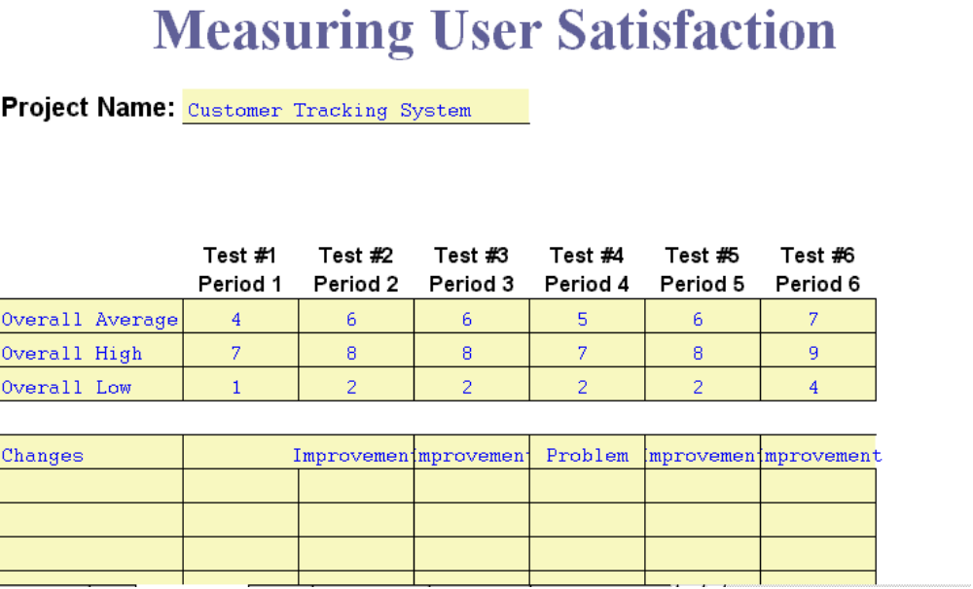
User Satisfaction Test (Con’t)
A shift in the user satisfaction rating indicates that something is happening.
Object-Oriented Systems Development Bahrami © Irwin/ McGraw-Hill

Slide 25
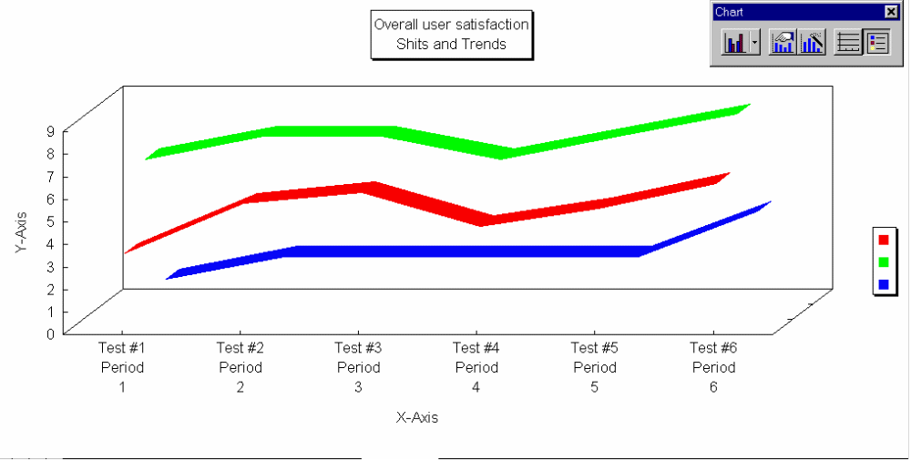
User Satisfaction Test (Con’t)
Plotting the high and low responses indicates where to go for maximum information.
Object-Oriented Systems Development Bahrami © Irwin/ McGraw-Hill
Notes:
Periodical plotting can reveal shifts in user satisfaction test, which can pinpoint a problem.

Slide 26
User Satisfaction Cycle
1. Create a user satisfaction test with the users.
2. Conduct the test regularly and frequently.
3. Read comments very carefully, especially if they express strong feeling.
4. Use the information.
Object-Oriented Systems Development Bahrami © Irwin/ McGraw-Hill

Slide 27

Summary
The main point here is that you must focus on the users' perception.
Many systems that are adequate technically have failed because of poor user perception.
Object-Oriented Systems Development Bahrami © Irwin/ McGraw-Hill

Slide 28

Summary (Con’t)
Performing the test regularly, helps us to keep user actively involved in the system development.
It also helps us to stay focused on users’ wishes.
Object-Oriented Systems Development Bahrami © Irwin/ McGraw-Hill

