Slide 1
Object-Oriented Systems Development:
Using the Unified Modeling Language
Chapter 13:
Software Quality Assurance

Slide 2

Goals
Bugs and Debugging
Testing strategies.
The impact of an object orientation on testing.
How to develop test cases.
How to develop test plans.
Object-Oriented Systems Development Bahrami © Irwin/ McGraw-Hill

Slide 3

Introduction
Two issues in software quality are:
Validation or user satisfaction
Verification or quality assurance.
Object-Oriented Systems Development Bahrami © Irwin/ McGraw-Hill

Slide 4
Introduction (Con’t)
Elimination of the syntactical bug is the process of debugging.
Detection and elimination of the logical bug is the process of testing.
Object-Oriented Systems Development Bahrami © Irwin/ McGraw-Hill

Slide 5

Introduction (Con’t)
Error Types:
  Language errors or syntax errors
  Run-time errors
  Logic errors
Object-Oriented Systems Development Bahrami © Irwin/ McGraw-Hill

Slide 6
Identifying Bugs and Debugging
The first step in debugging is recognizing that a bug exists.
Sometimes it's obvious, the first time you run the application, it shows itself.
Other bugs might not surface until a method receives a certain value, or until you take a closer look at the output.
Object-Oriented Systems Development Bahrami © Irwin/ McGraw-Hill

Slide 7

Identifying Bugs and Debugging (Con’t)
There are no magic tricks for debugging.
However, these steps might help:
Selecting appropriate testing strategies.
Developing test cases and sound test plan.
Debugging tools.
Object-Oriented Systems Development Bahrami © Irwin/ McGraw-Hill

Slide 8
Debugging Tools
Debugging tools are a way of looking inside the program to help us determine what happens and why.
It basically gives us a snapshot of the current state of the program.
Object-Oriented Systems Development Bahrami © Irwin/ McGraw-Hill

Slide 9

Testing Strategies
There are four types of testing strategies These are:
Black Box Testing
White Box Testing
Top-down Testing
Bottom-up Testing
Object-Oriented Systems Development Bahrami © Irwin/ McGraw-Hill

Slide 10
Black Box Testing
In a black box, the test item is treated as "black" whose logic is unknown.
All that's known is what goes in and what comes out, the input and output
Object-Oriented Systems Development Bahrami © Irwin/ McGraw-Hill

Slide 11
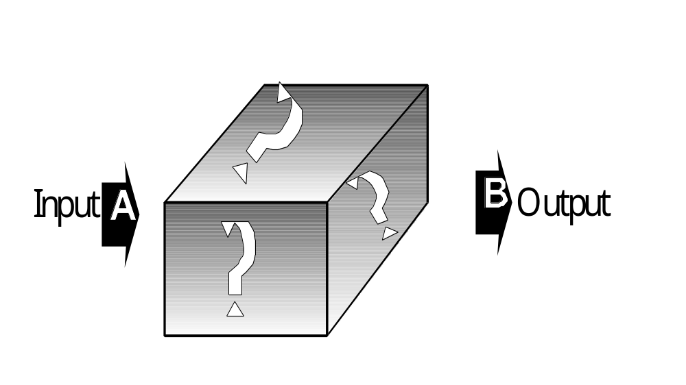
Black Box Testing(Con’t)
Black box test works very nicely in testing objects in an O-O environment.
Object-Oriented Systems Development Bahrami © Irwin/ McGraw-Hill

Slide 12

Black-Object Testing
Once you have created fully tested and debugged classes of objects you will put them into library for use or reuse.
Object-Oriented Systems Development Bahrami © Irwin/ McGraw-Hill

Slide 13
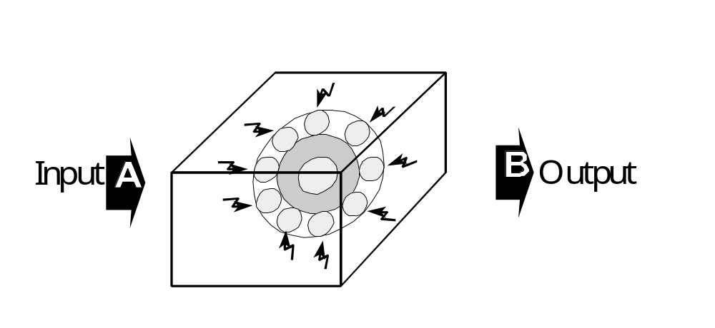
White Box Testing
White box testing assumes that specific logic is important, and must be tested to guarantee system’s proper functioning.
Object-Oriented Systems Development Bahrami © Irwin/ McGraw-Hill

Slide 14

White Box Testing (Con’t)
One form of white box testing is called path testing.
It makes certain that each path in a program is executed at least once during testing.
Object-Oriented Systems Development Bahrami © Irwin/ McGraw-Hill

Slide 15
White Box Testing (Con’t)
Two types of path testing are:
Statement testing coverage, and
Branch testing coverage.
Object-Oriented Systems Development Bahrami © Irwin/ McGraw-Hill

Slide 16

Statement Testing Coverage
Every statement in the program must be executed at least once.
Beizer states, ”Testing less than this for new software is unconscionable and should be criminalized.”
Object-Oriented Systems Development Bahrami © Irwin/ McGraw-Hill

Slide 17

Branch Testing Coverage
Every branch alternative must be executed at least once under some test.
Object-Oriented Systems Development Bahrami © Irwin/ McGraw-Hill

Slide 18

Top-down Testing
It assumes that the main logic of the application needs more testing than supporting logic.
Object-Oriented Systems Development Bahrami © Irwin/ McGraw-Hill

Slide 19

Bottom-up Approach
It takes an opposite approach.
It assumes that individual programs and modules are fully developed as stand alone processes.
These modules are tested individually, then combined for integration testing.
Object-Oriented Systems Development Bahrami © Irwin/ McGraw-Hill

Slide 20

Bottom-up Approach (Con’t)
Bottom-up testing is more appropriate for O-O systems.
You test each object then combine them and test the whole system by utilizing the top-down approach.
Object-Oriented Systems Development Bahrami © Irwin/ McGraw-Hill

Slide 21
Impact of Object Orientation on Testing
The impact of an object orientation on testing is summarized by the following:
  Some types of error could become less plausible (not worth testing for).
  Some types of error could become more plausible (worth testing for now).
  Some new types of error might appear.
Object-Oriented Systems Development Bahrami © Irwin/ McGraw-Hill
Notes:
For example, when you invoke a method, it may be hard to tell exactly which method gets executed. The method may belonging to one of many classes. It can be hard to tell the exact class of the method. When the code accesses it, it may get an unexpected value. In a non-object-oriented system, when you looked at
x = computePayroll();
you had to think about the behaviors of a single function. In an object-oriented environment, you may have to think about the behaviors of base::computePayroll(), of derived::computePayroll, and so on. For a single message, you need to explore (or at least think about) the union of all distinct behaviors. The problem can be complicated if you have multiple inheritance. However, by applying the design axioms and corollaries of object-oriented design (OOD; see Chapter 9), you can limit the differences in behavior between base and derived classes.
The testing approach is essentially the same in both environments. The problem of testing messages in an object orientation is the same as testing code that takes a function as a parameter and then invokes it. Marick argues that the process of testing variable uses in OOD essentially does not change, but you have to look in more places to decide what needs testing. Has the plausibility of faults changed? Are some types of fault now more plausible or less plausible? Since object-oriented methods generally are smaller, these are easier to test. At the same time, there are more opportunities for integration faults. They become more likely, more plausible.

Slide 22

Impact of Inheritance in Testing
Inheritance does make testing a system more difficult.
If you do not follow the OOD guidelines, you will end up with objects that are extremely hard to debug and maintain.
Object-Oriented Systems Development Bahrami © Irwin/ McGraw-Hill
Notes:
Suppose you have this situation [12]: The base class contains methods inherited() and redefined() and the derived class redefines the redefined() method.
The derived::redefined has to be tested afresh since it is a new code. Does derived::inherited() have to be retested? If it uses redefined() and the redefined() has changed, the derived::inherited() may mishandle the new behavior. So, it needs new tests even though the derived::inherited() itself has not changed. If the base::inherited has been changed, the derived::inherited() may not have to be completely tested. Whether it does depends on the base methods; otherwise, it must be tested again. The point here is that, if you do not follow the OOD guidelines, you will end up with objects that are extremely hard to debug and maintain.

Slide 23
Reusability of Tests
The simpler is a test, the more likely it is to be reusable in subclasses.
However, simple tests tend to find only the faults you specifically target; complex tests are better at both finding those faults and stumbling across others by sheer luck.
Object-Oriented Systems Development Bahrami © Irwin/ McGraw-Hill

Slide 24

Test Cases
All methods of your system must be checked by at least one test.
Construct some test input cases, then describe how the output will look like.
Compare the outcomes with the expected output.
Object-Oriented Systems Development Bahrami © Irwin/ McGraw-Hill

Slide 25
Objective of Testing
Myers describes testing as follows :
Testing is the process of executing a program with the intent of finding errors.
A good test case is the one that has a high probability of detecting an as-yet undiscovered error.
A successful test case is the one that detects an as-yet undiscovered error.
Object-Oriented Systems Development Bahrami © Irwin/ McGraw-Hill

Slide 26

Guidelines For Developing Test Cases
Test case is a set of What-if questions
The general format is:
If it receives certain input, it produces certain output.
Object-Oriented Systems Development Bahrami © Irwin/ McGraw-Hill

Slide 27
Guidelines For Developing Test Cases (Con’t)
Describe which feature or service (external or internal) your test attempts to cover.
If the test case is based on a use case, it is a good idea to refer to the use case name.
Remember that the use cases are the source of test cases.
Object-Oriented Systems Development Bahrami © Irwin/ McGraw-Hill

Slide 28
Guidelines For Developing Test Cases (Con’t)
Specify what you are testing and which particular feature (methods).
Specify what you are going to do to test the feature and what you expect to happen.
Object-Oriented Systems Development Bahrami © Irwin/ McGraw-Hill

Slide 29
Guidelines For Developing Test Cases (Con’t)
Test normal use of the function.
Test abnormal but reasonable use of function.
Test abnormal and unreasonable use of function.
Test the boundary conditions.
Object-Oriented Systems Development Bahrami © Irwin/ McGraw-Hill
Notes:
For example, if an edit control accepts 32 characters, try 33, then try 40. Also specify when you expect error dialog boxes, when you expect some default event, and when functionality still is being defined.

Slide 30
Guidelines For Developing Test Cases (Con’t)
Test objects' interactions and the messages sent among them. If you have developed sequence diagrams, they can assist you in this process.
When the revisions have been made, document the cases so they become the starting basis for the follow-up test.
Object-Oriented Systems Development Bahrami © Irwin/ McGraw-Hill

Slide 31

Guidelines For Developing Test Cases (Con’t)
Attempting to reach agreement on answers generally will raise other what-if questions.
Add these to the list and answer them, repeat the process until the list is stabilized, then you need not add any more questions.
Object-Oriented Systems Development Bahrami © Irwin/ McGraw-Hill

Slide 32

Test Plan
Testing is a balance of art, science, and luck.
Test plan offers a road map for testing activity.
Test plan should state test objectives, and how to meet them.
Object-Oriented Systems Development Bahrami © Irwin/ McGraw-Hill

Slide 33

Test Plan (Con’t)
The plan need not be very large.
Devoting too much time to the plans can be counter productive.
Object-Oriented Systems Development Bahrami © Irwin/ McGraw-Hill

Slide 34
Test Plan (Con’t)
The followings are the steps needed to create a test plan:
I. Objectives of Test.
2. Develop Test Case.
3. Identify Bugs and Debugging.
Object-Oriented Systems Development Bahrami © Irwin/ McGraw-Hill

Slide 35

Guidelines For Developing Test Plans
Requirements might dictate the format of the test plan.
The test plan should contain a schedule and a list of required resources.
Document every type of testing that you plan to complete.
Object-Oriented Systems Development Bahrami © Irwin/ McGraw-Hill

Slide 36

Guidelines For Developing Test Plans (Con’t)
A configuration control system provides a way of tracking the changes to the code.
Process must be in place to routinely bringing the test plan in sync with the product and/or product specification.
Object-Oriented Systems Development Bahrami © Irwin/ McGraw-Hill

Slide 37

Continuous Testing
Testing must take place on a continuous basis, and this refining cycle must continue throughout the development process until you are satisfied with the results.
Object-Oriented Systems Development Bahrami © Irwin/ McGraw-Hill

Slide 38
Continuous Testing (Con’t)
The steps to successful testing:
  Understand and communicate the business case for improved testing.
  Develop an internal infrastructure to support continuous testing.
  Look for leaders who will commit to and own the process.
  Measure and document your findings in a defect recording system.
  Publicize improvements as they are made and let people know what they are doing better.
Object-Oriented Systems Development Bahrami © Irwin/ McGraw-Hill

Slide 39
Myers Debugging Principles
Bug Locating Principles
Think.
If you reach an impasse, sleep on it.
If you reach an impasse, describe the problem to someone else.
Use debugging tools
Experimentation should be done as a last resort.
Object-Oriented Systems Development Bahrami © Irwin/ McGraw-Hill

Slide 40
Myers Debugging Principles (Con’t)
Where there is one bug, there is likely to be another.
Fix the error, not just the symptom of it.
The probability of the fix being correct, drops as the size of the program increases.
Object-Oriented Systems Development Bahrami © Irwin/ McGraw-Hill

Slide 41
Myers Debugging Principles (Con’t)
Beware of the possibility that an error correction creates a new error.
Object-Oriented Systems Development Bahrami © Irwin/ McGraw-Hill

Slide 42

Summary
Testing is a balance of art, science, and luck.
Testing may be conducted for different reasons.
Quality assurance testing looks for potential problems in a proposed design.
Object-Oriented Systems Development Bahrami © Irwin/ McGraw-Hill

Slide 43
Summary (Con’t)
We must develop a test plan for locating and removing bugs.
A test plan offers a road map for testing activity; it should state test objectives and how to meet them.
The plan need not be very large; in fact, devoting too much time to the plan can be counterproductive.
Object-Oriented Systems Development Bahrami © Irwin/ McGraw-Hill

Slide 44
Summary (Con’t)
There are no magic tricks to debugging; however, by selecting appropriate testing strategies and a sound test plan, you can locate the errors in your system and fix them by utilizing debugging tools.
Object-Oriented Systems Development Bahrami © Irwin/ McGraw-Hill

