Slide 1
Used Car Price Prediction & Analysis
SHREYA PATIL
2025 Feb 28

Slide 2
1. Overview
The used car market is growing rapidly, with buyers and sellers looking for fair pricing. However, determining the right price for a used car is challenging due to various factors like car age, kilometers driven, fuel type, and market trends. Analyzing these factors using data analytics and machine learning can help predict the optimal selling price, ensuring better decision-making for both buyers and sellers.
2

Slide 3
2. Problem Statement
Develop a data-driven model to predict the selling price of a used car based on various features such as its age, fuel type, kilometers driven, transmission type and current market price.
3

Slide 4
3. Data Decription
Dataset have 301 rows and 9 columns
Columns : Car_Name, Year, Selling_Price, Present_Price, Kms_Driven, Fuel_Type, Seller_Type , Transmission and Owner.
4

Slide 5

4. Exploratory Data Analysis:
Shape
Summary
Info
Duplicates
Null Values
Numerical and categorical Analysis
5

Slide 6
5. Data Preprocessing
Checking for missing values : In this data there is no missing values.
Checking for Duplicate values and dealing with them.
Checking for Extream Outliers .
Converting Categorical data into Numerical format using get_dummies() function.
6

Slide 7
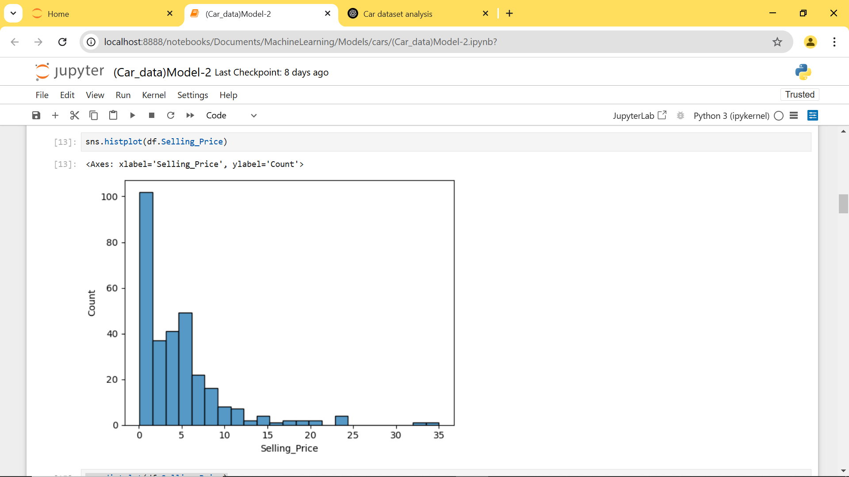
Histograms – Distribution of car prices
Histograms – Distribution of car prices
7

Slide 8
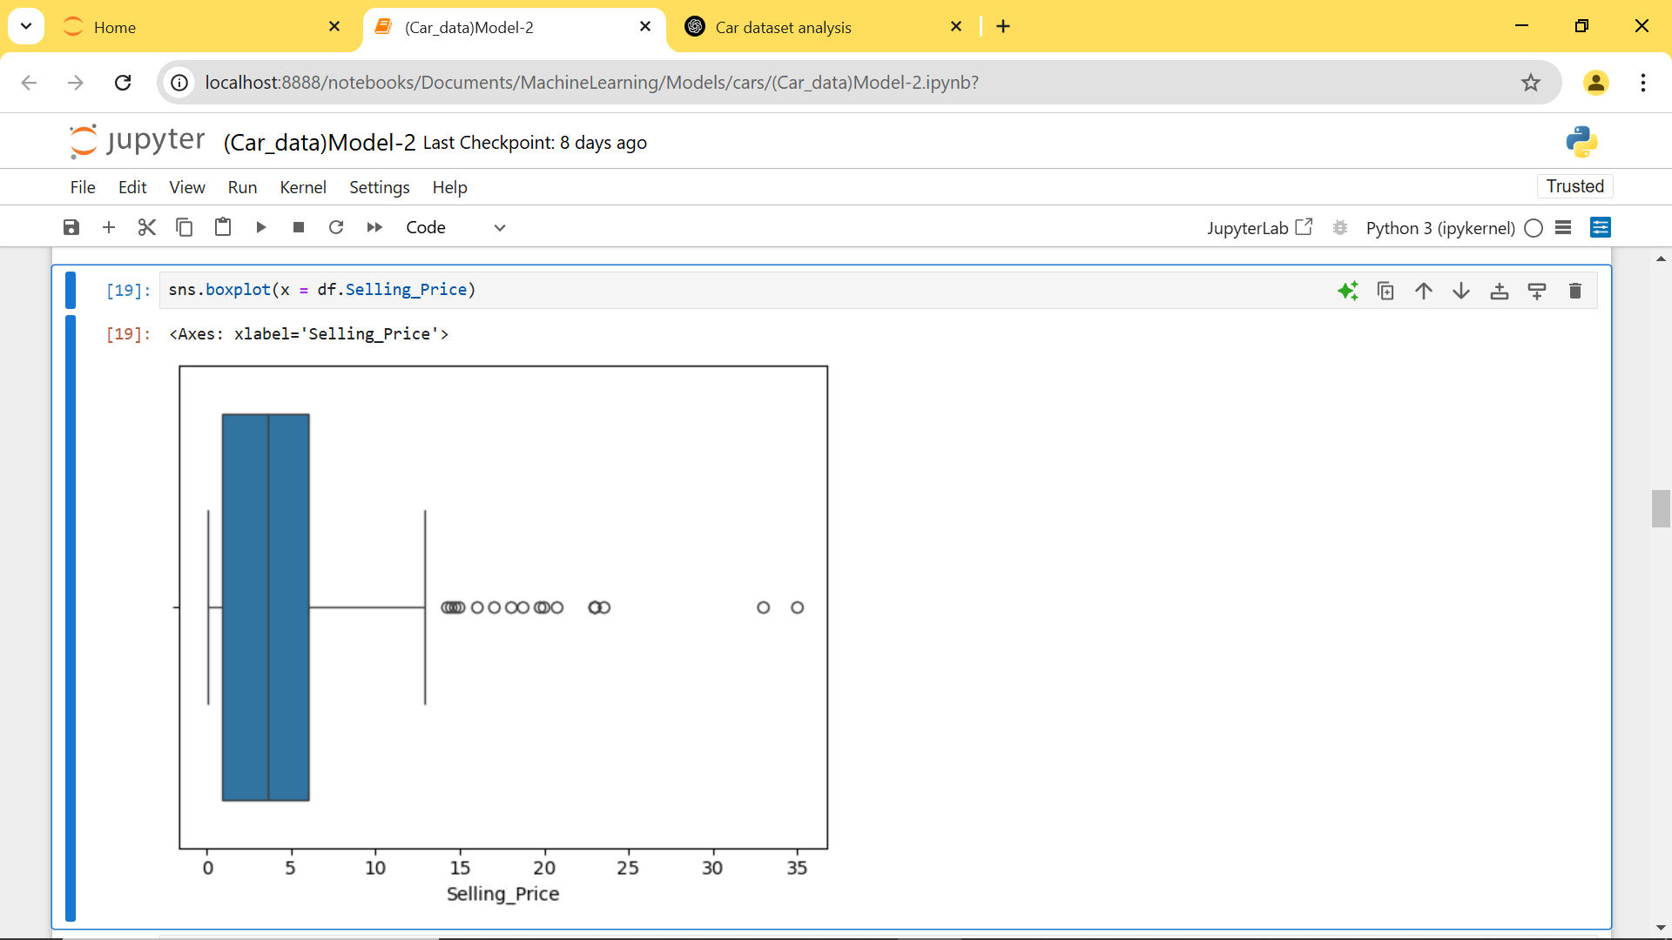
2. Boxplots – Outliers in car prices
8

Slide 9
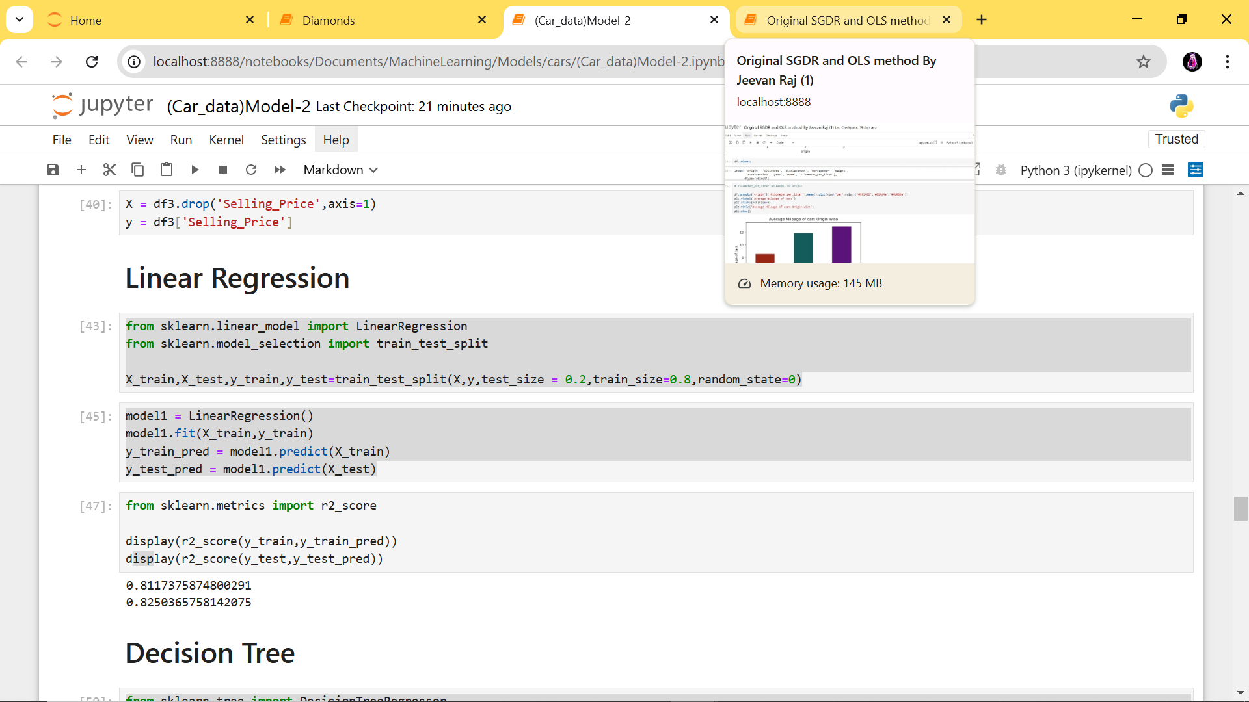
6. Model Selection :
Linear Regression
9

Slide 10
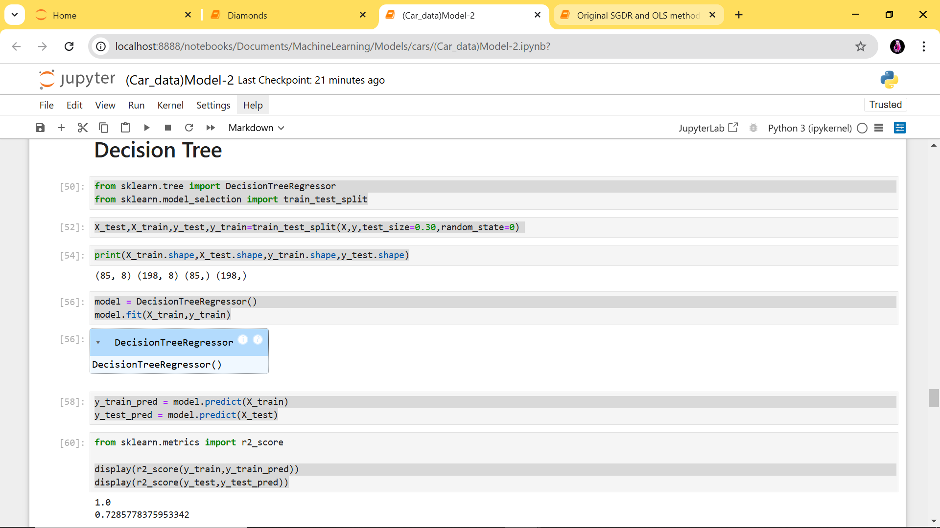
2. Decision Tree
10

Slide 11
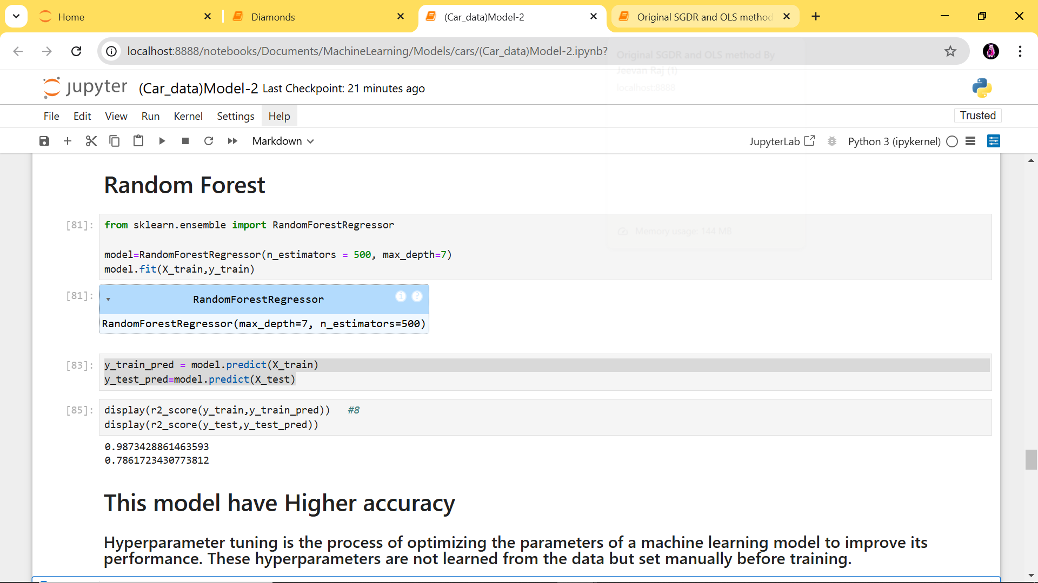
2. Random Forest
11

Slide 12
6. Conclusion :
The car price prediction model provides an effective and data-driven solution for estimating the selling price of used cars. It can be a helpful tool for buyers, sellers, and dealerships to make informed pricing decisions, boosting efficiency and transparency in the used car market.
12

Slide 13
Thank you
SHREYA PATIL
2025 Feb 28

