Slide 1

Retrieval-Augmented Intelligent Legal Assistant
for Court Judgments
Court Judgments · Hybrid Retrieval · LLM Reasoning · Cited Answer
Subject: Applied Machine Learning for Text Analytics
Team Members
A. Sahasra – 2420090091
K. P. Shreya – 2420090093
V. Gowrie – 2420030298
K. Ishta – 2420039803
Applied ML for Text Analytics — Legal RAG Assistant
1

Slide 2
Project Title & Problem Statement
Project Title
Core Problem
Retrieval-Augmented Intelligent Legal Assistant for Court Judgments
Court judgments are long, citation-heavy and domain-specific. Keyword search can miss semantically related precedents, while standalone LLMs may produce unsupported or hallucinated legal claims.
Why it matters
Text analytics challenge
Safety requirement
Faster legal research
Better access to precedents
Evidence-backed answers
Long-document understanding
Legal terminology
Cross-document relevance
Every material claim should be traceable to retrieved judgment passages
System should abstain when evidence is weak
Applied ML for Text Analytics — Legal RAG Assistant
2

Slide 3
Objectives
1
Build a searchable corpus of court judgments with metadata.
2
Develop legal-aware retrieval using dense + lexical signals.
3
Generate concise answers grounded in retrieved passages.
4
Attach case, paragraph/page and citation evidence to outputs.
5
Evaluate retrieval quality, answer quality and faithfulness.
6
Demonstrate a prototype for legal research assistance — not autonomous legal decision-making.
Applied ML for Text Analytics — Legal RAG Assistant
3

Slide 4
Literature Survey
Work | Approach | Key finding | Implication for project
Case Retrieval for LJP (Zhang & Dou, 2023) | Retrieve similar historical cases for judgment prediction | Historical cases improve realism of legal prediction | Use precedent retrieval as a first-class component
Rethinking Legal Judgment Prediction (Nigam et al., 2024) | Indian judgments + statutes + precedents + LLMs | Additional legal information improves prediction; expert-level reliability remains open | Ground responses in statutes/precedents, avoid overclaiming
LegalBench-RAG (Pipitone & Houir Alami, 2024) | Benchmark for legal RAG retrieval | Precise snippets are preferable to large imprecise chunks | Optimize passage-level retrieval and citation
NyayaRAG (Nigam et al., 2025) | RAG with facts, statutes and semantically retrieved prior cases | Combines realistic case context with precedent retrieval | Motivates India-focused retrieval + explanation pipeline
Applied ML for Text Analytics — Legal RAG Assistant
4

Slide 5
Research Gap Identification
Retrieval gap
Chunking gap
Evidence gap
Generic semantic search may retrieve topical matches without enough legal relevance, hierarchy or temporal context.
Fixed-size chunks can split holdings, exceptions, citations and procedural context.
A fluent answer is not enough; users need claim-level provenance and direct judgment evidence.
Evaluation gap
Scope gap
Legal RAG needs separate measurement of retrieval relevance, answer correctness and faithfulness.
Many studies target prediction or retrieval separately; an end-to-end court-judgment assistant must connect ingestion → retrieval → grounded response.
Applied ML for Text Analytics — Legal RAG Assistant
5

Slide 6
Innovation, Creativity & Novelty
Innovation
Hybrid retrieval: BM25/keyword + dense embeddings + metadata filters + cross-encoder reranking.
Creativity
Legal-structure-aware chunking around case sections, issues, holdings, statutes and cited precedents.
Novelty
Evidence-first answer generation: each claim is linked to retrieved passages; unsupported claims trigger a low-confidence / abstain response.
Research contribution
An evaluation matrix that separately measures Recall@k / MRR, citation correctness, groundedness, answer relevance and latency.
Applied ML for Text Analytics — Legal RAG Assistant
6

Slide 7
Proposed System Architecture
End-to-end pipeline for court-judgment question answering
1
→
2
→
3
→
4
→
5
→
6
Corpus
NLP Prep
Indexing
Retrieval
Generation
Verification
Judgments + metadata
OCR / text cleaning
BM25 + vector index
Hybrid top-k + reranking
LLM with retrieved evidence
Citations + faithfulness check
User query: “Which precedents support X?” → Answer + citations + confidence
Applied ML for Text Analytics — Legal RAG Assistant
7

Slide 8
Feasibility Analysis
Data
Technology
Publicly accessible judgment repositories or institution-provided datasets can support a prototype. Start with one jurisdiction/court to control scope.
Python, sentence-transformers / legal embeddings, BM25, FAISS/Chroma, reranker, and an open or API-based LLM.
Compute
Skills
Prototype can run on a single modern GPU or cloud notebook; retrieval can remain local while generation is modular.
Combines NLP preprocessing, information retrieval, embeddings, evaluation and prompt engineering — aligned with text analytics.
Risk controls: Use citations, confidence thresholds, human verification and an explicit “insufficient evidence” response.
Applied ML for Text Analytics — Legal RAG Assistant
8

Slide 9
Tools & Technologies
Software stack for the retrieval-augmented legal assistant
Python
Sentence-Transformers
Core language for the ML / NLP pipeline
Dense legal-domain embeddings
BM25
FAISS / ChromaDB
Lexical / keyword retrieval signal
Vector index & similarity search
Cross-Encoder Reranker
LLM (open-source / API)
Reorders top-k hybrid results
Grounded answer generation
OCR & Text Cleaning
Evaluation Suite
Judgment ingestion & preprocessing
Recall@k, MRR, faithfulness scoring
Compute: single modern GPU or cloud notebook — retrieval stays local while generation is modular.
Applied ML for Text Analytics — Legal RAG Assistant
9

Slide 10
Frontend & Backend Requirements
System requirements for the retrieval-augmented legal assistant
FRONTEND
BACKEND
Web UI (React)
API Layer (FastAPI)
Chat-style interface for legal research queries
REST endpoints for retrieval, generation, verification
Citation & Evidence View
Hybrid Retrieval Engine
Shows answer linked to case, paragraph, citation
BM25 + dense embeddings with cross-encoder reranking
Confidence & Abstain Display
Ingestion & Indexing Pipeline
Flags low-confidence or insufficient-evidence answers
OCR, legal-aware chunking, BM25 + vector indexing
Session & History Manager
Evaluation & Logging Service
Tracks past queries and saved research sessions
Recall@k, faithfulness scoring, response logging
Integration: Frontend calls the backend API; responses return grounded answers with citations and a confidence score.
Applied ML for Text Analytics — Legal RAG Assistant
14

Slide 11
Evaluation & Success Criteria
Dimension | Measures | Research question
Retrieval | Recall@k, Precision@k, MRR / nDCG | Are relevant precedents/passages retrieved?
Answer quality | Expert or rubric-based correctness + relevance | Does the response answer the legal question?
Faithfulness | Claim-to-source entailment / citation correctness | Are claims supported by retrieved evidence?
Usability | Latency, answer length, citation coverage | Is the assistant practical for research?
Ablation | BM25 vs dense vs hybrid vs reranker | Which component contributes most?
Target outcome: Improve evidence retrieval and citation coverage over a simple keyword baseline while reducing unsupported generated claims.
Applied ML for Text Analytics — Legal RAG Assistant
10

Slide 12
Existing Legal Search vs. This Project
Dimension | Existing Legal Websites | This Project (RAG Assistant)
Search method | Keyword / Boolean search over full judgments; misses semantically related precedents. | Hybrid retrieval — BM25 + dense embeddings + metadata filters, refined by reranking.
Document handling | Returns whole judgments or fixed pages; holdings and exceptions can get split apart. | Legal-structure-aware chunking around issues, holdings, statutes and precedents.
Answer format | A ranked list of documents — the user must read each judgment to find the answer. | A concise, generated answer grounded directly in the retrieved passages.
Evidence & citations | No claim-level links; citations must be located manually inside the judgment. | Every claim is linked to its case, paragraph/page and citation.
Reliability check | No confidence signal — results are shown regardless of relevance. | Faithfulness check with a low-confidence / abstain response when evidence is weak.
Net effect: Existing legal search returns documents to read — this project returns a grounded, cited, confidence-checked answer.
Applied ML for Text Analytics — Legal RAG Assistant
11

Slide 13
Project Plan
Indicative 10-week academic project schedule
W1
Scope & literature survey
W6
RAG prompt design + citation formatting
W2
Dataset collection + metadata schema
W7
Faithfulness / confidence verification
W3
Cleaning, OCR checks + legal-aware chunking
W8
Evaluation + ablation experiments
W4
BM25 + dense retrieval baseline
W9
Error analysis + UI/prototype refinement
W5
Hybrid retrieval + reranker
W10
Report, presentation + demo
Milestone 1
Milestone 2
Milestone 3
Working retrieval baseline
Grounded RAG prototype
Evaluation + final demo
Applied ML for Text Analytics — Legal RAG Assistant
12

Slide 14
Expected Outcome & References
Expected Outcome
Key References
A prototype legal research assistant that:
Retrieves relevant court-judgment passages
Summarizes evidence in plain language
Cites source passages/cases
Exposes confidence and uncertainty
Supports human legal research rather than replacing legal judgment
1. Zhang & Dou (2023), Case Retrieval for Legal Judgment Prediction, ACL Anthology.
2. Nigam et al. (2024), Rethinking Legal Judgement Prediction in a Realistic Scenario, arXiv.
3. Pipitone & Houir Alami (2024), LegalBench-RAG, arXiv.
4. Wiggers & Hartz (2024), LeReRAG: Measuring Legal Relevance in RAG Applications, IOS Press.
5. Nigam et al. (2025), NyayaRAG: Realistic Legal Judgment Prediction with RAG under the Indian Common Law System, IJCNLP/ACL Anthology.
6. Magesh et al. (2024), Hallucination-Free? Assessing the Reliability of Leading AI Legal Research Tools, arXiv.
Academic Value
Demonstrates applied ML for text analytics through retrieval, semantic similarity, reranking, generation, evaluation and error analysis.
Applied ML for Text Analytics — Legal RAG Assistant
13

Slide 15
Methodology
1
Data Collection – Gather court judgments with case and citation metadata.
2
Preprocessing – Apply OCR, text cleaning and legal-structure-aware chunking.
3
Indexing – Build BM25 and vector indexes for lexical and semantic search.
4
Retrieval – Combine hybrid top-k retrieval with cross-encoder reranking.
5
Generation – Use an LLM to generate concise answers from retrieved evidence.
6
Verification – Check citations, faithfulness and confidence before presenting the answer.
Applied ML for Text Analytics — Legal RAG Assistant
15

Slide 16
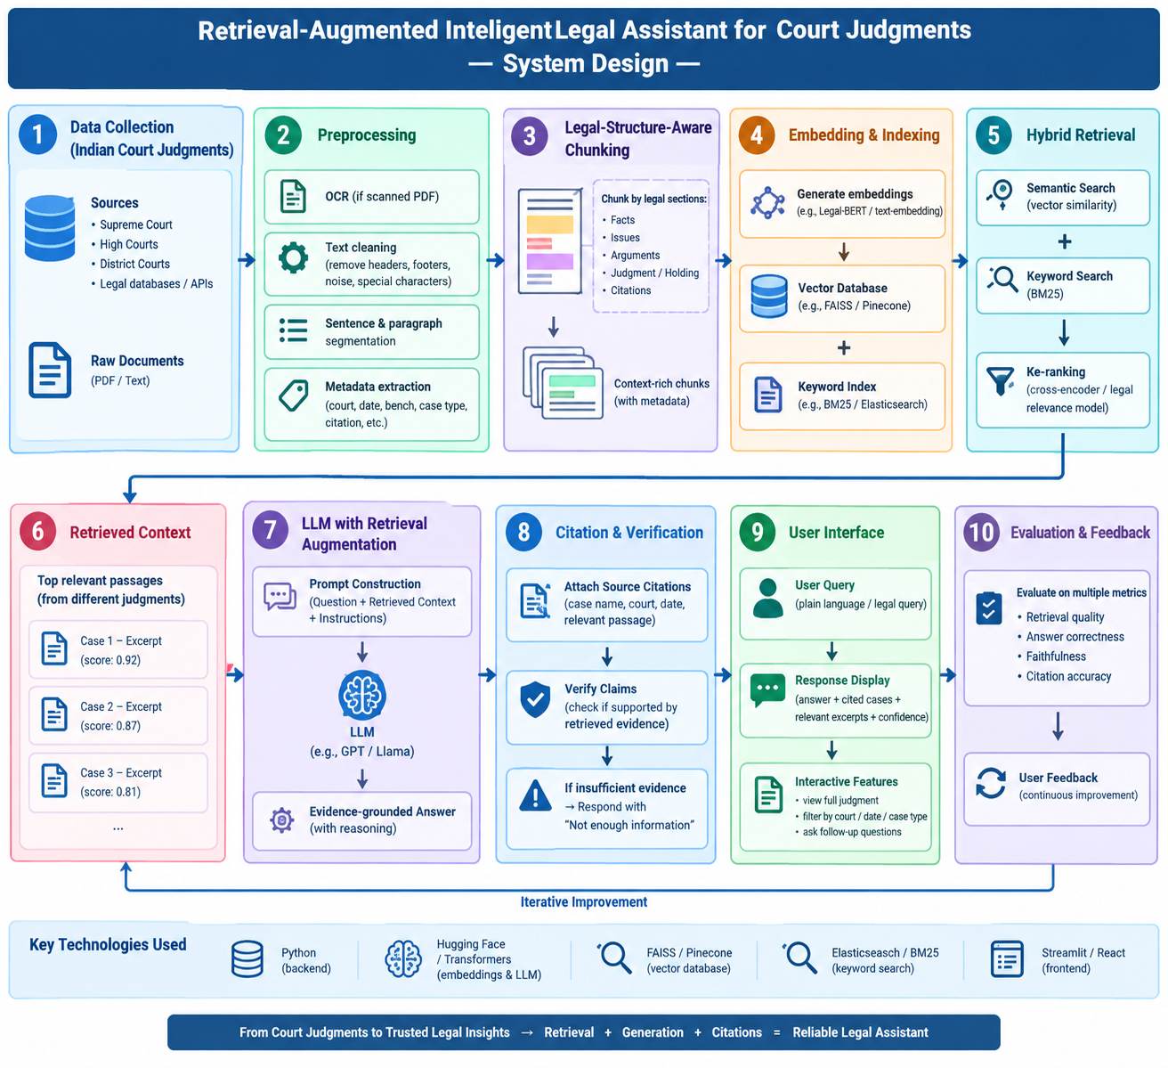
System Design
\
Applied ML for Text Analytics — Legal RAG Assistant
16

Slide 17
Modern Tools and Technologies
Technology stack for the retrieval-augmented legal assistant
Python
Sentence-Transformers
Core ML/NLP pipeline
Dense legal-domain embeddings
BM25
FAISS / ChromaDB
Lexical / keyword retrieval
Vector indexing and similarity search
Cross-Encoder
LLM
Reranking retrieved passages
Grounded answer generation
OCR + Text Cleaning
React
Judgment ingestion and preprocessing
Interactive frontend
FastAPI
Evaluation Suite
Backend REST API
Recall@k, MRR and faithfulness scoring
Applied ML for Text Analytics — Legal RAG Assistant
17

Slide 18
Performance Evaluation
Dimension | Measures
Retrieval | Recall@k, Precision@k, MRR / nDCG
Answer Quality | Correctness and relevance using an expert/rubric-based evaluation
Faithfulness | Claim-to-source entailment and citation correctness
Usability | Response latency, answer length and citation coverage
Ablation Study | Compare BM25, dense retrieval, hybrid retrieval and reranking
Target outcome: Improve evidence retrieval and citation coverage over a keyword baseline while reducing unsupported generated claims.
Applied ML for Text Analytics — Legal RAG Assistant
18

