Slide 1
Success
Shreya Vakkund

Slide 2

Skype
How it reached the peak of success

Slide 3
Topics
INTRODUCTION
Acquired by
HISTORY
Success

Slide 4
INTRODUCTION
Skype is a telecommunications application .
Skype was created by Niklas Zennström, Janus Friis in august 2003
It specializes in providing video chat, voice calls and file transferring between computers, tablets, mobile devices via the Internet.
Skype also provides instant messaging services and video conference calls.

Slide 5
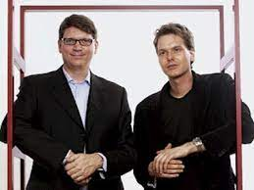


Acquired by
Skype was created by Niklas Zennström, Janus Friis in 2003.
Later in 2005, eBay acquired Skype for 3.5 billion USD.
In 2011, Microsoft corporation acquired Skype for 8.5 billion USD.

Slide 6
History
During the time when the telecom industry charged a fortune for international calls, Skype provided free video calls through the usage of P2P connectivity. Back in 2003, it was the need for a more efficient and low-cost communication system. The founders say that they were very naïve and highly optimistic in their journey throughout Skype. But it was this same spirit that led them to launch the service. They did not dive into the what-ifs and other nitty-gritty of all the things that could go wrong. The other main highlight of the concept was that there was nothing much complicated about functioning. There were no complicated procedures or troubling interface. Everything was simple and clear. This also was a contributing factor to the immense success of the idea.

Slide 7
Success
At the end of 2010, there were over 660 million worldwide users. with over 300 million estimated active each month as of August 2015.At one point in February 2012, there were 34 million users concurrently online on Skype.
This record was broken with 29 million simultaneous online users on 21 February 2011.
On 19 July 2012, Microsoft announced that Skype users had logged 115 billion minutes of calls in the quarter, up to 50% since the last quarter.
As of March 2020, Skype was used by 100 million people at least once a month and by 40 million people each day.
At end March 2020 there was a 70% increase in the number of daily users due to the covid-19 pandemic.

Slide 8
Failure

Slide 9
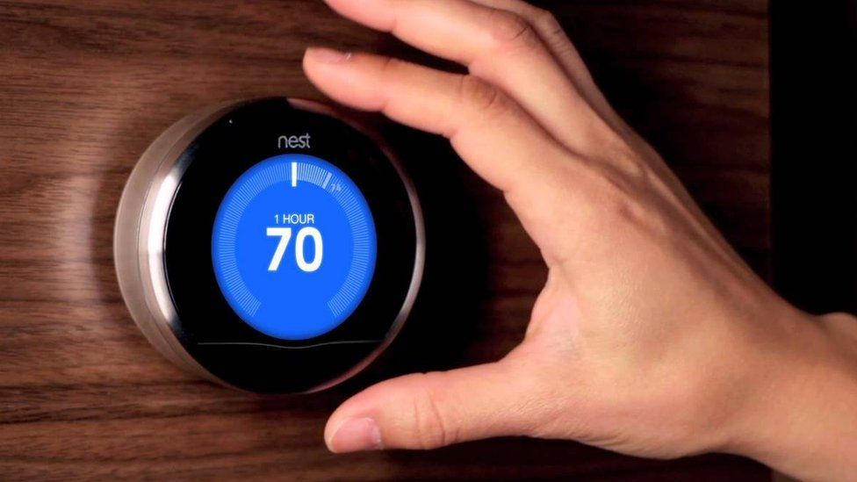
Nest thermostat
Which left the users in cold

Slide 10
Topics
Introduction
Marketing
Glitch

Slide 11
Introduction
The Nest Thermostat is a smart thermostat developed by Google Nest and designed by Tony Fadell, Ben Filson, and Fred Bould.
It is an electronic, programmable, and self-learning Wi-Fi-enabled thermostat that optimizes heating and cooling of homes and businesses to conserve energy.
The £200 Nest thermostat has been designed to learn the right temperatures for a home at any given time, potentially saving money on heating bills. Nest also offers a smoke alarm and security camera to allow users to keep an eye on their home via a Smartphone.

Slide 12
Marketing
In an effort to increase the number of homes using their learning thermostats, Nest began to partner with energy companies.
In February 2014, Direct Energy and Nest laboratories launched their Comfort and Control plan. The plan allowed Canadian customers in Alberta to receive a learning thermostat when they signed up for a five-year electricity contract.
In April 2014, Nest announced a partnership with the United Kingdom energy supplier nPower. The partnership offers customers a cut on the Nest installation price and locked energy prices for 5 years, when customers receive both gas and electricity from nPower and paying with direct debit.
In June 2014, Direct Energy and Nest Laboratories expanded the package to Direct Energy's United States market.

Slide 13
Glitch left the users in cold
The software bug meant that the devices quickly drained their batteries and shut down, resulting in heating and cooling systems going offline.
Nest says 99.5% of its customers are back online. But for those still remaining, fixing the problem could require a complex a nine-step process.
The smart thermostat’s rebooting process includes removing the device from the wall, charging it via a USB cable, and more.
Alternatively, for any customers who can’t solve the issue on their own, Nest has offered to send an electrician to help

Slide 14
Thank you !

