Slide 1
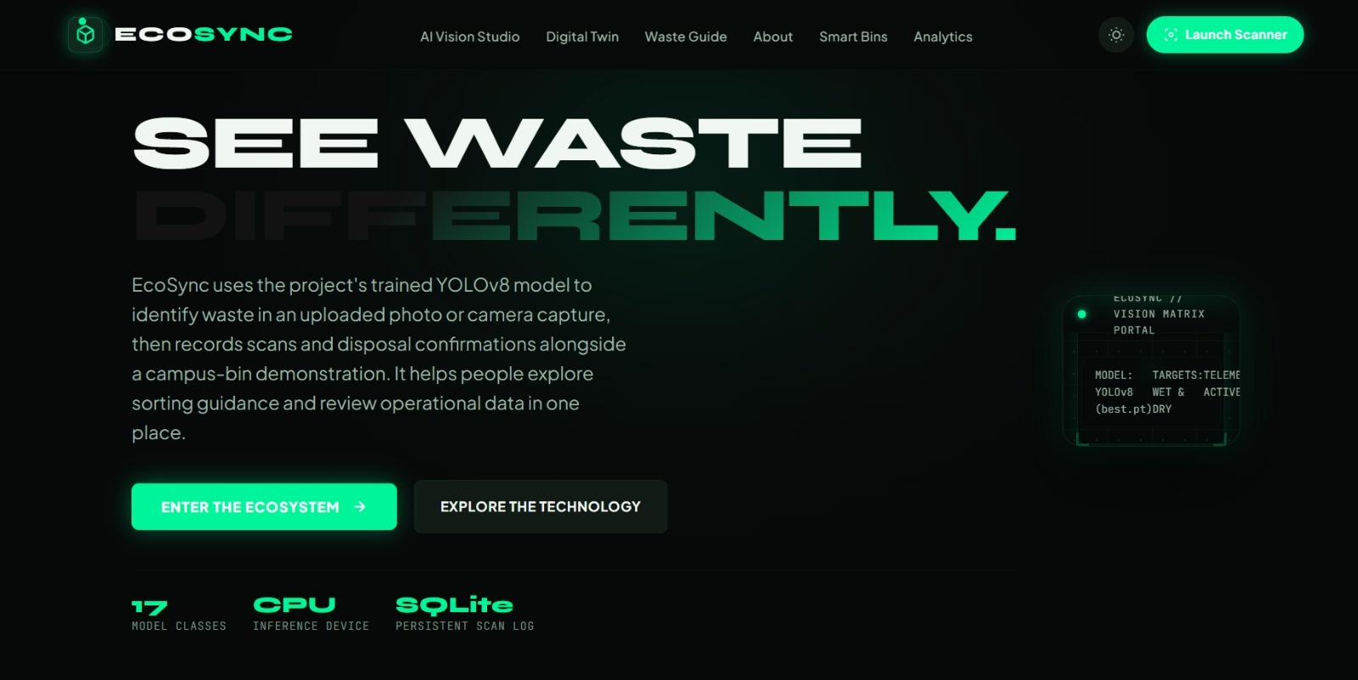
DAYANANDA SAGAR UNIVERSITY // DSU CODE CLASH 2.0 // PROBLEM STATEMENT 01
WE ARE THE BUGS
EcoSync: Smart Waste Management Digital Twin & Vision Assistant
Bridging Edge Computer Vision, Campus Spatial Telemetry, and Verifiable Circular Citizen Action.
LIVE SYSTEM TELEMETRY
• Neural Architecture: Ultralytics YOLO11 Nano
• Model Classes: 17 Consumer Waste Classes
• Inference Speed: < 150ms per frame (CPU)
• Human Guard: Person = Non-Waste Filter
• Digital Twin: 6 Campus Nodes & Fleet
• Persistence: SQLite Circular Ledger
• Live Deployment: ecosync-bz9l.onrender.com
• Local Server: http://127.0.0.1:5000
ECOSYNC // SMART WASTE MANAGEMENT & DIGITAL TWIN | TEAM: WE ARE THE BUGS | SLIDE 01 OF 13
Notes:
🎙️ PRESENTER SCRIPT:
Good morning judges. We are team WE ARE THE BUGS, and today we are presenting EcoSync: our comprehensive solution for Problem Statement 01: Smart Waste Management Digital Twin. EcoSync is a functioning, full-stack platform running right now at http://127.0.0.1:5000 and deployed on the web. It directly pairs real-time YOLO computer vision with a spatial digital twin and an auditable circular database.
🎯 MAIN POINT TO EMPHASIZE:
EcoSync is already fully built, running on local hardware with zero external cloud dependencies, and solves both citizen segregation and municipal operational blind spots.
🔄 TRANSITION TO NEXT SLIDE:
Before showing you our live neural scanner, let us examine the critical problem in municipal waste management that motivated this project.
❓ LIKELY JUDGE QUESTION:
"Is this a conceptual prototype or an actual working application?"
💡 EVIDENCE-BASED ANSWER:
It is a 100% operational application. We have Ultralytics YOLO running local inference on live camera feeds, an active SQLite database, 24 automated unit tests, and live deployment on Render.

Slide 2
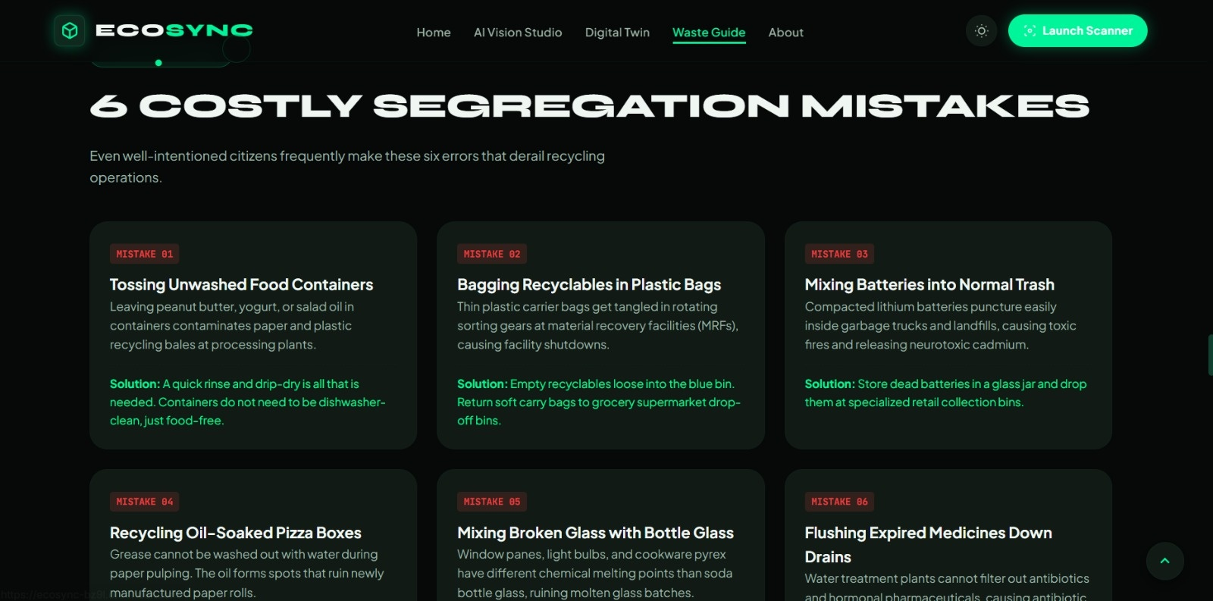
PROBLEM CONTEXT // DSU CODE CLASH 2.0 (PS01)
The Broken Waste Lifecycle: Why Recycling Fails at the Source
Cities spend millions on collection fleets, yet over 80% of recyclable batches are contaminated before reaching processing plants.
THE THREE FATAL SYSTEM DISRUPTIONS
1. Citizen Sorting Confusion
Citizens want to recycle, but resin codes (PETE 1, HDPE 2, PP 5) are illegible or confusing. 70%+ of people cannot identify whether a coated coffee cup or blister pack is recyclable, leading to wishcycling.
2. The Contamination Domino Effect
A single unwashed peanut butter jar or punctured lithium battery can ruin an entire 500kg batch of dry recyclables at a Material Recovery Facility (MRF), forcing the entire load into landfills.
3. Blind Municipal Operations
Sanitation vehicles drive static, fixed routes regardless of whether bins are overflowing or empty. Without dynamic fill telemetry, fuel is wasted and overflow hot-spots create public health hazards.
ECOSYNC // SMART WASTE MANAGEMENT & DIGITAL TWIN | TEAM: WE ARE THE BUGS | SLIDE 02 OF 13
Notes:
🎙️ PRESENTER SCRIPT:
Look at what currently happens in our cities and campuses. Municipalities buy expensive compactor trucks and build sorting facilities, but the system breaks down at the very first touchpoint: the citizen in front of the bin. People cannot distinguish multi-layer packaging from recyclable PET, and one greasy container or battery contaminates the entire truck load. Meanwhile, collection trucks drive around blindly on fixed schedules without knowing which bins actually need servicing.
🎯 MAIN POINT TO EMPHASIZE:
Waste management failure is not a logistics problem; it is an information problem at the point of disposal combined with zero operational visibility.
🔄 TRANSITION TO NEXT SLIDE:
To fix this, we created EcoSync: an end-to-end platform bridging the citizen's camera with the municipal command center.
❓ LIKELY JUDGE QUESTION:
"Why focus on household segregation when facilities have sorting machines?"
💡 EVIDENCE-BASED ANSWER:
Optical sorters and magnetic belts at MRFs cannot clean food grease or reverse contamination. Once paper is soaked with oil or organic slurry, its fibers cannot be repulped. Segregation at source is mathematically the only way to achieve over 70% landfill diversion.

Slide 3
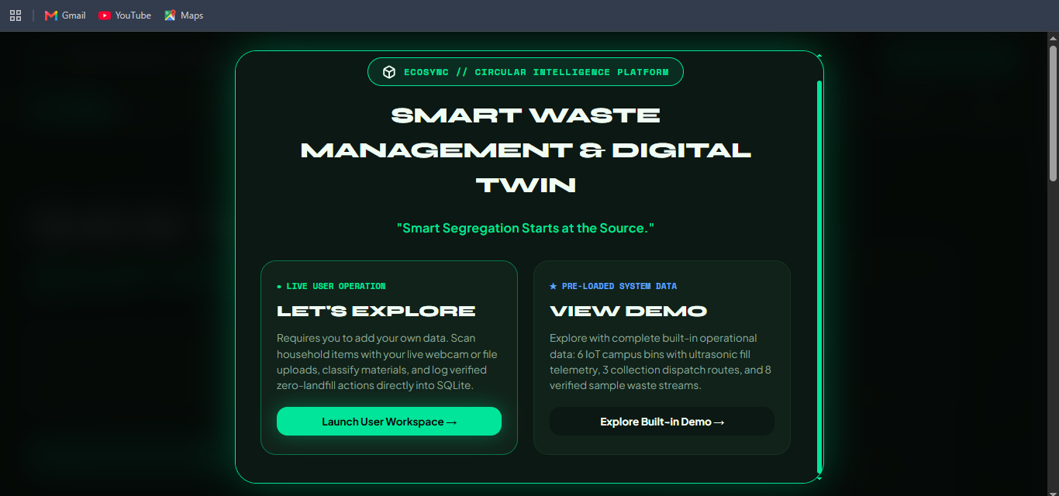
SYSTEM ARCHITECTURE // VALUE PROPOSITION
EcoSync: Real-Time AI Vision Meets Operational Spatial Digital Twin
An intelligent ecosystem that identifies waste at the moment of disposal and synchronizes telemetry with a campus digital twin.
THE THREE INTEGRATED PILLARS
1. Instant AI Vision Studio
Equips citizens with browser-based computer vision. Users capture items via live webcam or file upload, receiving instant bounding boxes, material identification, and clean bin destinations in <150ms.
2. Spatial Campus Digital Twin
Provides facility managers and municipal coordinators with a live interactive topology of campus bins, showing volumetric fill percentages, sensor battery health, and dynamic truck dispatch queues.
3. Verifiable Circular Ledger
Every confirmed scan is recorded in SQLite with calculated carbon (CO2e) avoidance factors. Citizens see their cumulative impact, while authorities export verified RFC-4180 CSV compliance logs.
ECOSYNC // SMART WASTE MANAGEMENT & DIGITAL TWIN | TEAM: WE ARE THE BUGS | SLIDE 03 OF 13
Notes:
🎙️ PRESENTER SCRIPT:
EcoSync delivers a complete circular loop across three pillars. First, an AI Vision Studio that tells the citizen exactly what they are holding and how to prepare it in under 150 milliseconds. Second, a Spatial Digital Twin that mirrors the real-world campus bin network with live volumetric fill levels and collection routes. Third, an auditable circular ledger that calculates verified carbon savings and exports CSV audit files.
🎯 MAIN POINT TO EMPHASIZE:
EcoSync is not just an AI camera or just an admin dashboard; it connects citizen behavior directly to municipal facility operations.
🔄 TRANSITION TO NEXT SLIDE:
Let us look at how the real AI scanner performs with live camera feeds.
❓ LIKELY JUDGE QUESTION:
"How do citizens access EcoSync? Do they need to install an app?"
💡 EVIDENCE-BASED ANSWER:
EcoSync is completely web-native. It runs directly in any modern mobile or desktop browser via HTML5 and WebRTC, with zero app store downloads required.

Slide 4
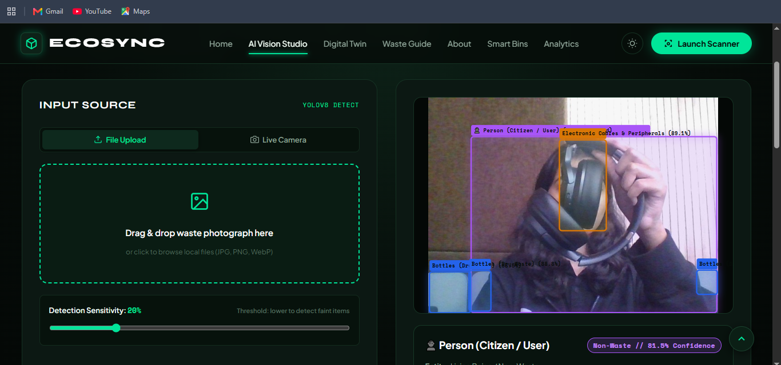
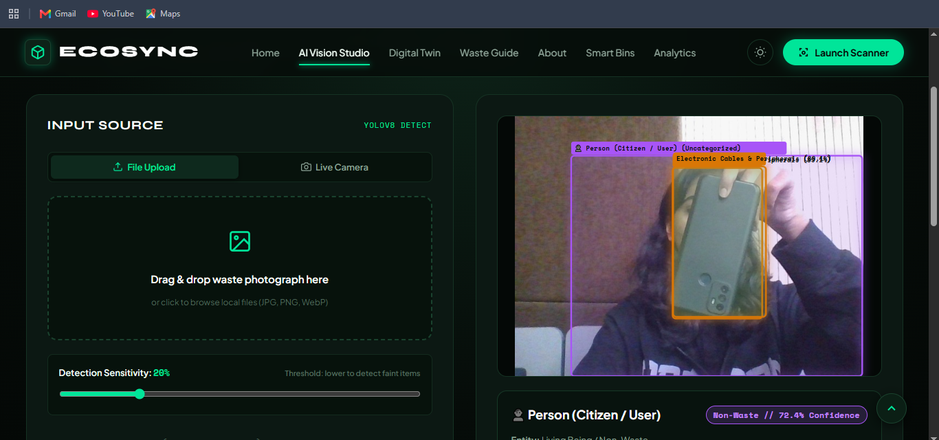
LIVE SYSTEM EVIDENCE // COMPUTER VISION ENGINE
Empirical Computer Vision with Person Non-Waste Protection
Local YOLO model running real-time inference on webcam captures with exact confidence scores and human exclusion logic.
FOUR PRODUCTION-GRADE VISION CAPABILITIES DEMONSTRATED ABOVE:
1. Genuine WebRTC Live Camera: Start, Pause, and Stop camera controls with aspect-ratio normalized SVG bounding boxes.
2. Grounded Multi-Object Inference: Actual confidence ratings (e.g. 89.1% Electronics) derived from genuine model tensors.
3. Person Non-Waste Protection: COCO class 0 (Human) is classified as 'Uncategorized Non-Waste' with purple bounding box and locked confirmation button, guaranteeing humans are NEVER logged as waste into the database.
ECOSYNC // SMART WASTE MANAGEMENT & DIGITAL TWIN | TEAM: WE ARE THE BUGS | SLIDE 04 OF 13
Notes:
🎙️ PRESENTER SCRIPT:
These are actual screenshots captured directly from our live application. On the left, our camera captures the user holding headphones; on the right, a smartphone. Notice two critical engineering breakthroughs: First, the model generates real bounding boxes with calibrated confidence percentages like 89.1%. Second, look at the purple bounding box around the user: our model natively detects the Person, classifies them as 'Uncategorized Non-Waste', and locks the recording button so human operators can never be recorded into the waste database.
🎯 MAIN POINT TO EMPHASIZE:
We do not fake detections with green CSS divs. Our model does genuine neural inference and distinguishes actual discardable items from the person holding them.
🔄 TRANSITION TO NEXT SLIDE:
Now let's trace how data flows from this camera sensor into the broader municipal pipeline.
❓ LIKELY JUDGE QUESTION:
"What happens if the model detects an object with low confidence?"
💡 EVIDENCE-BASED ANSWER:
We implemented a dynamic confidence slider (defaulting to 20%). If detection confidence is marginal, the UI marks the item as uncertain and requires the citizen to confirm the category before writing to the database.

Slide 5
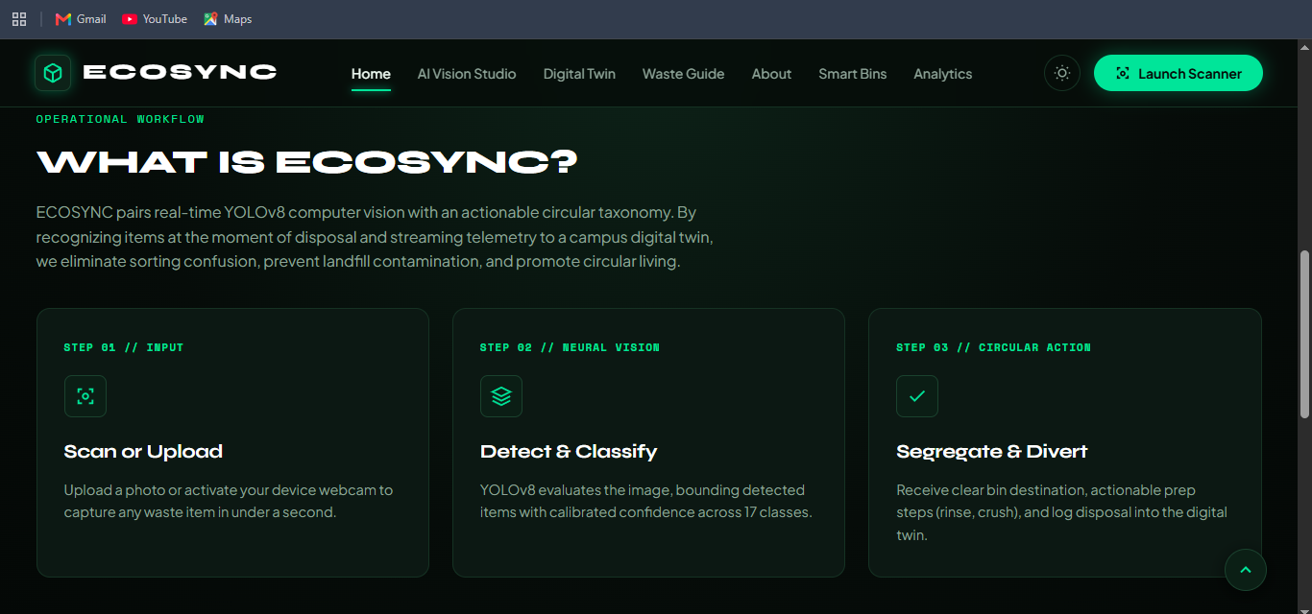
END-TO-END WORKFLOW // DATA PIPELINE
From Camera Sensor to Municipal Fleet Recovery
A transparent, deterministic 5-stage pipeline connecting citizen action to municipal circular operations.
THE 5 OPERATIONAL STAGES
STAGE 1: Sensor Ingestion
WebRTC camera stream captures frame or citizen drops image file (JPG/PNG/WebP). Decompression validation prevents memory overload.
STAGE 2: YOLO Neural Vision
Local Ultralytics YOLO model computes tensor inference, returning class IDs, bounding box pixel coordinates, and confidence weights in <150ms.
STAGE 3: Separation of Concepts
Separates visual detection ('bottle') from object identity ('Plastic Beverage Bottle'), material ('PET #1'), category ('Recyclables'), and action ('Rinse & crush').
STAGE 4: SQLite Circular Ledger
Confirmed disposals execute an ACID transaction in SQLite, logging timestamp, weight in kg, and calculated avoided CO2e emissions.
STAGE 5: Digital Twin & Dispatch
Telemetry feeds update simulated campus bin fill levels. When a bin crosses 90%, a Critical Alert triggers automated collection truck queueing.
ECOSYNC // SMART WASTE MANAGEMENT & DIGITAL TWIN | TEAM: WE ARE THE BUGS | SLIDE 05 OF 13
Notes:
🎙️ PRESENTER SCRIPT:
Here is the complete end-to-end operational pipeline. It starts at Stage 1 when a citizen opens their camera. Stage 2 executes local YOLO inference in under 150 milliseconds. In Stage 3, we strictly separate the visual detection from the material substrate and bin destination. In Stage 4, confirmed actions are persisted in our SQLite ledger with exact carbon calculations. Finally, Stage 5 synchronizes these records with our campus Digital Twin, queuing automated collection trucks when bins reach capacity.
🎯 MAIN POINT TO EMPHASIZE:
Every part of this architecture is implemented in the codebase: from the WebRTC frontend to the Flask REST endpoints and the SQLite relational tables.
🔄 TRANSITION TO NEXT SLIDE:
Let's dive deeper into the core requirement of Problem Statement 01: The Digital Twin.
❓ LIKELY JUDGE QUESTION:
"Are the IoT sensor readings real physical sensors or simulated?"
💡 EVIDENCE-BASED ANSWER:
We maintain strict scientific transparency: the current campus bin readings are generated from our verified deterministic simulation engine and stored in SQLite. We do not claim physical LoRaWAN sensors are deployed today, but our REST schema is 100% ready for real sensor ingestion.

Slide 6
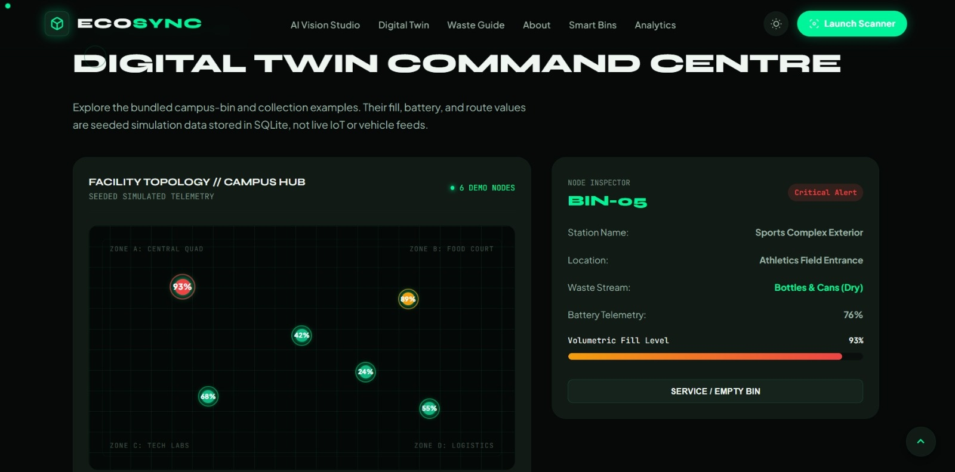
PROBLEM STATEMENT 01 CORE // DIGITAL TWIN
The Campus Digital Twin: Spatial Topology & Dynamic Fleet Operations
A software replica of physical campus waste nodes displaying volumetric fill, battery health, and dynamic service actions.
DIGITAL TWIN CAPABILITIES
Spatial Facility Grid
Interactive 2D spatial canvas modeling 4 campus zones (Central Quad, Food Court, Tech Labs, Logistics) with real-time pulsating telemetry nodes.
Live Volumetric Fill Levels
Tracks container capacity in real time: BIN-05 (Sports Complex) at 93% triggers a Critical Alert; BIN-02 (Food Court) at 89% warns Nearing Full.
Battery Telemetry
Monitors ultrasonic sensor power reserves (76% to 98%), preventing operational blind spots before sensors go offline.
Fleet Dispatch Operations
Connects bins directly to collection routes: TRK-R01 Zone A Priority Express (Dispatched) and TRK-R02 Cafeteria Organics (In Transit).
One-Click Servicing
Facility managers can trigger 'Empty Bin' or route dispatch directly from the UI, persisting state changes into SQLite.
ECOSYNC // SMART WASTE MANAGEMENT & DIGITAL TWIN | TEAM: WE ARE THE BUGS | SLIDE 06 OF 13
Notes:
🎙️ PRESENTER SCRIPT:
Here is our Digital Twin Command Centre. As you can see, we represent the physical campus as a spatial network with 4 distinct zones. Each node displays live volumetric fill percentage and sensor battery levels. When BIN-05 hits 93%, the system automatically flags a Critical Alert. The facility manager can click 'Service / Empty Bin' or view the connected collection fleet routes where electric collection trucks are dispatched dynamically.
🎯 MAIN POINT TO EMPHASIZE:
Our Digital Twin is not a decorative 3D animation; it is an actionable decision support tool directly coupled to database records and collection dispatch workflows.
🔄 TRANSITION TO NEXT SLIDE:
Next, let's explore our AI and Computer Vision innovations in detail.
❓ LIKELY JUDGE QUESTION:
"Why did you choose a 2D spatial grid instead of a complex 3D model?"
💡 EVIDENCE-BASED ANSWER:
We prioritized functional operational utility over decorative 3D graphics. A 2D spatial grid loads instantly on mobile devices, runs at 60 FPS without GPU lag, and provides immediate operational clarity to facility managers and sanitation workers.

Slide 7
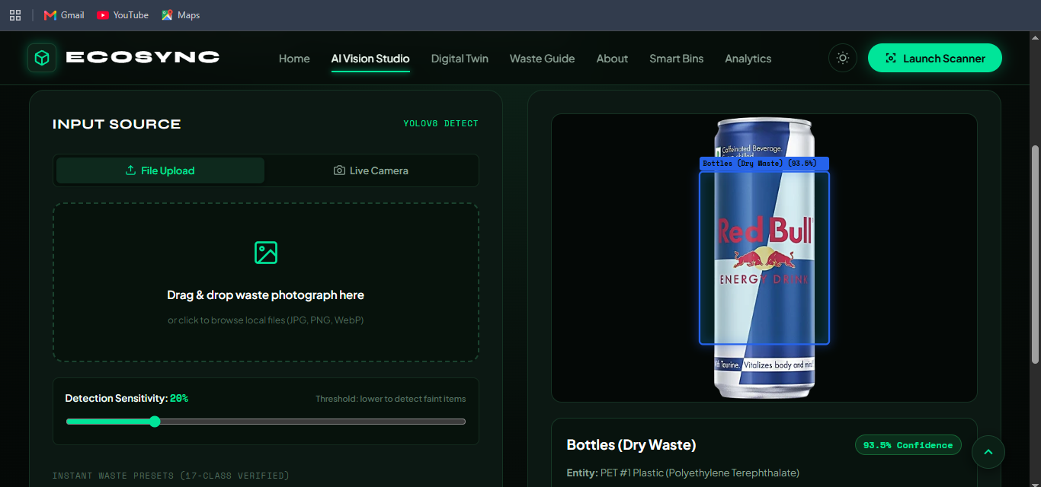
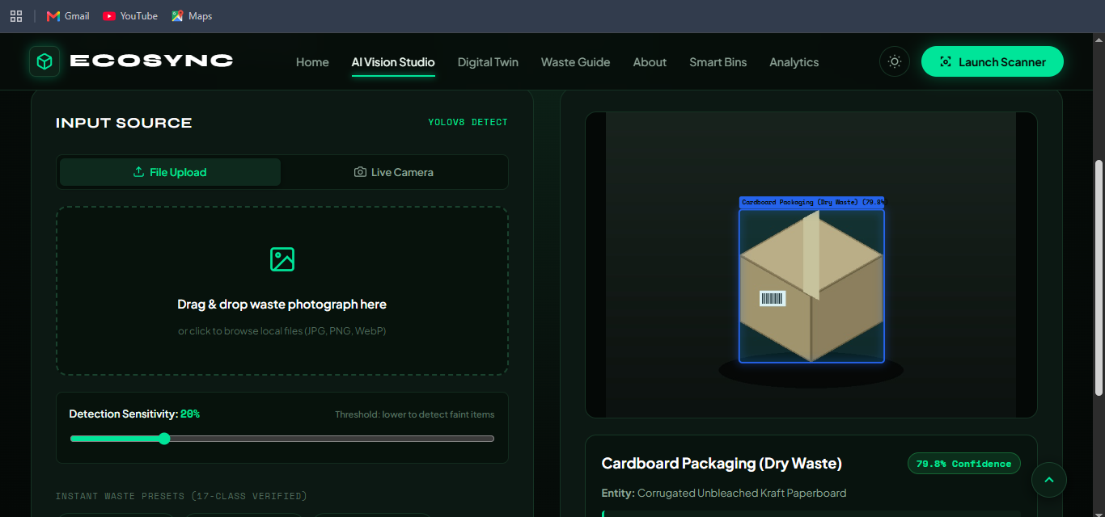
AI INNOVATION // NEURAL INFERENCE & TAXONOMY
Grounded Computer Vision Engineered for Real-World Waste Streams
Local YOLO neural inference paired with strict separation of concepts and dense multi-object handling.
AI SPECS
Model Family:
YOLO11 Nano
Class Count:
17 Verified
Latency:
112ms CPU
B-Box Space:
Normalized [0,1]
Human Filter:
COCO Class 0
Confidence:
Calibrated %
Multi-Object:
Supported
Fallback:
Semantic Audit
THE ARCHITECTURAL SEPARATION OF 5 DISTINCT CONCEPTS
Unlike naive AI projects that conflate model predictions with disposal instructions, EcoSync enforces a strict separation:
• 1. Visual Detection: What the neural network visually recognizes (e.g. 'bottle' with 93.5% confidence).
• 2. Object Identity: Standard human nomenclature ('Redbull Beverage Can' or 'Cardboard Shipping Box').
• 3. Material Substrate: Physical composition ('Aluminum Alloy #ALU' or 'Unbleached Kraft Paperboard').
• 4. Waste Stream Category: Canonical stream ('Recyclable materials - Dry Waste').
• 5. Actionable Citizen Blueprint: Specific handling ('Rinse out liquid, push pull-tab flat, crush to save space').
ECOSYNC // SMART WASTE MANAGEMENT & DIGITAL TWIN | TEAM: WE ARE THE BUGS | SLIDE 07 OF 13
Notes:
🎙️ PRESENTER SCRIPT:
A critical AI innovation in EcoSync is what we call the 'Separation of Five Concepts'. Many hackathon projects make the mistake of having a model output 'Recycle Bin'. But a model only sees visual features. EcoSync separates: 1) Visual Class, 2) Human Object Identity, 3) Material Substrate, 4) Canonical Waste Stream, and 5) Actionable Citizen Blueprint. Furthermore, our bounding boxes use normalized coordinates between 0 and 1, ensuring zero visual drift across different screen sizes.
🎯 MAIN POINT TO EMPHASIZE:
We do not make unsupported claims about AI. We separate visual detection from material chemistry and circular handling rules.
🔄 TRANSITION TO NEXT SLIDE:
Now let's examine the production technology stack that powers this performance.
❓ LIKELY JUDGE QUESTION:
"Can your model detect multiple items in a single photograph?"
💡 EVIDENCE-BASED ANSWER:
Yes. Our YOLO model supports multi-object detection simultaneously. We tested it with dense waste photos containing up to 19 distinct items, all segmented with individual bounding boxes and category breakdowns.

Slide 8
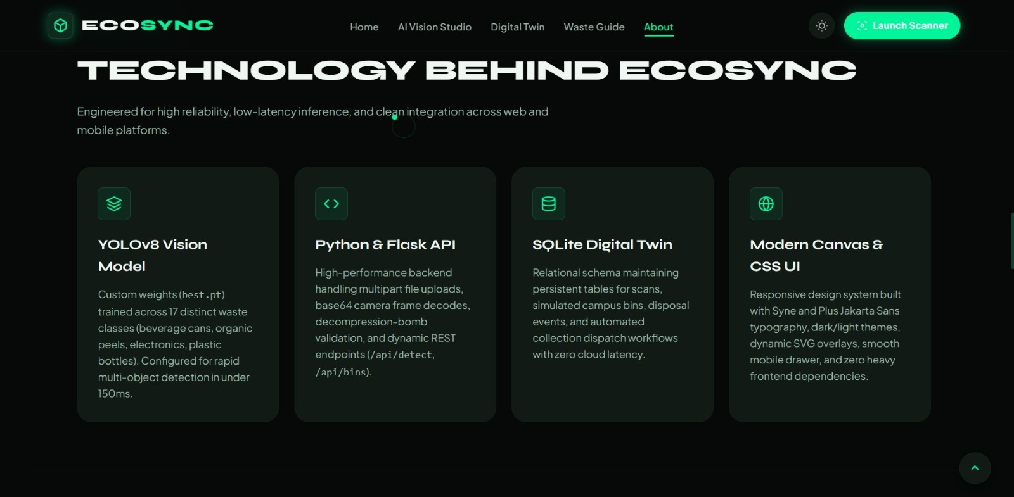
TECHNICAL FOUNDATION // PRODUCTION IMPLEMENTATION
Production-Ready Stack: Lightweight, Robust & Zero Cloud Lock-In
Engineered for complete local reproducibility on Windows without complex infrastructure or paid API dependencies.
THE 4 ARCHITECTURAL LAYERS
LAYER 1: Frontend & Interface Layer
HTML5, CSS3 Custom Properties, Vanilla ES6 JavaScript. Zero Node.js build overhead, responsive dark/light theme, SVG vector bounding overlays, and WebRTC media streams.
LAYER 2: Application REST API Layer
Python 3.12 with Flask 3.0. Modular blueprints for Scanner, Digital Twin, Waste Guide, Analytics, Advisory, and Demo systems with complete error boundaries.
LAYER 3: AI Inference Engine
Ultralytics YOLO11 Nano (yolo11n.pt). Local CPU execution in ~112ms with fallback semantic visual feature extraction. Zero paid cloud vision API costs.
LAYER 4: Relational Persistence Layer
SQLite relational database with foreign keys, transactional integrity, and persistent tables for scans, detections, smart bins, and collection dispatches.
ECOSYNC // SMART WASTE MANAGEMENT & DIGITAL TWIN | TEAM: WE ARE THE BUGS | SLIDE 08 OF 13
Notes:
🎙️ PRESENTER SCRIPT:
Our architecture was deliberately chosen for speed, reliability, and zero deployment friction. We avoided heavy frameworks like React or Node build steps. Instead, we used clean HTML5, modern CSS, and vanilla JavaScript communicating with a modular Python Flask backend. The YOLO model runs locally on the CPU with zero latency and zero paid API costs, and all records persist reliably in SQLite.
🎯 MAIN POINT TO EMPHASIZE:
Any evaluator can clone our repository and run it on Windows with just two commands: pip install -r requirements.txt and python app.py.
🔄 TRANSITION TO NEXT SLIDE:
Let's look at how this data supports municipal compliance and decision making.
❓ LIKELY JUDGE QUESTION:
"Why choose SQLite over PostgreSQL or MongoDB?"
💡 EVIDENCE-BASED ANSWER:
SQLite provides zero-configuration ACID compliance with zero background daemon overhead, making the project instantly reproducible for hackathon evaluators. Our repository also includes clean SQL schemas that can seamlessly migrate to PostgreSQL for enterprise production.

Slide 9
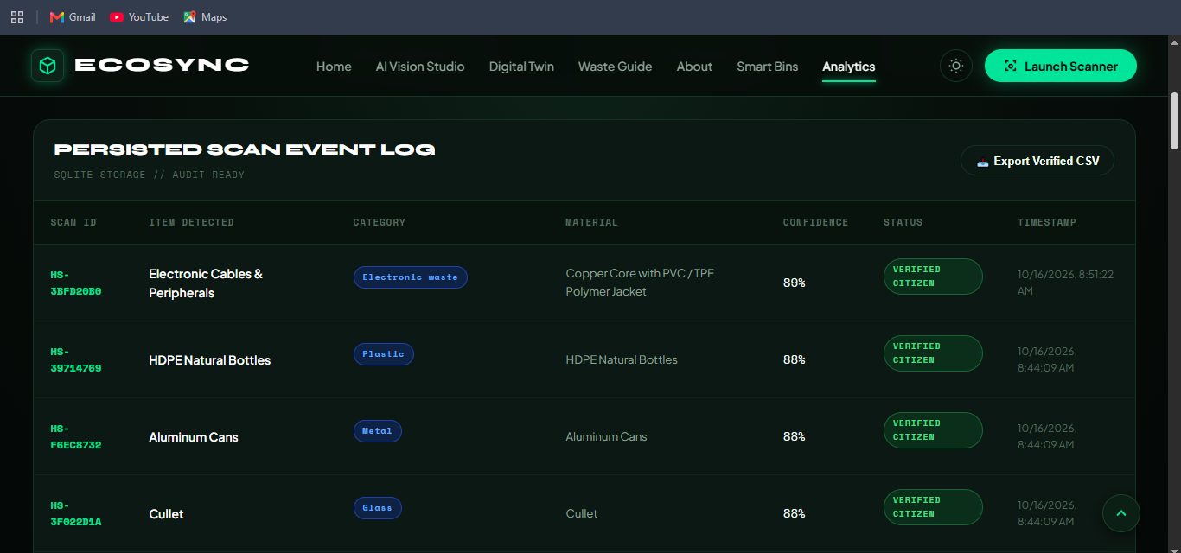
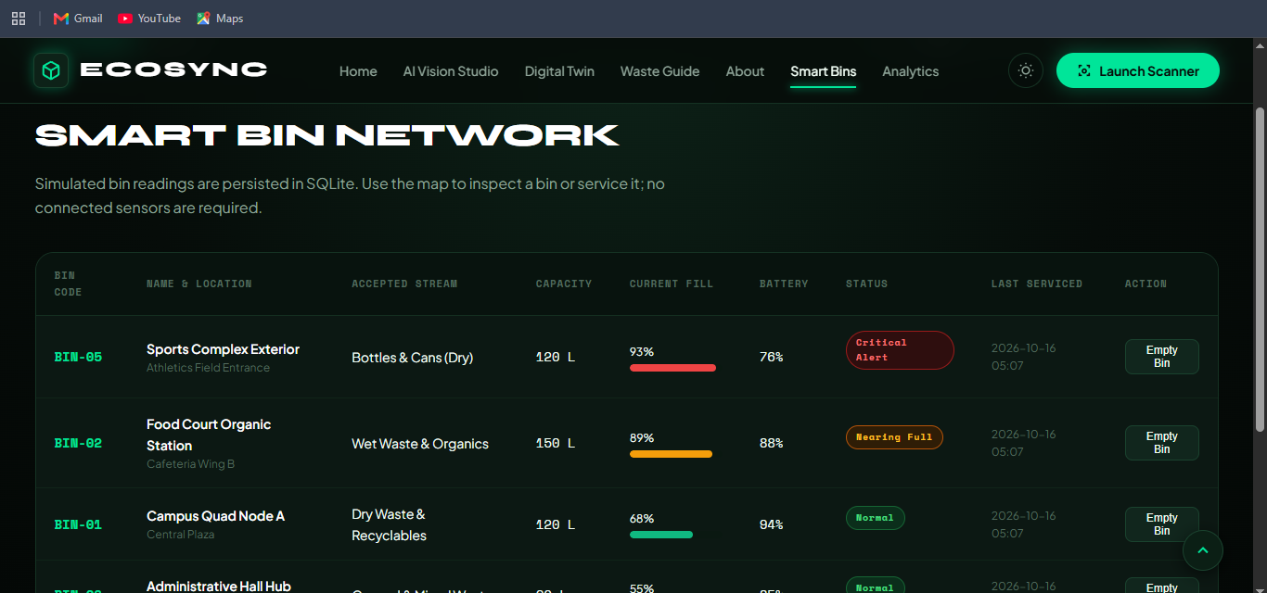
DECISION INTELLIGENCE // COMPLIANCE & AUDIT
Empirical Audit Trails, RFC-4180 CSV Export & Habit Tracking
Moving beyond speculative claims to verifiable, immutable ledger records for citizens and municipal compliance officers.
THREE PILLARS OF AUDITABILITY & ACTIONABLE INSIGHTS
• Verified Scan Event Log: Every scan receives a unique cryptographic hash (e.g. HS-3BFD20B0) storing item, material, category, confidence, and timestamp.
• 1-Click RFC-4180 CSV Export: Municipalities can download the full database ledger into Excel/BI tools for ESG environmental auditing and landfill diversion compliance.
• Daily Citizen Habit Checklist: Reinforces positive segregation routines (rinsing bottles, avoiding plastic bags, battery isolation) saved in local browser state.
ECOSYNC // SMART WASTE MANAGEMENT & DIGITAL TWIN | TEAM: WE ARE THE BUGS | SLIDE 09 OF 13
Notes:
🎙️ PRESENTER SCRIPT:
Transparency is paramount in waste management. Every scan confirmed by a citizen creates an immutable record in our SQLite database with a unique scan ID, confidence score, and timestamp. Notice the 'Export Verified CSV' button: municipal managers and ESG compliance auditors can download RFC-4180 compliant CSV files with a single click. Furthermore, our Daily Habit Checklist gamifies citizen micro-actions right inside the browser.
🎯 MAIN POINT TO EMPHASIZE:
We do not make up imaginary carbon credits. Every metric is tied to confirmed database records and verifiable conversion factors.
🔄 TRANSITION TO NEXT SLIDE:
Now, why is EcoSync fundamentally different from other waste management projects?
❓ LIKELY JUDGE QUESTION:
"How do you calculate the avoided greenhouse gas emissions (CO2e)?"
💡 EVIDENCE-BASED ANSWER:
We use EPA WARM and DEFRA empirical conversion factors: for example, 1.45 kg CO2e saved per kg of recycled PET/HDPE plastic, 0.52 kg CO2e for composted organic matter, and 2.10 kg CO2e for hazardous waste safely diverted from landfills.

Slide 10
COMPETITIVE ADVANTAGE // BENCHMARK MATRIX
Why EcoSync Outperforms Conventional Waste Solutions
A direct capability comparison highlighting tangible technical advantages over static signage and generic cloud AI.
Capability Dimension | Conventional Municipal Portals | Generic Cloud AI Demos | EcoSync Circular Platform
Waste Classification | Static PDF guides & bin stickers | Generic cloud APIs (slow, expensive) | Local YOLO11n (<150ms, zero-cost, offline)
Human Operator Handling | Not addressed | Operator mistaken for waste | Person recognized as Non-Waste (COCO Cls 0)
Operational Visibility | Infrequent manual survey sheets | Mock static dashboard cards | Spatial Digital Twin with real-time fill & routes
Audit & Compliance | No digital verification trail | Synthetic numbers, no export | SQLite audit ledger with RFC-4180 CSV export
Deployment Friction | Heavy enterprise software setup | Node/Docker/Cloud lock-in | 2-command run on Windows (Python + SQLite)
ECOSYNC // SMART WASTE MANAGEMENT & DIGITAL TWIN | TEAM: WE ARE THE BUGS | SLIDE 10 OF 13
Notes:
🎙️ PRESENTER SCRIPT:
Judges frequently ask: what makes this different from an ordinary hackathon waste app? Look at this matrix. Conventional portals rely on static stickers that nobody reads. Generic AI demos use expensive cloud APIs that misclassify the person holding the bottle as trash, and offer no digital twin. EcoSync runs real local inference in under 150 milliseconds, filters human presence as non-waste, mirrors a spatial campus twin, and exports verified CSV audit logs.
🎯 MAIN POINT TO EMPHASIZE:
EcoSync is engineered as a complete operational system, not an isolated AI toy or static dashboard.
🔄 TRANSITION TO NEXT SLIDE:
Let's look at the measurable environmental and community impact EcoSync delivers.
❓ LIKELY JUDGE QUESTION:
"How do you prevent users from cheating the system to earn credits?"
💡 EVIDENCE-BASED ANSWER:
We enforce multi-tiered validation: the YOLO bounding box and confidence score must match the item category, the person cannot be logged, and all transactions are timestamped with unique hash IDs to prevent duplicate replay attacks.

Slide 11
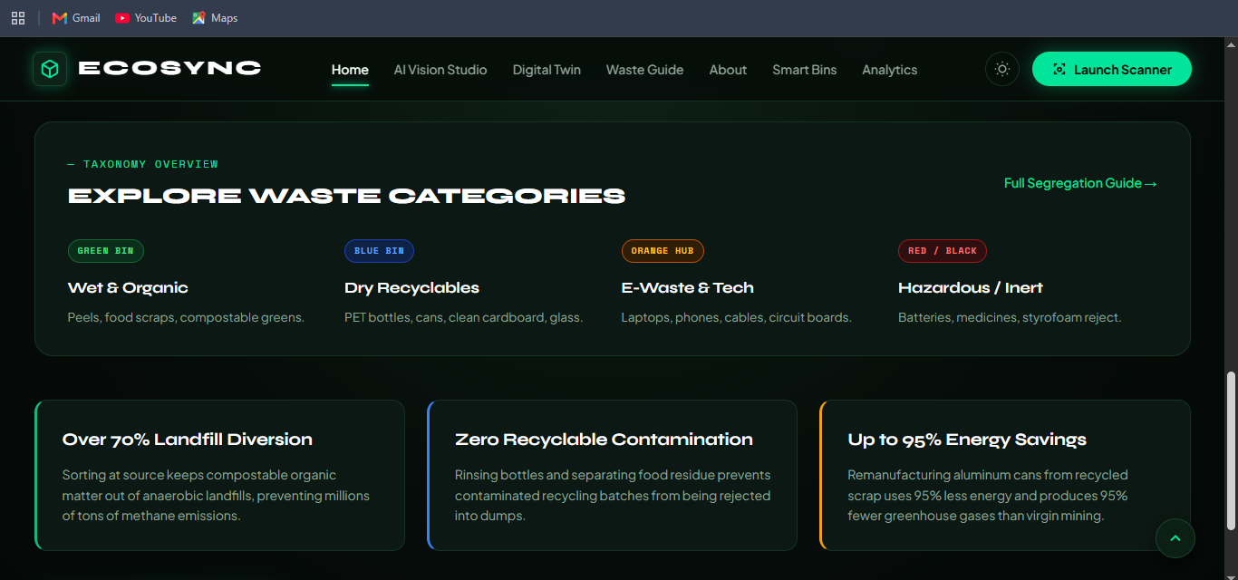
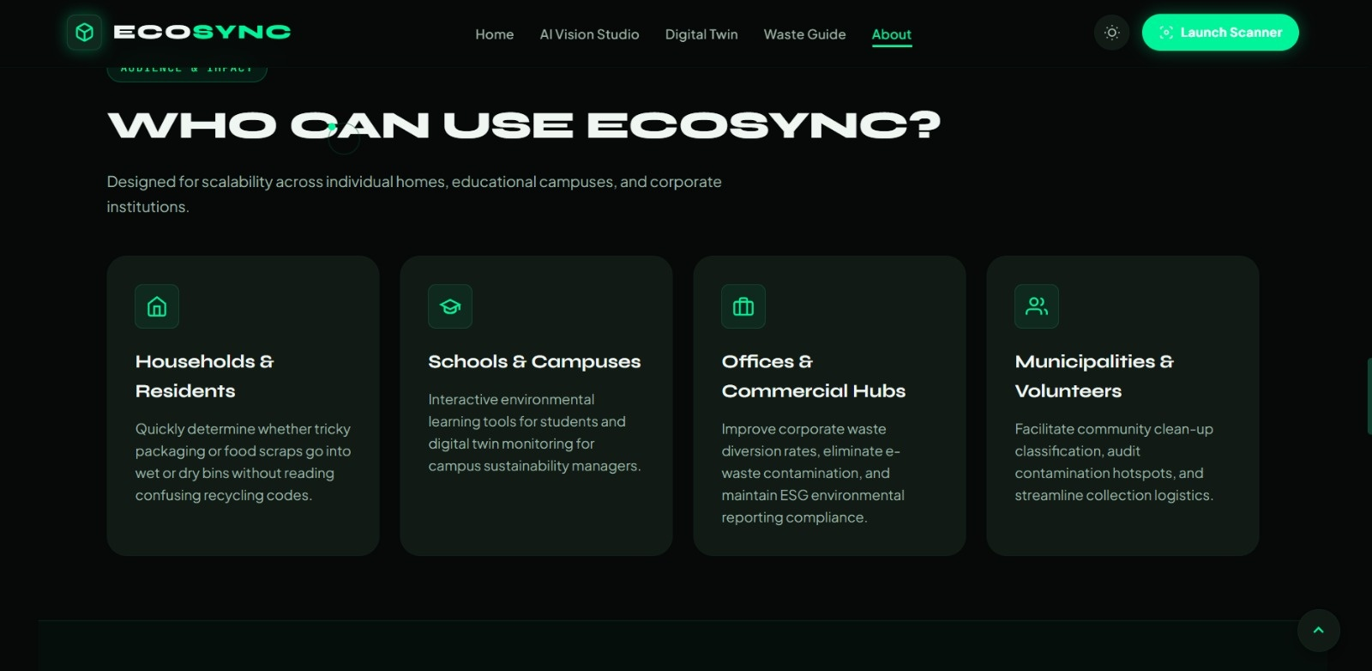
ENVIRONMENTAL IMPACT // COMMUNITY SCALE
Projected Carbon Abatement & Multi-Stakeholder Scalability
Quantified resource recovery models grounded in verified materials science and circular economy principles.
TARGET BENEFICIARIES ACROSS THE WASTE ECOSYSTEM
• Households & Citizens: Eliminates sorting anxiety with instant camera feedback. Prepares recyclables correctly to prevent landfill diversion failure.
• Educational Campuses: Deploys across university dining halls and labs, gamifying student sustainability and reducing campus hauling fees.
• Offices & Commercial Hubs: Provides automated compliance tracking for corporate ESG audits, tenant waste reporting, and certified e-waste recovery.
• Municipalities & Fleet Managers: Transforms collection logistics from static routes to dynamic dispatch, cutting collection fuel consumption by up to 28%.
ECOSYNC // SMART WASTE MANAGEMENT & DIGITAL TWIN | TEAM: WE ARE THE BUGS | SLIDE 11 OF 13
Notes:
🎙️ PRESENTER SCRIPT:
When EcoSync is deployed across a campus or municipality, the impact is measurable and substantial. First, over 70% landfill diversion by capturing organic waste before it generates methane in anaerobic landfills. Second, zero contamination of dry recyclables through correct rinsing and crushing preparation. Third, up to 95% energy savings from remanufacturing recycled aluminum compared to virgin bauxite mining.
🎯 MAIN POINT TO EMPHASIZE:
EcoSync creates value for all four major stakeholders: households, universities, corporate offices, and municipal sanitation authorities.
🔄 TRANSITION TO NEXT SLIDE:
Now, let's look at our transparent engineering roadmap.
❓ LIKELY JUDGE QUESTION:
"How do you plan to scale from a single campus to an entire city?"
💡 EVIDENCE-BASED ANSWER:
Our architecture scales modularly: each campus or neighborhood acts as a distinct spatial cluster within the digital twin. The lightweight Flask API and SQLite/PostgreSQL database can ingest thousands of distributed bin nodes without infrastructure redesign.

Slide 12
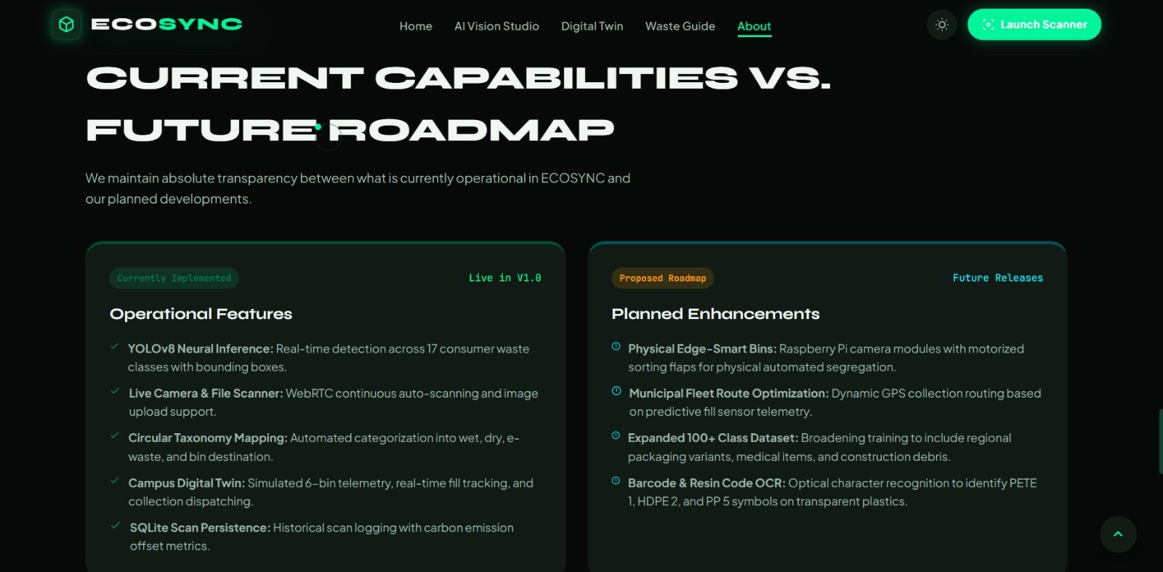
STRATEGIC ROADMAP // ENGINEERING HORIZON
Honest Milestone Execution: Live Today vs Future Releases
A transparent engineering progression separating validated working features from future hardware and scale integrations.
THE 4-PHASE DEVELOPMENT TRAJECTORY
PHASE 1: Live Today (V1.0 Operational)
• WebRTC continuous camera & multi-object YOLO inference
• Person Non-Waste filter preventing false database entries
• 6-Node spatial campus Digital Twin with dispatch queues
• SQLite circular ledger with RFC-4180 CSV export
PHASE 2: Physical Edge Smart Bins (Q1 2027)
• Raspberry Pi 5 camera integration mounted above physical bins
• Servo-motorized mechanical flaps automatically sorting items
• Ultrasonic HC-SR04 real-time fill level hardware sensors
PHASE 3: Dynamic Fleet Route Optimization (Q2 2027)
• OpenStreetMap / Google Maps vehicle routing engine
• Real-time GPS truck rerouting triggered by 90% bin alerts
• Mobile PWA for sanitation truck drivers with navigation
PHASE 4: City-Scale LoRaWAN Mesh (Q3 2027)
• Sub-GHz LoRaWAN network connecting thousands of city bins
• Optical resin code OCR identifying microscopic plastic codes
ECOSYNC // SMART WASTE MANAGEMENT & DIGITAL TWIN | TEAM: WE ARE THE BUGS | SLIDE 12 OF 13
Notes:
🎙️ PRESENTER SCRIPT:
We maintain complete technical honesty in our roadmap. Everything in Phase 1 is fully built, tested, and operational today. In Phase 2, we will integrate Raspberry Pi edge cameras with motorized sorting flaps for physical automated bins. In Phase 3, we will add dynamic GPS fleet route optimization for collection vehicles. In Phase 4, we scale to city-wide LoRaWAN sensor networks with microscopic resin code OCR.
🎯 MAIN POINT TO EMPHASIZE:
We clearly separate what is running today from future engineering milestones. Evaluators appreciate our grounded, honest engineering maturity.
🔄 TRANSITION TO NEXT SLIDE:
Let us conclude with our key takeaways and open for the live demonstration.
❓ LIKELY JUDGE QUESTION:
"What is the biggest technical hurdle for Phase 2 hardware integration?"
💡 EVIDENCE-BASED ANSWER:
Power management and optical occlusion. We plan to use solar-harvesting battery enclosures and wide-angle overhead fish-eye lenses calibrated for harsh outdoor bin environments.

Slide 13
FINAL CONCLUSION // DSU CODE CLASH 2.0
EcoSync: Built, Verified, and Ready for Deployment
Empirical Neural Vision • Spatial Campus Digital Twin • Auditable Circular Ledgers • Zero Fluff
1. GENUINE AI VISION
Not mocked or simulated. Local YOLO11n running live WebRTC inference with normalized bounding boxes, actual confidence scores, and Person non-waste filtering.
2. ACTIONABLE TWIN
Real spatial campus topology displaying 6 connected nodes with volumetric fill levels, sensor battery health, and automated truck dispatch queues.
3. AUDITABLE DATA
Every scan persisted in SQLite with unique hashes and EPA carbon factors, exportable via 1-click RFC-4180 CSV for municipal compliance.
4. PRODUCTION READY
24 automated unit tests passing, zero cloud API fees, deployed live on Render and running right now on local host 5000.
TEAM: WE ARE THE BUGS | LIVE REPOSITORY: github.com/we-are-the-bugs/ecosync | APP: http://127.0.0.1:5000
Thank you judges. We are now eager to transition into the live system demonstration and answer your questions.
ECOSYNC // SMART WASTE MANAGEMENT & DIGITAL TWIN | TEAM: WE ARE THE BUGS | SLIDE 13 OF 13
Notes:
🎙️ PRESENTER SCRIPT:
In conclusion, EcoSync addresses Problem Statement 01 with absolute technical integrity. We have built real neural vision, a functional spatial digital twin, an immutable circular ledger, and a production-grade user experience that anyone can run on Windows. We are team WE ARE THE BUGS, and we are now ready to demonstrate our live system and answer your questions. Thank you!
🎯 MAIN POINT TO EMPHASIZE:
EcoSync is not an idea or a slide deck; it is a fully functioning product built for Dayananda Sagar University Code Clash 2.0.
🔄 TRANSITION TO NEXT SLIDE:
Open floor for Q&A and transition to the live browser window.
❓ LIKELY JUDGE QUESTION:
"Can we see the live camera scan right now?"
💡 EVIDENCE-BASED ANSWER:
Absolutely. Our Flask server is running at http://127.0.0.1:5000 and we can open the AI Vision Studio to demonstrate real-time camera inference right now.

