Slide 1
CYBER FORENSICS • 23CSE334
Forensic Reconstruction of a
Conti Ransomware Incident
110.92×
109.13×
WRITE EVENTS
WRITE VOLUME
Memory + Storage Access Artifact Analysis
125.33×
7.98×
Comparative behavioral analysis of a selected Conti execution against a matched Idle control using the RanSMAP dataset.
THROUGHPUT
HIGH ENTROPY
Prepared by Shreya . B
B.Tech Computer Science & Engineering
RanSMAP • Selected Conti execution • Matched Idle control
Conti Forensics • Behavioral Evidence Case Study

Slide 2
01 • CASE FRAMING
Investigation at a Glance
02
QUESTION
How different is the selected Conti execution from normal Idle behavior?
CONTROLLED COMPARISON
Ransomware
Conti
The analysis does not rely on a single metric. It looks for convergence across storage volume, write frequency, throughput, entropy, memory activity, temporal correlation and repeated high-intensity windows.
Control
Idle
Dataset
RanSMAP
Environment
Windows 10
Matching basis
Same hardware configuration
BEHAVIORAL EVIDENCE
NOT MECHANISM PROOF
Run duration
≈203 s
Conti Forensics • Behavioral Evidence Case Study

Slide 3
02 • DATA & METHOD
Evidence Surface & Analytical Pipeline
03
ata_read.csv
ata_write.csv
mem_read.csv
Storage reads
Storage writes
Memory reads
mem_write.csv
mem_readwrite.csv
mem_exec.csv
Memory writes
Combined R/W
Memory execution
PIPELINE
01
Validate artifacts
02
Reconstruct timestamps
03
Aggregate @ 1 s
04
Compare Conti / Idle
05
Correlate activity
06
Build evidence matrix
Key decision rule
High-intensity window = storage writes ≥ 75th percentile AND mean write entropy ≥ 0.90.
Conti Forensics • Behavioral Evidence Case Study

Slide 4
03 • TEMPORAL RECONSTRUCTION
Incident Timeline — 203 Seconds of Activity
04
02:05:11.654
02:05:11.840
02:07:39.326
02:08:33
02:08:34.894
Memory execution begins
184 exec/s
ATA writes begin
Last memory-exec event
Peak ATA writes
12,434/s
ATA writes end
203.05 s
147.67 s
554,371
273
ATA WRITE DURATION
MEMORY EXEC DURATION
ATA WRITE EVENTS
MEMORY EXEC EVENTS
Interpretation
Execution activity starts almost immediately before storage modification, while the strongest storage burst occurs late in the run.
Conti Forensics • Behavioral Evidence Case Study

Slide 5
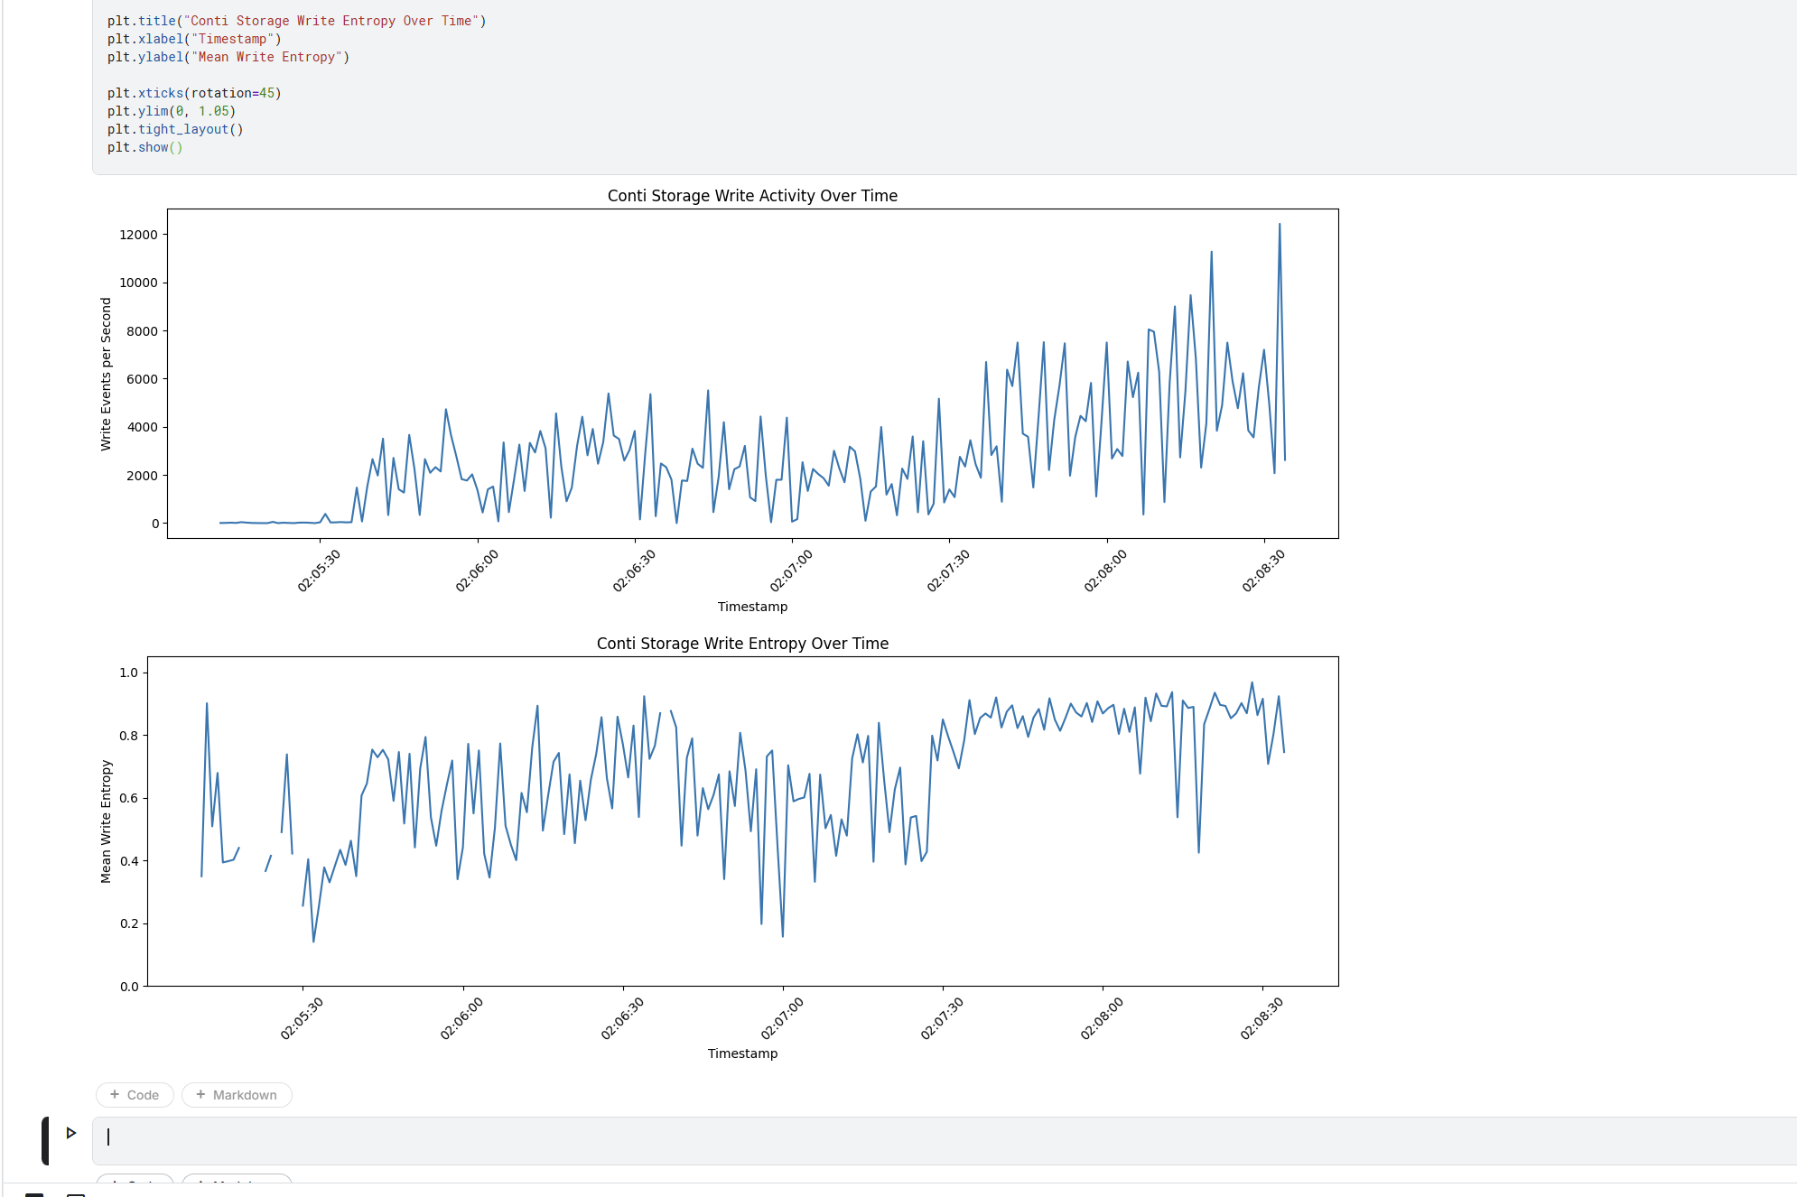
04 • PRIMARY EVIDENCE
Storage Modification Signature
05
554,371
CONTI ATA WRITES
Idle: 4,998
2,108.16 MB
RECORDED VOLUME
Idle: 19.32 MB
12,434/s
PEAK ATA RATE
Idle: 978/s
PRIMARY DISCRIMINATOR
Scale + persistence of storage activity outweigh an isolated peak.
Executed notebook: Conti storage-write activity + write entropy over time
Conti Forensics • Behavioral Evidence Case Study

Slide 6
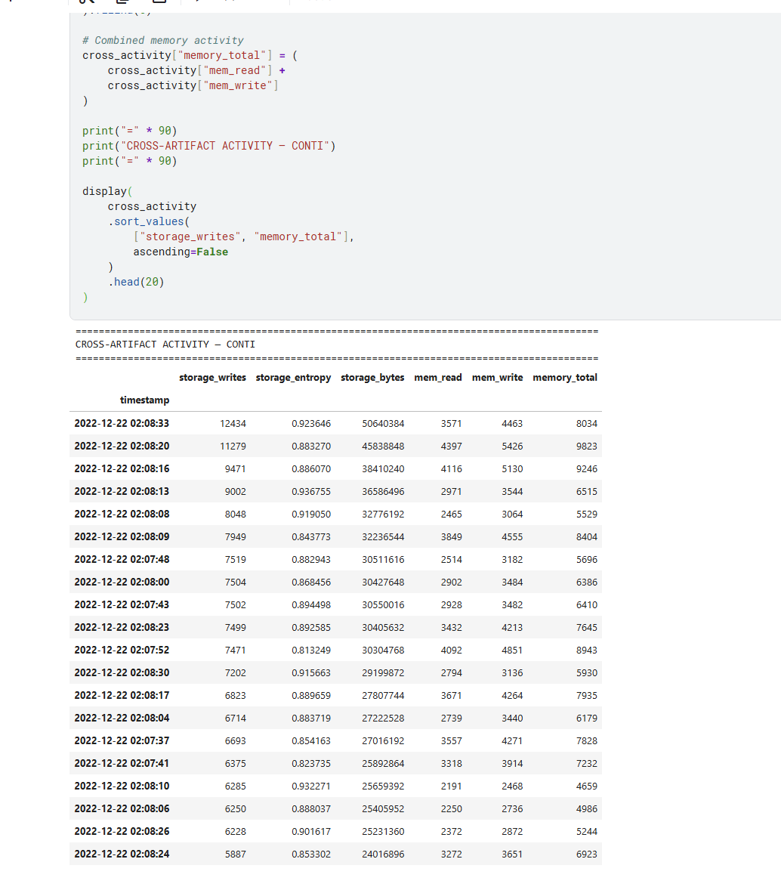
05 • STORAGE FORENSICS
Write Entropy — Strong Enrichment, Not Proof of Encryption
06
ENTROPY PROFILE
Mean entropy
Conti 0.7479
Idle 0.4420
1.69×
Entropy ≥ 0.90
Conti 59.69%
Idle 7.48%
7.98×
Forensic interpretation
High entropy supports a behavioral hypothesis; it is not unique to encryption and must be interpreted with volume, frequency and temporal behavior.
Notebook evidence snapshot
Conti Forensics • Behavioral Evidence Case Study

Slide 7
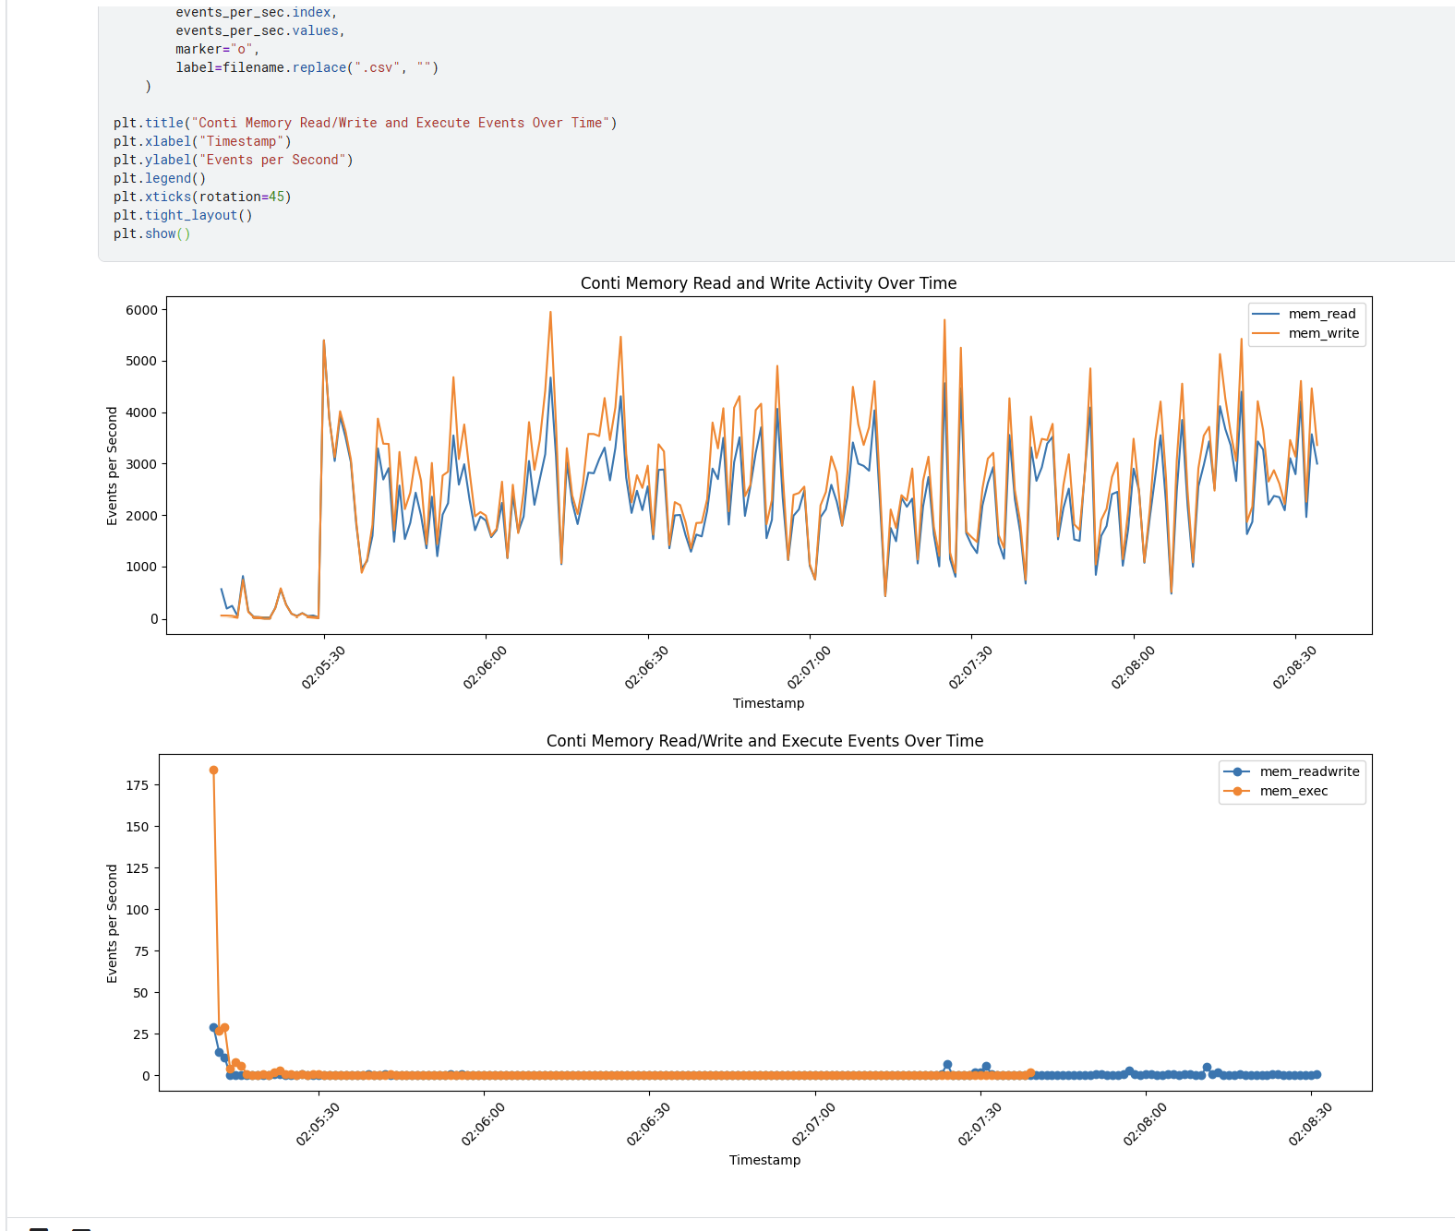
06 • MEMORY FORENSICS
Memory Activity — Elevated on Average, but Peak-Aware
07
CONTΙ MEMORY STREAMS
3.67×
• 446,720 memory-read events
• 518,188 memory-write events
• 105 read/write events
• 273 memory-execution events
• Execution concentrated near 02:05:11
AVERAGE MEMORY READ
4.35×
AVERAGE MEMORY WRITE
184/s
INITIAL EXEC BURST
Idle has higher absolute peak memory-read/write rates. Peak memory alone is therefore not discriminating.
CAVEAT
Executed notebook: memory read/write + execution activity
Conti Forensics • Behavioral Evidence Case Study

Slide 8
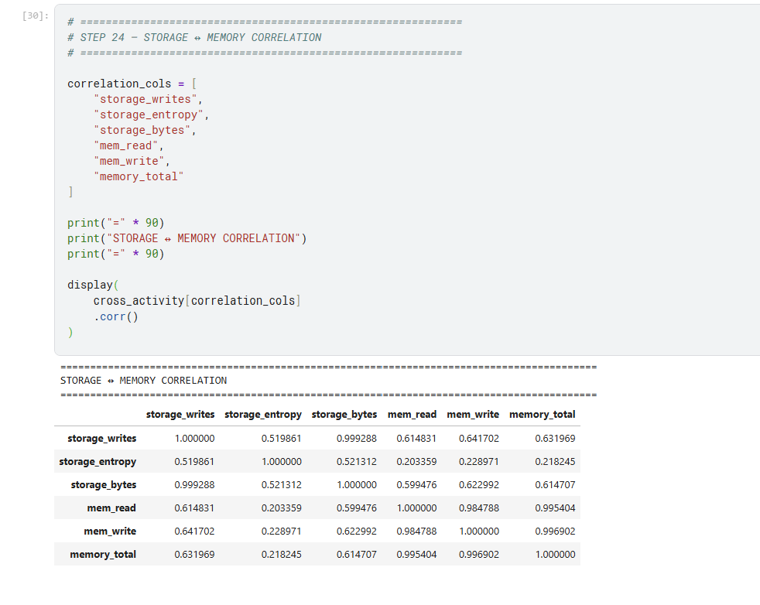
07 • CROSS-ARTIFACT ANALYSIS
Storage ↔ Memory: A Measurable Temporal Relationship
08
0.632
0.615
STORAGE WRITES ↔ TOTAL MEMORY
STORAGE BYTES ↔ TOTAL MEMORY
0.615
0.642
STORAGE WRITES ↔ MEM READ
STORAGE WRITES ↔ MEM WRITE
Interpretation
Positive temporal association supports a combined behavioral picture — not causation.
Executed notebook: storage–memory Pearson correlation matrix
Conti Forensics • Behavioral Evidence Case Study

Slide 9
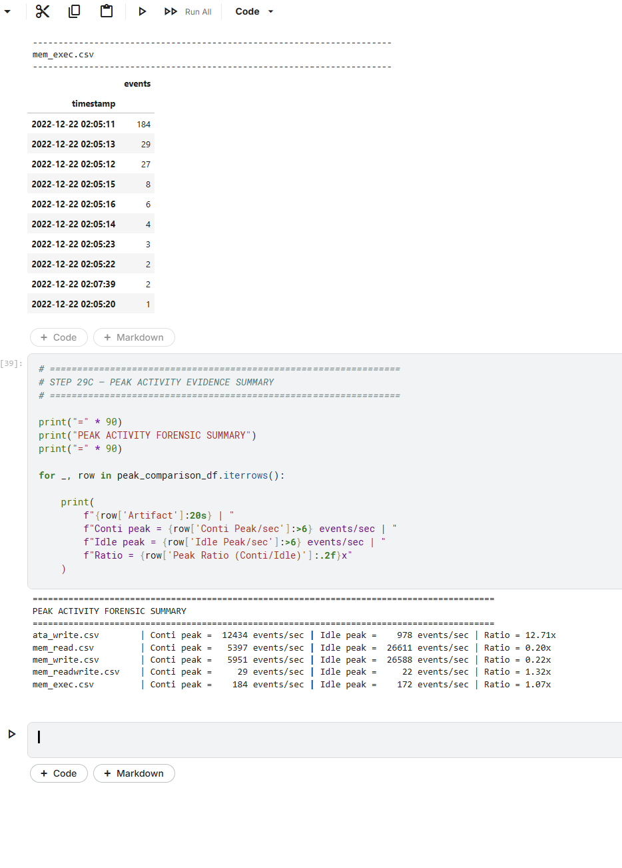
08 • INVESTIGATION TARGETS
High-Intensity Forensic Windows
09
11 candidate seconds
Storage-write activity ≥ 75th percentile
AND mean storage-write entropy ≥ 0.90
02:07:50
02:07:57
02:07:59
02:08:08
02:08:10
02:08:13
02:08:15
02:08:21
02:08:26
02:08:30
02:08:33
These are candidate investigation windows, not confirmed malicious events.
Executed notebook: peak activity evidence summary
Conti Forensics • Behavioral Evidence Case Study

Slide 10
09 • FORENSIC ASSESSMENT
Evidence Matrix — Convergence Across Independent Indicators
10
Indicator
Conti / Idle
Strength
Storage write events
110.92×
VERY HIGH
Storage write volume
109.13×
VERY HIGH
Storage throughput
125.33×
VERY HIGH
Mean storage entropy
1.69×
HIGH
High-entropy writes ≥ 0.90
7.98×
VERY HIGH
Average memory read / write
3.67× / 4.35×
MODERATE
Storage-memory correlation
0.632
MODERATE
Peak ATA write activity
12.71×
VERY HIGH
High-write/high-entropy windows
11 sec
HIGH-VALUE
Forensic principle: no single metric is conclusive; the evidentiary weight comes from convergence.
Conti Forensics • Behavioral Evidence Case Study

Slide 11
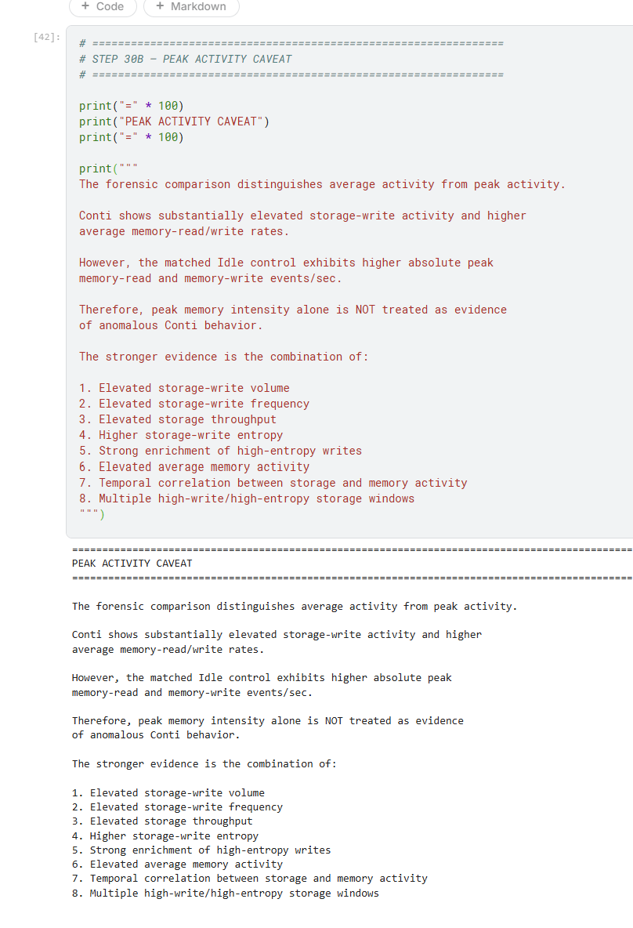
10 • ANALYTICAL DISCIPLINE
Peak Activity Caveat — What the Control Prevents Us From Claiming
11
WHAT WE CAN SAY
• Conti has markedly higher storage-write activity.
• Conti has higher average memory read/write rates.
• Storage and memory activity show positive temporal association.
• Repeated high-write/high-entropy windows exist.
WHAT WE CANNOT SAY
• Peak memory intensity alone proves malicious behavior.
• High entropy alone proves file encryption.
• Correlation proves causation.
• These artifacts alone identify a specific encryption mechanism.
Executed notebook: peak-activity caveat
Conti Forensics • Behavioral Evidence Case Study

Slide 12
11 • CONCLUSION
Final Assessment & Takeaway
12
The Conti execution is behaviorally distinct from the matched Idle control.
The strongest signal is the convergence of extreme storage modification with elevated average memory activity and repeated high-entropy write windows.
110.92×
109.13×
125.33×
7.98×
11 s
WRITE EVENTS
WRITE VOLUME
THROUGHPUT
HIGH ENTROPY
TARGET WINDOWS
FINAL FORENSIC POSITION
Strong behavioral forensic evidence of a high-intensity storage-modification phase accompanied by elevated memory activity — not, by itself, proof of a specific ransomware mechanism.
Conti Forensics • RanSMAP • Conti vs Idle • Presentation

