Slide 1
Police Investigation Management System
Shreya Agarwal, Elizabeth Lagani, Jack Padoleski, Say Lay Paw, Conner Smith, and Liam Sweeney
Faculty Advisor: Dr. Sangwon Yoon
Watson Institute for Systems Excellence
State University of New York at Binghamton
April 7th, 2025

Slide 2
Agenda
Last Meeting Highlights
Progress Updates
Key Updates
Next Steps

Slide 3
Last Meeting Highlights
Enable role-based access (Investigators, Detectives, Supervisors, Admins)
Prevent duplicate case numbers
Mark required fields with *
Show lead chain (max 10 by default, with “View All” option)
Sort leads by descending hierarchy
Add Executive Summary feature in final report + Word upload option
Auto-refresh page on new actions

Slide 4
Progress Update
Tasks | Status | Completion% | Target Completion Date
User Login & Authentication | Completed | 100%
Create Case & Leads | Completed | 100%
Lead Log | Completed | 100%
Lead Returns | Completed | 100%
Lead Hierarchy | Completed | 100%
Report Generation | In Progress | 90% | 07/04/25
Leads Desk | In Progress | 90% | 07/04/25
Notification | In Progress | 90% | 07/04/25
Search Leads | In Progress | 20% | 10/04/25
Filter & Sort | In Progress | 20% | 10/04/25
View Timeline Entries | In Progress | 20% | 10/04/25
Admin Management | In Progress | 50% | 15/04/25
View Chain of Custody | Not Started | 0% | 15/04/25
Cloud Migration | Not Started | 0% | 10/05/25

Slide 5
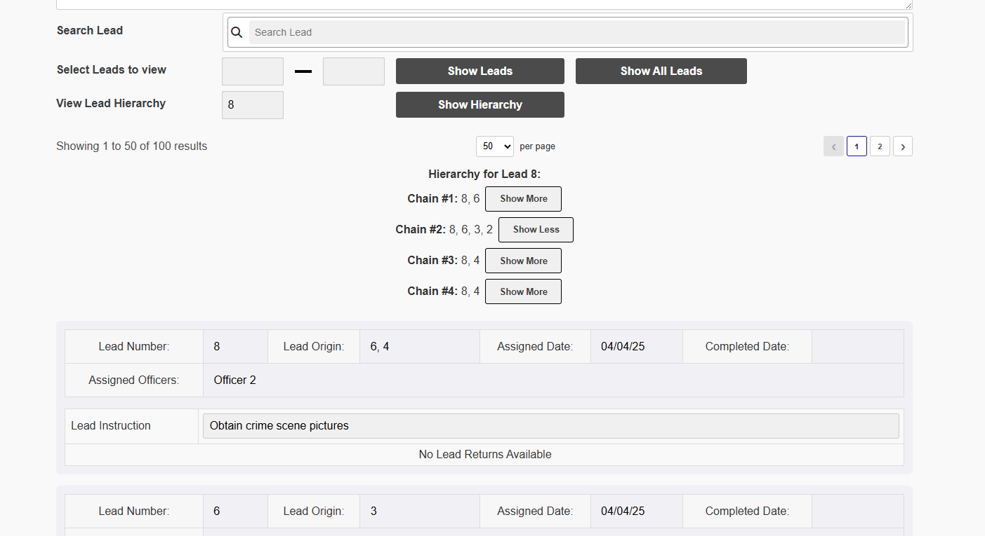
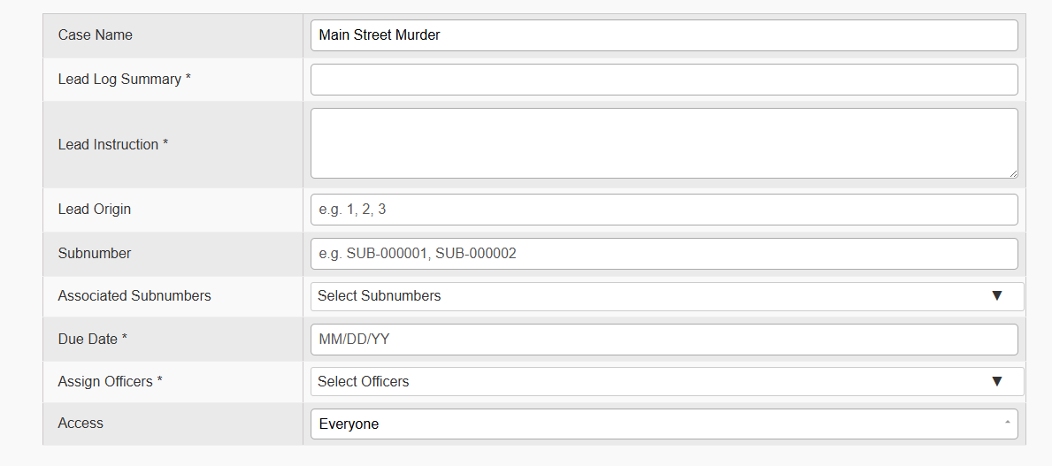
Key Updates
The report, as well as the Leads Desk functionality, has been updated along with fixing some comments from previous meeting

Slide 6
Next Steps
Continue developing the pending functionalities and cloud migration

Slide 7


