Slide 1
Event Correlation & Incident Response Dashboard
Level 2 Internship · Software, AI & Cybersecurity · Project 01
Python · Flask · SQLite · synthetic data only
Notes:
Introduce yourself and the project: a mini-SIEM that correlates logs into prioritised incidents.

Slide 2
The problem: alerts without context
Many sources
Alert fatigue
My goal
Auth, firewall and web logs each show a fragment. An analyst has to stitch them together by hand.
Isolated low-level events bury the one real intrusion. Prioritisation matters.
Normalise logs, correlate across sources, score severity, and present evidence-backed incidents.
Notes:
Why correlation matters. Keep it to 30 seconds.

Slide 3
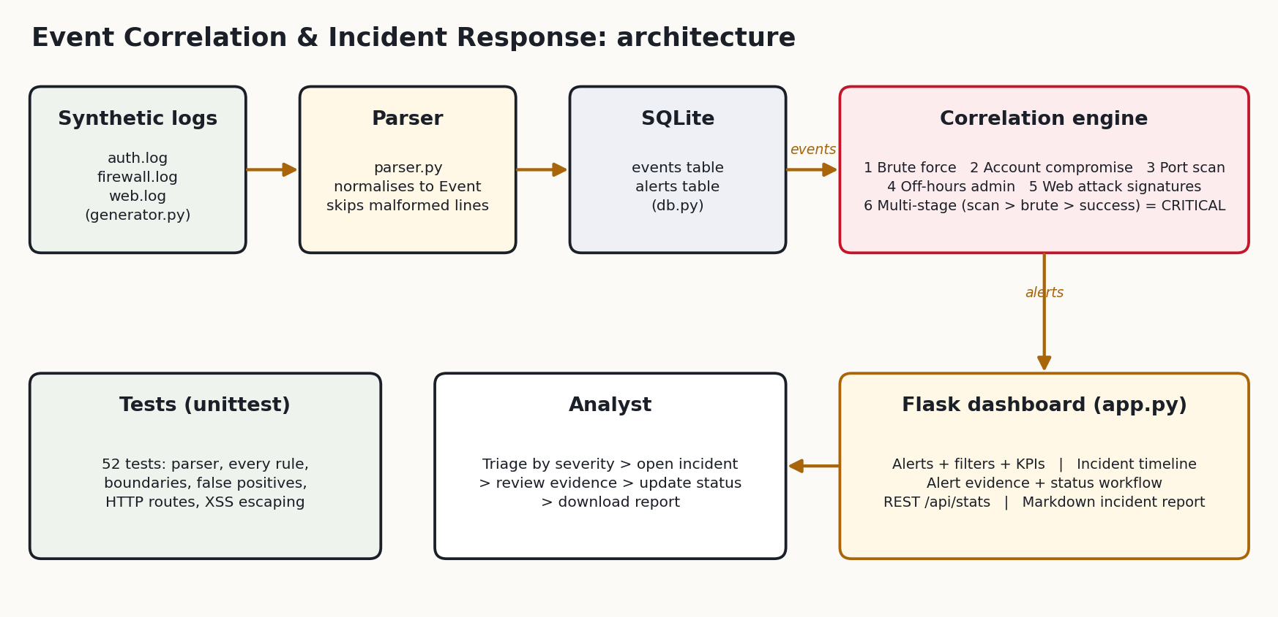
Architecture
Notes:
Walk left to right: logs -> parser -> SQLite -> rules -> alerts -> Flask. Mention tests and the analyst workflow below.

Slide 4
Six detections, one correlated story
Rule | Logic | Score
Brute force | ≥ 5 failed logins from one IP in 120 s | 70–85
Account compromise | Success after ≥ 3 failures in 5 min | 85
Port scan | ≥ 10 distinct ports from one IP in 60 s | 40–70
Off-hours admin | admin/root login outside 08:00–18:00 | 55 / 75
Web attack | SQLi / traversal / XSS in decoded URLs | 45–60
Multi-stage | Scan → brute force → success, same IP | 100
Notes:
The multi-stage rule correlates ALERTS from other rules, not raw logs. That is the showpiece.

Slide 5
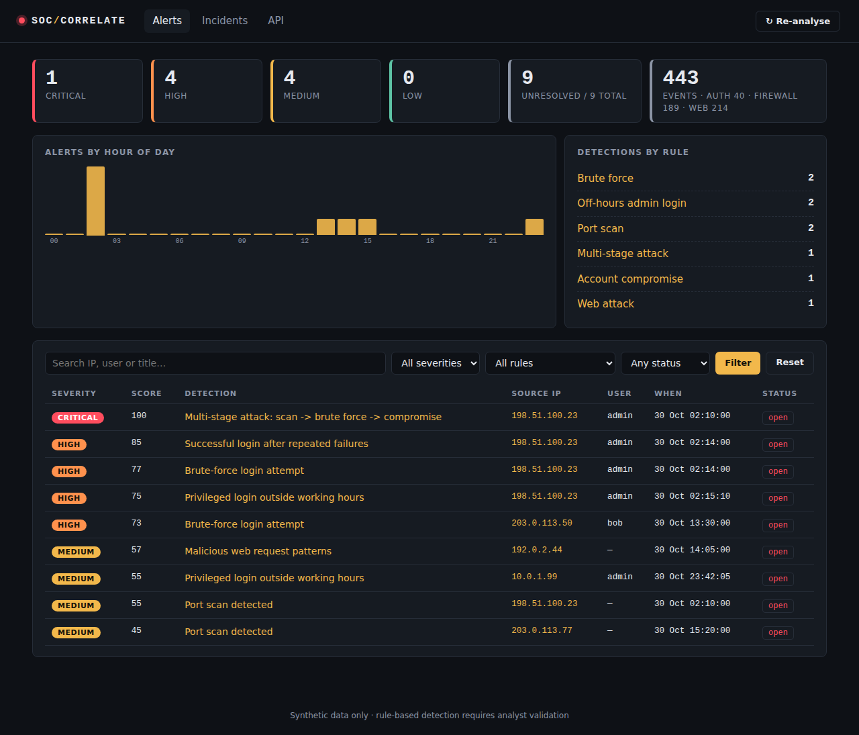
A 3-stage attack becomes one Critical incident
198.51.100.23
02:10 Port scan, 25 ports
02:14 12 failed admin logins
02:15 Admin login succeeds
Score 100 → Critical, with evidence and a downloadable report.
Notes:
Live demo here: click Critical, open the incident timeline, show evidence, change status, download report.

Slide 6
Testing: 52 tests, 0 failures
5
30
17
Parser tests
Rule tests
Integration + HTTP
Each rule tested at, below and above its threshold
Planted attacks found; benign decoys raise no alert (zero false positives)
Malformed logs skipped safely; re-analysis is idempotent
Stored-XSS check: log content is HTML-escaped in the UI
Notes:
Evidence is in docs/test_results.txt.

Slide 7
Limitations and next steps
Limitations
Static, rule-based thresholds; no ML
Batch analysis, not real-time streaming
Per-IP grouping; IP rotation not handled
Local use only: no auth/CSRF
Next steps
Real-time log tailing
Threat-intel and GeoIP enrichment
Baseline anomaly scoring
Wazuh / OpenSearch connectors
Notes:
Being upfront about limits shows maturity. Then thank the reviewers and take questions.

