Slide 1
FPGA-Based CNN Accelerator
Design and Implementation of a 4×4 PE-Based Convolution Engine
MATLAB HDL Coder
Verilog / RTL
Vivado FPGA
Streaming 3×3 RGB convolution • 4 filters • 16 PE lanes
Presented by:
Shreyashree U S
Department: PDMG
Guide: Gaurav Upadhyay

Slide 2
INTRODUCTION
Why FPGA for CNN Acceleration?
From general-purpose computing to application-specific parallel hardware
CPU
GPU
FPGA
General-purpose architecture
Flexible and programmable
Excellent for control and irregular workloads
Limited parallel MAC throughput compared with massively parallel accelerators
CNN inference can involve very large numbers of repeated operations
Thousands of small cores run in parallel
Handles large amounts of image and AI calculations very quickly
Supported by popular AI frameworks out of the box
Focused on maximum speed rather than low power use
Uses a lot of electricity and generates heat
Reconfigurable hardware
Custom datapaths and parallelism
On-chip BRAM and DSP resources
Streaming and pipelined dataflow
Can be tailored to precision, throughput and memory reuse

Slide 3
Objectives
Develop a MATLAB reference model for 3×3×3 RGB convolution.
Generate synthesizable RTL using MATLAB HDL Coder.
Convert the architecture to a streaming implementation using line buffers.
Support four convolution filters and four output values per valid window.
Implement a 4×4 PE-based architecture with 16 PE lanes.
Verify the complete RTL against a software-generated golden reference.
Use Vivado synthesis to analyze LUT, FF, BRAM, DSP and I/O utilization.

Slide 4
Methodology / Design Flow
MATLAB
reference
HDL-compatible
function
HDL Coder
RTL
Streaming
line buffers
4 filters
4×4 PE
architecture
MATLAB + Vivado
verification
Vivado
synthesis
CNN Convolution:
3×3 spatial window
Parallelism → PEs
3 × 3 × 3 = 27
MAC terms / filter
27 × 4 = 108
filter-weight products
3 RGB channels
Reuse → line buffers
4 filters
Pipelining → throughput

Slide 5
Accelerator Architecture
Line Buffer 1
BRAM
PE
PE
PE
PE
PE
PE
PE
PE
RGB Pixel
Input
3×3 RGB
Window
PE
PE
PE
PE
PE
PE
PE
PE
Line Buffer 2
BRAM
4 filter outputs
Y0, Y1, Y2, Y3
Architecture: 2 line buffers → 3×3×3 sliding window → 16 PE lanes → four accumulated outputs.

Slide 6
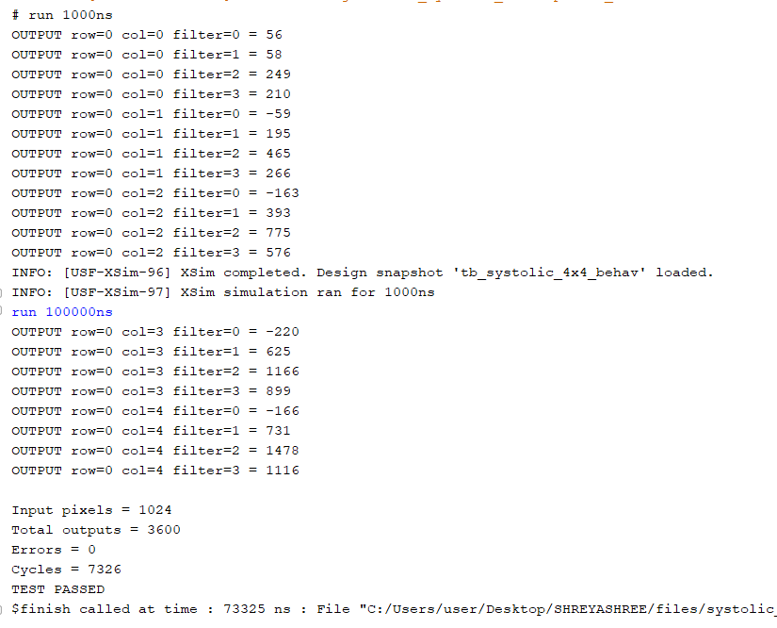
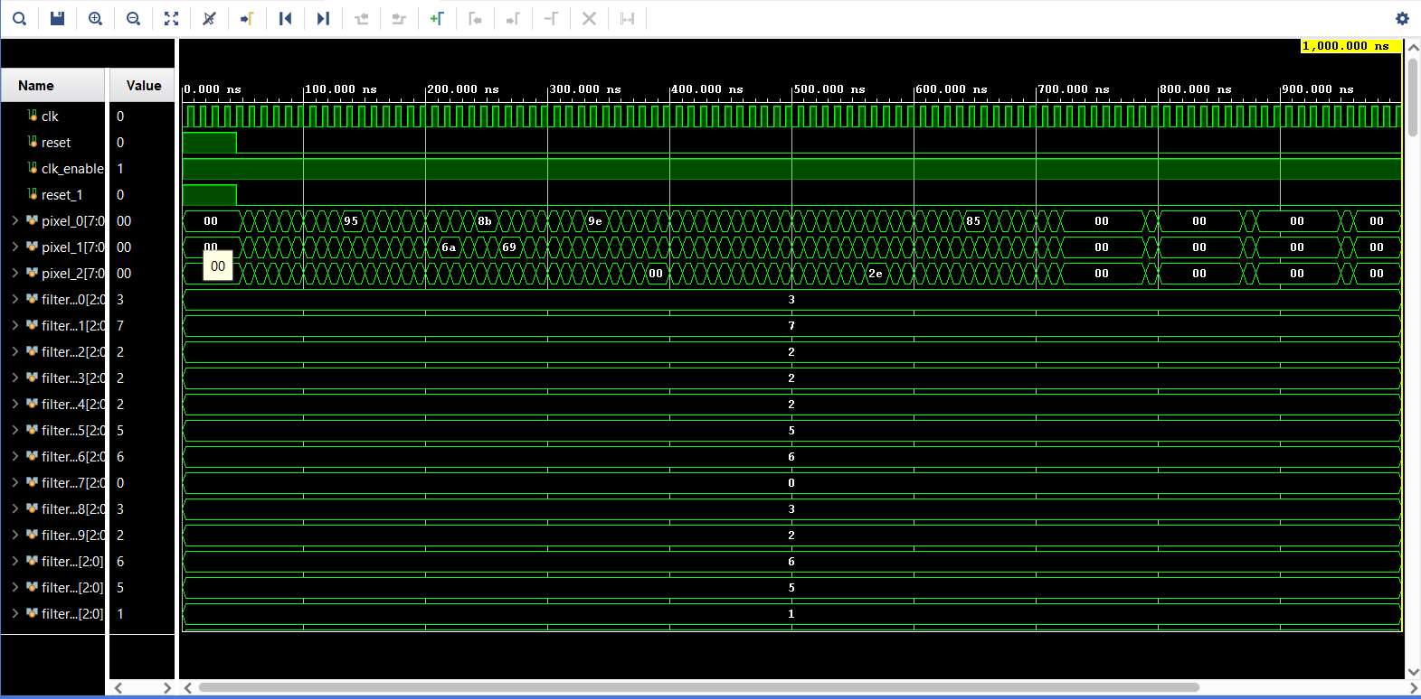
Verification Results
Golden outputs were generated from the software convolution model.
HEX files were used to provide reproducible hardware test vectors.
Vivado simulation compared every valid hardware output with the expected result.
Zero mismatches were observed in the final test.

Slide 7
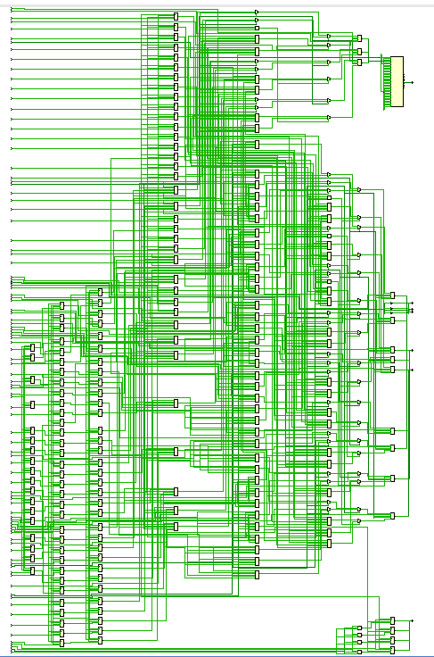
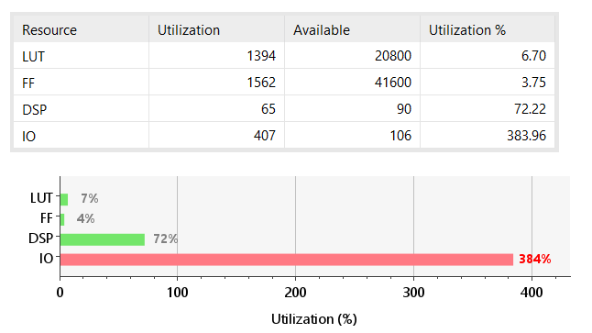
Vivado Synthesis
Vivado Resource Utilization
The 407 I/O count comes from the flattened top-level HDL interface, including many individual filter-weight ports.

Slide 8
Current Status and Future Integration
Completed
Future Work
✓ MATLAB reference model
✓ HDL Coder RTL generation
✓ Streaming line-buffer architecture
✓ Four-filter implementation
✓ 4×4 / 16-PE architecture
✓ MATLAB verification
✓ Vivado RTL simulation
✓ 3600 / 3600 outputs, 0 errors
✓ Vivado synthesis and utilization analysis
→ Weight BRAM interface
→ Weight-register / loader block
→ CPU / AXI control layer
→ Open-source RISC-V integration option
→ Larger PE arrays: 8×8 / 16×16
→ Full CNN layers: ReLU, pooling, multi-layer dataflow
→ Throughput, latency and energy benchmarking

Slide 9
Conclusion
A CNN convolution kernel was translated into synthesizable RTL using MATLAB HDL Coder.
The design was progressively transformed into a streaming architecture with line-buffered image data.
The final accelerator uses a 4×4 PE-based organization with 16 parallel accumulation lanes and four filter outputs.
The RTL was verified against a software-generated golden reference with 3600/3600 outputs correct and zero errors.
Vivado synthesis confirmed FPGA resource usage and enabled DSP-based implementation analysis.
The resulting design provides a foundation for memory-mapped weights, processor control and larger CNN accelerator architectures.
Thank you

