Slide 1
SME Cybersecurity Risk Assessment
Risk Register • Risk Matrix • Case Studies
Based on the NIST Cybersecurity Framework (CSF) 2.0
Internship Project

Slide 2
Project Overview
• Developed a practical cybersecurity risk assessment approach for a small or medium-sized business.
• Identified important business assets, threats, vulnerabilities and existing controls.
• Calculated risk using likelihood × impact and classified the resulting risk level.
• Mapped mitigation activities to the NIST CSF 2.0 Protect function.
• Applied the same assessment approach through two business-focused case studies.
SME Cybersecurity Risk Assessment Framework | 2

Slide 3
NIST CSF 2.0 Approach
Framework used to structure the assessment
Identify
Understand business assets, threats, vulnerabilities and risk.
Protect
Select safeguards and mitigation measures.
Assess
Compare original risk with residual risk after mitigation.
• The assessment focuses on practical risk reduction rather than only listing cybersecurity threats.
• The completed register uses the NIST CSF Function field to connect risks with the selected response.
SME Cybersecurity Risk Assessment Framework | 3

Slide 4
Risk Assessment Methodology
1. Identify
Business area and asset
2. Analyze
Threat and vulnerability
3. Score
Likelihood × impact
4. Treat
Recommended mitigation
5. Reassess
Residual risk
• Likelihood and impact are scored on a 1–5 scale.
• Risk score = Likelihood × Impact.
• Residual risk is recalculated after the proposed mitigation is applied.
SME Cybersecurity Risk Assessment Framework | 4

Slide 5
Risk Register
Five representative cybersecurity risks were assessed
Risk ID
Threat
Likelihood
Impact
Risk Score
Risk Level
R001
Phishing
4
5
20
Critical
R002
Ransomware
4
5
20
Critical
R003
Insider Threat
3
4
12
High
R004
Unauthorized Access
3
4
12
High
R005
Data Breach
3
5
15
High
SME Cybersecurity Risk Assessment Framework | 5

Slide 6
Risk Matrix
Likelihood and impact determine the risk score
Impact 1
Impact 2
Impact 3
Impact 4
Impact 5
Likelihood 5
5
10
15
20
25
• Critical risks: 16–25
• High risks: 10–15
• Moderate risks: 5–9
• Low risks: 1–4
Likelihood 4
4
8
12
16
20
Likelihood 3
3
6
9
12
15
Likelihood 2
2
4
6
8
10
Likelihood 1
1
2
3
4
5
SME Cybersecurity Risk Assessment Framework | 6

Slide 7
Risk Treatment & Residual Risk
Risk ID
Risk Score
Risk Level
R001
20 → 8
Critical → Moderate
R002
20 → 8
Critical → Moderate
R003
12 → 6
High → Moderate
R004
12 → 3
High → Low
R005
15 → 8
High → Moderate
• Mitigations reduce likelihood and/or impact rather than eliminating risk completely.
• The assessment therefore records both the original risk and the remaining residual risk.
SME Cybersecurity Risk Assessment Framework | 7

Slide 8
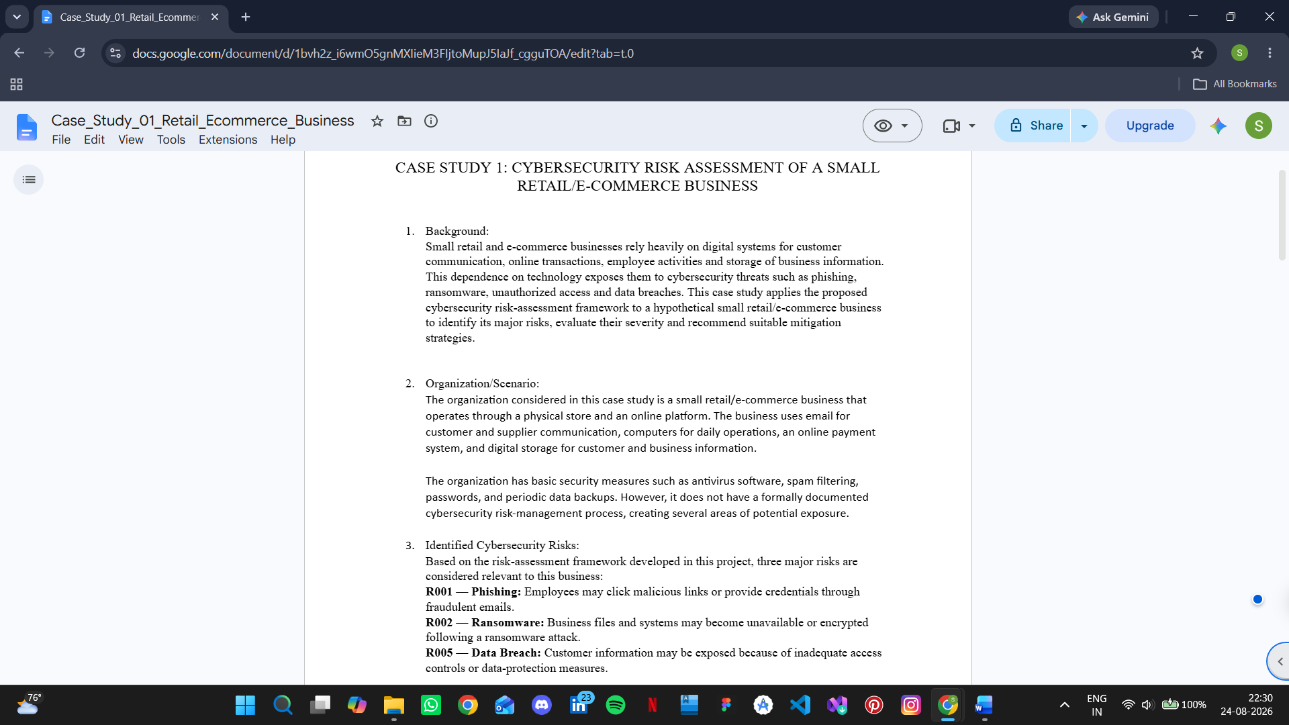
Case Study 1 — Retail / E-commerce Business
Scenario
A retail/e-commerce business was assessed using the same risk identification, scoring, treatment and residual-risk approach used in the SME assessment.
• Business assets and operational dependencies were considered.
• Cybersecurity threats and vulnerabilities were evaluated against existing controls.
• Mitigation measures were selected to reduce the highest-priority risks.
• The exercise demonstrated how the framework can be adapted to an online-facing business.
SME Cybersecurity Risk Assessment Framework | 8

Slide 9
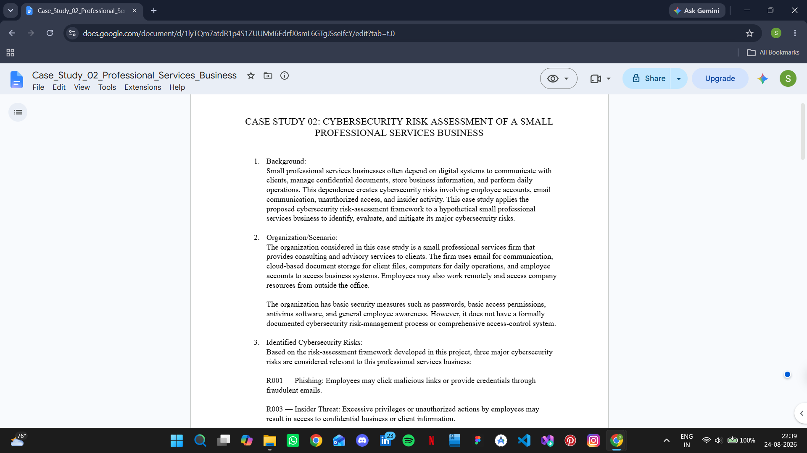
Case Study 2 — Professional Services Business
Scenario
A professional services business was assessed using the same structured cybersecurity risk assessment method, with attention to information, user access and business operations.
• Key assets and information-handling activities were considered.
• Threats and vulnerabilities were linked to realistic business processes.
• Controls and mitigation actions were selected according to the identified risks.
• The case study showed how the framework can be applied outside an e-commerce environment.
SME Cybersecurity Risk Assessment Framework | 9

Slide 10
Key Lessons Learned
• Risk assessment is more useful when risks are tied to specific business assets and processes.
• Likelihood and impact provide a simple way to prioritize cybersecurity risks.
• Mitigation should focus first on higher-risk areas and practical controls.
• Residual-risk assessment shows whether the proposed controls meaningfully reduce exposure.
• The NIST CSF provides a structured way to communicate cybersecurity priorities.
SME Cybersecurity Risk Assessment Framework | 10

Slide 11
Conclusion
Outcome
The project produced a practical SME cybersecurity risk assessment consisting of a risk register, risk matrix, mitigation planning, residual-risk evaluation and two applied case studies.
• The completed work demonstrates a repeatable approach for identifying, prioritizing and reducing cybersecurity risks.
• The framework can be adapted to different types of small and medium-sized businesses.
SME Cybersecurity Risk Assessment Framework | 11

Slide 12
References
• NIST Cybersecurity Framework (CSF) 2.0 — NIST SP 1299 / CSWP 29
• NIST Cybersecurity Framework 2.0: Small Business Quick-Start Guide — NIST SP 1300
• NIST Cybersecurity Framework 2.0: Resource & Overview Guide — NIST SP 1299
• CISA / StopRansomware Guide
• NIST Digital Identity Guidelines: Authentication and Authenticator Management — SP 800-63B
• NIST Cybersecurity Framework 2.0 for Small Business — NIST Small Business Cybersecurity Corner
SME Cybersecurity Risk Assessment Framework | 12

