Slide 1
MACHINE LEARNING IN GENOMICS
RNA-to-Protein
Expression Prediction
Predicting protein abundance from single-cell RNA sequencing data
using classical ML and Graph Neural Networks
Team 37 | Emily Beermann · Shreya Gouri · Vaishnavi Chennakeshav · Pallavi Mallepura Kadirappa · Priya Priya
github.com/shreya-g3/team-37

Slide 2
PROBLEM & DATASET
What are we predicting?
166,186
18,000+
44
Single Cells
RNA Features
Protein Targets
Human PBMC multiome dataset
Gene expression measurements
Antibody-derived tags (ADT)
The Challenge
RNA sequencing is cheap and scalable. Measuring proteins directly (via CITE-seq) is expensive. The goal is to build a model that accurately predicts protein abundance from RNA measurements alone — enabling protein-level insights at RNA-seq cost.
Evaluation metric:
Pearson correlation (r) per protein, averaged across all proteins and cross-validation folds.

Slide 3
DATA PREPROCESSING
From raw counts to model-ready features
1
2
3
4
Load
Data
Normalise
RNA
CLR Proteins
HVG Selection
Load RNA & protein
.h5ad AnnData files
normalize_total (10K)
+ log1p transform
Centred log-ratio norm
per cell
2,000 highly variable
genes selected
5-Fold Cross-Validation Split
Fold 1: 132,949 train | 33,237 test
Fold 2: 132,949 train | 33,237 test
Fold 3: 132,949 train | 33,237 test
Fold 4: 132,949 train | 33,237 test
Fold 5: 132,949 train | 33,237 test
Stratified by cell type · random_state=42 · same splits used across ALL models

Slide 4
MODELS EXPLORED
Classical ML to Graph Neural Networks
Baseline
Classical
Lasso V2
ElasticNet V2
Baseline · L1 regularization (MultiTaskLasso)
PCA features (256 dims) · log1p targets · α=0.05
L1+L2 combined regularization · α=0.05, l1_ratio=0.7
Sparse protein prediction on PCA features
Deep
Primary
MLP
GNN ★
Multi-layer perceptron · 30 epochs · MSE loss
Log1p targets · PCA features (256 dims)
Graph Neural Network · 50 epochs · SpatialGraphSAGE
Cell graph · neighbor message passing · log1p targets

Slide 5
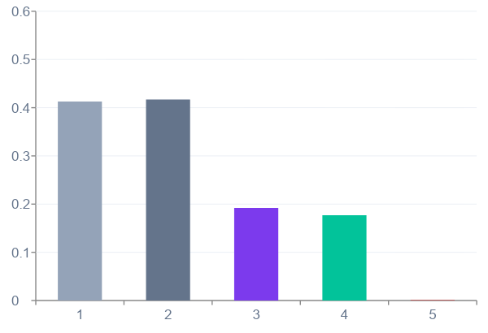
MODEL RESULTS
Performance comparison across all trained models
0.417
ElasticNet V2 · Best Train Pearson r
α=0.05 · l1_ratio=0.7 · PCA features
GNN — 50 Epochs
Train Pearson r: 0.177 Valid Pearson r: 0.001
MLP — 30 Epochs
Train loss ↓ 21.8M → 19.9M | Val loss ↓ 337M → 327M

Slide 6
PRIMARY MODEL · GNN
Graph Neural Network — 50 Epochs
TRAINING SET
0.1774
−7.90
4,471
4,092
Pearson r
R²
RMSE
MAE
VALIDATION SET
0.0008
−3.02
24,407
21,148
Pearson r
R²
RMSE
MAE
Observation: Large train/valid gap indicates overfitting on the cell similarity graph. The model learns training-set patterns but does not generalise to held-out cells. Next steps: add dropout, reduce LR, try mini-batch training, increase graph connectivity.

Slide 7
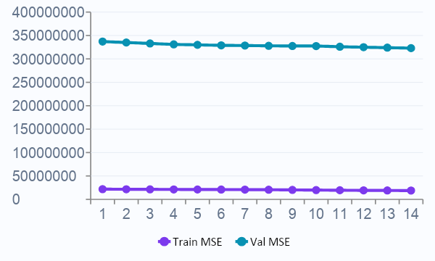
MLP & BASELINE RESULTS
MLP 30-epoch training · Lasso baseline
MLP — 30 Epochs
Lasso & ElasticNet — Baselines
Training & Validation Loss (MSE)
Baseline
Lasso V2 (L1 · PCA features)
0.413
0.002
Train Pearson r
Valid Pearson r
0.192
−6.24
Train R²
Valid R²
ElasticNet V2 (L1+L2 · PCA features)
Train Pearson r: 0.417 Valid Pearson r: 0.002 α=0.05 · l1_ratio=0.7 · max_iter=500

Slide 8
MODEL EVALUATION
Computed metric results — all 4 models
Model
Split
Pearson r
R²
RMSE
MAE
Train Pearson r
Lasso V2
Train
0.413
0.192
—
—
ElasticNet
0.417
(Baseline)
Valid
0.001
−6.24
21,320
17,979
Lasso
0.413
ElasticNet V2
Train
0.417
—
—
—
MLP
0.192
(α=0.05, L1+L2)
Valid
0.002
−2.04
21,300
17,964
GNN ★
0.177
MLP
Train
0.192
—
—
—
(30 epochs)
Valid
0.001
—
—
—
GNN ★
Train
0.177
−7.90
4,471
4,092
(Primary · 50ep)
Valid
0.001
−3.02
24,407
21,148
★ GNN is the primary model. RMSE/MAE on log1p protein scale (not normalised). Lasso/EN/MLP RMSE & MAE not captured in terminal output.

Slide 9
TECHNICAL ARCHITECTURE
Engineering decisions & implementation
Shared CV Splits
Codebase
1
All models use the same 5 stratified folds (random_state=42) ensuring fair comparison
Python
68.7%
Dimensionality Reduction
Jupyter Notebooks
31.3%
2
TruncatedSVD / PCA on 18K+ gene features → 256 dims for deep models
Feature Engineering
3
2,000 highly variable genes selected via cell_ranger flavor; subset saved for reproducibility
Pipeline Summary
Raw RNA/Protein data
→ Preprocessing (HVG, CLR)
→ 5-fold CV split
→ Model training & eval
→ Submission predictions
Scaling Strategy
4
StandardScaler fit on training fold only; transform applied to validation — prevents leakage

Slide 10
CONCLUSIONS & NEXT STEPS
What we learned — and where we're headed
Key Findings
Next Steps
ElasticNet V2 achieves best train Pearson r = 0.417; Lasso V2 baseline at 0.413
GNN (primary model): train Pearson = 0.177, valid = 0.001 — clear overfitting gap
MLP training loss decreases steadily over 30 epochs — further tuning needed
Lasso baseline confirms that simple L1 models set a useful lower bound
HVG selection (2K genes) effectively compresses the 18K+ feature space
Tune GNN: add dropout, reduce LR, try mini-batch training & more epochs
Run full cross-validated Lasso/ElasticNet with PCA features
Extend GNN training (100+ epochs) with learning rate scheduling
Hyperparameter search for MLP (depth, width, learning rate schedule)
Ensemble ElasticNet V2 + GNN predictions for improved Pearson r

