Slide 1

IRBM: PROTEIN EXPRESSION PREDICTION FROM RNA
EMILY BEERMANN, SHREYA GOURI, VAISHNAVI CHENNAKESHAV, PALLAVI MALLEPURA KADIRAPPA, PRIYA PRIYA

Slide 2
THE PROBLEM AND CHALLENGES
The problem: Protein expression profile is expensive and technically challenging compared to transcriptomics. Predicting protein expression from RNA-sequencing could provide a cost-effective alternative.
Challenges:
Post-translational regulation of proteins affects how reliably proteins can be predicted from rna - expect no model to perform extremely well
Large dataset with many zero values - noisy input signals make it harder for models to learn rna-protein relationship
Spatiality - add neighbourhood mean gene expression feature to simpler models, GNN handles spatiality intrinsically

Slide 3
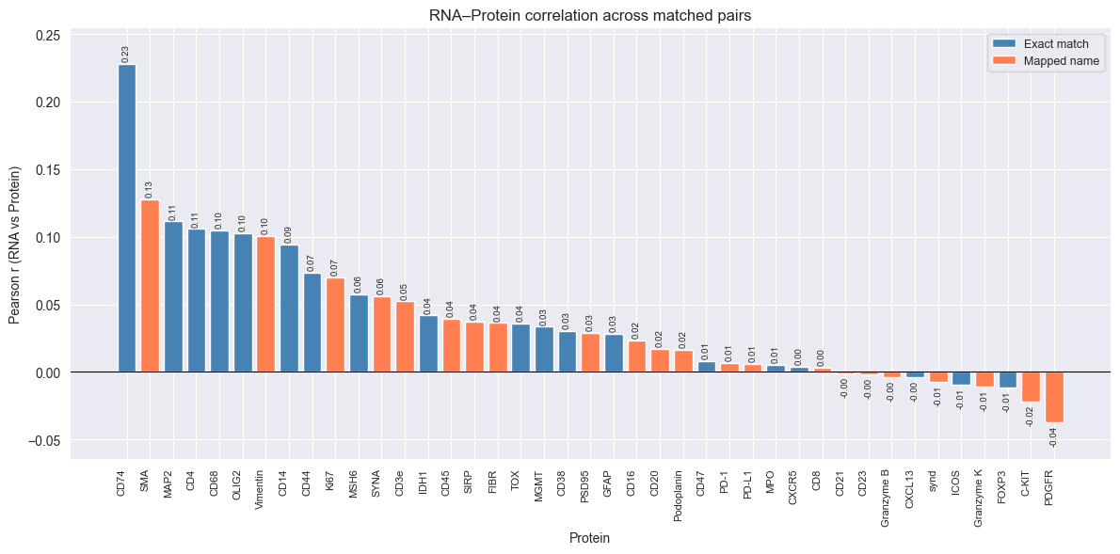
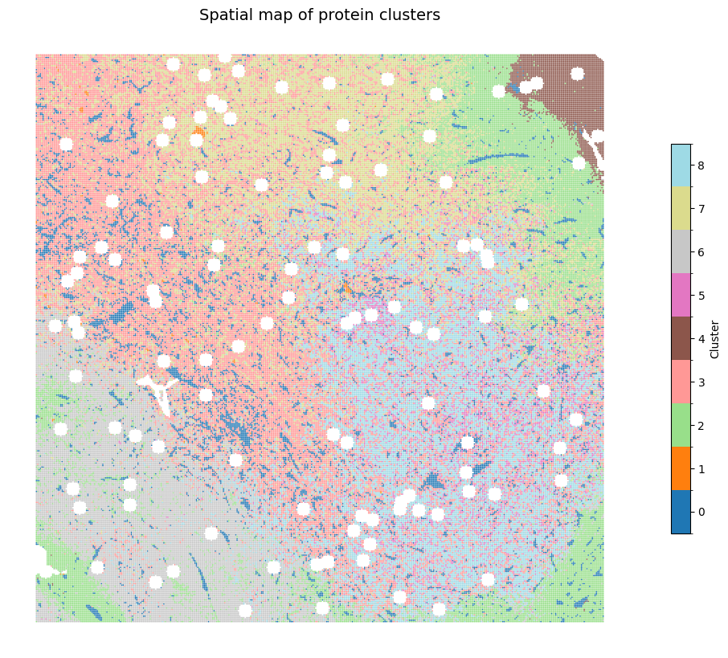
EDA RNA-PROTEIN CORRELATION + PROTEIN CLUSTERING

Slide 4
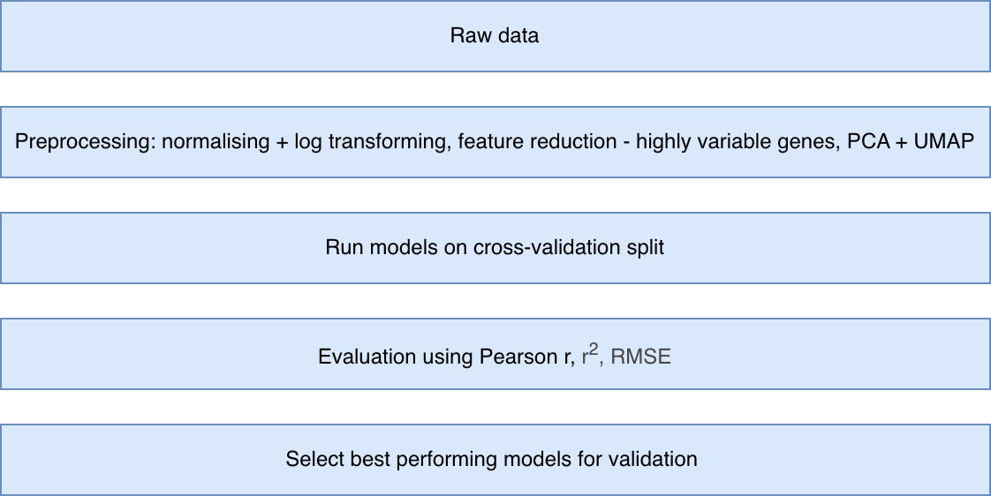
MODEL SELECTION PIPELINE

Slide 5
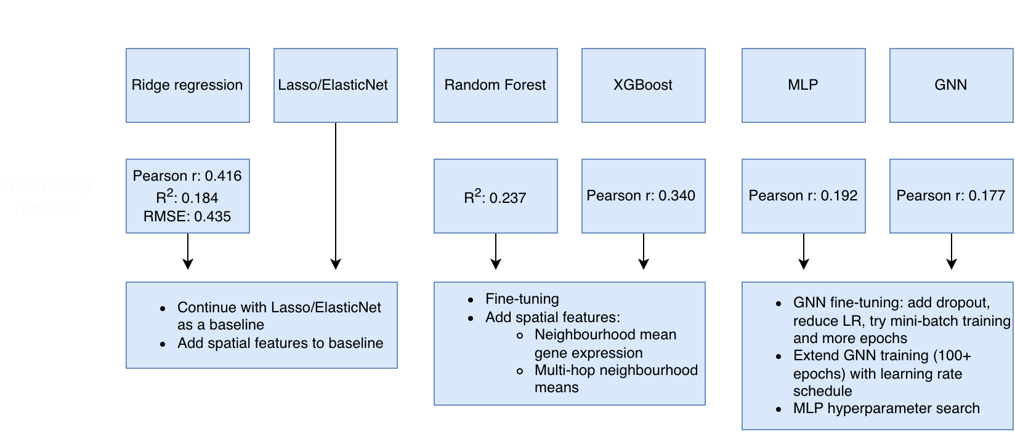
CURRENT MODELS

Slide 6
NEXT STEPS
Establish Lasso/ElasticNet baseline metrics for comparison
Fine-tune tree based models + neural networks
Run cross-validation for all models + evaluate using pearson r, r², RMSE
Add spatial features to tree-based models and compare performance
Select best performing models for validation

