Slide 1
Fake News Detection

Slide 2
PROJECT ORGANISATION-TEAM MEMBERS
NAME | BRANCH | YEAR | MODELS
SHREYA SHANKAR | CSE | 1 | Naive Bayes
SURBHI SAWAN | CSE | 1 | SVM
PRIYANSHI SRIVASTAVA | CO | 1 | Neural Network using TensorFlow
VIDUSHI BHATNAGAR | CO | 1 | Neural Network using Keras
LAVANYA SAXENA | IT | 1 | LSTM
PRANJALI SRIVASTAVA | IT | 1 | Doc2Vec model

Slide 3

Problem Statement
⧫ Develop a machine learning program to identify fake/unreliable news based on content acquired.
Notes:
From a pragmatic engineering and research point of view, Fake news is a too general and too vague problem to address directly.
For this reason, it is split into smaller, more approachable problems: Fact Checking, Source credibility and Trust, News bias and Misleading headlines.

Slide 4
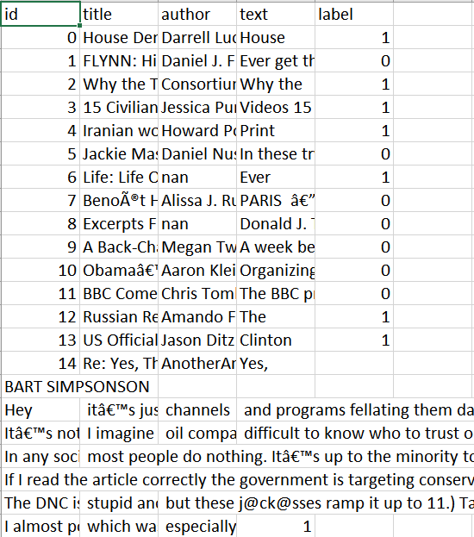
Data
⧫ Dataset source - Kaggle
⧫ ID, Title, Author, Text, Label
⧫ Label 1 - Unreliable
⧫ Label 0 - Reliable

Slide 5
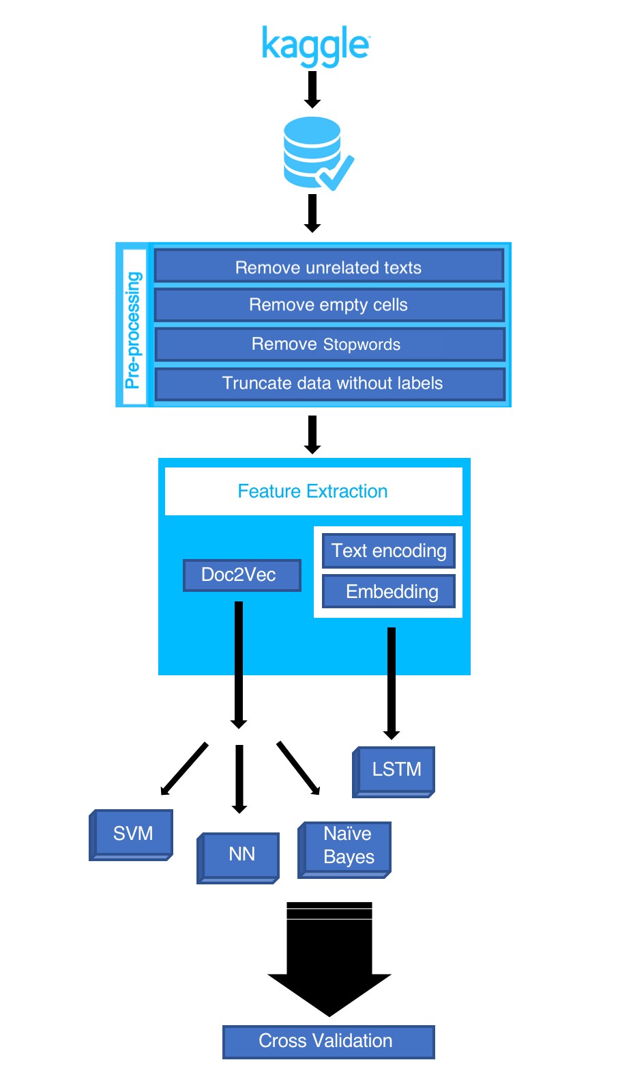
Workflow

Slide 6
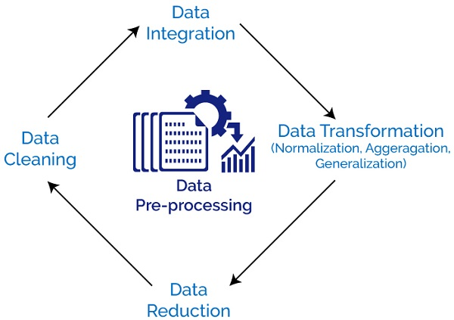
Data Preprocessing
Perform various text cleaning steps (remove all non-alphanumeric characters, delete stopwords, delete missing rows, etc.)
For Doc2Vec, convert to LabeledSentences(), comma separated word format

Slide 7
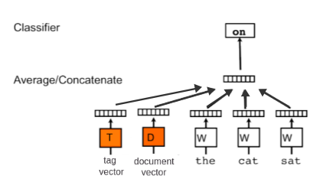
Doc2Vec Model
⧫ Based on Word2Vec model
⧫ Preserves word order information
⧫ Extracts Word2Vec features and adds an additional “document vector” with information about the entire document

Slide 8
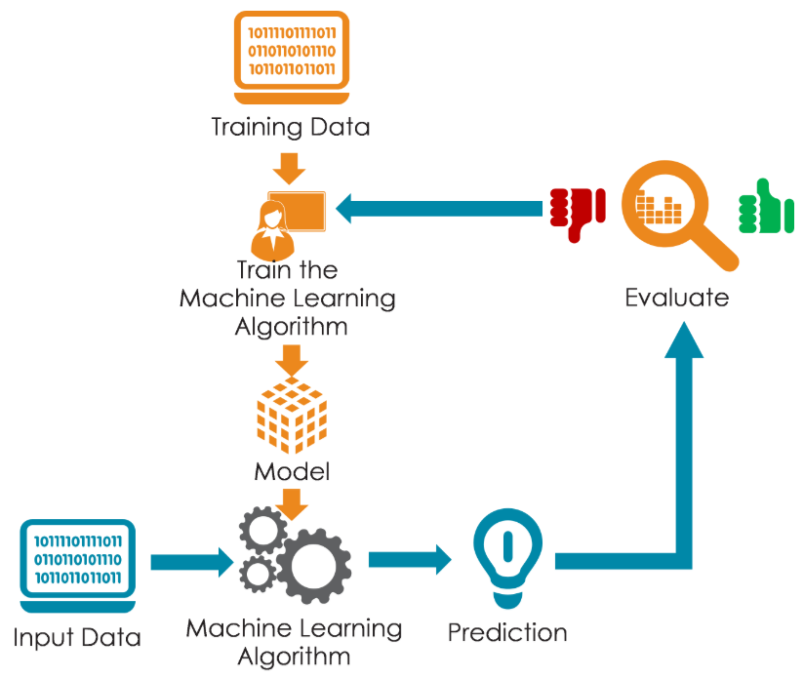
Training a Model
⧫ Models used-
Naive Bayes
Support Vector Machine (SVM)
Neural Network
Long Short-Term Memory (LSTM)

Slide 9
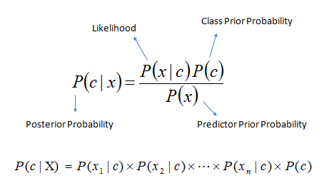
Naive Bayes
⧫ Classification technique based on Bayes’ theorem with an assumption of independence among predictors
1. Convert data set into a frequency table
2. Create likelihood table by finding probabilities
3. Use Naive Bayesian equation to calculate posterior probability for each class

Slide 10
Support Vector Machine (SVM)
SVM with
Radial Basis Function kernel
Prediction
Feature Vector

Slide 11
Neural Network
Hidden Layers
Feature Vector
Prediction Output
300
300
300
300

Slide 12
Neural Network
TensorFlow
Hidden Layer Structure
(300, 300)
(300, 300, 300)
Learning rate:
0.001
Training Steps:
20000
Keras
Hidden Layer Structure
(256, 256, 80)
Learning rate:
0.01
Training Steps:
10000

Slide 13
LSTM
Fully Connected Layer
LSTM
Prediction
Encode
Embed
Text
Numeric Sequence
Feature Vector
Truncate

Slide 14
Comparison of Models
Model | Accuracy
Naive Bayes | 72.94%
SVM | 88.42%
Neural Network using TensorFlow | 81.42%
Neural Network using Keras | 92.62%
LSTM | 94.53%

Slide 15
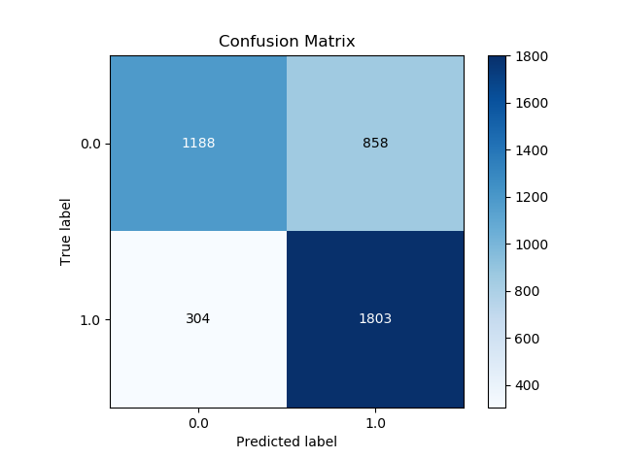
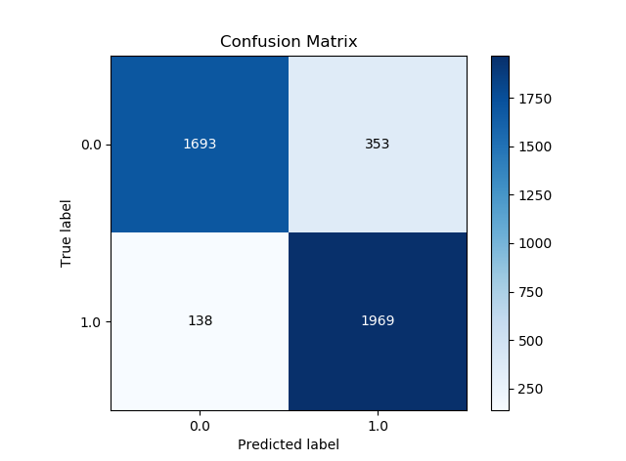
Confusion Matrices
Naive Bayes
SVM

Slide 16
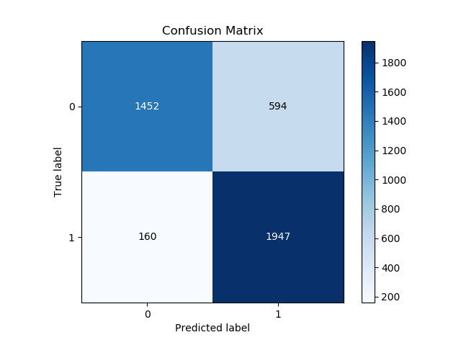
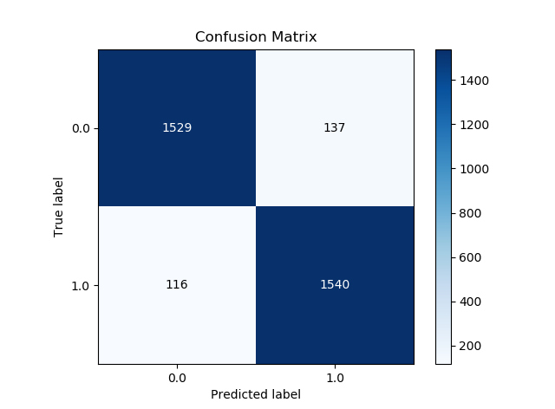
Confusion Matrices
Neural Network using TensorFlow
Neural Network using Keras

Slide 17
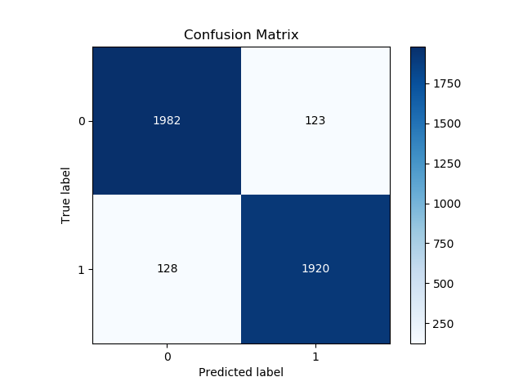
Confusion Matrices
LSTM

Slide 18
Project Timeline
 |  | Started learning basic python
10 April | 17 April | 24 April | 1 May | 8 May | 15 May | 22 May | 29 May | 5 June | 12 June | 19 June | 26 June
Task 1
5 days
Task 2
Learned Statistics and probability
Task 3
4 days
5 days
Task 4
6 days
Learned Statistics and probability
Task 5
5 days
Learned NLP
Learned NLP
Task 6
7 days
TRAINED MODELS
Task 7
10 days
Task 8
10 days
Completed models
Project start
We’re here
Project end
Milestone 1
Milestone 2
Milestone 3
Milestone 4

Slide 19
Details of Programming language and libraries used
Python 3.6+
Numpy
Tensorflow
Gensim
Pandas
Nltk

Slide 20
References
⧫ Fake News Detection: A Data Mining Perspective
⧫ Fake News Identification - Stanford CS 229
⧫ BS Detector
⧫ Datasets from Kaggle

Slide 21
Links for Project Repository
GITHUB Link: ……………………………………………………………………………………………………………..
https://github.com/shreya-jpg/fake-news-analysis

