Slide 1
My Bank Banking Application Team : Asset Avengers Module : Loan Application

Slide 2
Overview
Loans module allows users to view all the available loans in the bank .
As well as search particular loans by loanType.
It also allows user to calculate EMI.
And provide a user- friendly responsive user interface.
It also allows the users to apply for loans.

Slide 3
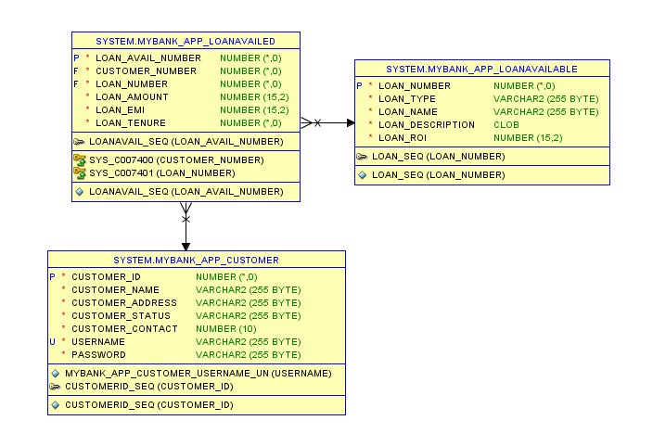
Database
Design

Slide 4
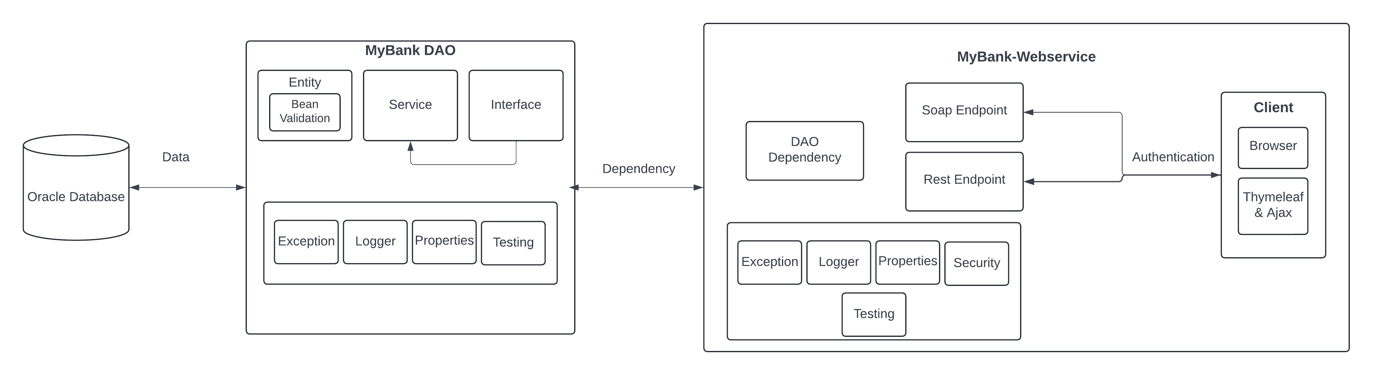
Project Structure

Slide 5
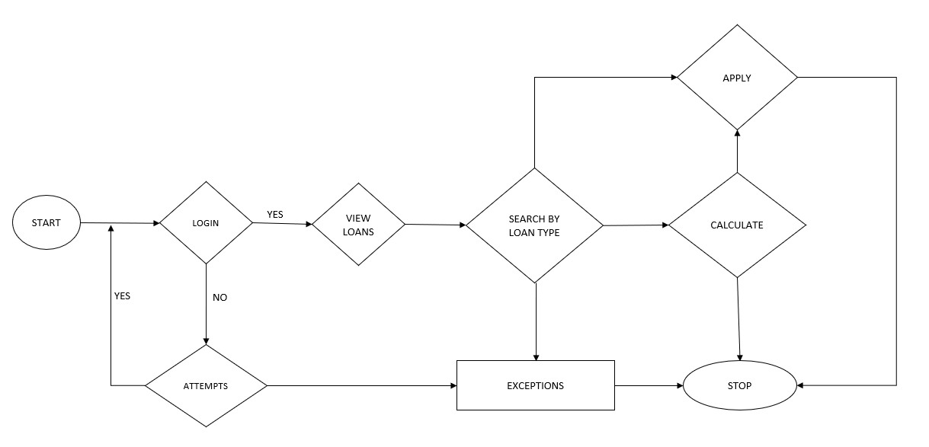
Data Flow Diagram

Slide 6
Thankyou

