Slide 1
Optimization of Mechanical Ventilation in ARDS
Shreya Singal
Mentor: Prof. Vibhor Pandhare

Slide 2
Problem statement
Patients with brain injury (BI) often require mechanical ventilation to maintain adequate oxygenation. If these patients develop ARDS, lung damage significantly impairs gas exchange.
Selecting appropriate ventilator parameters is challenging because:
incorrect settings can reduce oxygen delivery
severe lung damage limits gas exchange
ventilation strategies must balance oxygenation and lung protection
Objective
To study how ventilator settings and ARDS severity influence respiratory physiology

Slide 3
Motivation
Why Mechanical Ventilation in ARDS?
ARDS affects 10% of all ICU admissions and up to 23% of all mechanically ventilated patients
Mortality ranges from 35–46% even with treatment
When combined with Brain Injury, outcomes worsen significantly — BI impairs the brain's ability to control breathing, making ventilator dependence more severe
Why is setting selection hard?
BI and ARDS impose conflicting demands — ARDS needs high PEEP to keep lungs open, but high PEEP can raise intracranial pressure in BI patients
Wrong settings cause barotrauma (lung damage from pressure), volutrauma (from excess volume), or hypoxia
Clinicians currently rely entirely on experience and general protocols — no personalized guidance exists for BI+ARDS patients

Slide 4
Objectives and Workflow
Simulate 3,888 patient-ventilator combinations using the Pulse Physiology Engine across varying BI and ARDS severities to generate a comprehensive physiological dataset
Design an ARDS-specific health score function based on clinical guidelines (ARDSNet) that converts 8 measured vitals into a single interpretable outcome metric
Train and compare 9 ML models to identify the best surrogate model for predicting patient health score from ventilator settings — separately for Pressure Control and Volume Control modes
Optimize ventilator settings using grid search over the full action space to find the setting combination that maximizes predicted health score for each of the 6 severity combinations
Deploy findings as an interactive clinical decision support tool via Streamlit

Slide 5
Literature Review
Study | What They Did | Gap My Work Fills
ARDSNet Trial, NEJM 2000 | Established lung-protective ventilation — low TV (6 mL/kg), PEEP titration reduces ARDS mortality | Protocol is generalized — not personalized to individual severity or co-morbidity like BI
LUNG SAFE Study, JAMA 2016 | 29,144 patients across 50 countries — ARDS affects 23% of ventilated patients, mortality 35–46% | Observational only — does not optimize settings or account for BI co-occurrence
Ventilatory Management of ALI, JAMA 2002 | Clinical review of PC vs VC strategies in ARDS | Expert opinion based — no data-driven personalized recommendations
Explainable ML for MV Duration, PMC 2022 | ML predicts ventilation duration in ARDS from EHR data | Prediction only — does not optimize ventilator settings or simulate physiological response
Novel ML for Respiratory Failure, Nature 2022 | ML predicts need for MV in ICU patients | Does not address what settings to use once patient is ventilated
Dynamic Ventilator in Pulse, PMC 2023 | Implements and validates mechanical ventilator model in Pulse Physiology Engine | Single condition modeling — no BI+ARDS combination, no ML optimization on top
Research Gap : No existing work combines Brain Injury and ARDS in a unified simulation framework, runs a full factorial ventilator parameter sweep, and uses ML to generate personalized optimal settings for each severity combination.

Slide 6
Simulation Setup
Step 1: Load healthy patient (StandardMale@0s.json)
Step 2: Apply Brain Injury (severity 0.3 or 0.7)
Step 3: Apply ARDS (severity 0.3, 0.6, or 0.9)
Step 4: Set Ventilator (all parameters)
Step 5: Run simulation for 6 hours
Step 6: Record vitals every 2 hours
Step 7: Save results to JSON + CSV
Time step: 2 hours between measurements (4 snapshots: 0h, 2h, 4h, 6h)

Slide 7
All Ventilator Parameters Explained
Parameter | What it Controls | Normal Range
ventilation_mode | How breath is delivered | Pressure or Volume
sub_mode | Who triggers breath | CMV or AC
fio2 | Oxygen concentration | 0.3 - 1.0 (30-100%)
peep | Keeps lungs open after exhale | 5-15 cmH2O
inspiratory_pressure | How HARD ventilator pushes | 8-20 cmH2O
tidal_volume | How MUCH air per breath | 300-700 mL
respiration_rate | Breaths per minute | 12-24
flow | How FAST air is delivered | 40-60 L/min

Slide 8
Experimental Design
TOTAL = 3,888 SIMULATIONS
PRESSURE CONTROL (972 simulations)
VOLUME CONTROL (2,916 simulations)
Pressure Control
BI (2) × ARDS (3) × fio2 (3) × peep (3) × RR (3) × InspPress (3) × Modes (2)
= 2 × 3 × 3 × 3 × 3 × 3 × 2 = 972
Volume Control
BI (2) × ARDS (3) × fio2 (3) × peep (3) × RR (3) × Flow (3) × TV (3) × Modes (2)
= 2 × 3 × 3 × 3 × 3 × 3 × 3 × 2 = 2,916
Total
972 + 2,916 = 3,888 simulations

Slide 9
Disease parameters (What's wrong with the patient)
Parameter | Levels | Values | Explanation
BI Severity | 2 | 0.3, 0.7 | Brain Injury Severity • 0.3 = Mild brain damage • 0.7 = Severe brain damage • Higher severity = Worse breathing control
ARDS Severity | 3 | 0.3, 0.6, 0.9 | Lung Injury Severity • 0.3 = Mild lung inflammation • 0.6 = Moderate lung damage • 0.9 = Severe ARDS, lungs barely work

Slide 10
Mode parameters (How the ventilator works)
Parameter | Levels | Values | Explanation
ventilation_mode | 2 | PC, VC | How breath is delivered • PC = Pressure Control (set pressure, volume varies) • VC = Volume Control (set volume, pressure varies) • PC is gentler on injured lungs
sub_mode | 2 | CMV, AC | Who triggers the breath • CMV = Machine gives ALL breaths • AC = Patient triggers, machine assists • CRITICAL for brain injury patients!
Parameter | Levels | Values | Explanation
ventilation_mode | 2 | PC, VC | How breath is delivered • PC = Pressure Control (set pressure, volume varies) • VC = Volume Control (set volume, pressure varies) • PC is gentler on injured lungs
sub_mode | 2 | CMV, AC | Who triggers the breath • CMV = Machine gives breaths • AC = Patient triggers, machine assists • CRITICAL for brain injury patients!

Slide 11
Common Settings
Parameter | Levels | Values | Explanation
ventilation_mode | 2 | PC, VC | How breath is delivered • PC = Pressure Control (set pressure, volume varies) • VC = Volume Control (set volume, pressure varies) • PC is gentler on injured lungs
sub_mode | 2 | CMV, AC | Who triggers the breath • CMV = Machine gives ALL breaths • AC = Patient triggers, machine assists • CRITICAL for brain injury patients!
Parameter | Levels | Values | Explanation
fio2 | 3 | 0.3, 0.6, 1.0 | Fraction of Inspired Oxygen • 0.3 = 30% oxygen (more than room air) • 0.6 = 60% oxygen • 1.0 = 100% pure oxygen • Higher fio2 = More oxygen to patient
peep | 3 | 6, 10, 14 | Positive End Expiratory Pressure (cmH2O) • Keeps lungs open AFTER exhaling • 6 = Low PEEP (lungs may collapse) • 14 = High PEEP (keeps ARDS lungs open) • Essential for ARDS patients
respiration_rate | 3 | 12, 18, 24 | Breaths per minute • 12 = Slow breathing • 18 = Normal breathing • 24 = Fast breathing • Higher rate = More CO2 removed

Slide 12
Pressure Control
Parameter | Levels | Values | Explanation
ventilation_mode | 2 | PC, VC | How breath is delivered • PC = Pressure Control (set pressure, volume varies) • VC = Volume Control (set volume, pressure varies) • PC is gentler on injured lungs
sub_mode | 2 | CMV, AC | Who triggers the breath • CMV = Machine gives ALL breaths • AC = Patient triggers, machine assists • CRITICAL for brain injury patients!
Parameter | Levels | Values | Explanation
inspiratory_pressure | 3 | 8, 14, 20 | How hard ventilator pushes (cmH2O) • 8 = Gentle breath (small volume) • 14 = Moderate breath • 20 = Strong breath (large volume) • Higher pressure = More air, but risk of lung damage
set: inspiratory_pressure = 14 cmH2O, Machine pushes at exactly 14 pressure
Volume varies based on lung stiffness
Stiff lungs : Less volume
Flexible lungs : More volume

Slide 13
Volume Control
Parameter | Levels | Values | Explanation
ventilation_mode | 2 | PC, VC | How breath is delivered • PC = Pressure Control (set pressure, volume varies) • VC = Volume Control (set volume, pressure varies) • PC is gentler on injured lungs
sub_mode | 2 | CMV, AC | Who triggers the breath • CMV = Machine gives ALL breaths • AC = Patient triggers, machine assists • CRITICAL for brain injury patients!
Parameter | Levels | Values | Explanation
flow | 3 | 40, 50, 60 | How fast air is delivered (L/min) • 40 = Slow, gentle delivery • 50 = Medium speed • 60 = Fast delivery • Higher flow = Shorter inspiration time
tidal_volume | 3 | 300, 500, 700 | Amount of air per breath (mL) • 300 = Small breath (like shallow breathing) • 500 = Normal breath • 700 = Large breath (like deep breathing) • Higher volume = More oxygen, but risk of overstretching lungs
set: tidal_volume = 500 mL, Machine delivers exactly 500 mL each breath
Pressure varies based on lung stiffness
Stiff lungs : Higher pressure needed
Flexible lungs : Lower pressure needed

Slide 14
What We Measure (Output Parameters)
Parameter | What it tells us | Normal Range | Dangerous
Heart Rate | How hard heart works | 60-100 bpm | >120 bpm
PaO2 | Oxygen in blood | 80-100 mmHg | <60 mmHg
PaCO2 | CO2 in blood | 35-45 mmHg | >50 mmHg
pH | Blood acidity | 7.35-7.45 | <7.30
SpO2 | Oxygen saturation | 95-100% | <90%
Respiratory Rate | Breaths per minute | 12-24 | <8 or >30

Slide 15
P1 Configuration
Parameter | Value
Patient ID | P1
Brain Injury Severity | 0.3 (Mild)
ARDS Severity | 0.3 (Mild)
Ventilation Mode | Pressure Control
Sub Mode | Continuous Mandatory Ventilation (CMV)
FiO2 | 0.3 (30% oxygen)
PEEP | 6 cmH2O
Inspiratory Pressure | 8 cmH2O
Respiration Rate (set) | 12 breaths/min
Parameter | Value
Patient ID | P1
Brain Injury Severity | 0.3 (Mild)
ARDS Severity | 0.3 (Mild)
Ventilation Mode | Pressure Control
Sub Mode | Continuous Mandatory Ventilation (CMV)
FiO2 | 0.3 (30% oxygen)
PEEP | 6 cmH2O
Inspiratory Pressure | 8 cmH2O
Respiration Rate (set) | 12 breaths/min

Slide 16
Results over time for P1
Parameter | Value
Patient ID | P1
Brain Injury Severity | 0.3 (Mild)
ARDS Severity | 0.3 (Mild)
Ventilation Mode | Pressure Control
Sub Mode | Continuous Mandatory Ventilation (CMV)
FiO2 | 0.3 (30% oxygen)
PEEP | 6 cmH2O
Inspiratory Pressure | 8 cmH2O
Respiration Rate (set) | 12 breaths/min
Time | Heart Rate | MAP | SpO2 | PaO2 | PaCO2 | pH | Respiratory Rate | Status
0h | 72 bpm | 95 mmHg | 97.4% | 89 mmHg | 39 mmHg | 7.42 | 12.0 | Normal
2h | 177 bpm | 97 mmHg | 14.0% | 22 mmHg | 162 mmHg | 6.86 | 12.5 | Critical
4h | 177 bpm | 97 mmHg | 14.0% | 23 mmHg | 172 mmHg | 6.83 | 12.5 | Critical
6h | 177 bpm | 96 mmHg | 14.2% | 23 mmHg | 173 mmHg | 6.83 | 12.5 | Critical

Slide 17
P6 Configuration
Parameter | Value
Patient ID | P1
Brain Injury Severity | 0.3 (Mild)
ARDS Severity | 0.3 (Mild)
Ventilation Mode | Pressure Control
Sub Mode | Continuous Mandatory Ventilation (CMV)
FiO2 | 0.3 (30% oxygen)
PEEP | 6 cmH2O
Inspiratory Pressure | 8 cmH2O
Respiration Rate (set) | 12 breaths/min
Parameter | Value
Patient ID | P6
Brain Injury Severity | 0.3 (Mild)
ARDS Severity | 0.3 (Mild)
Ventilation Mode | Pressure Control
Sub Mode | Assisted Control (AC)
FiO2 | 0.3 (30% oxygen)
PEEP | 6 cmH2O
Inspiratory Pressure | 8 cmH2O
Respiration Rate (set) | 24 breaths/min (backup rate)

Slide 18
Results over time for P6
Parameter | Value
Patient ID | P1
Brain Injury Severity | 0.3 (Mild)
ARDS Severity | 0.3 (Mild)
Ventilation Mode | Pressure Control
Sub Mode | Continuous Mandatory Ventilation (CMV)
FiO2 | 0.3 (30% oxygen)
PEEP | 6 cmH2O
Inspiratory Pressure | 8 cmH2O
Respiration Rate (set) | 12 breaths/min
Time | Heart Rate | MAP | SpO2 | PaO2 | PaCO2 | pH | Respiratory Rate | Status
0h | 72 bpm | 95 mmHg | 97.4% | 89 mmHg | 39 mmHg | 7.42 | 12.0 | Normal
2h | 177 bpm | 97 mmHg | 14.2% | 22 mmHg | 161 mmHg | 6.86 | 0.0 | Critical
4h | 177 bpm | 97 mmHg | 14.1% | 23 mmHg | 171 mmHg | 6.84 | 0.0 | Critical
6h | 177 bpm | 96 mmHg | 14.4% | 24 mmHg | 172 mmHg | 6.83 | 0.0 | Critical

Slide 19
Key Observations for P1
Parameter | Value
Patient ID | P1
Brain Injury Severity | 0.3 (Mild)
ARDS Severity | 0.3 (Mild)
Ventilation Mode | Pressure Control
Sub Mode | Continuous Mandatory Ventilation (CMV)
FiO2 | 0.3 (30% oxygen)
PEEP | 6 cmH2O
Inspiratory Pressure | 8 cmH2O
Respiration Rate (set) | 12 breaths/min
Observation | Value | Meaning
Heart Rate Change | 72 → 177 bpm | Body trying to compensate for low oxygen
pH Change | 7.42 → 6.83 | Severe acidosis (life-threatening)
PaO2 Change | 89 → 23 mmHg | Severe hypoxemia (ARDS worsening)
PaCO2 Change | 39 → 173 mmHg | Severe hypercapnia (CO2 not being removed)
Respiratory Rate | 12.5 (maintained) | Machine kept breathing!
P/F Ratio | 297 → 77 | Mild ARDS → Severe ARDS
Key Observations for P6
Observation | Value | Meaning
Heart Rate Change | 72 → 177 bpm | Body trying to compensate
pH Change | 7.42 → 6.83 | Severe acidosis
PaO2 Change | 89 → 24 mmHg | Severe hypoxemia
PaCO2 Change | 39 → 172 mmHg | Severe hypercapnia
Respiratory Rate | 12 → 0 | PATIENT STOPPED BREATHING
P/F Ratio | 297 → 80 | Mild ARDS → Severe ARDS

Slide 20
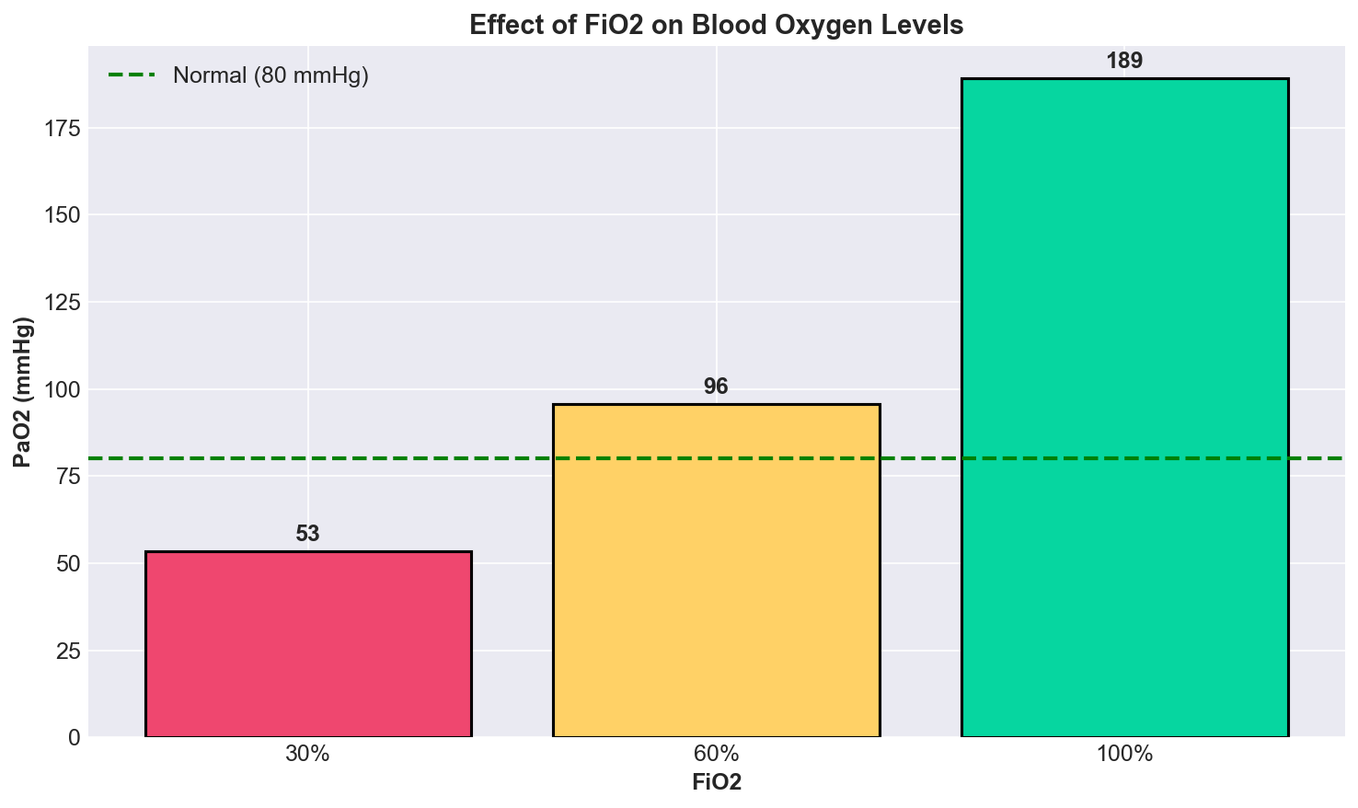
Effect of FiO2 on Blood Oxygen Levels
Parameter | Value
Patient ID | P1
Brain Injury Severity | 0.3 (Mild)
ARDS Severity | 0.3 (Mild)
Ventilation Mode | Pressure Control
Sub Mode | Continuous Mandatory Ventilation (CMV)
FiO2 | 0.3 (30% oxygen)
PEEP | 6 cmH2O
Inspiratory Pressure | 8 cmH2O
Respiration Rate (set) | 12 breaths/min
This graph shows how increasing FiO2 (Fraction of Inspired Oxygen) affects the patient’s arterial oxygen level (PaO2).
30% FiO2 → PaO2 = 53 mmHg
This is below the normal threshold of 80 mmHg.
Indicates significant hypoxemia (low oxygen in blood).
60% FiO2 → PaO2 = 96 mmHg
Oxygenation improves dramatically.
Patient crosses the normal oxygenation threshold.
100% FiO2 → PaO2 = 189 mmHg
Very high oxygenation level.
Shows strong response to supplemental oxygen.
Interpretation
The graph demonstrates a clear positive relationship between FiO2 and blood oxygenation:
Higher oxygen delivery leads to higher PaO2.
Moderate oxygen support (around 60%) may already restore acceptable oxygen levels.
Extremely high FiO2 gives excellent oxygenation but may not always be clinically ideal long-term due to oxygen toxicity risk.
The green dashed line at 80 mmHg represents the approximate normal PaO2 target.

Slide 21
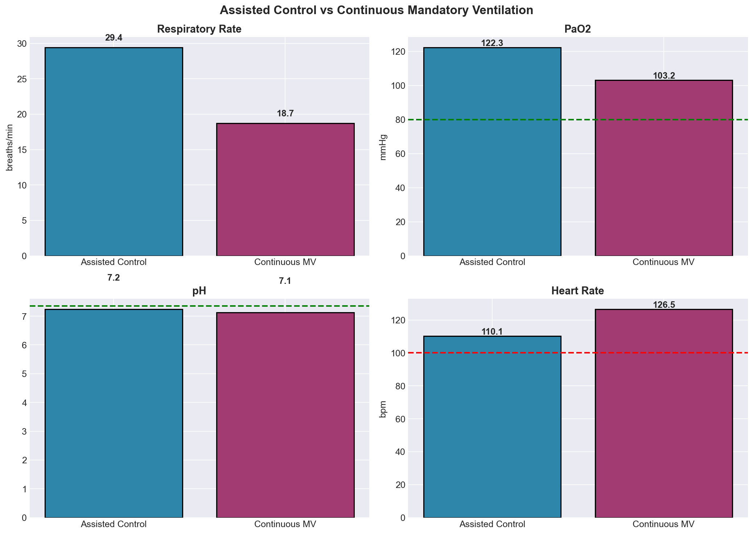
Assisted Control vs Continuous Mandatory Ventilation
Parameter | Value
Patient ID | P1
Brain Injury Severity | 0.3 (Mild)
ARDS Severity | 0.3 (Mild)
Ventilation Mode | Pressure Control
Sub Mode | Continuous Mandatory Ventilation (CMV)
FiO2 | 0.3 (30% oxygen)
PEEP | 6 cmH2O
Inspiratory Pressure | 8 cmH2O
Respiration Rate (set) | 12 breaths/min
Respiratory Rate
Assisted Control shows a higher respiratory rate because the mode allows patient-triggered breaths in addition to mandatory breaths, while CMV delivers fixed ventilation support.
PaO2 (Blood Oxygen)
Both ventilation modes maintain oxygenation above the normal threshold, but Assisted Control provides better overall oxygenation.
Blood pH
Both modes show acidic blood conditions, though Assisted Control maintains slightly better acid-base balance than CMV.
Heart Rate
Continuous Mandatory Ventilation results in a higher heart rate, indicating greater physiological stress compared to Assisted Control.
Overall, Assisted Control ventilation performs better by improving oxygenation, maintaining more stable pH, and reducing cardiovascular stress compared to Continuous Mandatory Ventilation.

Slide 22
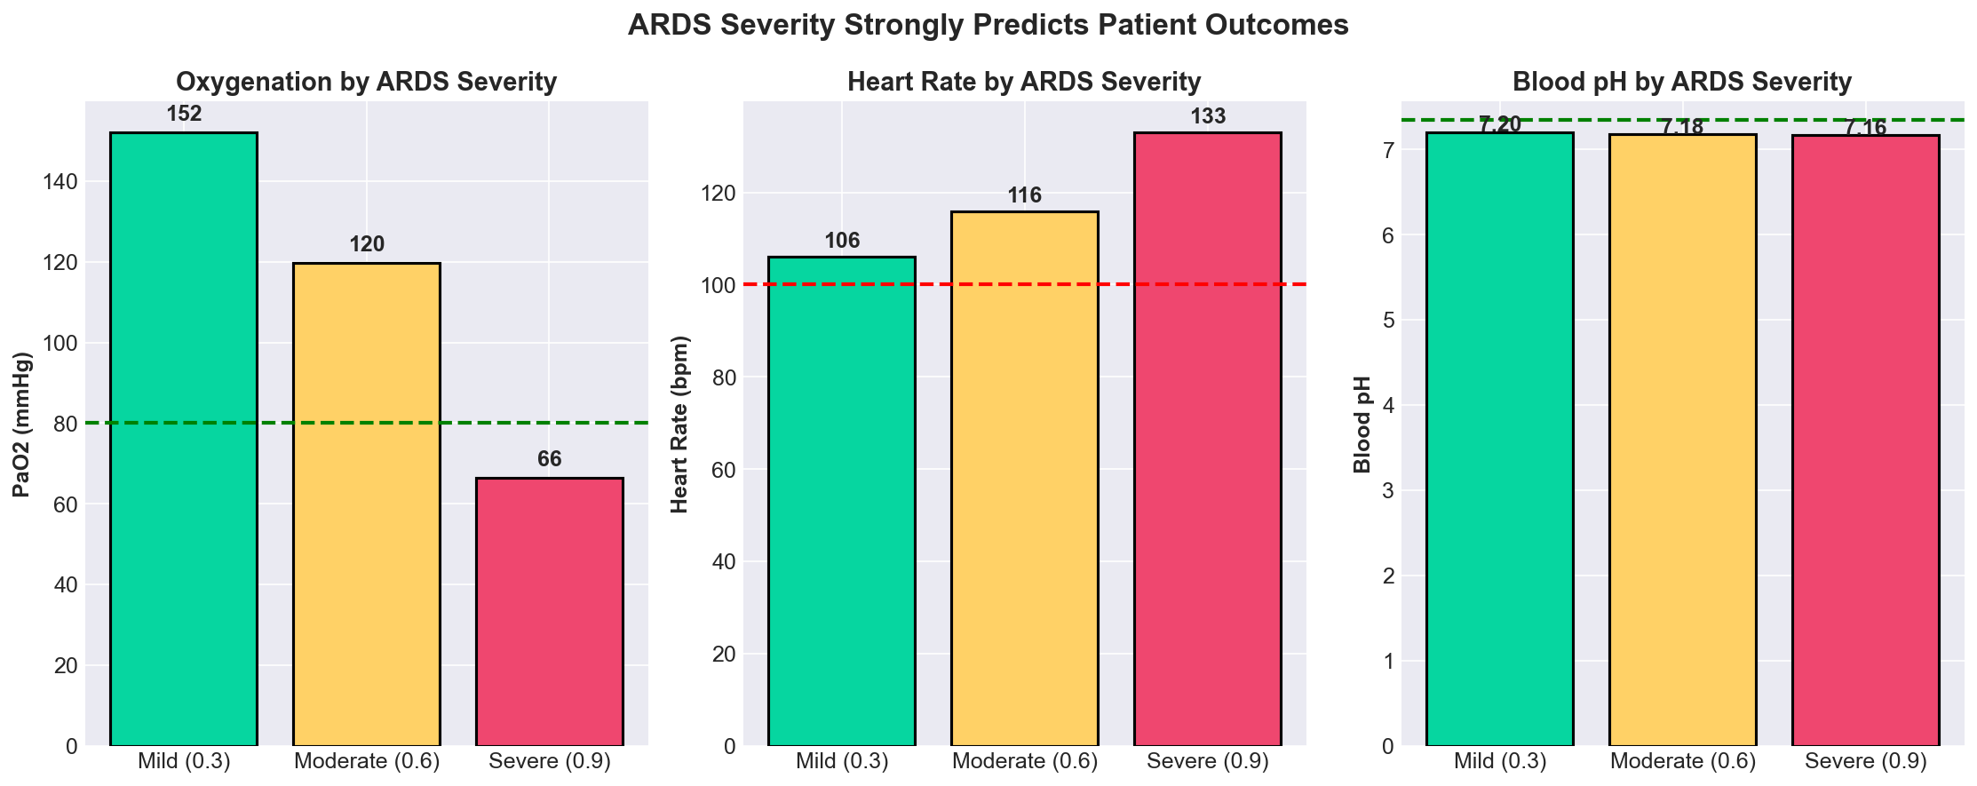
ARDS Severity Strongly Predicts Patient Outcomes
Parameter | Value
Patient ID | P1
Brain Injury Severity | 0.3 (Mild)
ARDS Severity | 0.3 (Mild)
Ventilation Mode | Pressure Control
Sub Mode | Continuous Mandatory Ventilation (CMV)
FiO2 | 0.3 (30% oxygen)
PEEP | 6 cmH2O
Inspiratory Pressure | 8 cmH2O
Respiration Rate (set) | 12 breaths/min
This figure shows how increasing ARDS severity affects major physiological parameters.
Oxygenation by ARDS Severity
As ARDS severity increases, blood oxygen levels decrease significantly. Severe ARDS leads to oxygen levels falling below the normal threshold, showing impaired gas exchange in the lungs.
Heart Rate by ARDS Severity
Heart rate increases with disease severity, indicating greater cardiovascular stress and compensatory response to reduced oxygen delivery.
Blood pH by ARDS Severity
Blood pH gradually decreases as ARDS becomes more severe, showing worsening acidosis and overall physiological imbalance.
The graph demonstrates that increasing ARDS severity is associated with poorer patient outcomes, including reduced oxygenation, higher cardiovascular stress, and worsening acid-base balance.

Slide 23
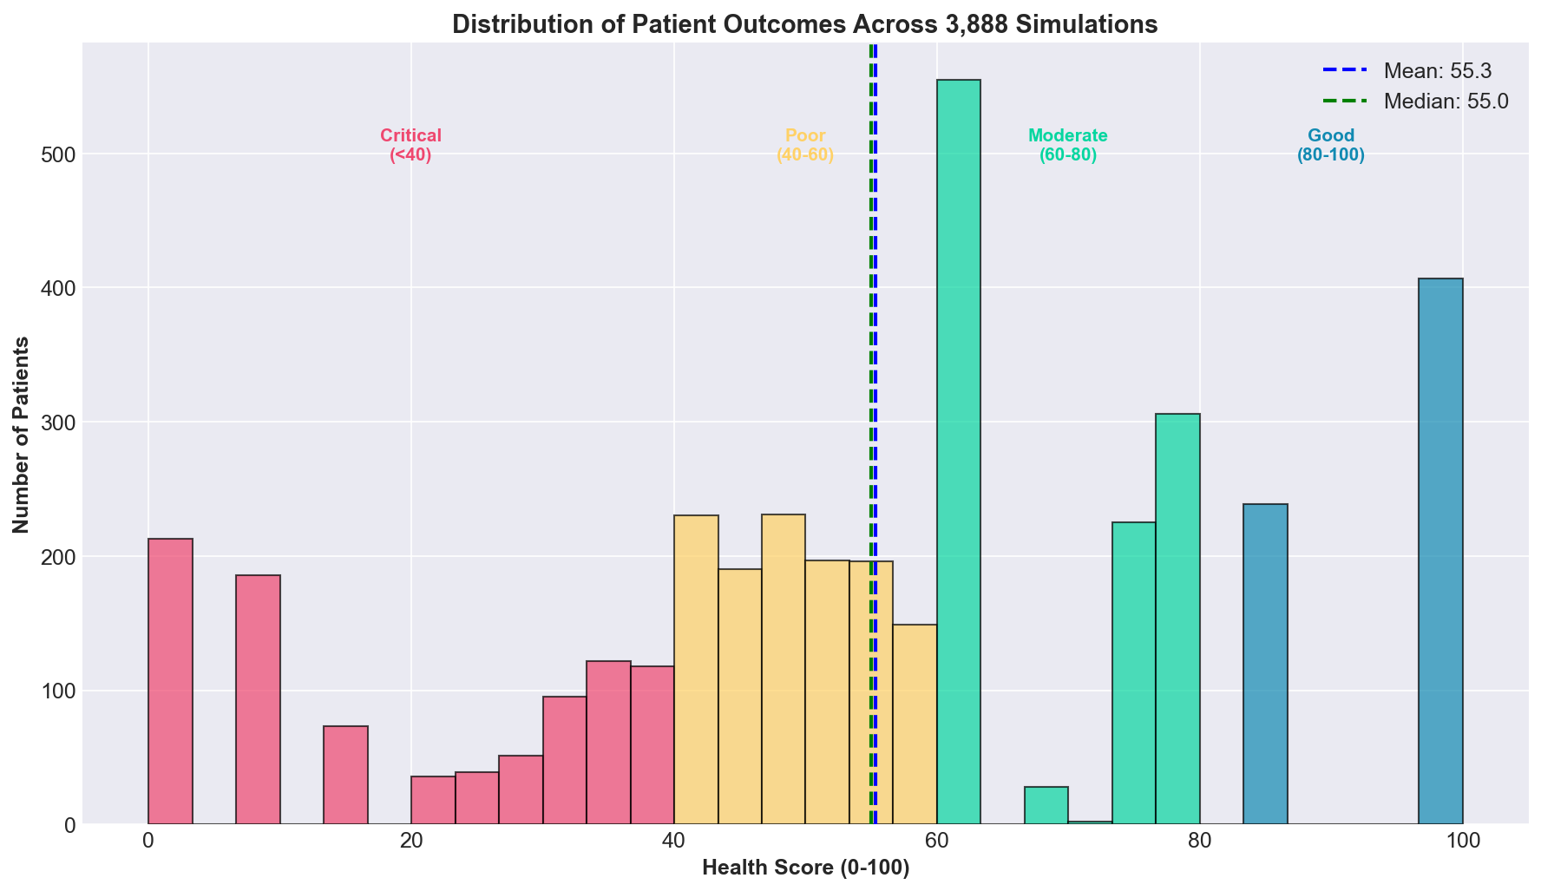
Distribution of Patient Outcomes Across 3,888 Simulations
Parameter | Value
Patient ID | P1
Brain Injury Severity | 0.3 (Mild)
ARDS Severity | 0.3 (Mild)
Ventilation Mode | Pressure Control
Sub Mode | Continuous Mandatory Ventilation (CMV)
FiO2 | 0.3 (30% oxygen)
PEEP | 6 cmH2O
Inspiratory Pressure | 8 cmH2O
Respiration Rate (set) | 12 breaths/min
This histogram shows the distribution of overall patient health scores obtained from all simulations.
Distribution of Health Scores
Most patients fall within the poor to moderate health score ranges, while fewer patients achieve extremely low or extremely high scores.
Mean and Median
The mean and median values are close to each other, indicating a fairly balanced distribution without strong skewness.
Variability in Outcomes
The wide spread of scores suggests significant variability in patient response depending on disease severity and treatment conditions.
Overall, the simulations show that most patients achieve intermediate outcomes, while only a smaller group reaches either critical or excellent health conditions.

Slide 24
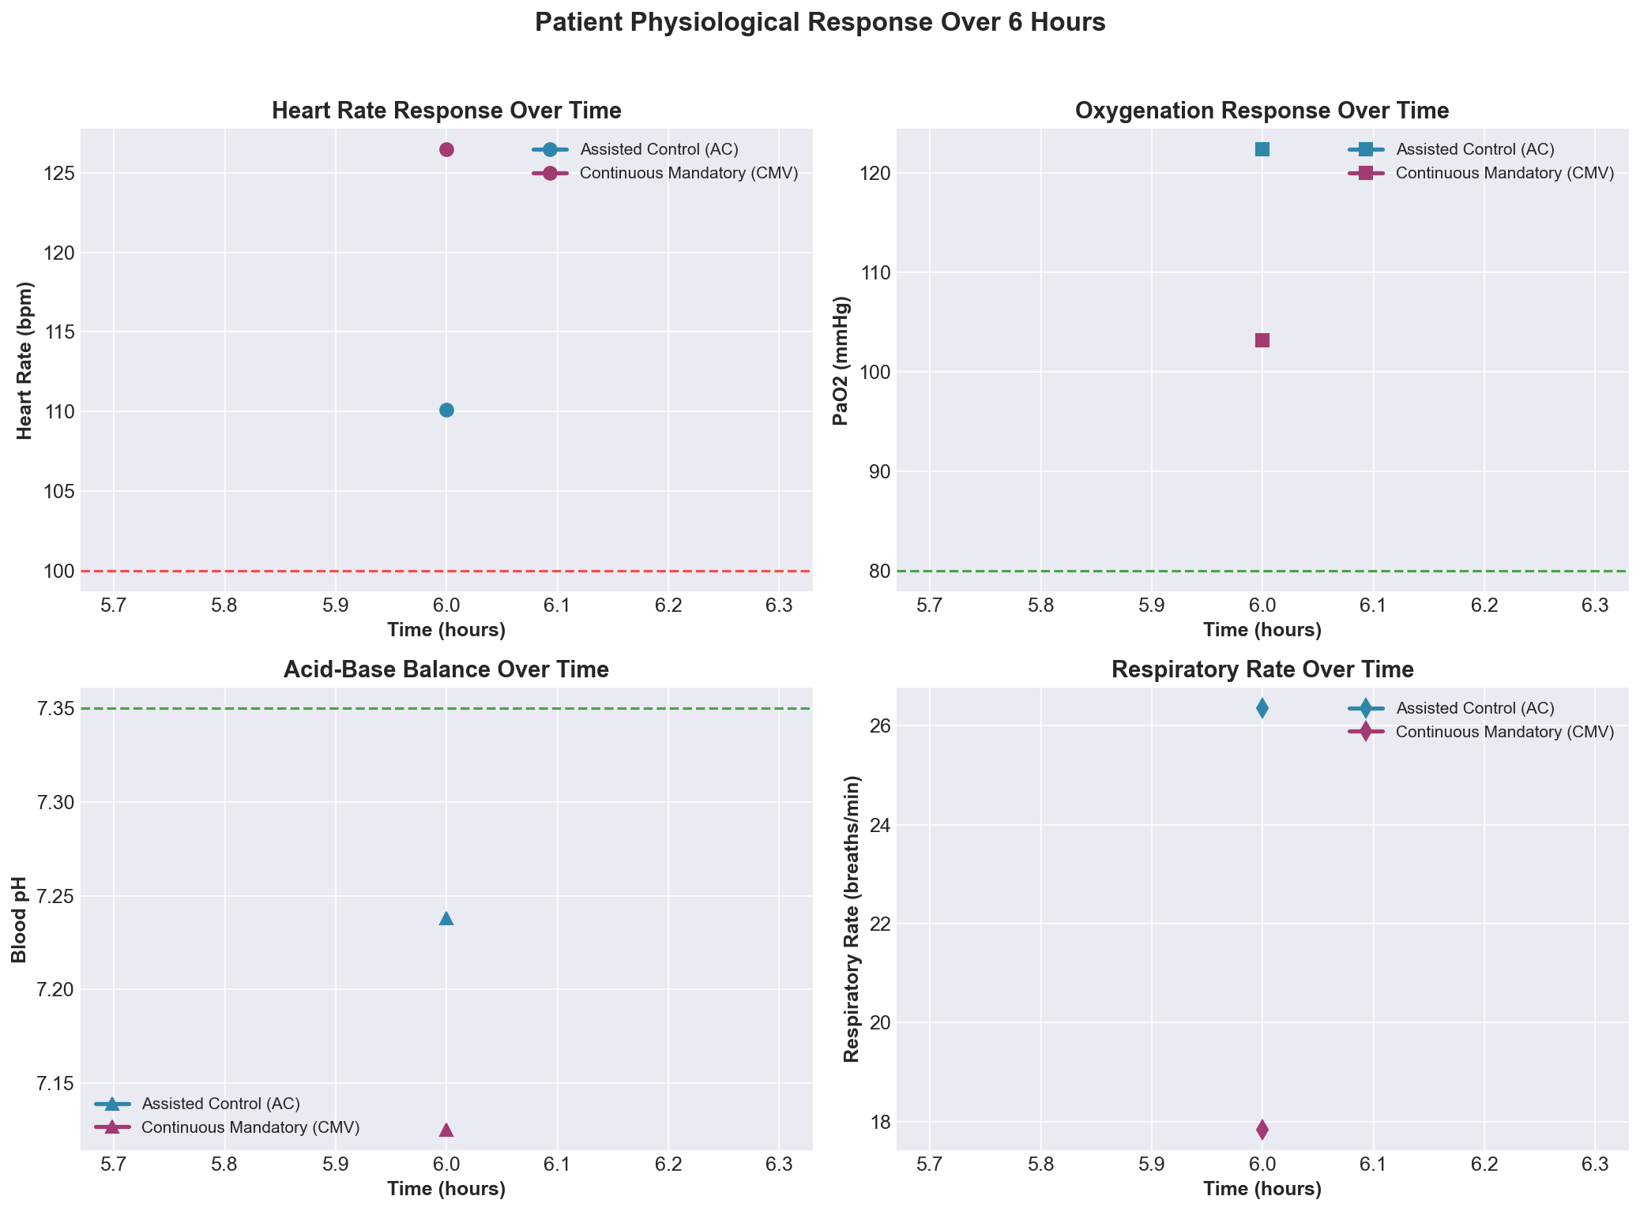
Patient Physiological Response Over 6 Hours
Parameter | Value
Patient ID | P1
Brain Injury Severity | 0.3 (Mild)
ARDS Severity | 0.3 (Mild)
Ventilation Mode | Pressure Control
Sub Mode | Continuous Mandatory Ventilation (CMV)
FiO2 | 0.3 (30% oxygen)
PEEP | 6 cmH2O
Inspiratory Pressure | 8 cmH2O
Respiration Rate (set) | 12 breaths/min
This figure compares the physiological response of patients over 6 hours under Assisted Control (AC) and Continuous Mandatory Ventilation (CMV).
Heart Rate Over Time
Patients under CMV show consistently higher heart rates, indicating greater physiological stress compared to AC.
Oxygenation Over Time
Assisted Control maintains better oxygenation throughout the observation period, showing improved respiratory support.
Acid-Base Balance
Patients receiving AC maintain a more stable blood pH, while CMV patients remain more acidotic.
Respiratory Rate
AC supports higher respiratory activity due to patient-assisted breathing, whereas CMV provides fixed mandatory breaths.
Overall, Assisted Control ventilation demonstrates better physiological stability and improved patient response over time compared to Continuous Mandatory Ventilation.

Slide 25
Patient state space
Parameter | Value
Patient ID | P1
Brain Injury Severity | 0.3 (Mild)
ARDS Severity | 0.3 (Mild)
Ventilation Mode | Pressure Control
Sub Mode | Continuous Mandatory Ventilation (CMV)
FiO2 | 0.3 (30% oxygen)
PEEP | 6 cmH2O
Inspiratory Pressure | 8 cmH2O
Respiration Rate (set) | 12 breaths/min
Vital | Unit | Clinical Role in ARDS
Heart Rate | beats/min | Reflects hemodynamic stress; compensatory tachycardia in hypoxia
MAP | mmHg | Organ perfusion pressure; must stay >65 in ARDS
SpO₂ | 0 to 1 | Primary bedside oxygenation monitor; ARDS target 0.92–0.98
PaO₂ | mmHg | Direct measure of oxygenation failure defines ARDS severity
PaCO₂ | mmHg | Ventilation adequacy; permissive hypercapnia (up to 55) accepted in ARDS
pH | — | Acid-base balance; mild acidosis (7.30–7.45) tolerated in ARDS
Respiratory Rate | breaths/min | Ventilator-patient synchrony and breathing effort
Tidal Volume | mL | Measured lung output; lung-protective compliance indicator
These are the vitals recorded from every Pulse simulation : 8 per time snapshot, across 4 time points (0h, 2h, 4h, 6h)
Patient profile fixed across all simulations: Male, 45 years, 173 cm, 66 kg
Two disease severity inputs:
ARDS Severity: 0.3 (mild), 0.6 (moderate), 0.9 (severe)
Brain Injury Severity: 0.3 (mild), 0.7 (severe)

Slide 26
Action space
Parameter | Value
Patient ID | P1
Brain Injury Severity | 0.3 (Mild)
ARDS Severity | 0.3 (Mild)
Ventilation Mode | Pressure Control
Sub Mode | Continuous Mandatory Ventilation (CMV)
FiO2 | 0.3 (30% oxygen)
PEEP | 6 cmH2O
Inspiratory Pressure | 8 cmH2O
Respiration Rate (set) | 12 breaths/min
Ventilator Setting searched:
Ventilator Modes:
Setting | Description | Unit | Values used
FiO₂ | Fraction of Inspired Oxygen | Fraction | 0.3, 0.6, 1.0
PEEP | Positive End-Expiratory Pressure | cmH₂O | 6, 10, 14
INS.P | Inspiratory Pressure (PC only) | cmH₂O | 8, 14, 20
RR | Respiratory Rate | breaths/min | 12, 18, 24
TV | Tidal Volume (VC only) | mL | 350, 450, 550, 650
Mode Code | Full Name
ACP | Assisted Pressure Control
CMP | Continuous Mandatory Pressure Control
ACV | Assisted Volume Control
CMV | Continuous Mandatory Volume Control

Slide 27
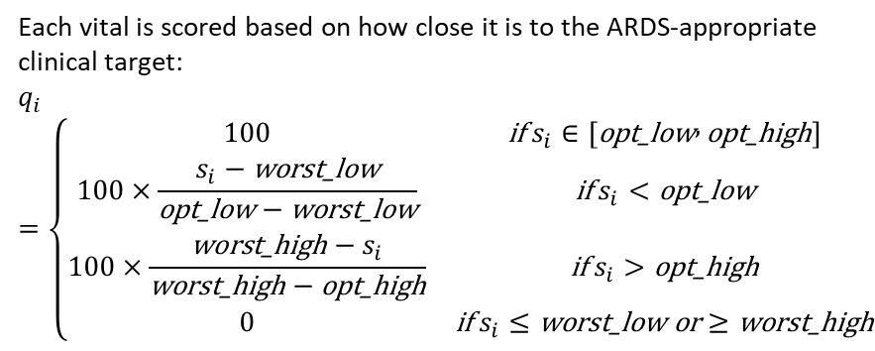
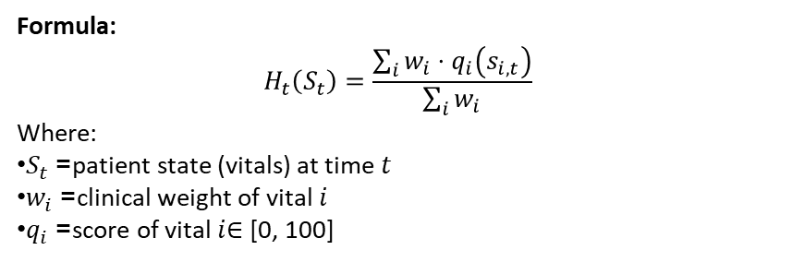
Reward Function : Health Score H_t(S_t)
Parameter | Value
Patient ID | P1
Brain Injury Severity | 0.3 (Mild)
ARDS Severity | 0.3 (Mild)
Ventilation Mode | Pressure Control
Sub Mode | Continuous Mandatory Ventilation (CMV)
FiO2 | 0.3 (30% oxygen)
PEEP | 6 cmH2O
Inspiratory Pressure | 8 cmH2O
Respiration Rate (set) | 12 breaths/min
Formula:
$$H_{t}\left(S_{t}\right)=\frac{\sum_{i}{w_{i}}⋅q_{i}\left(s_{i,t}\right)}{\sum_{i}{w_{i}}}$$
Where:
$S_{t}$= patient state (vitals) at time $t$
$w_{i}$= clinical weight of vital $i$
$q_{i}$= score of vital $i$∈ [0, 100]
Each vital is scored based on how close it is to the ARDS-appropriate clinical target:
$$q_{i}=\left\{\begin{matrix}100 & \text{if} s_{i}∈\left[\text{opt}\text{_}\text{low} , \text{opt}\text{_}\text{high}\right] \\ 100×\frac{s_{i}−\text{worst}\text{_}\text{low}}{\text{opt}\text{_}\text{low}−\text{worst}\text{_}\text{low}} & \text{if} s_{i}<\text{opt}\text{_}\text{low} \\ 100×\frac{\text{worst}\text{_}\text{high}−s_{i}}{\text{worst}\text{_}\text{high}−\text{opt}\text{_}\text{high}} & \text{if} s_{i}>\text{opt}\text{_}\text{high} \\ 0 & \text{if} s_{i}≤\text{worst}\text{_}\text{low} \text{or}≥\text{worst}\text{_}\text{high}\end{matrix}\right.$$

Slide 28
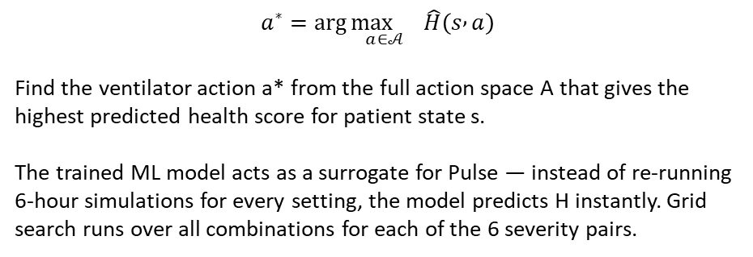
Parameter | Value
Patient ID | P1
Brain Injury Severity | 0.3 (Mild)
ARDS Severity | 0.3 (Mild)
Ventilation Mode | Pressure Control
Sub Mode | Continuous Mandatory Ventilation (CMV)
FiO2 | 0.3 (30% oxygen)
PEEP | 6 cmH2O
Inspiratory Pressure | 8 cmH2O
Respiration Rate (set) | 12 breaths/min
Objective Function
$$a^{∗}=\arg{\underset{a∈𝒜}{\max{}}}\hat{H}\left(s , a\right)$$
Find the ventilator action a* from the full action space A that gives the highest predicted health score for patient state s.
The trained ML model acts as a surrogate for Pulse — instead of re-running 6-hour simulations for every setting, the model predicts H instantly. Grid search runs over all combinations for each of the 6 severity pairs.

Slide 29
Model Comparison Results
Parameter | Value
Patient ID | P1
Brain Injury Severity | 0.3 (Mild)
ARDS Severity | 0.3 (Mild)
Ventilation Mode | Pressure Control
Sub Mode | Continuous Mandatory Ventilation (CMV)
FiO2 | 0.3 (30% oxygen)
PEEP | 6 cmH2O
Inspiratory Pressure | 8 cmH2O
Respiration Rate (set) | 12 breaths/min
9 models compared separately for Pressure Control and Volume Control:
Model | Test R² | MAE
Random Forest | 0.9790 | 2.2598
LightGBM | 0.9805 | 2.3776
XGBoost | 0.9744 | 2.4910
Decision Tree | 0.9711 | 2.5999
Gradient Boosting | 0.9386 | 4.4481
MLP | 0.6959 | 10.7313
Ridge | 0.1563 | 18.5206
Lasso | 0.1563 | 18.5095
SVR | 0.0334 | 19.4775
Model | Test R² | MAE
LightGBM | 0.8705 | 4.3599
Random Forest | 0.8605 | 3.9065
XGBoost | 0.8295 | 4.4520
Decision Tree | 0.7950 | 4.1262
Gradient Boosting | 0.7909 | 6.6467
Ridge | 0.1464 | 15.6959
Lasso | 0.1464 | 15.6944
SVR | -0.0758 | 15.3890
MLP | -0.3905 | 19.9388

Slide 30
Optimal Ventilator Settings
Parameter | Value
Patient ID | P1
Brain Injury Severity | 0.3 (Mild)
ARDS Severity | 0.3 (Mild)
Ventilation Mode | Pressure Control
Sub Mode | Continuous Mandatory Ventilation (CMV)
FiO2 | 0.3 (30% oxygen)
PEEP | 6 cmH2O
Inspiratory Pressure | 8 cmH2O
Respiration Rate (set) | 12 breaths/min
ARDS | BI | Mode | Sub-Mode | FiO₂ | PEEP | INS.P | RR | Score
Mild (0.3) | Mild (0.3) | Pressure Control | Assisted PC | 0.3 | 10 | 8 | 12 | 87.5
Mild (0.3) | Severe (0.7) | Pressure Control | Assisted PC | 0.6 | 10 | 8 | 12 | 87.2
Moderate (0.6) | Mild (0.3) | Volume Control | Assisted VC | 0.6 | 10 | N/A | 18 | 84.5
Moderate (0.6) | Severe (0.7) | Volume Control | Assisted VC | 0.6 | 10 | N/A | 12 | 84.5
Severe (0.9) | Mild (0.3) | Volume Control | Assisted VC | 1.0 | 10 | N/A | 24 | 84.1
Severe (0.9) | Severe (0.7) | Volume Control | Assisted VC | 1.0 | 10 | N/A | 24 | 84.2

