Slide 1

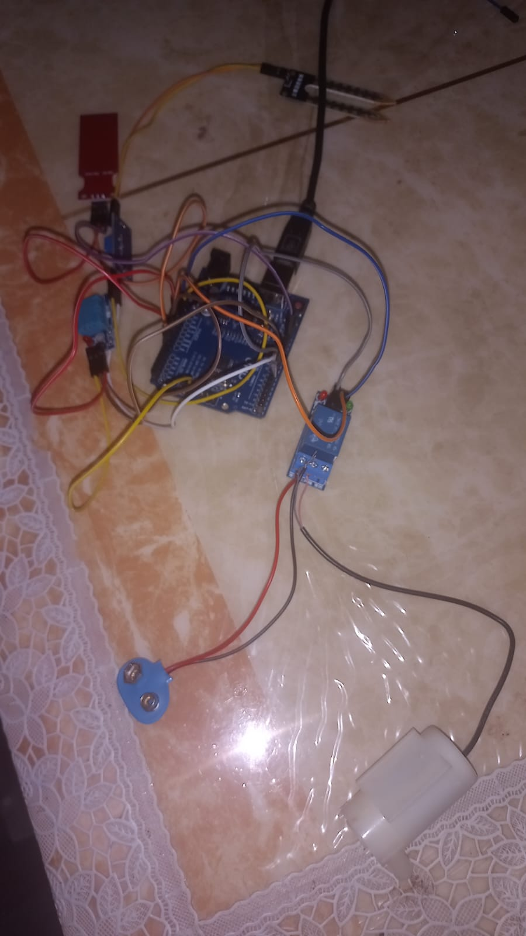
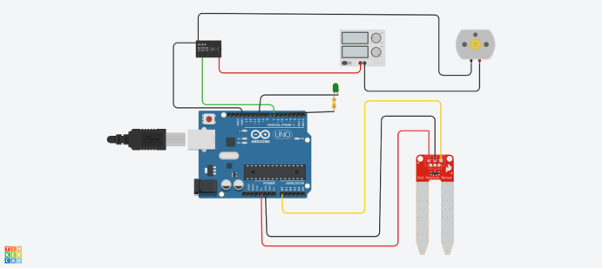
UE22CS251B: MPCA Soil Analysis and Irrigation system
The aim of this project is to design and implement a Soil Analysis and irrigation system using Arduino Uno R3 model. The system will monitor the soil moisture level and automatically water the plants when necessary. This project is designed to provide a solution for individuals who struggle to maintain proper watering schedules for their plants, compramising plant’s health,the farmers and crop owners assiting them in watering their crops tough weather conditions in some demographics.
Student PIC
Student PIC
Student PIC
MPCA class teacher PIC
<Name > <SRN>
<Name > <SRN>
<Name > <SRN>
<Name >

