Slide 1
FINAL PROJECT SUBMISSION · BBA AI & DS · 2026
HireTrack
Internship Recruitment Tracking System
for Startups
Name
Roll No.
Class
Mentor
Shreya Chopra
25BBA149
BBA AI & DS
Ms. Ishika (FacePrep)

Slide 2
Project Overview
THE IDEA
5
What is
HireTrack?
System Modules
20+
A centralized Internship Recruitment Tracking System built for early-stage startups — giving HR teams enterprise-level visibility at zero software cost.
Built as an Excel-based ATS with 5 modules: Candidate Database, Pipeline Tracker, Interview Log, Recruiter Metrics, and a live Dashboard.
Sample Candidates
38
Live Excel Formulas
₹0
Cost to Startup

Slide 3




The Problem
Scattered Data
Missed Follow-Ups
Every recruiter keeps a different spreadsheet. No one has the full picture.
Candidates wait days without responses and quietly accept other offers.
No Visibility
Wasted Hours
Founders have zero insight into how many candidates are at each stage.
2+ hours per week just reconciling duplicate records across teams.
93% of Indian startups (early-stage) operate recruitment entirely through manual Excel sheets with no pipeline structure.

Slide 4






The Solution
Candidate Database
Pipeline Tracker
Interview Log
Full profiles — source, skills, CTC, contact, resume link in one central sheet.
Stage-by-stage view: Applied → Screened → Interview → Offer → Joined.
Date, mode, interviewer, feedback ratings — all logged in one place.
Recruiter Metrics
Live Dashboard
Website + Web App
Per-recruiter KPIs: calls, offers, rejection rate, avg. days to hire.
Auto-updating charts and 6 KPI cards — funnel drop-off at a glance.
Landing page + live browser tracker. Deployable to GitHub Pages instantly.

Slide 5
TECH STACK
Tools & Technologies Used
1
2
3
Excel / Google Sheets
38 Live Excel Formulas
HTML, CSS, JavaScript
Core ATS engine — five linked sheets, zero external software cost.
VLOOKUP, IFS, COUNTIFS, data validation — powering pipeline automation.
Landing page and a live browser-based candidate tracker (add/edit/delete).
4
5
6
Excel Charts
GitHub & GitHub Pages
Space Grotesk / JetBrains Mono
Bar + pie charts driving the auto-updating KPI dashboard.
Version control and free static hosting for instant deployment.
Typography system for a clean, modern product feel.
Shreya Chopra · FacePrep Internship Project · HireTrack

Slide 6
HOW IT WAS BUILT
Implementation Process
01
02
03
04
Research & Planning
Excel ATS Development
Dashboard & Web App
Testing & Deployment
Studied recruitment gaps across early-stage startups; scoped 5 core modules and the data model.
Built Candidate Database, Pipeline Tracker, Interview Log and Recruiter Metrics with 38 live formulas.
Designed the auto-updating KPI dashboard in Excel and coded a browser-based live tracker in HTML/CSS/JS.
Validated with 20 sample candidates, fixed formula errors, and deployed the website to GitHub Pages.
Built solo in 3 weeks — from problem research to a working, presentable product.

Slide 7
What's Done
✓
Problem research & competitive analysis completed
✓
Interview Log with star ratings & color-coded outcomes
✓
Full project presentation built
✓
Recruiter Metrics sheet with KPI cards
✓
Excel ATS with 5 sheets, 38 live formulas, zero errors
✓
Excel Dashboard with bar chart + pie chart
✓
Candidate Database with 20 sample entries & dropdowns
✓
Website landing page designed & coded (HTML/CSS/JS)
✓
Pipeline Tracker with visual stage checkmarks
✓
Live browser-based candidate tracker (add/edit/delete)

Slide 8
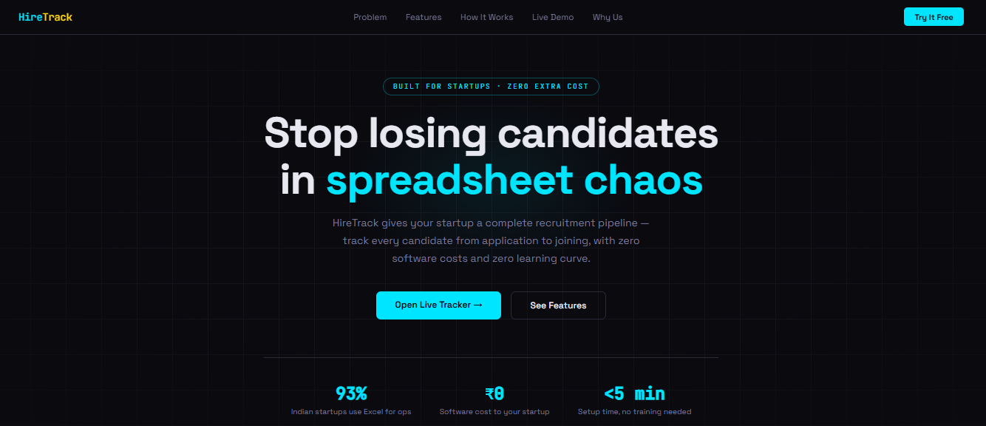
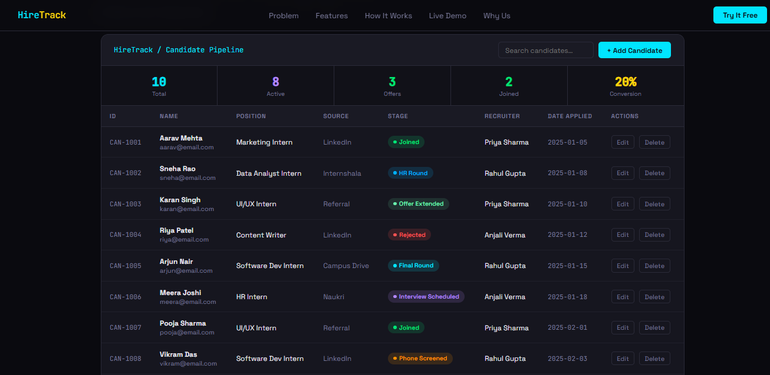
SEE IT IN ACTION
HireTrack Website & Live Tracker
Landing page
Live browser-based candidate tracker
Shreya Chopra · FacePrep Internship Project · HireTrack

Slide 9
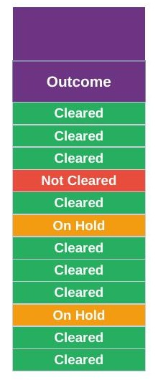
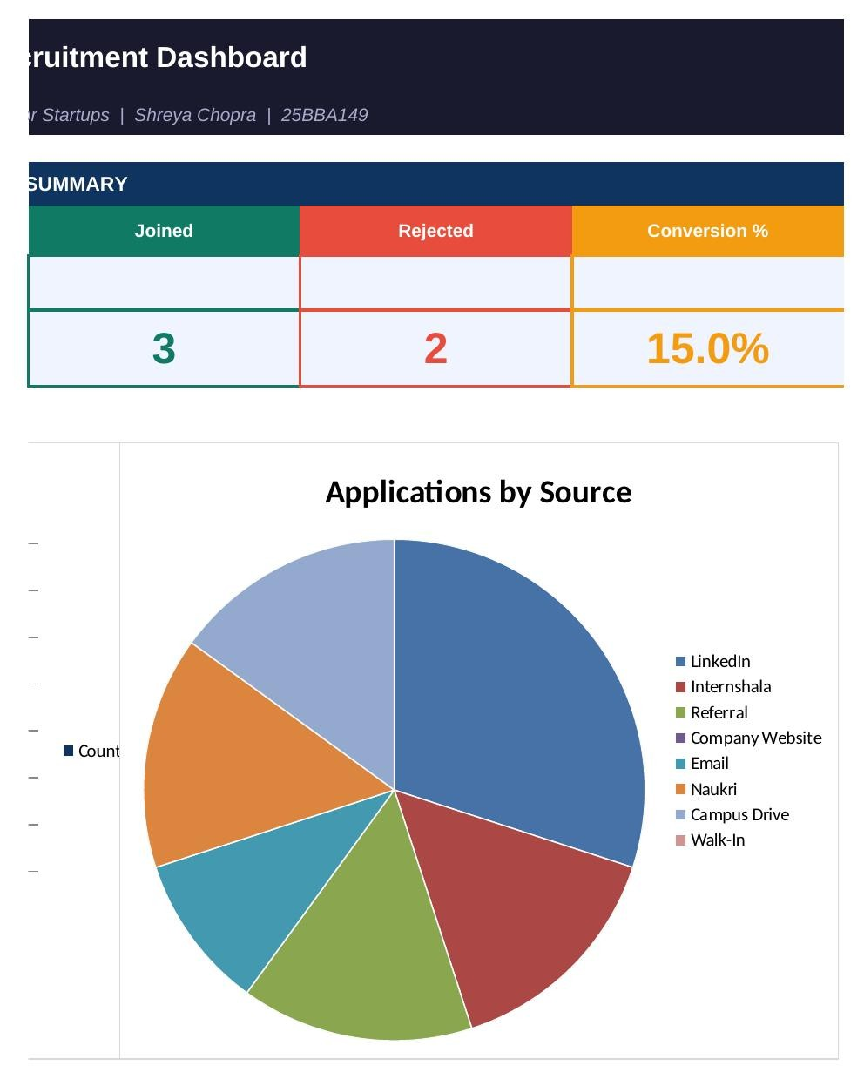
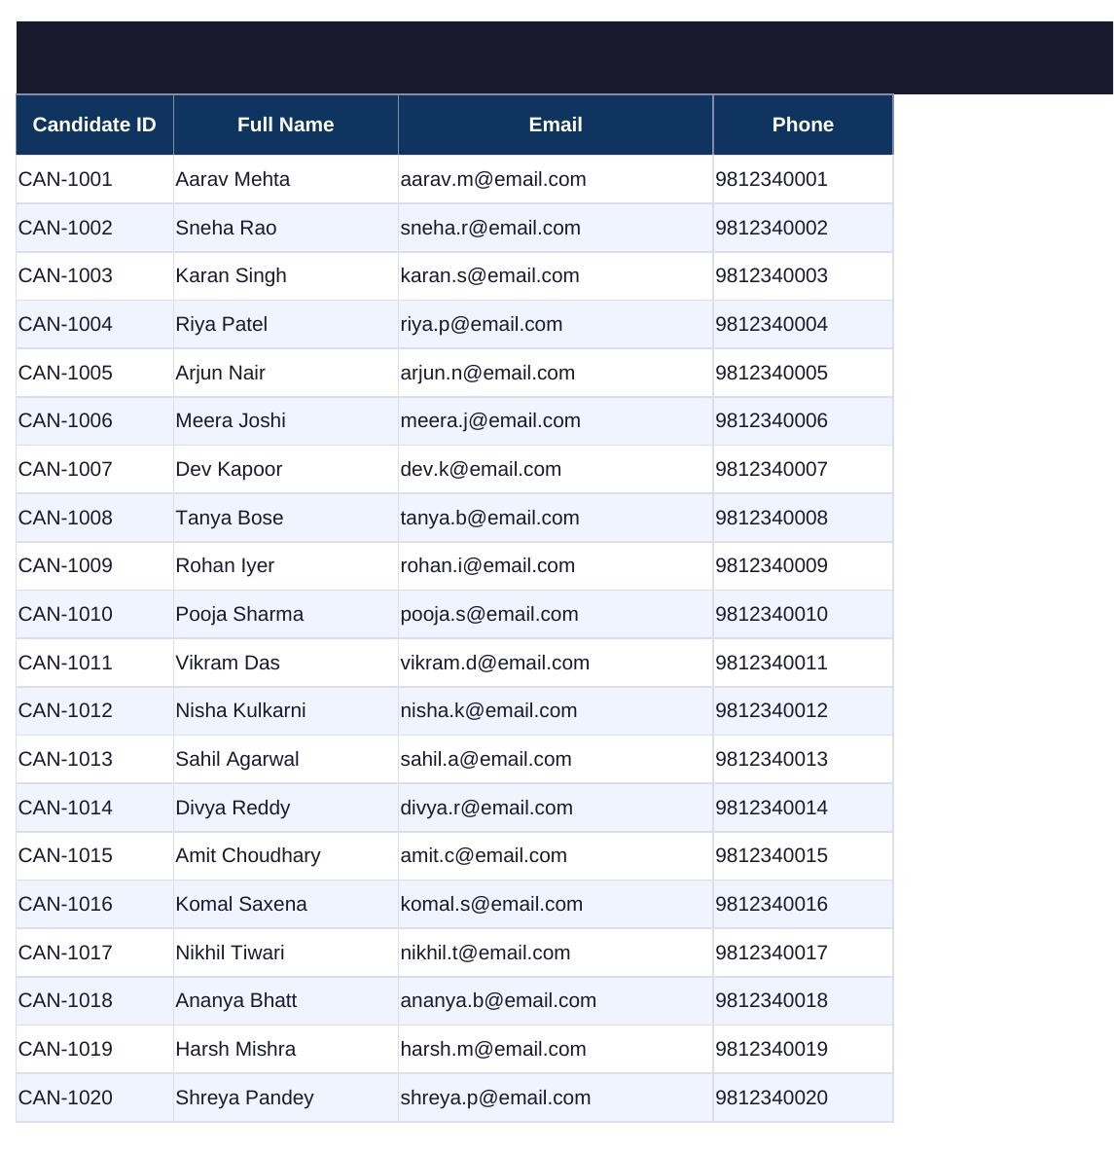
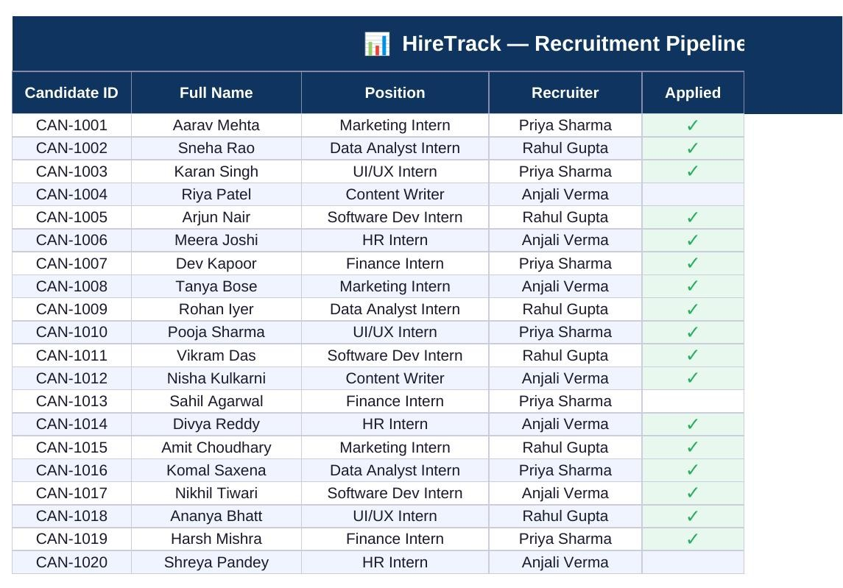
SEE IT IN ACTION
Excel ATS — Core Modules
Candidate Database
Pipeline / Status Tracker
Interview Log
Live Dashboard
Shreya Chopra · FacePrep Internship Project · HireTrack

Slide 10
Why Startups Will Use This
WITHOUT HIRETRACK
WITH HIRETRACK
✕ Random Excel files, no structure
✓ One centralized candidate pipeline
✕ Candidates fall through cracks
✓ Stage tracker flags every gap
VS
✕ No recruiter accountability
✓ Per-recruiter KPI metrics
✕ Founders have zero visibility
✓ Live dashboard for leadership
✕ Enterprise ATS costs ₹50K+/year
✓ HireTrack costs ₹0 — runs on Excel

Slide 11
THANK YOU
HireTrack
Recruitment simplified for the startups that need it most.
GitHub
Roll No.
Class
https://github.com/shreya05-org/hiretrack
25BBA149
BBA AI & DS
Shreya Chopra · FacePrep Internship Project ·

