Slide 1
Team Rosville

Slide 2
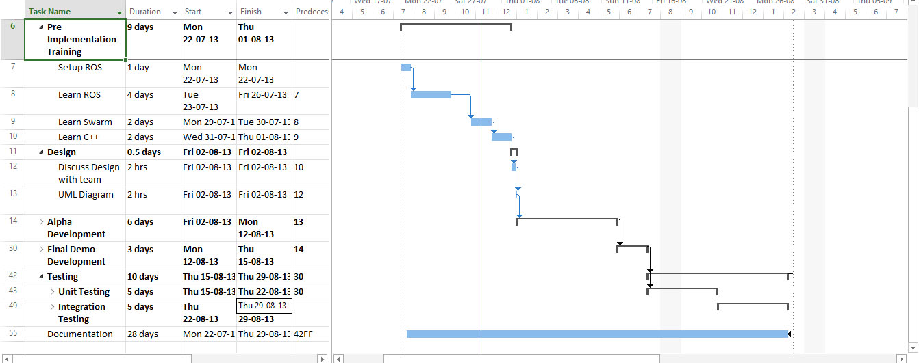
Gantt Chart
Picture of new gantt chart?
Old version --V

Slide 3
Work Breakdown Structure
Picture of new WBS?
https://raw.github.com/shreya07/softeng306-Rosville/master/Plan/WBS.jpg?login=kand617&token=33aecd9e9b466898c8724dd98c2cdad6

Slide 4
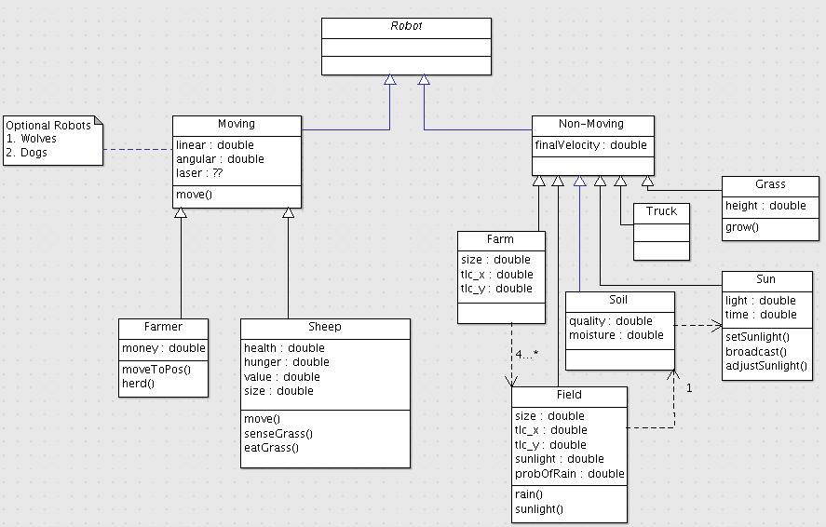
UML Diagram

Slide 5
Group Discussion Achievements
Update Gantt Chart and WBS.
Set up a ROS environment.
Confident with git commands.
Work through basic ROS tutorials.
Complete a UML diagram for the robots.
Group coding session.

