Slide 1

Team RosVille

Slide 2

What have we been up to?
Project Management
Problem Analysis
ROS and C++
Git

Slide 3

Project Management
Assigned roles
  following a rotation system
Following a professional approach to meetings
  Agenda of meetings
  Setting up ground rules and expectations

Slide 4
Roles

Slide 5
Problem analysis
What did we get out of group discussions?
  Common View
  Requirements
  WBS => Gantt Chart
  Use-cases

Slide 6
Requirements
https://github.com/shreya07/softeng306-Rosville/wiki/Requirements

Slide 7
WBS (W.I.P)
https://raw.github.com/shreya07/softeng306-Rosville/master/Plan/WBS.jpg?login=kand617&token=33aecd9e9b466898c8724dd98c2cdad6

Slide 8
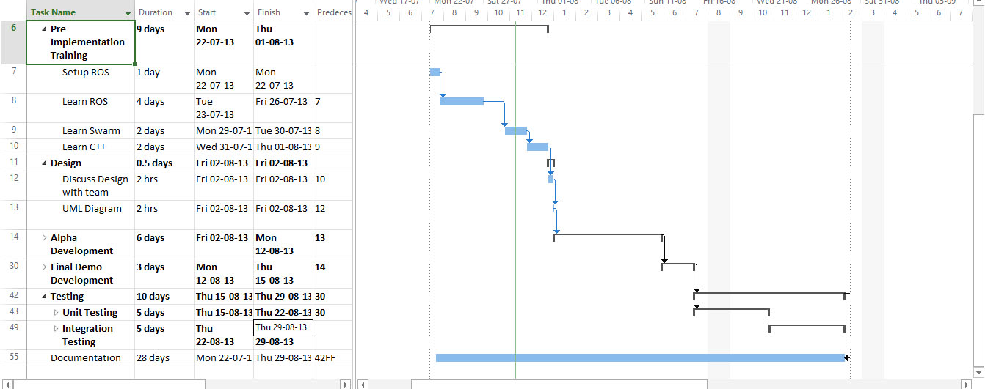
Gantt Chart
  living document
  review and revise

Slide 9
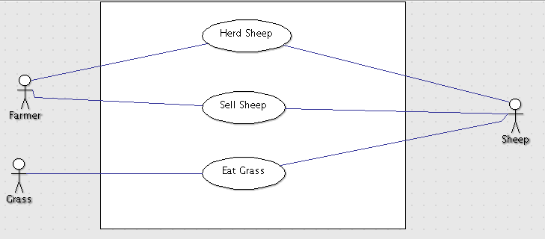
Use-cases
Example

Slide 10
ROS and C++
Initial hurdles
  Installation, Catkin etc
Solution to the hurdles
What did we get out of it in the end?

Slide 11
Git
Making use of tutorials
Created a private repo
Wiki

