Slide 1

The Economic Impacts of Flood : Evidence from Eastern India
ED300
Submitted in partial fulfillment of the requirements for the award of the Degree of
INTEGRATED MASTER OF SCIENCE
in
Quantitative Economics and Data Science by
SHREYA MISHRA IED/10032/23
Guide: Dr. Saheli Bose
Department for Quantitative Economics and Data Science Birla Institute of Technology, Mesra
Ranchi-835215, Jharkhand

Slide 2
Introduction
Increasing Frequency & Intensity: Natural disasters are becoming more frequent and severe due to climate change and extreme weather variability
.
Significant Economic Losses: Disasters cause large economic costs including infrastructure damage, agricultural losses, and population displacement.
Major Global Concern: Events such as floods, cyclones, droughts, and cloudbursts increasingly threaten economic stability and human livelihoods.
Policy Relevance: Understanding disaster impacts is crucial for economic planning, disaster risk reduction and climate adaptation policies.
Need for Empirical Analysis: Quantitative analysis helps generate evidence-based insights for effective disaster management and development planning.

Slide 3
Why study floods ?
Why Floods?
Most frequent natural disaster in India (National Disaster Management Authority – NDMA, Government of India)
~40 million hectares flood-prone; ~7.2 million hectares affected annually (National Flood Commission, Government of India)
Average annual damage of ~₹1,805 crore to crops and infrastructure (Central Water Commission – CWC, Government of India)
Limited empirical research on the economic impacts of floods at the regional/state level in India (NDMA; National Institute of Disaster Management – NIDM)
2

Slide 4
Why Eastern India ?
Bihar accounts for 17.2% of India's flood-prone area; Odisha, West Bengal, and Jharkhand face recurring inundation across their own basins (NIDM/NRSC)
Transboundary rivers — Kosi, Gandak, Bagmati (Nepal-origin, Bihar) and Ganga-Brahmaputra tributaries (West Bengal) — drive large-scale Gangetic flooding (CWC)
Odisha's Mahanadi, Brahmani, and Baitarani; West Bengal's Damodar and Hooghly; and Jharkhand's Subarnarekha routinely breach embankments during monsoon (CWC/NDMA)
Floodplain-dependent agriculture across all four states magnifies economic losses from annual inundation (CSO/RBI)
All four states fall below the national per capita NSDP average, limiting flood resilience and recovery capacity (MoSPI)
2

Slide 5
Conceptual Framework
Short-Run Economic Damage: Floods cause immediate losses through crop destruction, infrastructure damage, and population displacement.
Long-Run Economic Consequences: Recurrent flooding can lead to persistent poverty, slower economic growth, livelihood shifts, and migration.
Agrarian Multiplier Effect: Flood shocks spread through the rural economy by reducing farm incomes, affecting food supply chains and regional food security.
Positive Externalities: Floodwaters deposit nutrient-rich alluvial silt and recharge groundwater, improving soil fertility and supporting post-flood agricultural productivity.
Policy & Infrastructure Response: Due to recurring floods Governments invest in embankments, drainage systems, early warning networks, and climate-resilient infrastructure to reduce flood vulnerability and strengthen disaster resilience.

Slide 6
Literature Review
Author(s) & year of publication
Journal
Title
Major Findings
Constructed a GIS-based Flood Risk Index (FRI) via AHP, integrating geomorphological, land cover, topographic, and population density parameters; validated against MODIS inundation maps (1988–2006).
Sinha, R., Bapalu, G.V., Singh, L.K.
& Rath, B.
(2008)
Flood Risk Analysis in the Kosi River Basin, North Bihar Using Multi-Parametric Approach of Analytical Hierarchy Process (AHP)
J. Indian Soc. Remote Sens.
36: 293–307
Embankment-based flood control is insufficient; sediment aggradation raises riverbed levels over time, increasing flood severity — relevant to Bihar’s engineering-dependent flood management approach.
District-level flood hazard mapping of Bihar using multi-temporal satellite imagery; delineates high/moderate/low hazard zones across all 38 districts — Bihar accounts for
~17.2% of India’s total flood-prone area.
National Remote Sensing Centre (NRSC), ISRO /
NDMA / Govt. of
Bihar (2010)
Flood Hazard Atlas — Bihar:
Flood Hazard Atlas of Bihar —
A Geospatial Approach _{A Geospatial Approach}
(NRSC–ISRO / NDMA
/ GoB)
Serves as a foundational spatial reference for the present study’s flood exposure variable and village-level panel construction.
5

Slide 7
Gaps in Literature
Effect of Floods on Land Use: Limited evidence on how flood inundation affects land use change at the assembly constituencies in Bihar over time.
Measurement of Economic Activity: Existing studies rely on survey-based data; satellite proxies (Nightlights, NDBI, NDVI) at granular geographic levels remain underutilised in Indian flood literature.
Transmission Mechanisms: Studies document flood impacts but rarely identify the channels — whether damage operates through infrastructure destruction, agricultural loss, or reduced road connectivity.
Assembly constituency level Empirical Identification: Most India-focused studies work at state or district level; rigorous consituency panel estimation with fixed effects is largely absent.

Slide 8
Research Questions
Do floods reduce economic activity in affected assembly constituencies?
Economic activity is measured using satellite-derived night-lights data (VIIRS/DMSP).
The relationship is estimated using panel OLS regression models with Assembly Constituency (AC) fixed effects and year fixed effects, along with district-clustered standard errors.
Does the impact of floods on economic activity vary across states in Eastern India?
Separate state-level regressions are estimated for Bihar, Jharkhand, Odisha, and West Bengal using satellite night-lights data (VIIRS/DMSP).
The empirical specification follows a fixed-effects OLS framework with Assembly Constituency and year fixed effects.
What is the impact of flood inundation on built-up areas and physical infrastructure?
Built-up intensity and infrastructure exposure are measured using the Normalized Difference Built-up Index (NDBI) derived from Landsat-8 imagery.
The relationship is estimated using OLS panel regressions with Assembly Constituency and year fixed effects, including lagged NDBI as a control variable and district-clustered standard errors.
4

Slide 9
Data Description
Panel structure
Unit of observation: Assembly Constituency (AC) × year States: Bihar, Jharkhand, Odisha, West Bengal
Period: 2014–2019 (5 usable years after lag construction)
~800 ACs; N ≈ 4,000 AC-year observations
AC identifiers from ECI; district codes (Census 2011) used as SE clusters
Variable
Defination/use
Source
Seasonal_Ratio
Proportion of AC area flooded — flood-exposure measure
JRC Global Surface Water
Night Lights (mean & median)
VIIRS DNB (NOAA),
harmonised with DMSP-OLS
Night-time radiance — proxy for local economic activity
NDBI (mean & median)
Normalized Difference Built-up Index — proxy for built-up
/urban land
Normalized Difference Vegetation Index — agriculture
/ vegetation proxy
Landsat-8 SR (USGS / NASA)
NDVI (mean & median)
Landsat-8 SR (USGS / NASA)
All raster variables aggregated to AC polygons via zonal statistics; lagged regressors constructed within AC; SEs clustered at district level.

Slide 10
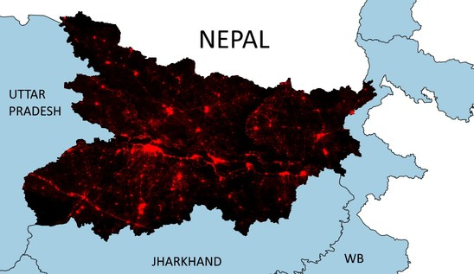
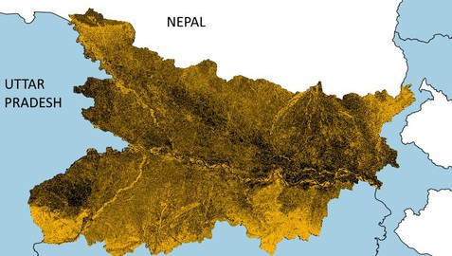
Data Description
Economic Activity Proxy: Nightlights (VIIRS/DMSP)
Nightlights (VIIRS/DMSP, 2014) used as a proxy for economic activity.
Higher light intensity indicates greater economic
activity.
Used to analyze economic impacts of floods across assembly constituencies in Bihar.
Built-up Area Exposure: NDBI (Landsat-8)
The Normalized Difference Built-up Index (NDBI) identifies urban and built-up areas.(2014)
This helps analyze how floods affect infrastructure
and urban development.
Built-up density indicates areas where economic losses may be higher during floods

Slide 11
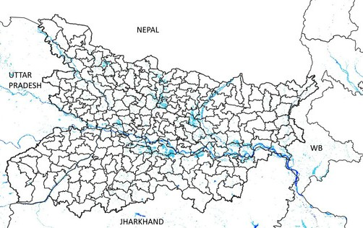
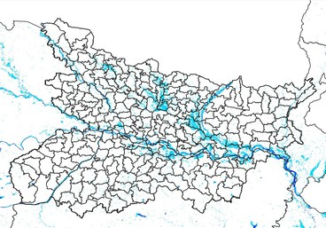
Data Description
Flood Exposure – 2014 Flood Exposure – 2017
Flood exposure derived from EC-JRC Global Surface Water Dataset. The maps highlight seasonal and permanent water bodies across Bihar.
Similar flood patterns are observed in West Bengal, Jharkhand, and Odisha, suggesting scope for future regional analysis across Eastern India.

Slide 12
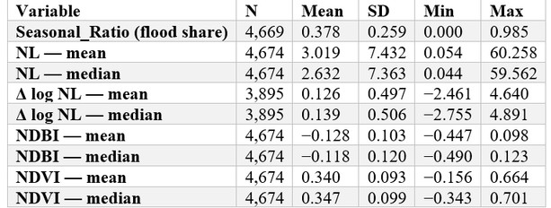
Summary Statistics — Variables
Sample: 765 ACs × 6 years (2014–2019) = 4,674 AC-year observations across 108 districts. Estimation sample N ≈ 3,890 after lag construction (2014 dropped).

Slide 13
Summary Statistics — Flood Exposure
By State
By Year
Takeaways
Substantial cross-state variation: Jharkhand AC-shares are highest, Bihar lowest among the four
2014is an outlier (incomplete JRC seasonal-water coverage);dropped from estimation via lag construction
Year-on-year exposure is other wises table around 0.41–0.47—supports use of year FE to absorb common shocks

Slide 14
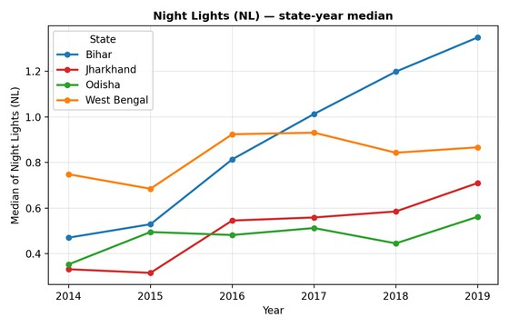
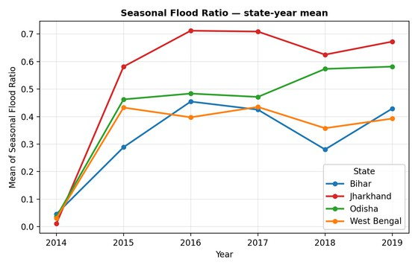
Summary Statistics
Figure 1.1: Median of night-time lights radiance across Assembly Constituencies, 2014–2019
Figure 1.2: Average of night-time lights radiance across Assembly Constituencies, 2014–2019

Slide 15
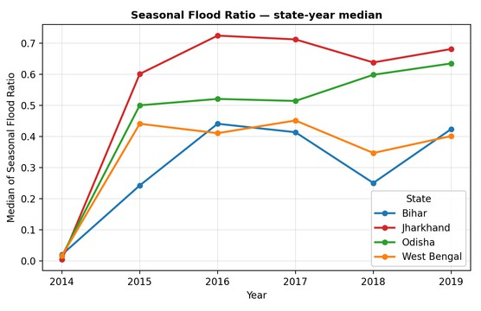
Summary Statistics
Figure 2.1: Median of proportion of land with flooding across Assembly Constituencies, 2014–2019.
Figure 2.2: Average of proportion of land with flooding across Assembly Constituencies, 2014–2019.

Slide 16
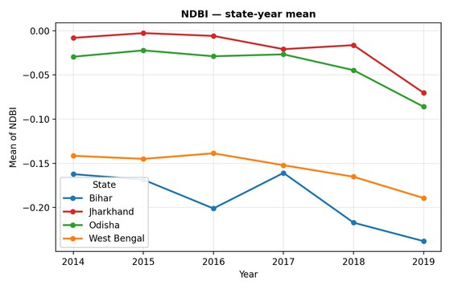
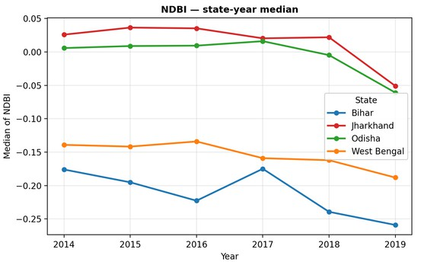
Summary Statistics
Figure 3.1: Median of Normalized Difference Built-up Index across Assembly Constituencies, 2014–2019.
Figure 3.2: Average of Normalized Difference Built-up Index across Assembly Constituencies, 2014–2019.

Slide 17
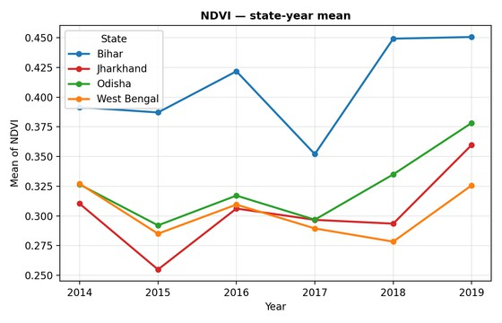
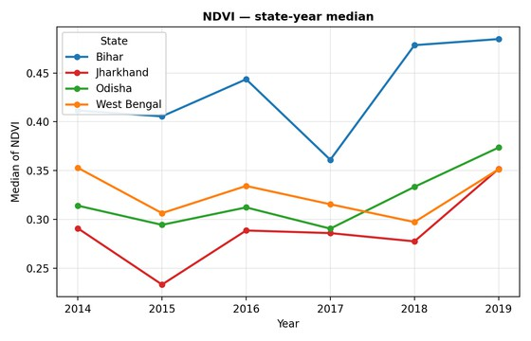
Summary Statistics
Figure 3.1: Median of Normalized Difference Vegetation Index across Assembly Constituencies, 2014–2019.
Figure 3.2: Average of Normalized Difference Vegetation Index across Assembly Constituencies, 2014–2019.

Slide 18
Methodology
Estimator. OLS with AC fixed effects (α_{i}) and year fixed effects (γ_{t} )
Standard errors clustered by district.
Estimation strategy. Each equation is estimated twice:
Pooled—all four states, all years
State-by-state—Bihar,Jharkhand,Odisha,WestBengal separately
Both equations are run on mean and median AC-level aggregations. Equation 1 - Night Lights (economic activity)
∆logNL_{it} = β₁Flood_{it}+β₂NDVI_{i,t−1}+β₃NDBI_{i,t−1}+α_{i}+γ_{t}+ε_{it}
Equation 2 — NDBI (built-up land)
NDBI_{it} = β₁Flood_{it}+β₂NDVI_{i,t−1}+β₃NL_{i,t−1}+β₄NDBI_{i,t−1}+α_{i}+γ_{t}+ε_{it}
Coefficient of interest: β₁ — contemporaneous effect of flood exposure (Seasonal_Ratio) on the outcome.

Slide 19
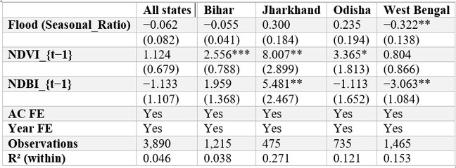
Results — Night Lights (Median model)
Dependentvariable :
∆logNL (median radiance growth)
Cluster- robust SEs ( district) in parentheses. ∗ ∗ ∗ p < 0 0. 1 , ∗ ∗ p < 0.05 ,
∗ p < 0 1. 0 .
Reading: Pooled flood effect small and indistinguishable from zero. West Bengal shows a significant negative effect(β1=−0.322,p<0.05): a10-pp rise in flood share lowers ∆logNL by∼3.2 log points.

Slide 20
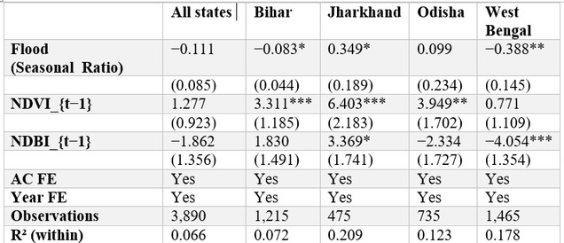
Results — Night Lights (Mean model)
Dependent variable :
∆logNL (mean radiance growth)
Cluster- robust SEs ( d i s t r i c t ) i n parentheses. ∗ ∗ ∗ p < 0 0. 1 , ∗ ∗ p < 0.05 ,
∗ p < 0 1. 0 .
Reading: With mean radiance, the flood effect strengthens. West Bengal again negative and significant; Bihar turns marginally negative; Jharkhand flips positive (small sample, N = 475). Odisha insignificant.

Slide 21
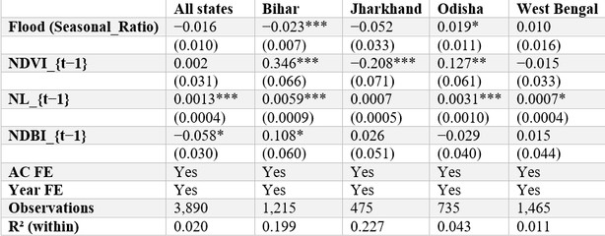
Results — NDBI (Median model)
Dependent variable :
NDBIt (built-up index level); β4 on NDBIt− 1 subject to Nickellbias
Cluster- robust SEs ( district) in parentheses.
∗ ∗ ∗ p < 0 0. 1 , ∗ ∗ p < 0.05 , ∗ p < 0 1. 0 .
Reading: Pooled flood effect on built-up index small and insignificant. Bihar shows a significant negative effect (−0.023, p < 0.01); Odisha a small positive effect (+0.019, p < 0.10).

Slide 22
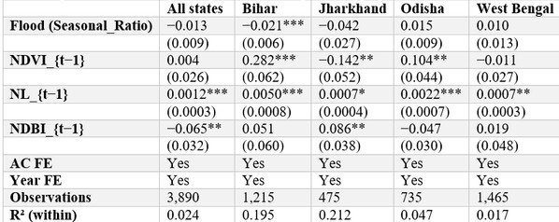
Results — NDBI (Mean model)
Dependent variable :
NDBIt (built-up index level); β4 on NDBIt− 1 subject to Nickellbias
Cluster- robust SEs ( district) in parentheses.
∗ ∗ ∗ p < 0 0. 1 , ∗ ∗ p < 0.05 , ∗ p < 0 1. 0 .
Reading: Mean and median NDBI results agree. Bihar’s flood effect remains negative and highly significant
⁽ −0.021, p < 0.01). NL_{t−1} loads positively across states.

Slide 23
Conclusion
Main Findings
Pooled across all four states, flood exposure shows no statistically significant effect on night-lights growth (Δ log NL) or built-up intensity (NDBI) — the pooled coefficient masks substantial state-level heterogeneity.
West Bengal · Flooding significantly reduces night-lights growth (β₁ ≈ −0.32 to −0.39, p < 0.05) — the strongest and most consistent evidence of economic-activity contraction across specifications.
Bihar · Flooding significantly reduces the built-up index (β₁ ≈ −0.02, p < 0.01) and shows a marginal negative night-lights effect — consistent with a structural physical-damage channel rather than a pure activity shock.
Jharkhand & Odisha · Flood effects are noisy or counter-intuitive across both outcomes, likely reflecting small AC-level samples, lower flood severity, and topographic differences from the Indo-Gangetic plain.
.

Slide 24
Conclusion
.
What This Implies
The flood-impact channel is state-specific, not a uniform regional phenomenon — pooling four states into a single regression obscures economically meaningful heterogeneous responses.
Night-lights and NDBI capture complementary dimensions of flood damage — NL reflects economic flow (activity, electricity use) while NDBI reflects physical stock (the built environment).
Results support state-tailored flood-resilience and adaptation policy rather than a blanket national approach — Bihar and West Bengal warrant priority attention given significant findings.
Caveat
Short panel (T = 5) → Nickell bias on NDBI's lagged-DV coefficient (~20% downward); the flood coefficient β₁ is largely unaffected.

Slide 25
Future Work
How does flood exposure affect road connectivity, and can better roads reduce flood-related economic losses?
Using Geo Sadak road-network data at the Assembly Constituency (AC) level, a flood × road-density interaction term is added to the night-lights (VIIRS/DMSP) fixed-effects OLS model.
Do constituencies with better road infrastructure experience lower economic disruption during floods?
This will be tested using AC-level road density through interaction terms or sample- split regressions within the night-lights fixed-effects panel framework.
Are urbanised or built-up regions more economically vulnerable to floods than rural areas? A heterogeneity analysis is conducted using flood × baseline NDBI interaction terms or urban-rural AC classifications within the fixed-effects night-lights regression model.

Slide 26
References
Jain, S.K. et al. (2006). Flood inundation mapping. Natural Hazards. Kale, V.S. (2003). Monsoon floods on Indian rivers. Natural Hazards.
Nickell, S. (1981). Biases in dynamic models with fixed effects. Econometrica. Pekel, J.F. et al. (2016). Global surface water mapping. Nature.
Sinha, R. et al. (2008). Flood risk in Kosi basin using AHP. JISRS. Census of India (2011). Office of the Registrar General, GoI. CWC (2024). Annual Flood Damage Report. GoI.
ECI (2008). Delimitation Files for Assembly Constituencies. GoB (2024). State Flood Reports. Dept. of Disaster Management. MoSPI (2024). State-wise Per Capita NSDP. GoI.
NDMA (2024). Flood Frequency & Damage Statistics. GoI. NIDM (2024). Flood Hazard Atlas of India. GoI. NRSC/ISRO & NDMA (2010). Flood Hazard Atlas of Bihar. GEE (2024). Landsat-8 Surface Reflectance. USGS/NASA.
JRC (2024). Global Surface Water Dataset. European Commission. MoRTH (2024). Geo Sadak Road Infrastructure Database. GoI. NOAA/VIIRS (2024). Day-Night Band Annual Composites.
NOAA/DMSP (2014). Nighttime Lights — Operational Linescan System.

