Slide 1
Imbalance Problem in Machine Learning
Shreya Sharma

Slide 2
Contents
What is imbalance problem and its types
Forms of imbalance
Initial methods to try
Advanced methods
Comparison of methods
Common Pitfalls
Imbalance in Deep Learning
Checklist of methods and order to try
Code/libraries
References
Appendix

Slide 3
What is imbalance problem?
An imbalance problem with respect to an input property occurs when the distribution of that property affects the model performance. For example, imbalance in classes can make the model biased towards majority class
If not addressed, imbalance causes adverse effect on the final detection performance
Types of imbalance problems
Class – number of labels
Scale – object sizes
Spatial – object locations
Objective – contribution of different tasks to overall loss
Classification
Object Detection

Slide 4
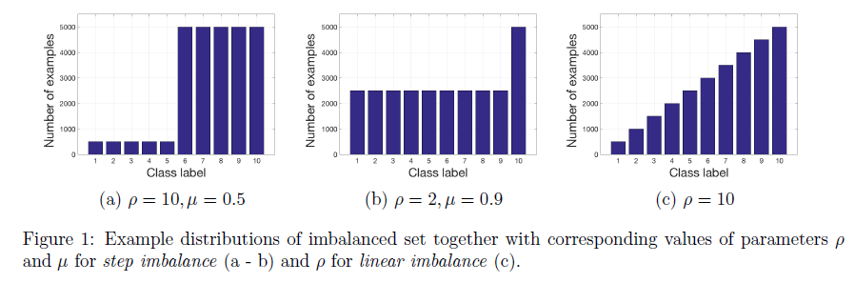

Forms of Imbalance
Step Imbalance
Number of examples is equal within minority classes and equal within majority classes but differs between majority and minority classes
Defined by 2 parameters
Fraction of minority class (µ)
Ratio between number of examples in majority class to minority class (ρ)
Linear Imbalance
Number of examples vary linearly
Defined by parameter ρ

Slide 5
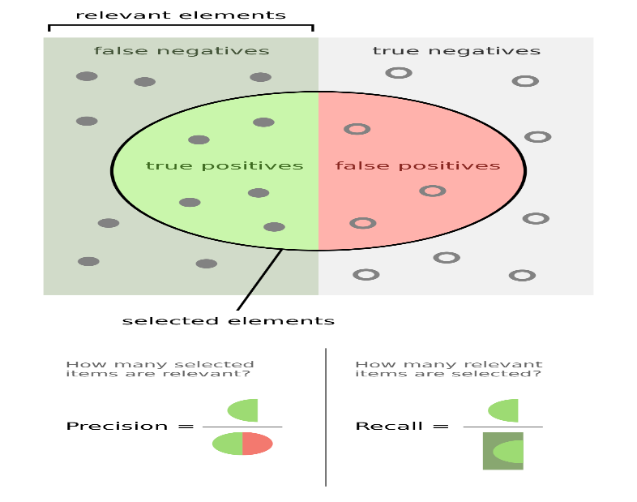
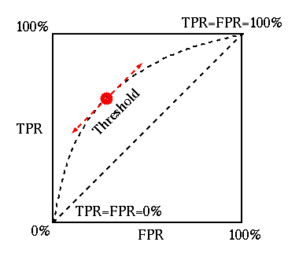
Initial methods to handle imbalance
Collect more data
Change evaluation metric from accuracy to f-measure and ROC-AUC
Try tree-based models or boosting method
Decision tree perform well on imbalanced data. It learns a hierarchy of if/else questions that force both classes to be addressed
XGBoost implicitly balances the data before classification

Slide 6
Advanced methods
Data-level
Classifier-level
Hybrid

Slide 7
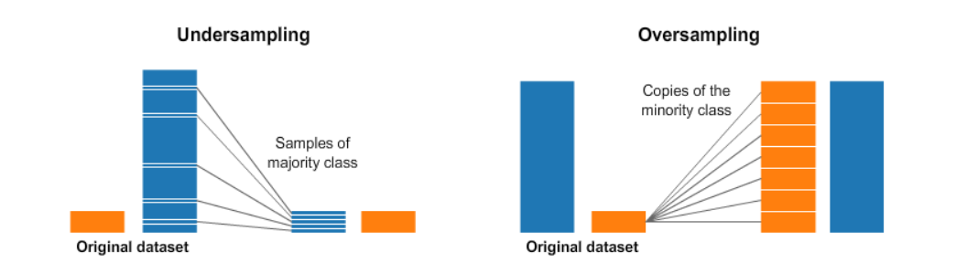
A. Data-level Methods
Undersampling
Random majority undersampling
Tomek Links
Clustering-based
Removing data redundancy
Oversampling
Random minority oversampling
SMOTE
Modified SMOTE
Adasyn
Clustering-based
Data Boost IM
Class-aware sampling
Data Augmentation of minority class
Notes:
Removing data redundancy: reduce the amount of redundant samples either through distance measure or by looking at the magnitude of gradients
Adasyn: extension of SMOTE to generate harder examples, aims to synthesize samples from underrepresented class
Data boost IM: identifies difficult examples with boosting pre-processing and uses them to generate synthetic data
Class-aware sampling: ensures uniform class distribution from each mini-batch and control the selection of examples from each class

Slide 8
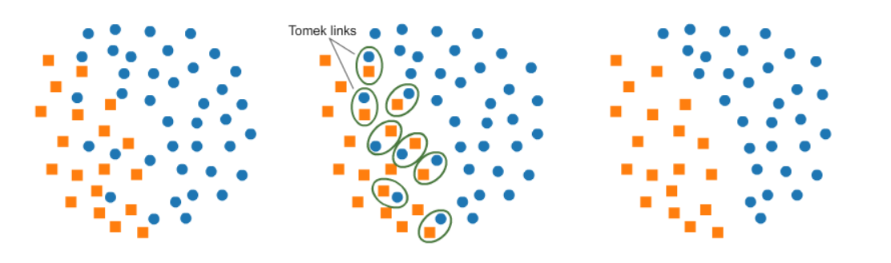
Tomek Links
Pairs of very close instances, but of opposite classes. Removing the instances of the majority class of each pair increases the space between two classes, facilitating the classification process

Slide 9
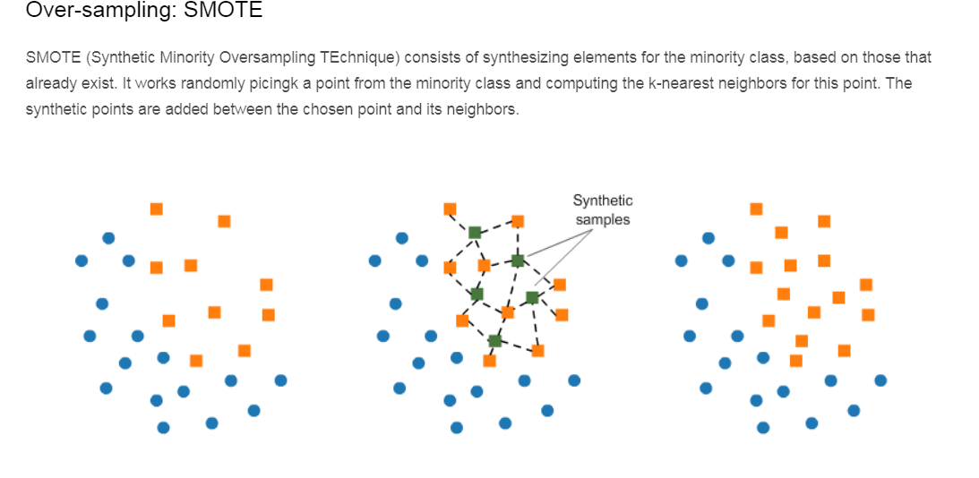
SMOTE
Synthetic Minority Oversampling Technique
Synthesize elements for the minority class, based on those that already exist. It works by randomly picking a point from the minority class and computing the k-nearest neighbors for this point. The synthetic points are added between the chosen point and its neighbors
Drawbacks
While generating synthetic samples does not consider neighboring examples from other classes. This can result in increase in overlapping of classes and can introduce additional noise
Not very effective for high dimensional data

Slide 10
Cluster-based oversampling
first clusters the dataset and then oversamples each cluster separately.
In this case, the K-means clustering algorithm is independently applied to minority and majority class instances to identify clusters in the dataset.
Subsequently, each cluster is oversampled such that all clusters of the same class have an equal number of instances and all classes have the same size.

Slide 11
B. Classifier-level Methods
Weighing of loss functions
Inverse class frequency
Focal loss
Class-balanced loss
Thresholding
Applied in test phase and involves changing the output class probabilities
Correct class probability by dividing the network output of each class by its prior prob.
Cost-sensitive learning
Assign different cost to misclassified samples from different classes
Harder examples are given higher cost
Modify the learning rate such that the higher cost examples contribute more to the update of weights
Train the network by minimizing the misclassification cost instead of the standard loss function
Result similar to oversampling
Circular learning approach: first train the classifier on easy examples and then on hard examples

Slide 12
B. Classifier-level Methods
Transfer learning
Design a model (meta-learner) to learn how the model evolves as the size of training data increases
The meta-learner model is trained gradually by increasing the number of examples from the classes with the large number of examples.
The resulting meta-model is able to transform another model trained with less examples to a model trained with more examples which makes it useful to be exploited by an underrepresented class
One-class classification
From the perspective of change detection or anomaly detection
Concept learing technique that recognized positive instances rather than discriminating between two classes
Common technique is to use autoencoders to learn identity mapping
Works well for extremely high imbalance
Weakly supervised learning
using unlabeled samples whose labels are generated using a classifier or manually. Noisy labels can be used

Slide 13
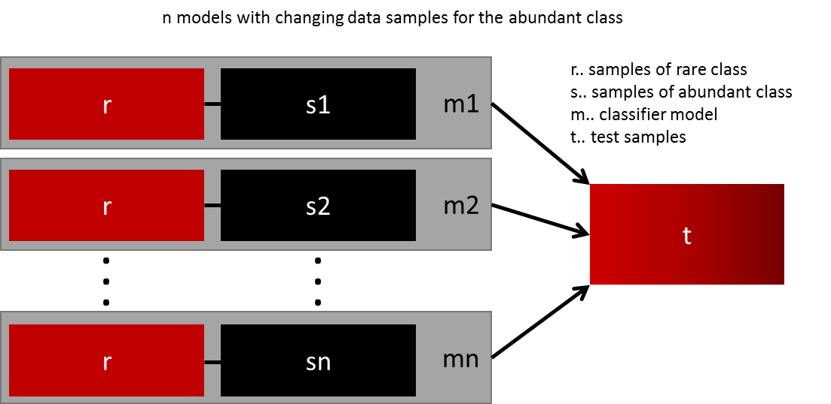
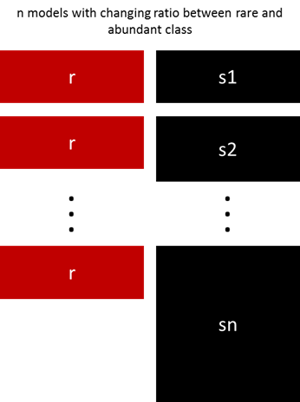
C. Hybrid Methods
Ensembling
With different resampled datasets- same ratio
With different resampled datasets- different ratio
EasyEnsemble and BalanceCascade
train a committee of classifiers on undersampled subsets
SMOTEBoost
boosting + SMOTE
Two-level training
pre-training on balanced dataset and Then fine-tuning the last output layer before softmax on the original imbalanced data

Slide 14
Comparison
Oversampling – best in deep learning
Undersampling – not suitable especially when number of minority classes are less. When minority classes are high, oversampling and underdamping becomes equivalent
Cost-sensitive learning- performs similar to oversampling
Thresholding- worked particularly well when applied jointly with oversampling. Please note that thresholding does not have an actual effect on the ability of the classifier to discriminate between a given class from another but rather helps to find a threshold on the network output that guarantees a large number of correctly classified cases.
Ensembling – huge computational time so not practical
One-class method- works in case of extremely high imbalance
Two-phase training – with oversampling is better than baseline

Slide 15
Common Pitfalls
Train-test split
Always split into test and train sets BEFORE trying any resampling techniques! Oversampling before splitting the data can allow the exact same observations to be present in both the test and train sets! This can allow our model to simply memorize specific data points and cause overfitting.
K-fold cross-validation
Keep in mind that over-sampling takes observed rare samples and applies bootstrapping to generate new random data based on a distribution function. If cross-validation is applied after over-sampling, basically what we are doing is overfitting our model to a specific artificial bootstrapping result. That is why cross-validation should always be done before over-sampling the data, just as how feature selection should be implemented. Only by resampling the data repeatedly, randomness can be introduced into the dataset to make sure that there won’t be an overfitting problem.

Slide 16
Deep Learning
Adjust class-weights
Increase batch size to ensure each batch has sufficient samples from all classes
Use precision, recall, f-measure, ROC as evaluation metric

Slide 17
Initial Things to try
Get more data
Change evaluation metric
Try tree-based method

Slide 18
Code
Sklearn.utils resample()
https://scikit-learn.org/stable/modules/generated/sklearn.utils.resample.html
Imbalanced-learn library
https://imbalanced-learn.readthedocs.io/en/stable/
Multi-class AUC
https://github.com/kleimanr/auc_mu
Oversampling example
https://www.curiousily.com/posts/practical-guide-to-handling-imbalanced-datasets/

Slide 19
References
https://www.kaggle.com/rafjaa/resampling-strategies-for-imbalanced-datasets
https://www.curiousily.com/posts/practical-guide-to-handling-imbalanced-datasets/
https://www.ele.uri.edu/faculty/he/PDFfiles/ImbalancedLearning.pdf
https://www.tensorflow.org/tutorials/structured_data/imbalanced_data
https://colab.research.google.com/drive/1xL2jSdY-MGlN60gGuSH_L30P7kxxwUfM
https://www.kdnuggets.com/2017/06/7-techniques-handle-imbalanced-data.html
https://www.dlology.com/blog/multi-class-classification-with-focal-loss-for-imbalanced-datasets/
https://www.kaggle.com/tboyle10/methods-for-dealing-with-imbalanced-data
https://www.analyticsvidhya.com/blog/2017/03/imbalanced-classification-problem/
https://arxiv.org/pdf/1909.00169.pdf

