Slide 1

Nutrition Analysis On Wheat Dataset
Name: SHREYA SINGH
Sec: B
Roll No.: 64
Uni. Roll No.: 2019118
Under the mentorship of: Dr. Guru Prasad M S

Slide 2
Analyzing wheat grains' nutritional composition, particularly iron and zinc content, is crucial for understanding their health benefits and potential nutritional deficiencies. K-means clustering, a powerful unsupervised machine learning algorithm, systematically categorizes wheat samples based on their iron and zinc concentrations. By employing this method on different regions, we can unveil patterns and groupings within the dataset, shedding light on distinct clusters exhibiting varying levels of these essential minerals. This analysis not only aids in identifying wheat varieties rich in iron and zinc but also contributes to enhancing our understanding of the nutritional diversity present within this staple grain.
Introduction

Slide 3
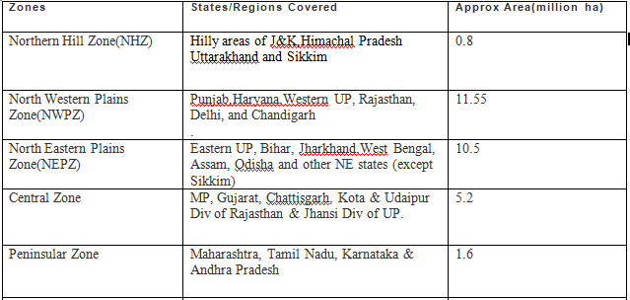
Indian Wheat Growing Zones

Slide 4
1. Introduction: Iron and zinc serve as vital micronutrients essential for various physiological functions within the human body. Iron plays a pivotal role in oxygen transportation, enzymatic reactions, and overall energy metabolism. Zinc, likewise, contributes significantly to immune function, cell division, and the proper functioning of numerous enzymes.
Methodology

Slide 5
• Prototype-based, partitioning technique
• Number of clusters, K, must be specified
• Each cluster is associated with a centroid (center point)
• Each point is assigned to the cluster with the closest centroid
• The basic algorithm is very simple :
1: Select K points as the initial centroids.
2: repeat
3: Form K clusters by assigning all points to the closest centroid.
4: Recompute the centroid of each cluster.
5: until The centroids don't change
K-Means Clustering

Slide 6
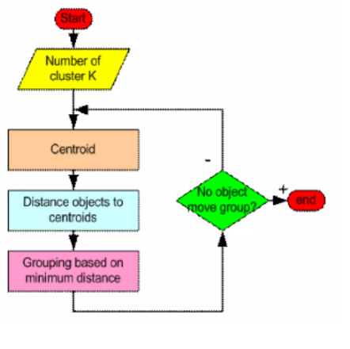
How the K-Means clustering algorithm works?

Slide 7
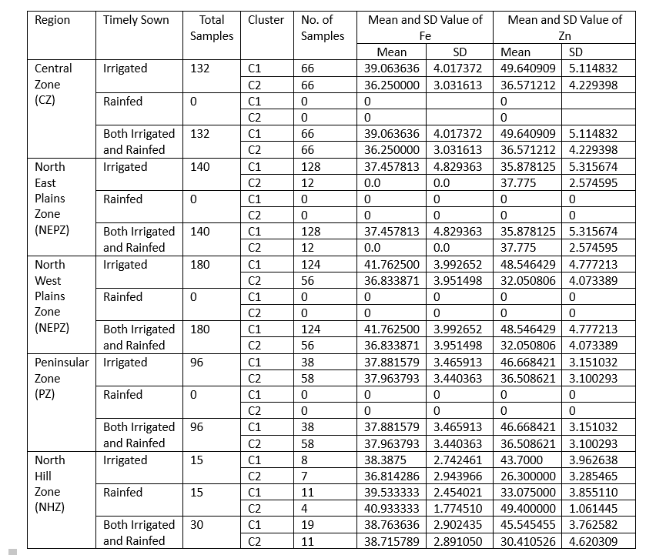
Result:

Slide 8
Through this project, we are able to find the iron and zinc content in various seeds of different regions and the regions are further divided on the basis of irrigated timely sown and rainfed timely sown. By applying k-means clustering we will able to find the number of clusters through the elbow method and clusters are divided according to similarity in the data points by finding the mean of each cluster we will able to know the zinc and iron content. Then, we can compare them accordingly.
Conclusion

Slide 9
THANK YOU!!

