Slide 1


Base-Delta-Immediate Compression: Practical Data Compression for On-Chip Caches
Gennady Pekhimenko
Vivek Seshadri
Onur Mutlu , Todd C. Mowry
Phillip B. Gibbons*
Michael A. Kozuch*
*
Notes:
This is a joint work between CMU and Intel Labs Pittsburgh.

Slide 2
Executive Summary
Off-chip memory latency is high
Large caches can help, but at significant cost
Compressing data in cache enables larger cache at low cost
Problem: Decompression is on the execution critical path
Goal: Design a new compression scheme that has
1. low decompression latency, 2. low cost, 3. high compression ratio
Observation: Many cache lines have low dynamic range data
Key Idea: Encode cachelines as a base + multiple differences
Solution: Base-Delta-Immediate compression with low decompression latency and high compression ratio
Outperforms three state-of-the-art compression mechanisms

Slide 3
Motivation for Cache Compression
Significant redundancy in data:
0x00000000
0x0000000B
0x00000003
0x00000004
…
How can we exploit this redundancy?
Cache compression helps
Provides effect of a larger cache without making it physically larger

Slide 4
Background on Cache Compression
Hit
L2 Cache
CPU
L1 Cache
Decompression
Uncompressed
Uncompressed
Compressed
Key requirements:
Fast (low decompression latency)
Simple (avoid complex hardware changes)
Effective (good compression ratio)

Slide 5
Shortcomings of Prior Work
Compression Mechanisms | Decompression Latency | Complexity | Compression Ratio
Zero | ✓ | ✓ | ✗

Slide 6
Shortcomings of Prior Work
Compression Mechanisms | Decompression Latency | Complexity | Compression Ratio
Zero | ✓ | ✓ | ✗
Frequent Value | ✗ | ✗ | ✓

Slide 7
Shortcomings of Prior Work
Compression Mechanisms | Decompression Latency | Complexity | Compression Ratio
Zero | ✓ | ✓ | ✗
Frequent Value | ✗ | ✗ | ✓
Frequent Pattern | ✗ | ✗/✓ | ✓

Slide 8
Shortcomings of Prior Work
Compression Mechanisms | Decompression Latency | Complexity | Compression Ratio
Zero | ✓ | ✓ | ✗
Frequent Value | ✗ | ✗ | ✓
Frequent Pattern | ✗ | ✗/✓ | ✓
Our proposal: BΔI | ✓ | ✓ | ✓

Slide 9
Outline
Motivation & Background
Key Idea & Our Mechanism
Evaluation
Conclusion

Slide 10
Key Data Patterns in Real Applications
Zero Values: initialization, sparse matrices, NULL pointers
0x00000000
0x00000000
0x00000000
0x00000000
…
Repeated Values: common initial values, adjacent pixels
0x000000FF
0x000000FF
0x000000FF
0x000000FF
…
Narrow Values: small values stored in a big data type
0x00000000
0x0000000B
0x00000003
0x00000004
…
Other Patterns: pointers to the same memory region
0xC04039C0
0xC04039C8
0xC04039D0
0xC04039D8
…

Slide 11
How Common Are These Patterns?
SPEC2006, databases, web workloads, 2MB L2 cache
“Other Patterns” include Narrow Values
43% of the cache lines belong to key patterns

Slide 12
Key Data Patterns in Real Applications
Zero Values: initialization, sparse matrices, NULL pointers
Low Dynamic Range:
Differences between values are significantly smaller than the values themselves
0x00000000
0x00000000
0x00000000
0x00000000
…
Repeated Values: common initial values, adjacent pixels
0x000000FF
0x000000FF
0x000000FF
0x000000FF
…
Narrow Values: small values stored in a big data type
0x00000000
0x0000000B
0x00000003
0x00000004
…
Other Patterns: pointers to the same memory region
0xC04039C0
0xC04039C8
0xC04039D0
0xC04039D8
…

Slide 13
Key Idea: Base+Delta (B+Δ) Encoding
4 bytes
32-byte Uncompressed Cache Line
0xC04039C0
0xC04039C8
0xC04039D0
…
0xC04039F8
0xC04039C0
Base
12-byte
Compressed Cache Line
0x00
0x08
0x10
…
0x38
1 byte
1 byte
1 byte
✓ Fast Decompression: vector addition
✓ Simple Hardware:
arithmetic and comparison
20 bytes saved
✓ Effective: good compression ratio

Slide 14
Can We Do Better?
Uncompressible cache line (with a single base):
Key idea:
Use more bases, e.g., two instead of one
Pro:
More cache lines can be compressed
Cons:
Unclear how to find these bases efficiently
Higher overhead (due to additional bases)
0x00000000
0x09A40178
0x0000000B
0x09A4A838
…

Slide 15
B+Δ with Multiple Arbitrary Bases
✓ 2 bases – the best option based on evaluations

Slide 16
How to Find Two Bases Efficiently?
First base - first element in the cache line
Second base - implicit base of 0
Advantages over 2 arbitrary bases:
Better compression ratio
Simpler compression logic
✓ Base+Delta part
✓ Immediate part
Base-Delta-Immediate (BΔI) Compression

Slide 17
B+Δ (with two arbitrary bases) vs. BΔI
Average compression ratio is close, but BΔI is simpler

Slide 18
BΔI Implementation
Decompressor Design
Low latency
Compressor Design
Low cost and complexity
BΔI Cache Organization
Modest complexity

Slide 19
BΔI Decompressor Design
Compressed Cache Line
B₀
B₀
Δ₀
Δ₀
Δ₁
Δ₁
Δ₂
Δ₂
Δ₃
Δ₃
B₀
B₀
B₀
B₀
+
+
+
+
Vector addition
V₀
V₁
V₂
V₃
V₀
V₁
V₂
V₃
Uncompressed Cache Line

Slide 20
BΔI Compressor Design
32-byte Uncompressed Cache Line
8-byte B₀
1-byte Δ
CU
8-byte B₀
2-byte Δ
CU
8-byte B₀
4-byte Δ
CU
4-byte B₀
1-byte Δ
CU
4-byte B₀
2-byte Δ
CU
2-byte B₀
1-byte Δ
CU
Zero
CU
Rep.
Values
CU
CFlag &
CCL
CFlag &
CCL
CFlag &
CCL
CFlag &
CCL
CFlag &
CCL
CFlag &
CCL
CFlag &
CCL
CFlag &
CCL
CFlag &
CCL
Compression Selection Logic (based on compr. size)
Compression Flag & Compressed Cache Line
Compressed Cache Line

Slide 21
BΔI Compression Unit: 8-byte B₀ 1-byte Δ
32-byte Uncompressed Cache Line
8 bytes
V₀
V₀
V₀
V₁
V₁
V₂
V₂
V₃
V₃
B₀=
V₀
B₀
B₀
B₀
B₀
-
-
-
-
Δ₀
Δ₁
Δ₂
Δ₃
Within 1-byte range?
Within 1-byte range?
Within 1-byte range?
Within 1-byte range?
Is every element within 1-byte range?
Yes
No
B₀
B₀
Δ₀
Δ₀
Δ₁
Δ₁
Δ₂
Δ₂
Δ₃
Δ₃

Slide 22
BΔI Cache Organization
Tag Storage:
Data Storage:
32 bytes
Conventional 2-way cache with 32-byte cache lines
Set₀
…
…
Set₀
…
…
Set₁
Tag₀
Tag₁
Set₁
Data₀
Data₁
…
…
…
…
Way₀
Way₁
Way₀
Way₁
BΔI: 4-way cache with 8-byte segmented data
Tag Storage:
8 bytes
Set₀
…
…
…
…
Set₀
…
…
…
…
…
…
…
…
Tag₀
Tag₁
Tag₂
Tag₃
S₀
Set₁
Set₁
S₀
S₁
S₂
S₃
S₄
S₅
S₆
S₇
_{C}
✓C - Compr. encoding bits
…
…
…
…
…
…
…
…
…
…
…
…
Way₀
Way₁
Way₂
Way₃
✓Twice as many tags
✓Tags map to multiple adjacent segments
2.3% overhead for 2 MB cache

Slide 23
Qualitative Comparison with Prior Work
Zero-based designs
ZCA [Dusser+, ICS’09]: zero-content augmented cache
ZVC [Islam+, PACT’09]: zero-value cancelling
Limited applicability (only zero values)
FVC [Yang+, MICRO’00]: frequent value compression
High decompression latency and complexity
Pattern-based compression designs
FPC [Alameldeen+, ISCA’04]: frequent pattern compression
High decompression latency (5 cycles) and complexity
C-pack [Chen+, T-VLSI Systems’10]: practical implementation of FPC-like algorithm
High decompression latency (8 cycles)

Slide 24
Outline
Motivation & Background
Key Idea & Our Mechanism
Evaluation
Conclusion

Slide 25
Methodology
Simulator
x86 event-driven simulator based on Simics [Magnusson+, Computer’02]
Workloads
SPEC2006 benchmarks, TPC, Apache web server
1 – 4 core simulations for 1 billion representative instructions
System Parameters
L1/L2/L3 cache latencies from CACTI [Thoziyoor+, ISCA’08]
4GHz, x86 in-order core, 512kB - 16MB L2, simple memory model (300-cycle latency for row-misses)

Slide 26
Compression Ratio: BΔI vs. Prior Work
SPEC2006, databases, web workloads, 2MB L2
1.53
BΔI achieves the highest compression ratio

Slide 27
Single-Core: IPC and MPKI
3.6%
16%
5.6%
4.9%
24%
5.1%
21%
5.2%
13%
8.1%
19%
14%
BΔI achieves the performance of a 2X-size cache
Performance improves due to the decrease in MPKI

Slide 28
Multi-Core Workloads
Application classification based on
Compressibility: effective cache size increase
(Low Compr. (LC) < 1.40, High Compr. (HC) >= 1.40)
Sensitivity: performance gain with more cache
(Low Sens. (LS) < 1.10, High Sens. (HS) >= 1.10; 512kB -> 2MB)
Three classes of applications:
LCLS, HCLS, HCHS, no LCHS applications
For 2-core - random mixes of each possible class pairs (20 each, 120 total workloads)

Slide 29
Multi-Core: Weighted Speedup
If at least one application is sensitive, then the performance improves
BΔI performance improvement is the highest (9.5%)

Slide 30
Other Results in Paper
IPC comparison against upper bounds
BΔI almost achieves performance of the 2X-size cache
Sensitivity study of having more than 2X tags
Up to 1.98 average compression ratio
Effect on bandwidth consumption
2.31X decrease on average
Detailed quantitative comparison with prior work
Cost analysis of the proposed changes
2.3% L2 cache area increase

Slide 31
Conclusion
A new Base-Delta-Immediate compression mechanism
Key insight: many cache lines can be efficiently represented using base + delta encoding
Key properties:
Low latency decompression
Simple hardware implementation
High compression ratio with high coverage
Improves cache hit ratio and performance of both single-core and multi-core workloads
Outperforms state-of-the-art cache compression techniques: FVC and FPC

Slide 32
Base-Delta-Immediate Compression: Practical Data Compression for On-Chip Caches
Gennady Pekhimenko,
Vivek Seshadri ,
Onur Mutlu , Todd C. Mowry
Phillip B. Gibbons*,
Michael A. Kozuch*
*
Notes:
This is a joint work between CMU and Intel Labs Pittsburgh.

Slide 33
Backup Slides

Slide 34
B+Δ: Compression Ratio
SPEC2006, databases, web workloads, L2 2MB cache
Good average compression ratio (1.40)
But some benchmarks have low compression ratio

Slide 35
Single-Core: Effect on Cache Capacity
Fixed L2 cache latency
2.3%
1.7%
1.3%
BΔI achieves performance close to the upper bound

Slide 36
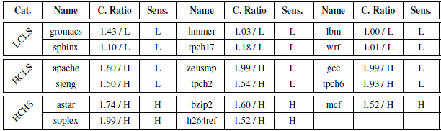

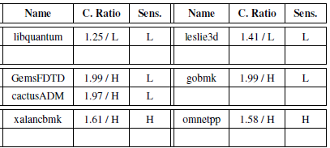
Multiprogrammed Workloads - I

Slide 37
Cache Compression Flow
CPU
Hit L1
L1 Data Cache
Uncompressed
Writeback
Compress
Hit L2
Decompress
Miss
L2 Cache
Compressed
Writeback
Decompress
Compress
Miss
Memory
Uncompressed

Slide 38
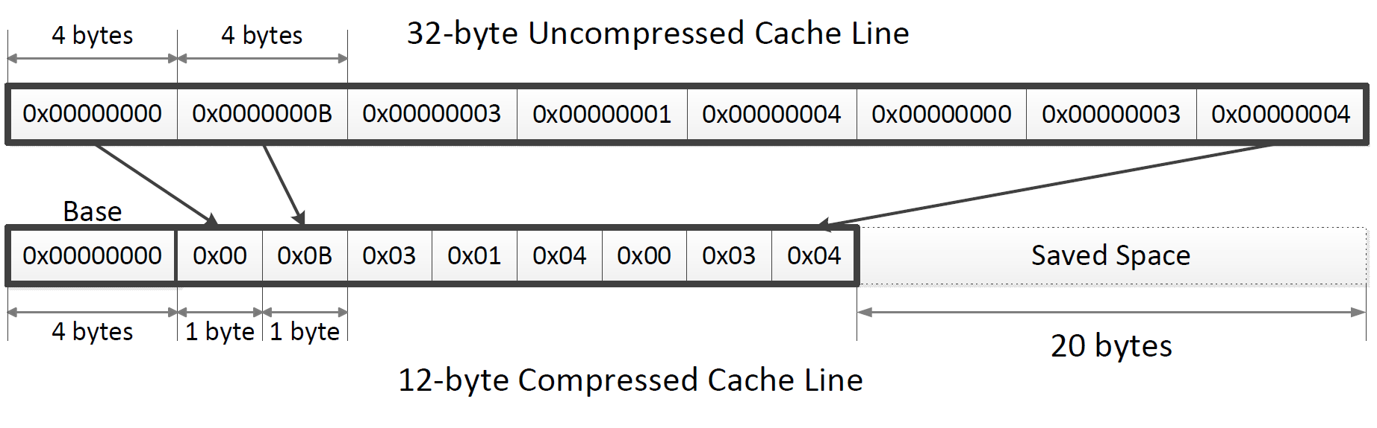
Example of Base+Delta Compression
Narrow values (taken from h264ref):

