Slide 1
YouTube Channel Real Performance Analysis
Unlocking YouTube Channel Performance: Data-Driven Insights & Revenue Prediction
Shreya Singh Chauhan| Unified Mentor|11 August

Slide 2
Understand The Problem
YouTube channels often struggle to identify what drives growth and revenue.
Multiple metrics like views, subscribers, likes, shares, and comments influence performance.
Without structured analysis, it’s hard to optimize content for maximum engagement.

Slide 3
Project Objective
Analyze YouTube channel data to uncover performance patterns.
Identify high-impact metrics influencing revenue.
Predict potential revenue using input parameters.

Slide 4
Dataset Description
Source: YouTube channel performance dataset.
Key Parameters:
Views – Total views per video.
Subscribers – Subscriber count at upload time.
Likes – Audience approval metric.
Shares – Video share count.
Comments – Audience interaction measure.
Video Duration – Length of the video in seconds.
Data Size: Number of videos (as per dataset).

Slide 5
Techniques Used
Data Cleaning – Removing duplicates, handling nulls, and formatting values.
Exploratory Data Analysis (EDA) – Identifying trends & patterns.
Visualization – Using histograms, bar charts, and KPI dashboards.
Predictive Modelling – Estimating revenue based on channel parameters.

Slide 6
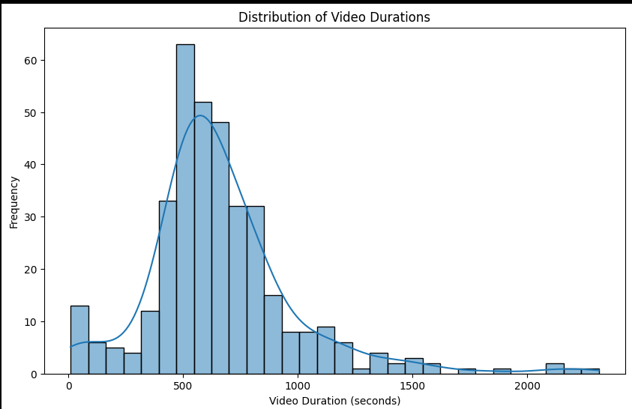
Video Duration Analysis

Slide 7
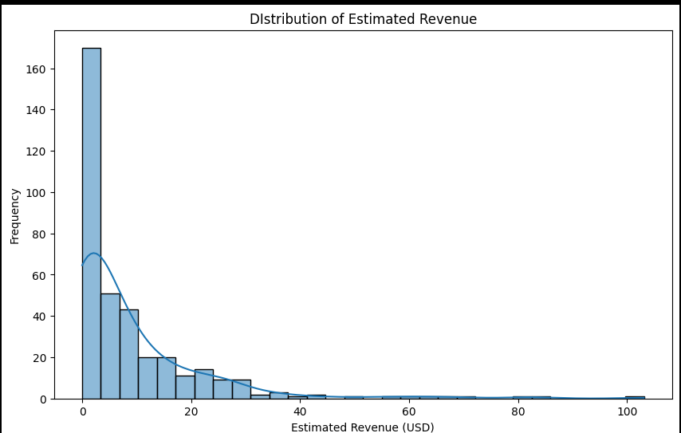
Duration of Estimate Revenue

Slide 8
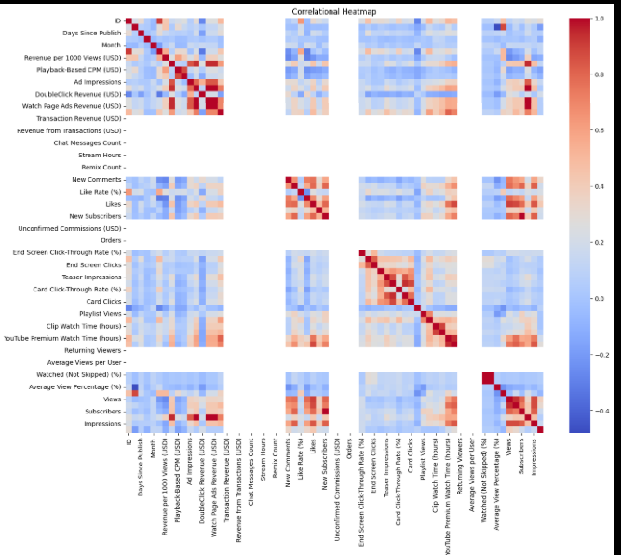
Correlational Heatmap

