Slide 1
WELCOME EVERYONE
PRESENTATION BY - MISS SHREYA SHAILENDRA PATIL

Slide 2
AYURVEDIC MEDICINE ORDER APP
JAVA J2EE BATCH 2

Slide 3
AYURVEDIC MEDICINE ORDER APP
Introduction
Problem Statement
Solution Overview
How It Works
Target Audience
Market Analysis
Use Cases Diagram
Entity Mapping
Service Interfaces
User Stories
Conclusion

Slide 4
Introduction
Welcome to the world of holistic wellness!
Ayurveda, the ancient India system of medicine, emphasizes balance and harmony in the body, mind and spirit.
In today’s fast-placed world, accessing Ayurvedic medicines and products can be challenging.
Introducing the Ayurvedic Medicine Order App – your one-stop solution for convenient and hassle-free access to a wide range of authentic Ayurvedic products.
Founded on the principles of Ayurveda.
Bridging the gap between tradition and technology.
Empowering users to prioritize their health and well-being.

Slide 5
Problem Statement
Limited availability at local stores.
Time-consuming visits to multiple shops.
Busy lifestyles and limited mobility further exacerbate these challenges, leaving many consumers frustrated and underserved.
Despite the growing popularity of Ayurveda, many individuals face challenges in accessing the medicines and products they need.

Slide 6
Solution Overview
Introducing the Ayurvedic Medicine Order App- revolutionizing the way you access Ayurvedic healthcare.
A user-friendly interface.
A vast selection of authentic Ayurvedic products from trusted brands.
Experience the convenience and reliability of the Ayurvedic Medicine Order App today!

Slide 7
How It Works
Using the Ayurvedic Medicine Order App is simple. Here’s how it works:
1. Login: Create an account or log in to your existing account securely.
2. View All Products(Medicines): By get all you can able to see n number of medicines.
3. Place an Order: By post order you can able to place your order with the number of quantity you required.

Slide 8
Target Audience
The Ayurvedic Medicine Order App is tailored to meet the need of a diverse range of individuals who prioritize their health and well-being.
Those who proactively seek natural and holistic approaches to maintaining their health.
Seniors who rely on Ayurvedic medicines for their wellness needs and may benefit from the ease of ordering through an app.
Residents of urban areas where access to traditional Ayurvedic stores may be limited.

Slide 9
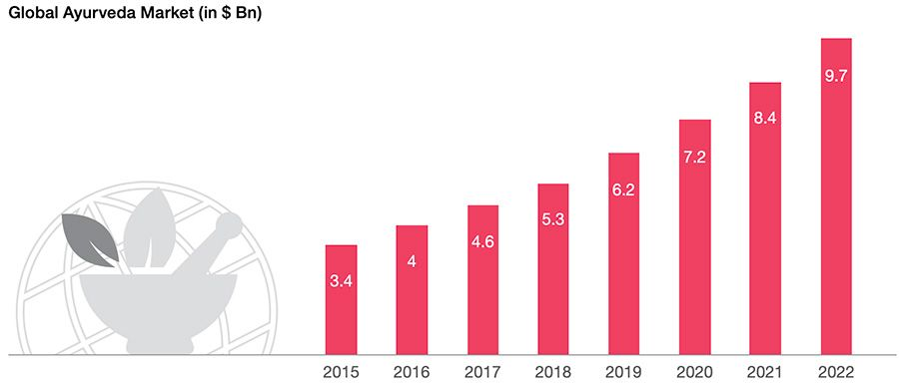

Market Analysis
From year 2015 to 2022 growth of Ayurveda market
Companies shares that deals with Ayurvedic products
The Ayurvedic medicine market is experiencing robust growth, fuelled by increasing consumer awareness and demand for natural and holistic healthcare solutions.

Slide 10
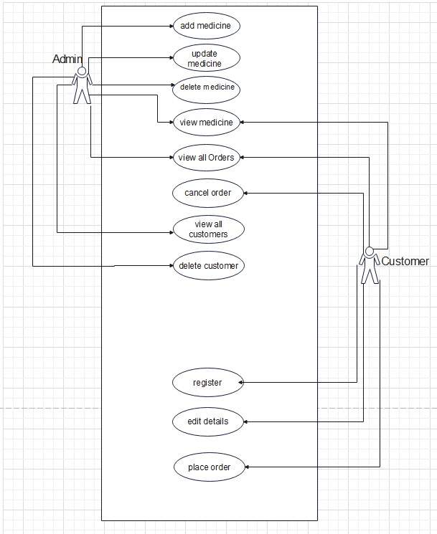
Use Cases Diagram

Slide 11
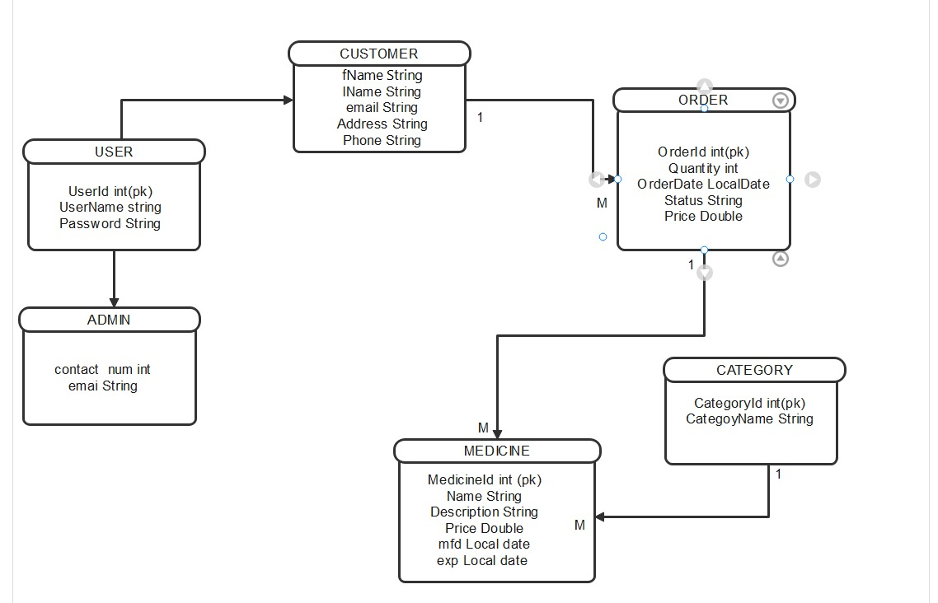
Entity Mapping

Slide 12
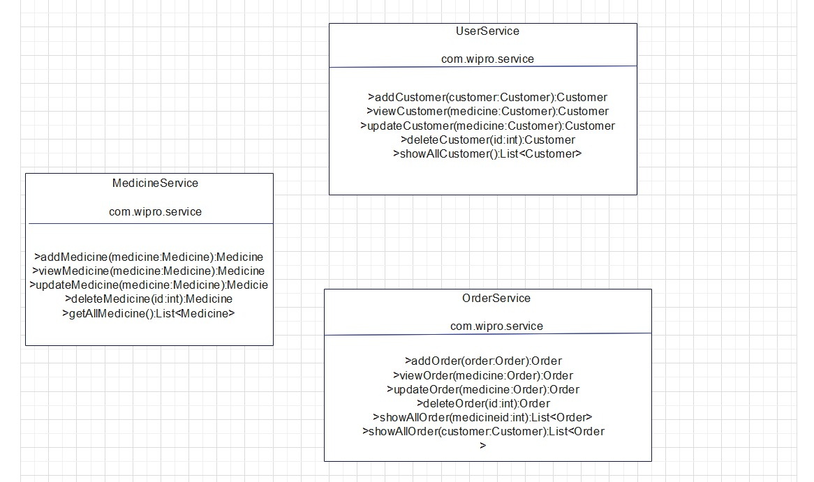
Service Interfaces

Slide 13
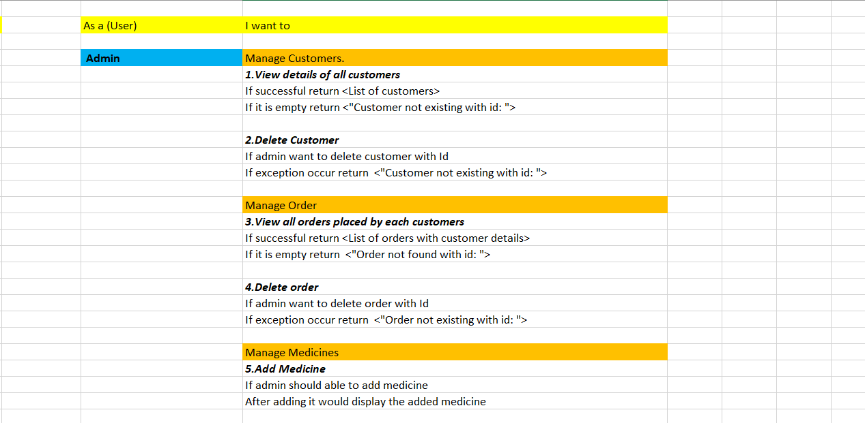
User Stories

Slide 14
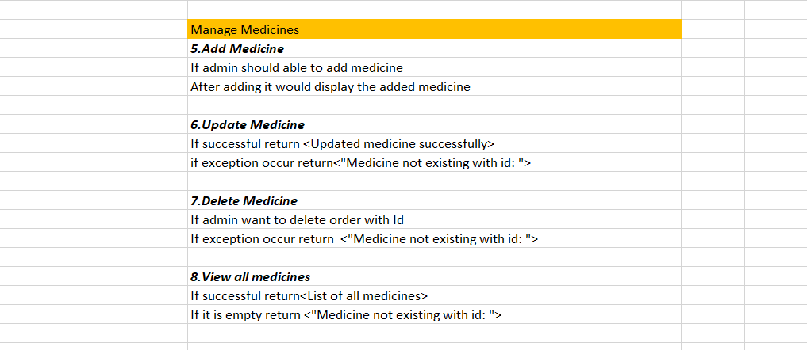

Slide 15
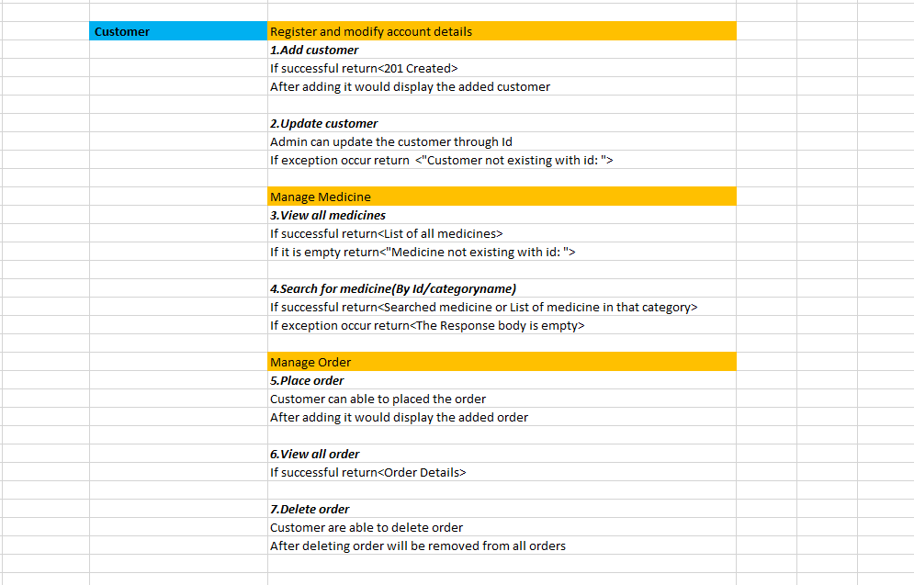

Slide 16
Conclusion
Prioritize your health with Ayurvedic Medicine Order App.
Experience convenience and reliability.
Join us on the journey towards happy-healthy life.
Health is Wealth,
not just a thought but today’s reality!

Slide 17
THANK YOU

