Slide 1
The Problem
India is the second largest populated country. With such a large population, it is difficult for the police force to maintain law and order.
Communication gap between the police force and ordinary citizens.

Slide 2
Our Approach to the solution
Building an application to minimize the communication gap between the police force and ordinary citizens.
There are several instances when we find something suspicious about a person but can’t really do anything about it. That person may be a criminal who went underground. Imagine a scenario when you can actually report such people. What a great help it would be to the police force!

Slide 3
Take, for example, the children begging on traffic signals. Most of them are victims of child trafficking and have missing reports registered with the police.
But none of us would want to go to the police station to report such cases. It is just too much effort for some random person and will be a wastage of time for both police and citizens
So, using our application, people would be able to report any suspicious person or victim that they find anywhere just with a few button clicks.

Slide 4
Functioning
Citizens just need to click a photo of the person and upload it on the app.
The nearest police station will be notified about the report.
Furthur, the app matches the image with the police databases (missing and criminal database) using facial recognition techniques.
If match is found, police can take required action.

Slide 5
Citizen version
Citizens need to login and then they will be allowed to click and upload images.
These images will be sent to the police station.

Slide 6
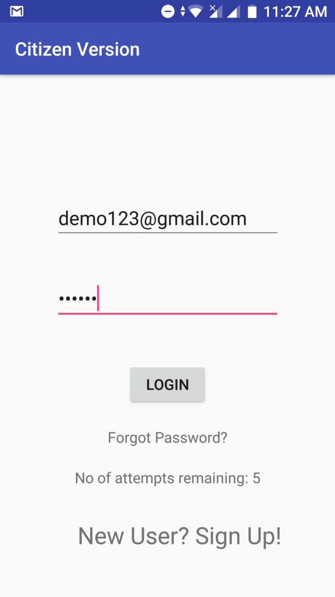
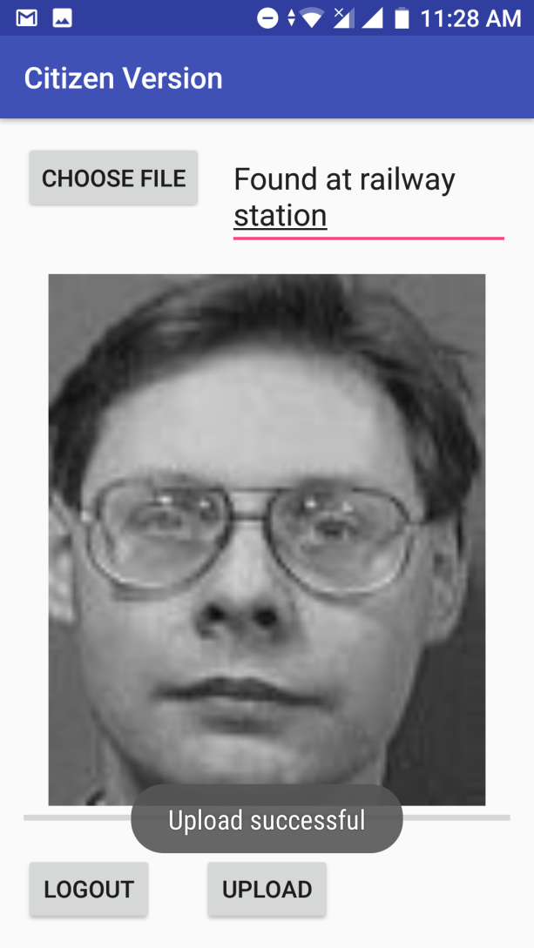
Screenshots

Slide 7
The Police version
The photos sent by the citizens are matched with the police database,i.e, criminal database and missing person database.

Slide 8
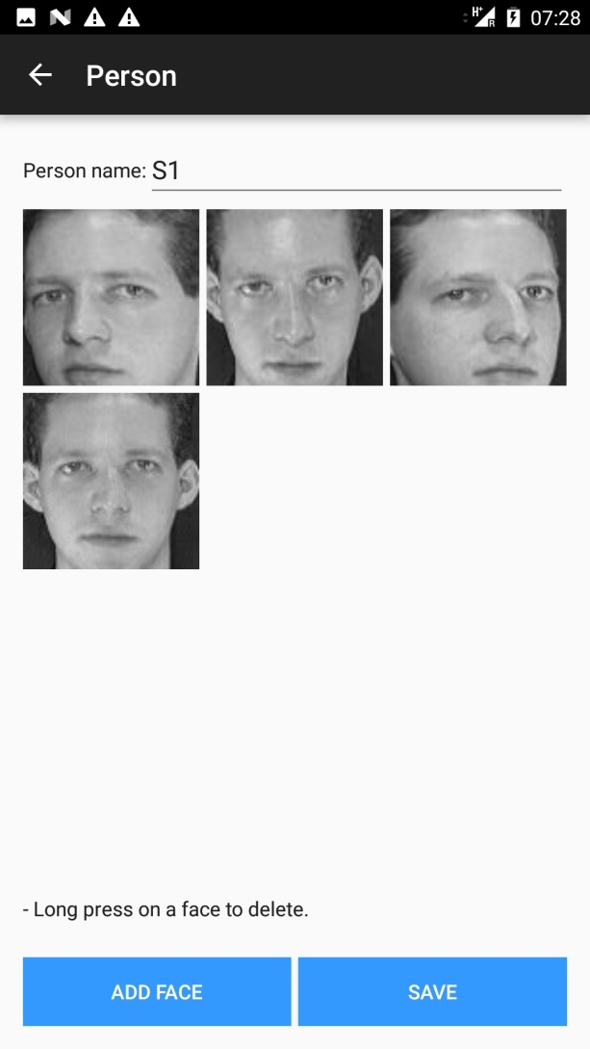
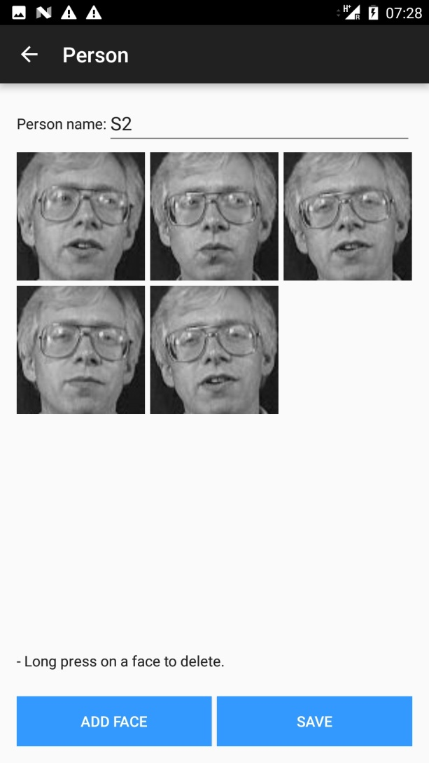
Police version – Demo missing person database

Slide 9
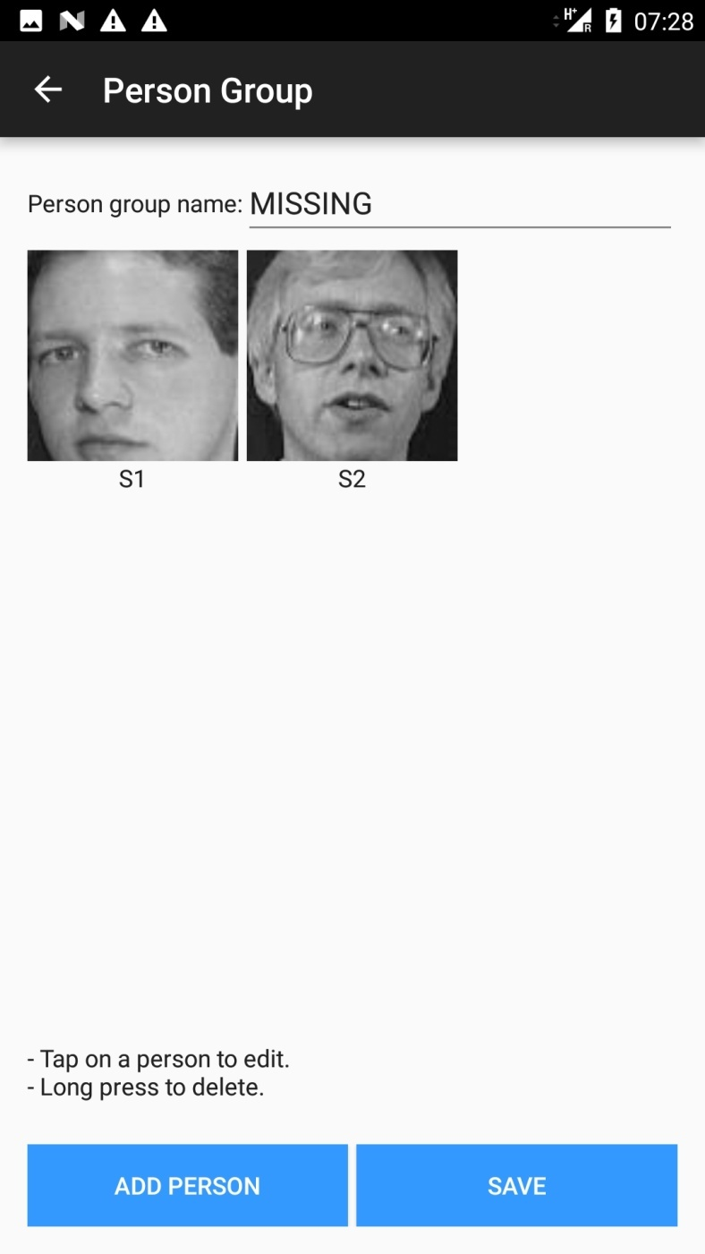

Slide 10
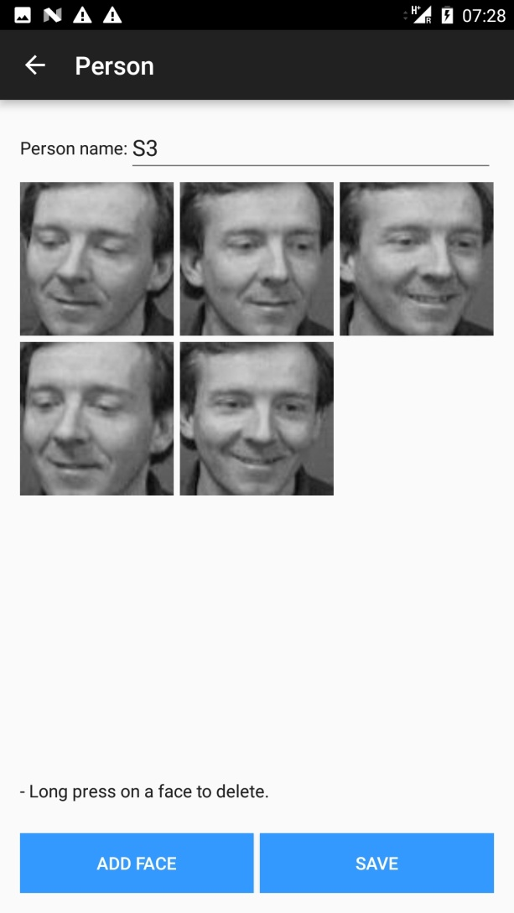
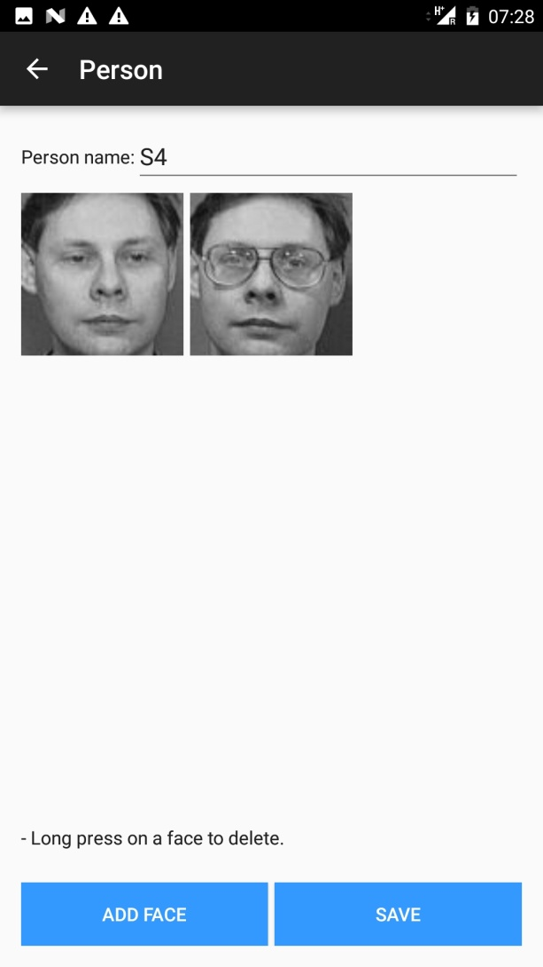
Demo criminal database

Slide 11
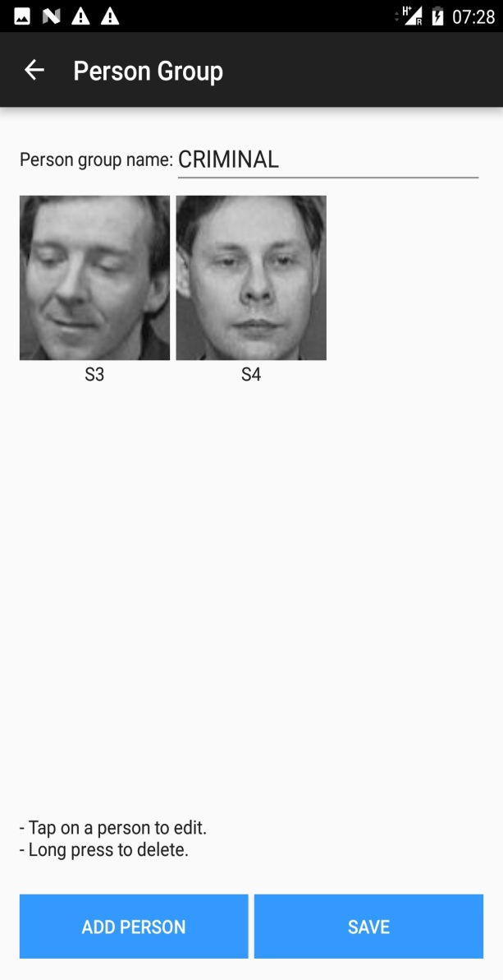

Slide 12
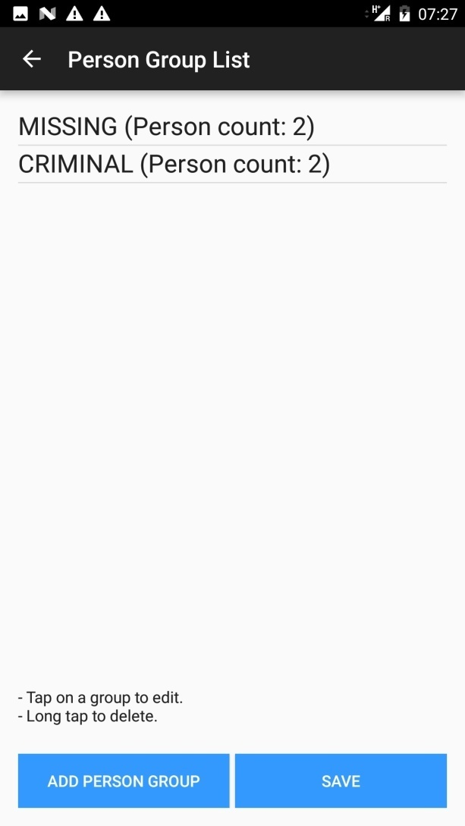
Person group list

Slide 13
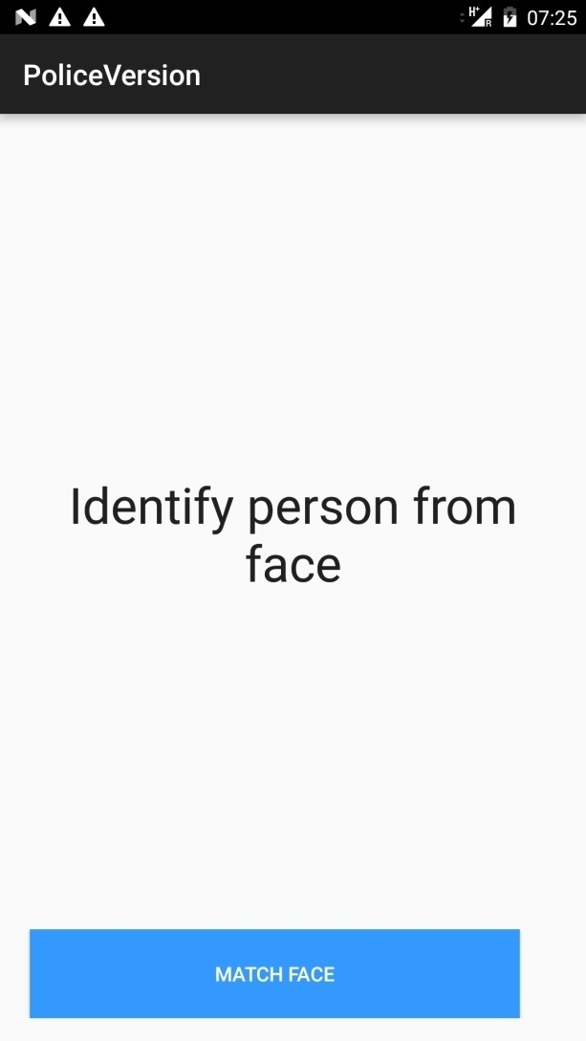
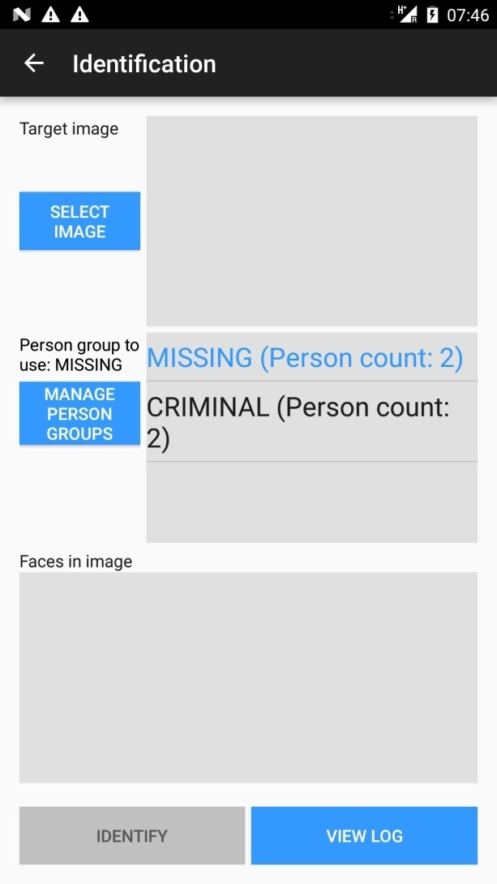
The interface

Slide 14
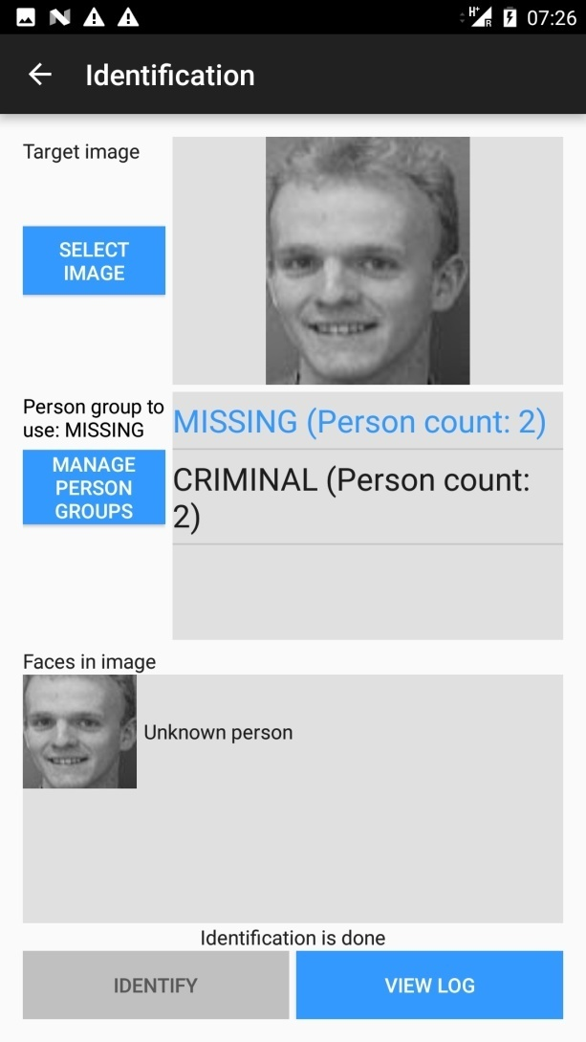

Matching faces

Slide 15
