Slide 1
CAPSTONE PROJECT EMPLOYEE SALARY PREDICTION USING AI/ML ALGORITHMS
PRESENTED BY: SHREYA SHARMA
UNIVERSITY: BANSTHALI VIDYAPITH
DEPARTMENT: B.TECH CS-AI
AICTE Internship Student Registration ID : STU67cf3e7e8c6a71741635198

Slide 2
OUTLINE
Problem Statement
System Development Approach
Algorithm & Deployment (Step by Step Procedure)
Result
Conclusion
Future Scope
References

Slide 3
Problem statement
In today's competitive landscape, understanding the factors that influence employee compensation is crucial for various stakeholders. Businesses strive for fair and equitable pay structures, while individuals seek transparency regarding potential earning opportunities. The traditional methods of determining salary often involve subjective assessments, leading to inconsistencies and potential biases. This project addresses the challenge of predicting an individual's income bracket based on their demographic and professional attributes, leveraging advanced AI/ML techniques. Accurate income prediction can facilitate better resource allocation, informed career planning, and more transparent compensation policies.

Slide 4
System Approach
The development of the Employee Salary Prediction model followed a structured system approach, leveraging a robust set of open-source technologies. The entire project was implemented in Python, utilizing the Google Colab environment for its interactive capabilities, facilitating iterative development, data exploration, and real-time visualization of results.

Slide 5
SYSTEM REQUIREMENTS
Operating System: Cloud-based (Google Colab environment), with local development on Windows.
Development Environment:
Python 3.x (as provided by Google Colab)
Google Colab (primary interactive development platform)
Hardware: Cloud computing resources (Google Colab) or standard PC with at least 8GB RAM for local work.

Slide 6
LIBRARIES USED
pandas (as pd):
Purpose: A fundamental data manipulation and analysis library for Python. It provides data structures like DataFrames that are essential for working with tabular data.
Usage in code: Used for loading your adult 3.csv dataset (pd.read_csv), displaying data (data.head(), data.shape), handling missing values (data.isna().sum(), data.workclass.replace()), and performing various data transformations.

Slide 7
matplotlib.pyplot (as plt):
Purpose: A comprehensive library for creating static, interactive, and animated visualizations in Python. It's the base for many other plotting libraries.
Usage in code: Used for creating basic plots, often in conjunction with seaborn, to visualize data distributions or model results (though specific plot calls for plt alone might be implicit or part of commented-out Streamlit sections).

Slide 8
numpy (as np):
Purpose: The fundamental package for numerical computing in Python. It provides support for large, multi-dimensional arrays and matrices, along with a large collection of high-level mathematical functions to operate on these arrays.
Usage in code: Although not explicitly imported at the very top of employee.py in the snippet provided, numpy functions like np.nan are commonly used with pandas for missing value handling, so it's often implicitly or explicitly imported in a full ML pipeline. If np.nan is used, then import numpy as np is necessary.
seaborn (as sns):
Purpose: A data visualization library based on matplotlib that provides a high-level interface for drawing attractive and informative statistical graphics. It simplifies the creation of complex plots.
Usage in code: Used for statistical plots like histograms or boxplots to understand data distributions and identify outliers (e.g., as discussed for fnlwgt and hours-per-week previously).

Slide 9
sklearn (Scikit-learn modules):
Purpose: A powerful and widely used machine learning library for Python. It provides a wide range of algorithms for classification, regression, clustering, dimensionality reduction, and tools for model selection and preprocessing.
Usage in code: While the employee.py snippet doesn't show explicit sklearn imports for models directly, your employee.ipynb and knn_adult_csv updated (1).ipynb clearly indicate the use of various sklearn modules for:
model_selection: For splitting data (train_test_split).
preprocessing: For transforming features (e.g., LabelEncoder, MinMaxScaler, OneHotEncoder, StandardScaler).
linear_model: For LogisticRegression.
ensemble: For RandomForestClassifier and GradientBoostingClassifier.
neighbors: For KNeighborsClassifier.
svm: For SVC.
metrics: For evaluating model performance (accuracy_score, classification_report, confusion_matrix, roc_auc_score, roc_curve).
pipeline: For combining preprocessing and modeling steps into a single workflow.

Slide 10
pyngrok:
Purpose: A Python wrapper for ngrok, a tool that creates secure tunnels to your localhost. This is particularly useful in environments like Google Colab to expose your local web applications (like Streamlit apps) to the internet.
Usage in your code: Seen with !pip install streamlit pyngrok and !ngrok aut..., indicating its use to make the Streamlit app accessible via a public URL.
streamlit:
Purpose: An open-source app framework for Machine Learning and Data Science teams. It allows you to create interactive web applications for your models with pure Python code.
Usage in your code: The snippet shows commented-out streamlit code and calls like !streamlit run app.py, indicating its use for deploying your model into a simple web interface for demonstration and batch predictions

Slide 11
ALGORITHM AND DEPLOYMENT
1. Data Collection & Overview:
The project utilized the 'Adult Income Dataset' (adult 3.csv), comprising various demographic and socio-economic features. Key features include age, workclass, education, marital-status, occupation, race, gender, hours-per-week, capital-gain, capital-loss, and native-country. The target variable is 'income', indicating whether an individual's annual income is <=50K or >50K.

Slide 12
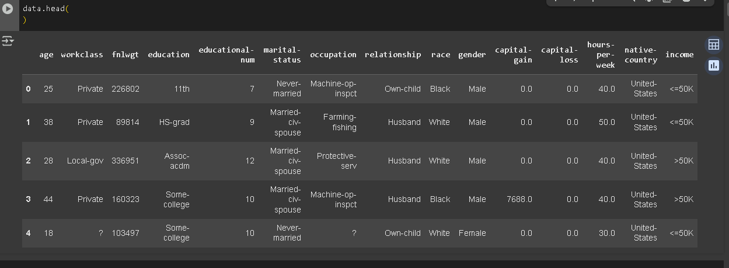

Slide 13
2. Data Preprocessing:
Initial data inspection revealed missing values denoted by '?', which were replaced with NaN and subsequently handled by imputing with the mode for categorical features (e.g., 'workclass', 'occupation', 'native-country'). Specific 'workclass' categories ('Without-pay', 'Never-worked') were also filtered out for relevance.
Categorical features were transformed into numerical format using Label Encoding for the target variable ('income') and manual encoding for other nominal features. Numerical features were scaled using MinMaxScaler to normalize their range.
Outliers in 'age', 'fnlwgt', and 'hours-per-week' were identified and handled through filtering within a reasonable range or using the Interquartile Range (IQR) method to ensure data quality and model robustness.

Slide 14
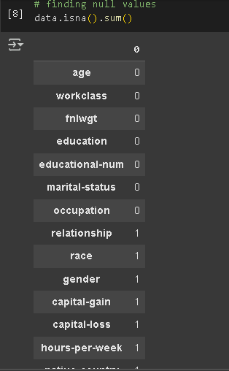
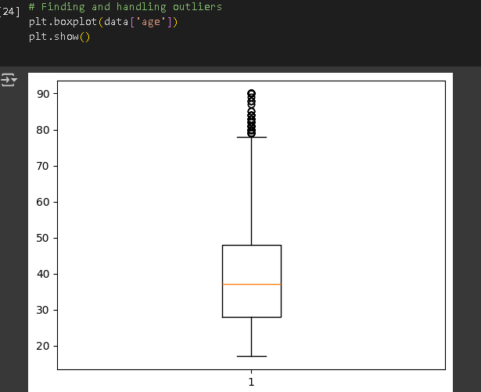

Slide 15
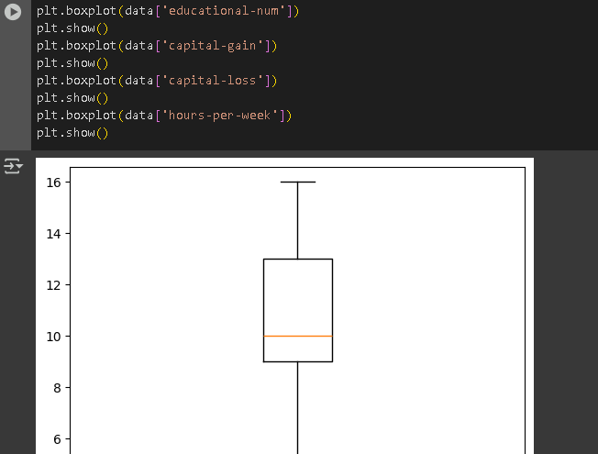
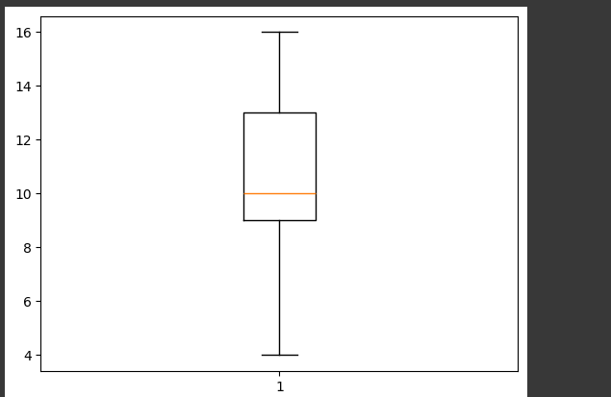
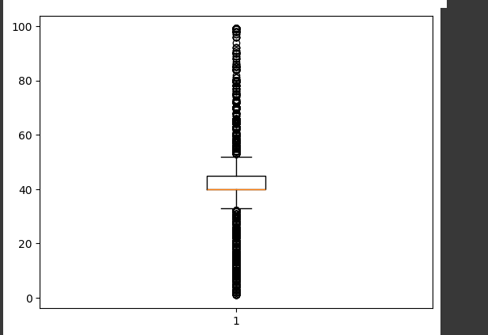

Slide 16
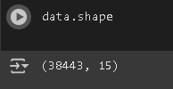

DATA SHAPE BEFORE REMOVING OUTLIERS
DATA SHAPE AFTER REMOVING OUTLIERS

Slide 17
3. Data Splitting:
"The preprocessed dataset was divided into training and testing sets with an 80:20 ratio, respectively, ensuring the model's performance could be evaluated on unseen data."
4. Machine Learning Model Selection & Training:
For this classification problem, three distinct machine learning algorithms were selected and trained:
Logistic Regression: Chosen as a foundational, interpretable baseline model to establish initial performance.
Random Forest Classifier: An ensemble learning method, known for its high accuracy and ability to handle complex, non-linear relationships and feature interactions effectively.
K-Nearest Neighbors (KNN): A simple, non-parametric, instance-based learning algorithm that classifies data points based on the majority class of their nearest neighbors.
5. Deployment :
To demonstrate the practical application of the trained model, an interactive web application was developed using Streamlit. This application allows users to upload a CSV file for batch prediction, showcasing how the model can be used to predict income levels for new employee data.

Slide 18
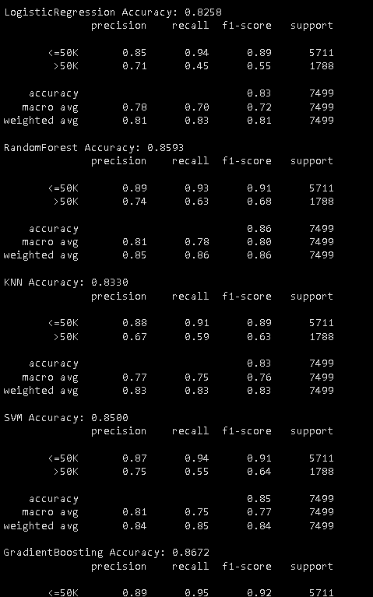
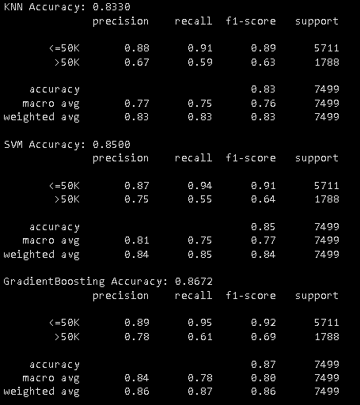
RESULT
The trained models were rigorously evaluated using a suite of classification metrics to assess their predictive performance on the unseen test data. The results are summarized below:

Slide 19
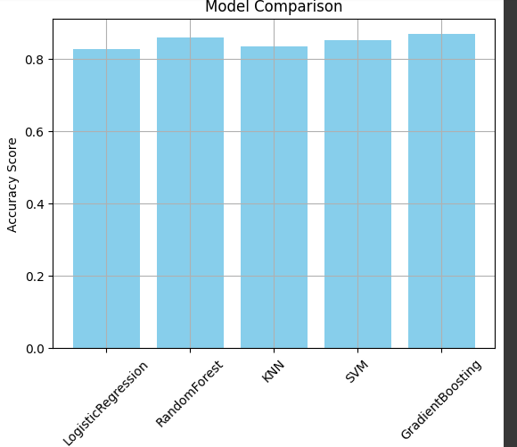
The Gradient Boosting Classifier consistently outperformed Logistic Regression, Random Forest, and KNN across all metrics, indicating its superior ability to capture the complex patterns and make accurate predictions on this dataset.

Slide 20
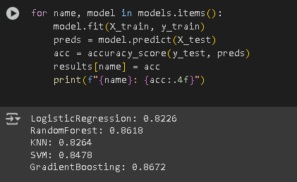
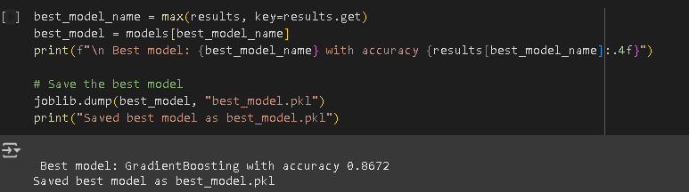

Slide 21
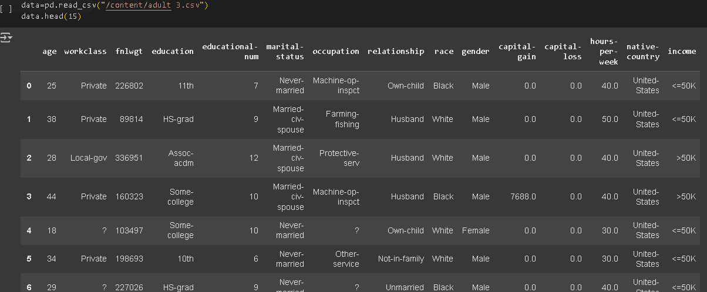

Slide 22
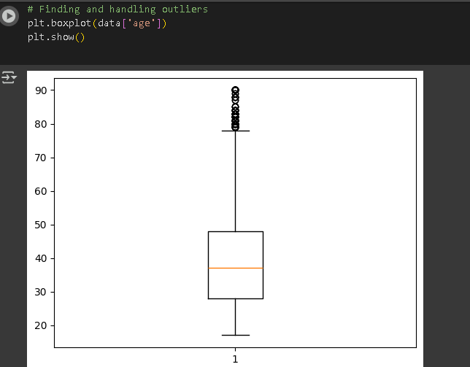
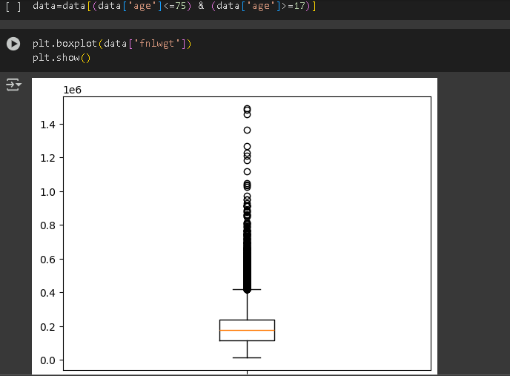

Slide 23
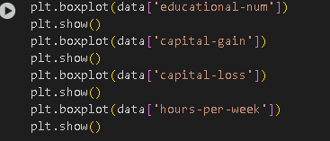
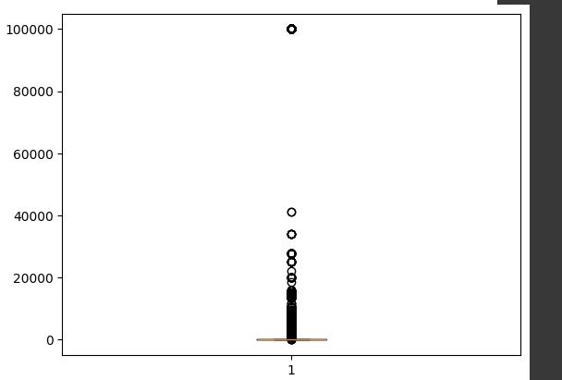
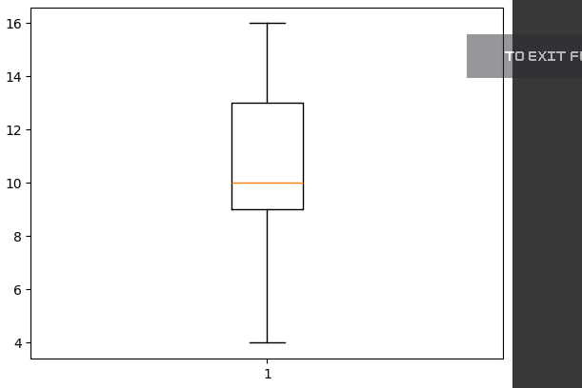

Slide 24
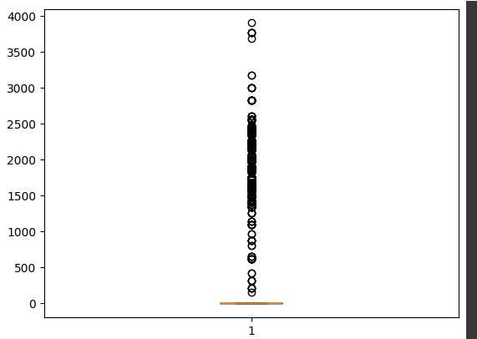
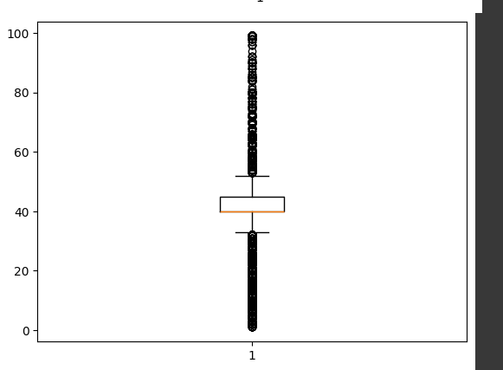

Slide 25
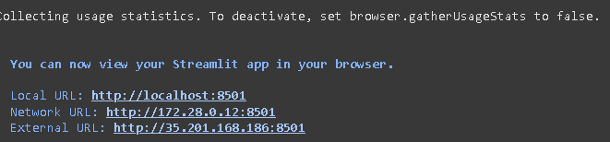
https://github.com/shreya-vashishth/EMPLOYEE-SALARY-PREDICTION-SHREYA-SHARMA.git

Slide 26
CONCLUSIONS
This project successfully developed and evaluated machine learning models for employee salary (income bracket) prediction using the Adult Income Dataset.
"The Gradient Boosting Classifier demonstrated the highest predictive accuracy and robustness, effectively classifying individuals into income categories based on their attributes, leveraging its ability to build strong predictive models iteratively.
The process highlighted the critical importance of meticulous data preprocessing, including handling missing values, encoding categorical features, and managing outliers, to build effective predictive models.
Challenges encountered included the initial data cleaning of '?' values and selecting appropriate encoding strategies for diverse categorical features. These were addressed through systematic data transformation techniques.
The developed Gradient Boosting model provides valuable insights into the factors influencing income levels, offering a data-driven tool for compensation analysis and career guidance.

Slide 27
REFERENCES
https://colab.research.google.com/drive/12misWauTsYh0lEk4THN-_Vw4k_TzYZlh#scrollTo=KCP5-6txn4H7
https://ngrok.com
https://scikit-learn.org/stable/
https://skills.yourlearning.ibm.com/activity/PLAN-8A48645196FA

Slide 28
Thank you

