Slide 1

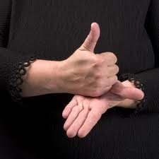
SIGN LANGUAGE RECOGNITION
USING
MACHINE LANGUAGE
Submitted By:
Shruti Shreya (20BCS9229) Sahil Kumar (20BCS9238)
Submitted To:
Supervisor: Er. Parwinder Kaur
Co-Supervisor: Dr. Dheresh Saini

Slide 2
Table of Content:
Introduction
Objectives
Technologies Used
Designs
Screenshots
Outcomes

Slide 3
INTRODUCTION:
In this sign language recognition project, we create a sign detector, which detects numbers from I to 10 that can very easily be extended to cover a vast multitude of other signs and hand gestures including the alphabets.
This can be very helpful for the deaf and dumb people in communicating with others as knowing sign language is not something common to all, moreover, this can be extended to creating automatic editors, where the person can easily write by just their hand gestures.

Slide 4
OBJECTIVES
In this Sign Language recognition project, we create a sign detector, which detects numbers from 1 to 10. We can easily extend this project and add alphabet too.
This project can be done with the help of 3 steps: -
1. Creating the dataset.
2 . Training a CNN on the captured dataset.
3. Predicting the data.
This project is all about the interaction between deaf & dumb people with normal people for making communication easy, better, and efficient.

Slide 5


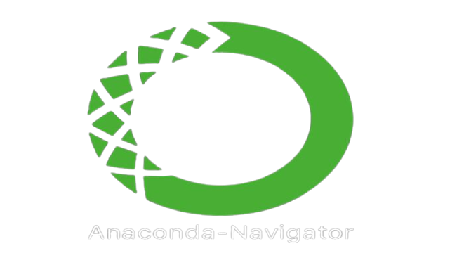




TECHNOLOGIES USED:
Python
Jupyter IDE
Anaconda Navigator
Libraries:
Numpy
cv2 (openCV)
Keras
Tensorflow

Slide 6
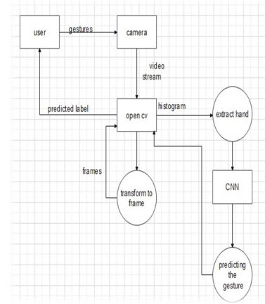
Dataflow Diagram for Sign Language Recognition
DESIGNS:

Slide 7
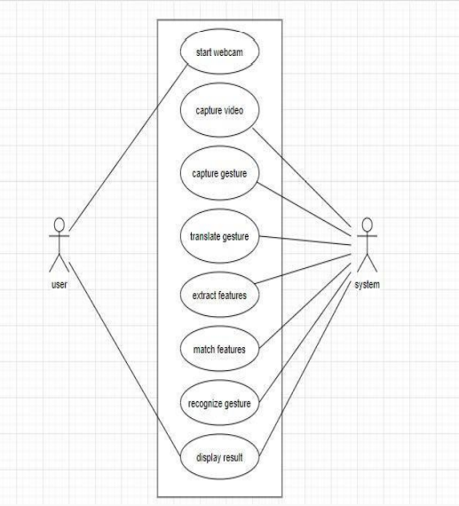
Use case Diagram For Sign Language Recognition System
DESIGNS:

Slide 8
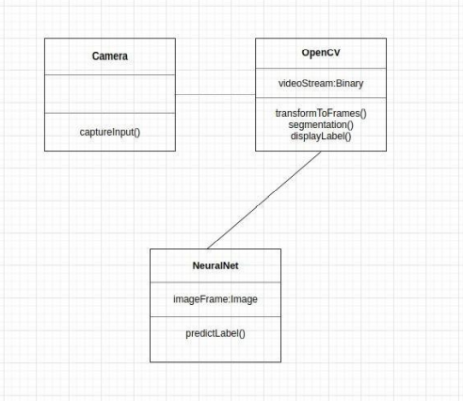
DESIGNS:
Class Diagram For Sign Language Recognition System

Slide 9
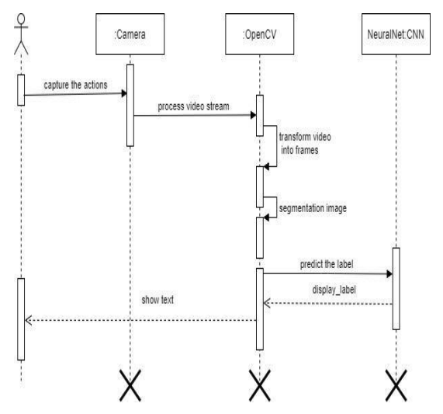
DESIGNS:
Sequence Diagram For Sign Language Recognition System

Slide 10
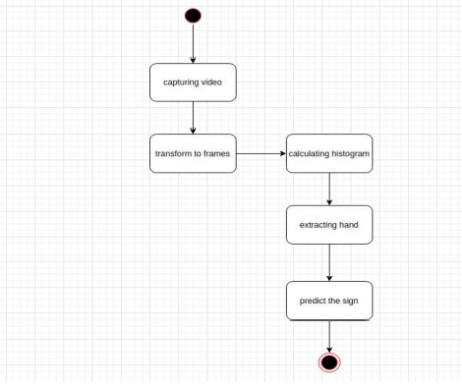
DESIGNS:
State Chart Diagram For Sign Language Recognition System

Slide 11
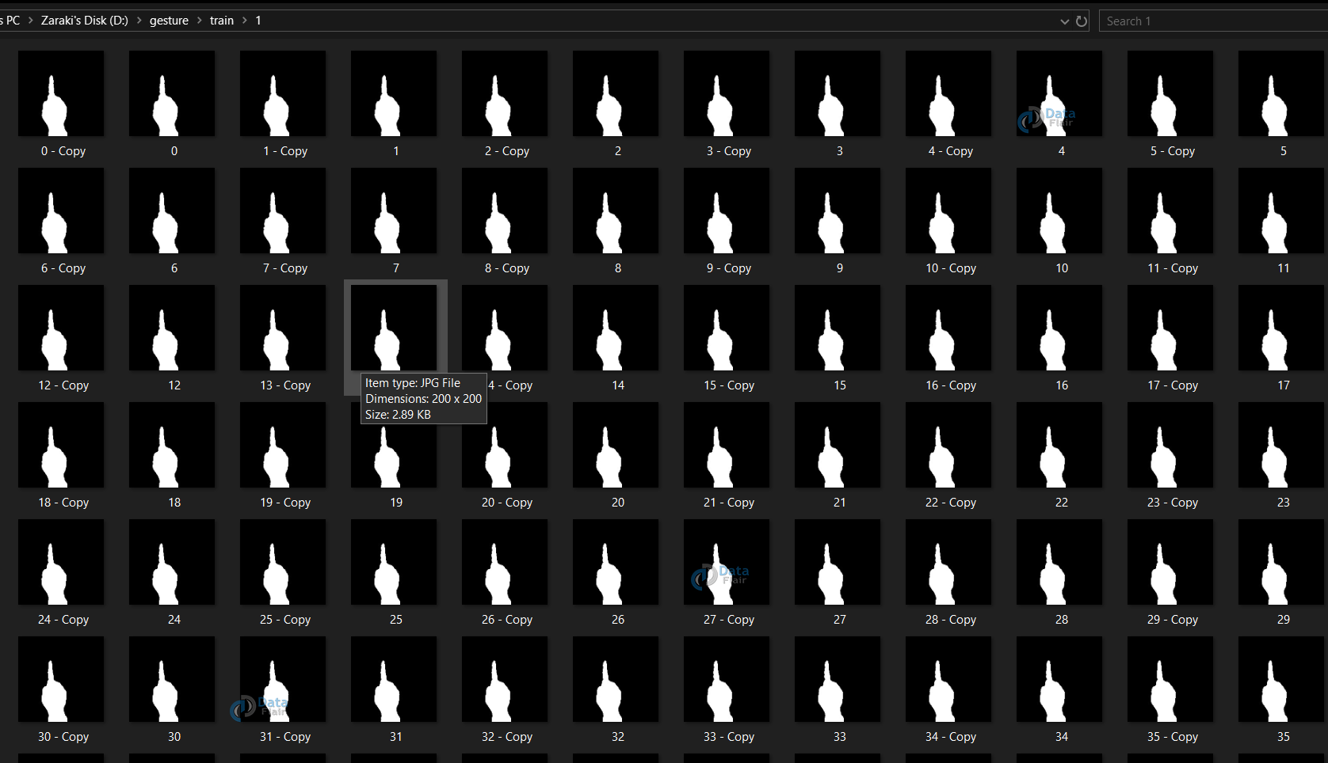
SCREENSHOTS
Dataset:

Slide 12
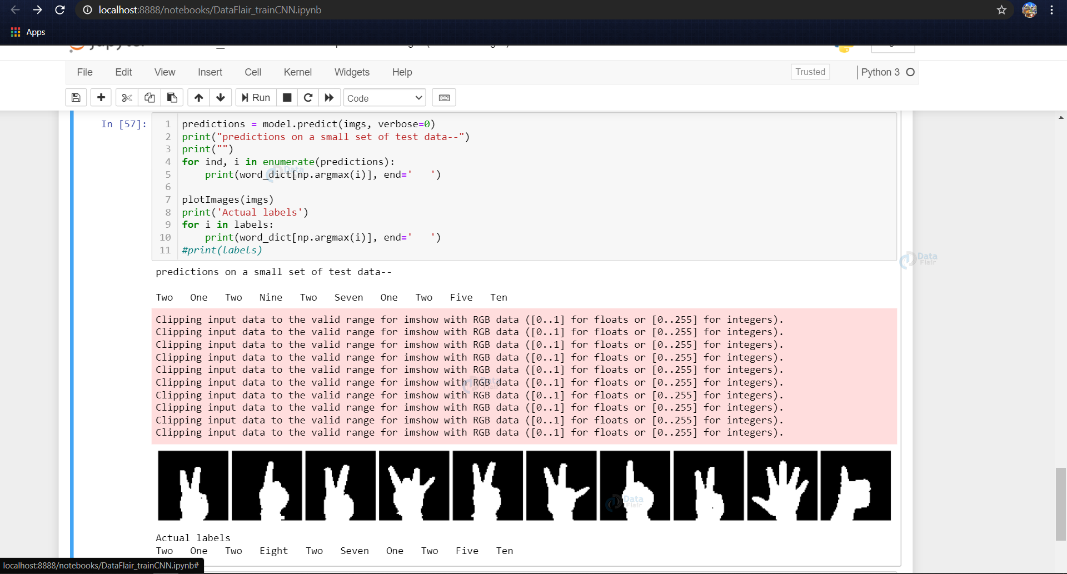
SCREENSHOTS
Training CNN:

Slide 13
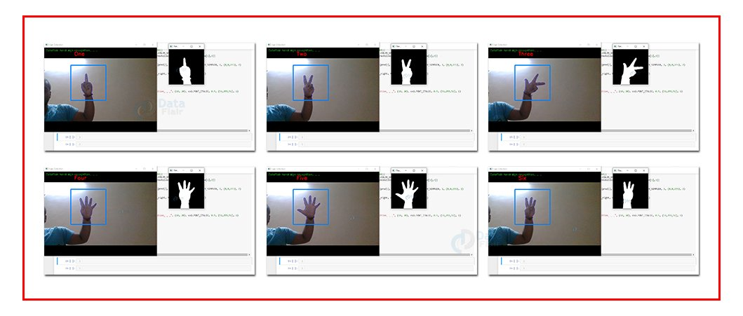
OUTCOMES:
Sign Language Recognition Output

Slide 14
Demonstration
Of Project
CODE

Slide 15


