Slide 1
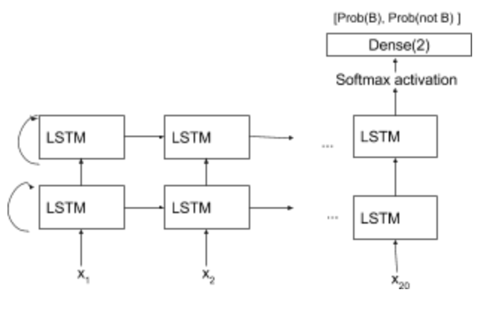
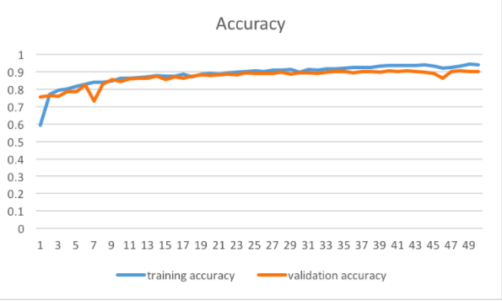


bu.edu/cs
Identifying Brazilian Names using a Recurrent Neural Network
By Duaa Tashkandi, Wjdan Alharthi, Ben Gaudiosi, and Shreya Ramesh
Introduction
In an effort to help the Digaai, an online platform that aggregates and tracks the Brazilian diaspora and its cultural influence, the goal of our project is to classify a person's full name as either Brazilian or not Brazilian.
We came up with several different models, including a logistic regression, a vanilla neural network, and a recurrent neural network. Using these machine learning techniques, we’ve managed to develop a fairly accurate model for determining whether or not a person is Brazilian based on their first and last name.
RNN Model
A recurrent neural network is different from a vanilla one because it takes previous inputs into account, and each input has an associated timestamp. In our implementation, each letter of the name would be an input to the network with the position as the timestamp, e.g. the first letter of the name would have a timestamp of 1.
Evaluation
We first tried the RNN on just first name inputs, and got an accuracy of 86% on training data. We then trained the model on inputs of first name and last name as two separate features and got an accuracy of 90% on the training data.
Figure 2 compares the training accuracy to the validation accuracy.
Conclusion
IIn the end, the RNN was the most csuccessful because it took into account the order of the characters. There are several ways we imagine the RNN could be improved. First, we could use pre-trained character embedding instead of one-hot encoding. Another improvement would be better and leaner sampling of data, from a more accurate source than Facebook. We hope that the model we’ve created here will be useful in achieving Digaai’s goal of tracking the Brazilian cultural diapsora.
Datasets
For Brazilian name sets, we scraped Facebook pages of Brazilian groups, for example, “Clash of Clans Brazil” or “Brazilians for Animal Rights.” For non-Brazilian data, we scraped Facebook pages of colleges to ensure ethnic diversity in the name set of non-Brazilians. The final Distribution of Brazilian and non-Brazilian classes is 50:50. We have collected a total of 60,000 names. Therefore, we have a baseline accuracy of 50% we aimed to beat, which would be random guessing.
We used 80% of our data for training and 20% for testing and validation
Figure 1: A graph representing our RNN. The first letter of the name is X₁, the second X₂, etc. “LSTM” stands for Long-short term memory which is a block used for building connections between inputs.
References
Treeratpituk, Pucktada, and C. Lee Giles. "Name-Ethnicity Classification and Ethnicity-Sensitive Name Matching." AAAI. 2012
Lee, Kim, Ko, D. Choi, J. Choi, Kang. “Name Nationality Classification with Recurrent Neural Networks.” IJCAI. 2017.
Figure 2: A graph showing our training and validation accuracy. The X axis is number of epochs, while the Y axis is the accuracy of the model.
@BUCompSci

