Slide 1
High Fidelity Point Cloud Upsampling
Using geometric aware-oversampling and Perturbation Learning

Slide 2
Dataset: PU-Net
Built for upsampling : PU-Net’s dataset is made for the point cloud upsampling task. It includes pairs of sparse (low-resolution) and dense (high-resolution) patches.
Diverse variety : The PU-Net dataset includes a 147 3D shapes and surfaces. It features models with smooth areas, sharp edges, and complex structures.
Benchmarking standard : Nearly all SOTA upsampling methods—including PU-Net, PU-GAN, Grad-PU, PUGCN, and PUDM—benchmark on the PU-Net dataset.
Fidelity/uniformity metrics : PU-Net dataset offers detailed ground truth for assessing uniformity (NUC), surface deviation, and distribution quality(Uniformity/coherence, Chamfer/HD, P2F).
Protocols : Uses Poisson disk, sparse-to-dense for fairness protocols to create training pairs, ensuring that upsampling performance is not biased

Slide 3
MODULES
Geometry aware feature encoding
ShapeNet + Borderline-SMOTE
KNN+gaussian kernel density
Perturbation Module
Loss Design
Global shape consistency
Local Geometry consistency (gram matrix)
Uniformity and repulsion loss

Slide 4
Geometry aware feature encoding
Borderline SMOTE+ ShapeNet
https://docs.google.com/drawings/d/1JKAiICrj0YkBsDxg1btPg8QwUBAAabnkQG4ydws8UU4/edit?usp=sharing
Gaussian Kernel Density based
https://docs.google.com/drawings/d/1e2ZcSpWvXpKhrOhFTvtWmALKVLxLtK538JmhHlg_7SM/edit?usp=sharing

Slide 5
Comparison
Aspect | GKD based encoding | Borderline SMOTE based | Triangulation Oversampling based
Density-aware? | Yes (Gaussian kernel) | No (fixed neighbor count) | No
Minority region focus | Adaptive by KDE + threshold | By neighbor label count | Yes(high computational costs)
Feature interpolation mode | Weighted blend in high-dim latent space | Linear interpolation in input/feature space | None
Robust to data geometry? | High (manifold/structural continuity) | Moderate (misses manifold curvature) | Low(relies only on mathematics)
Noise handling | Adaptive perturbation (attention guided) | Typically absent | Absent(needs robust deep learning)
Multi-scale context | Yes (fine+coarse, residual fusion) | Usually no | Sometimes(depends on the KNN)

Slide 6
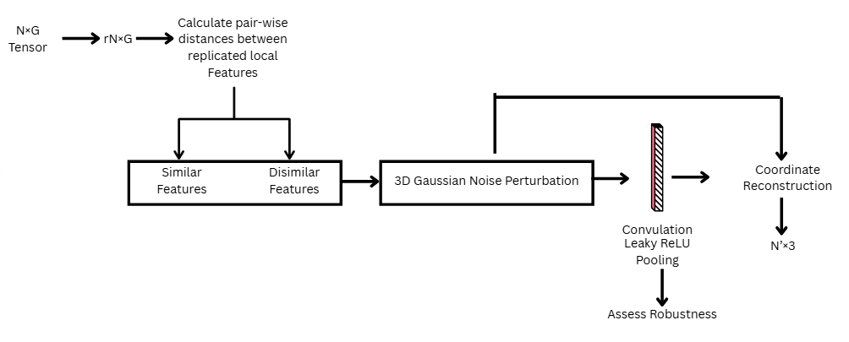
C. Perturbation Module

Slide 7
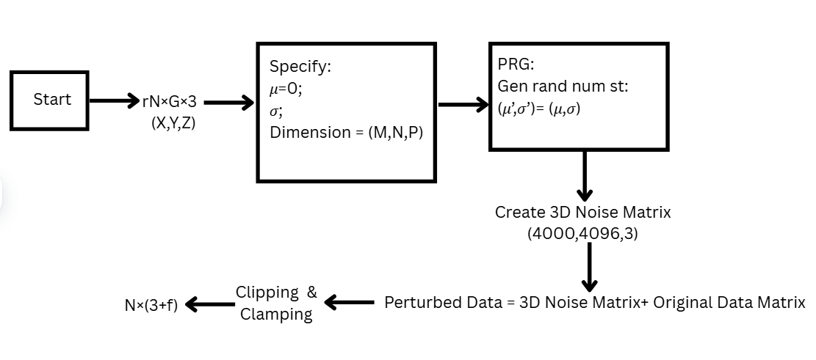
3D Gaussian Noise Perturbation

