Slide 1
Hack-A-Roo
Hogan Preparatory Academy Usecase
TEAM MEMBERS
Shreyaa Sridhar
Harika Adivanne
Sulochana Rani Mulpuri
Navya Battu

Slide 2
Introduction
Hogan Preparatory Academy uses multiple data platforms that collect and manage different types of data. The big three types of data collected are attendance, behavior, and achievement.
Automate the data process.

Slide 3
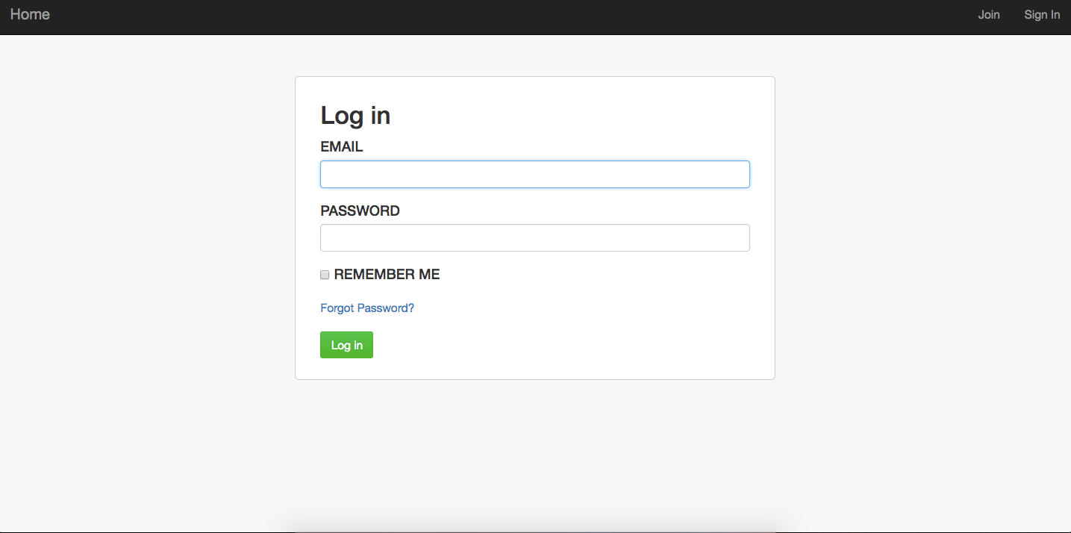
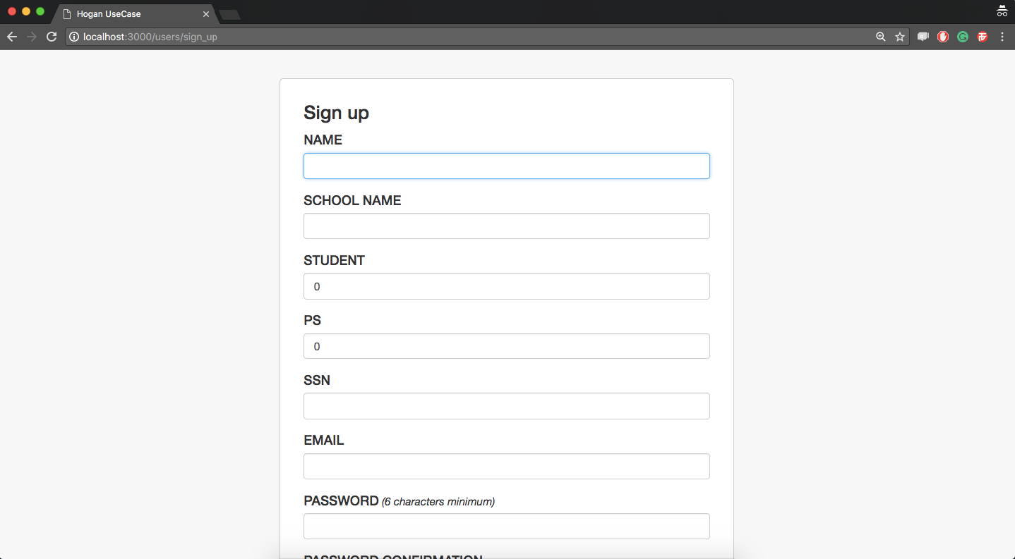
Login and Register Page

Slide 4
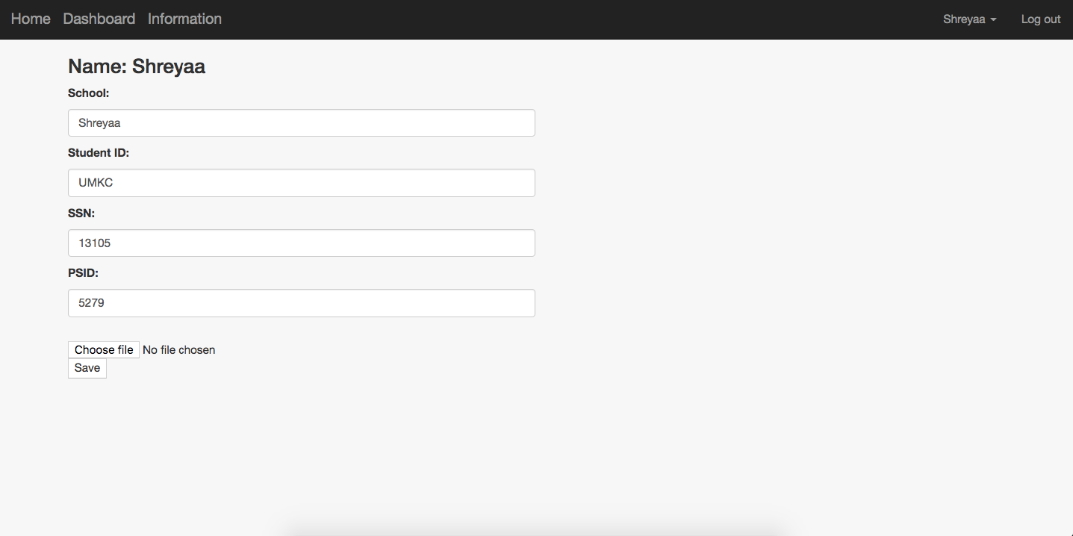
User Dashboard

Slide 5
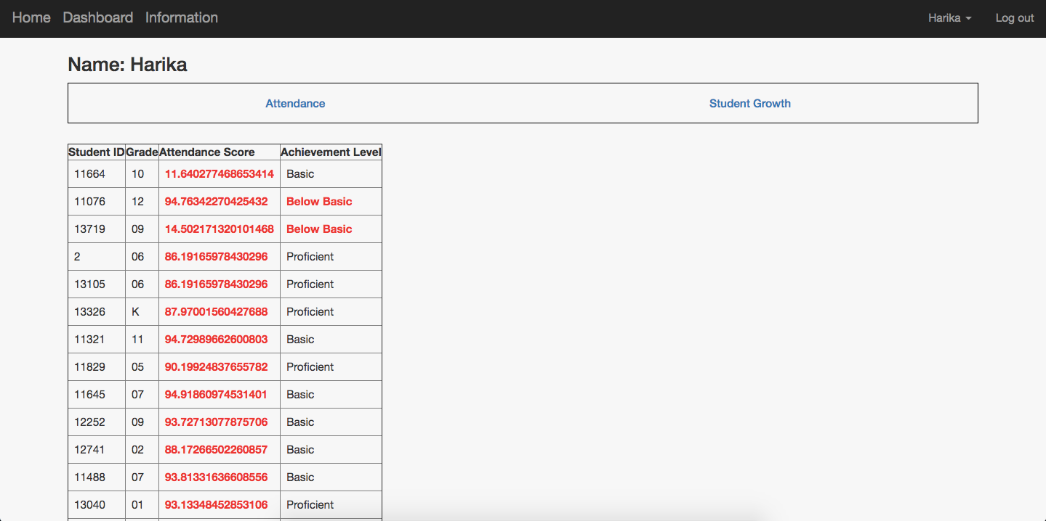
Admin Dashboard

Slide 6
THANK YOU !!!

