Slide 1
Hack-A-Roo
Hogan Preparatory Academy Usecase
TEAM MEMBERS
Shreyaa Sridhar
Harika Adivanne
Sulochana Rani Mulpuri
Navya Battu

Slide 2
Introduction
Hogan Preparatory Academy uses multiple data platforms that collect and manage different types of data. The big three types of data collected are attendance, behavior, and achievement.
Automate the data process.

Slide 3
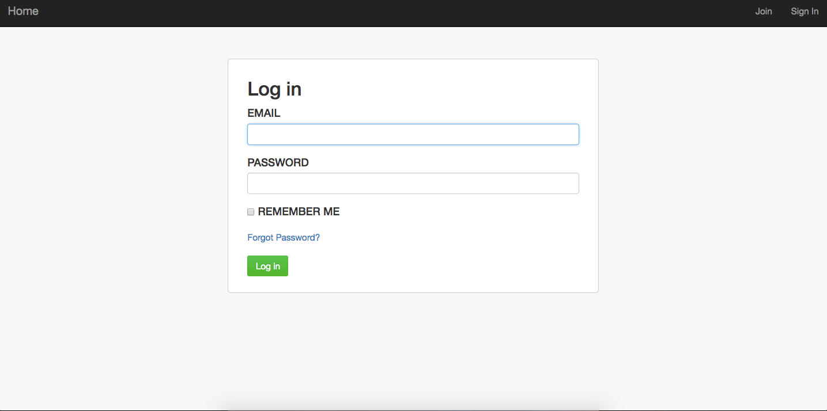
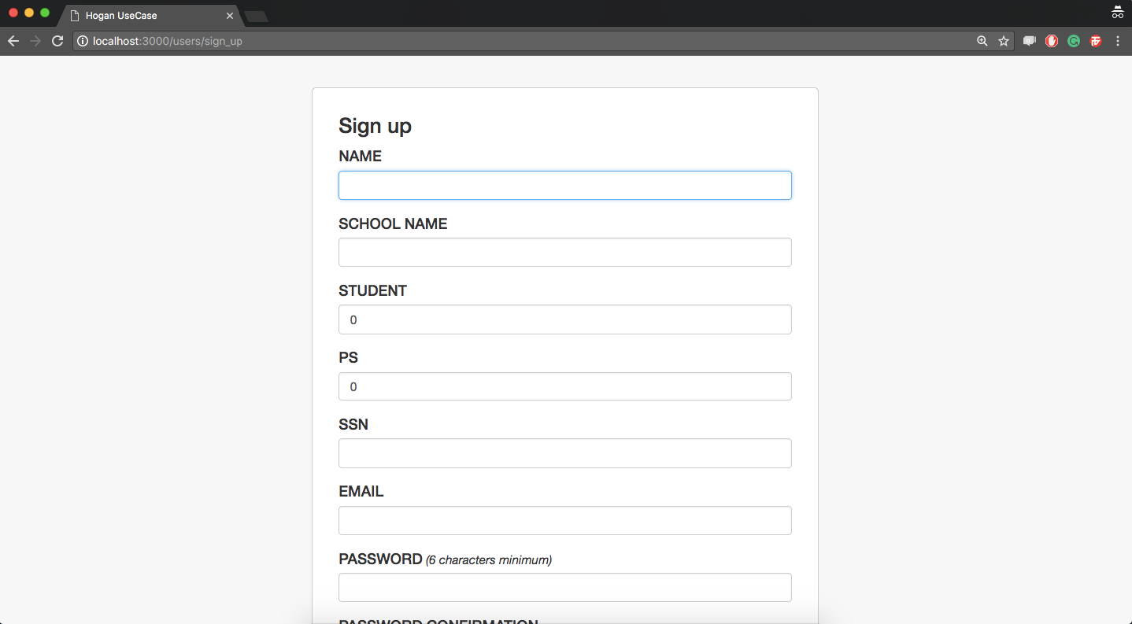
Login and Register Page

Slide 4
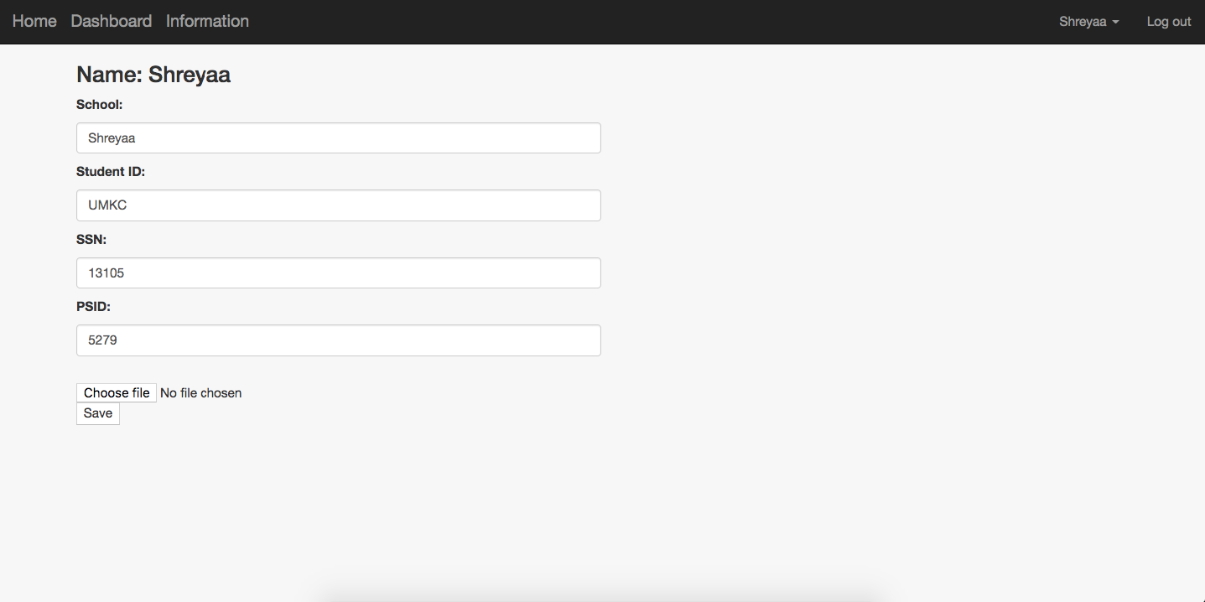
User Dashboard After giving the basic details of student , by clicking on choose file we can upload .csv or excel files.

Slide 5
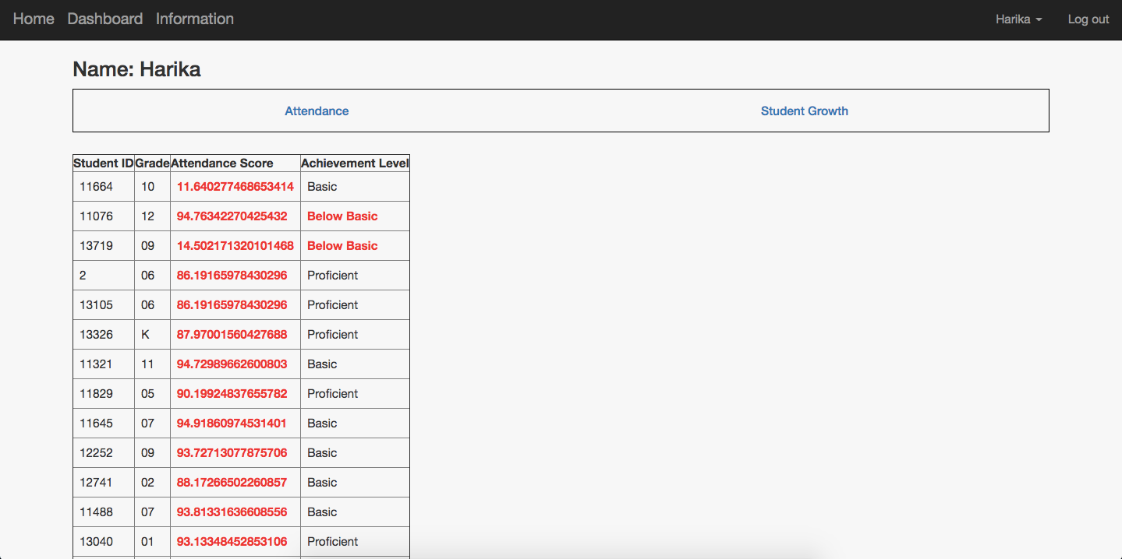
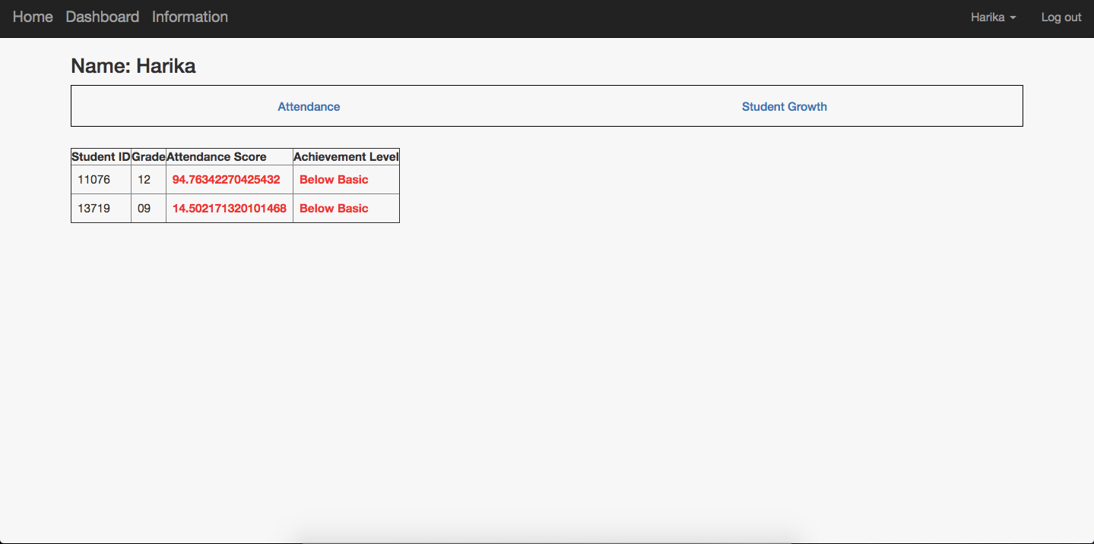
Admin Dashboard
By clicking on Attendance tab it shows students who have attendance less than 95 and achievement level as less than basic like for example - below example

Slide 6
THANK YOU !!!

