Slide 1
TRAVEL
CS 5540 - Principles of Big Data Management
Fall 2017
Team Members
Shreyaa Sridhar , Vinay Maturi , Hari Naga Raju Velivela

Slide 2
Motivation
Every person has variety of interests and hobbies but travel is one universal interest that is experienced by all people from different walks of life. Memories and photographs created during travel are shared widely in social media nowadays.
We as a team desired to collect this large pool of data and analyze effectively, which made ‘Travel’ an obvious choice as the topic.

Slide 3







TECHNOLOGIES USED
Reference : www.google.com/logos

Slide 4
Phase 1
Collected tweets and saved as a JSON file.
From the JSON file , extracted the hashtags and URLs and saved as text file.
Word count on the hashtags and URLs using Apache Hadoop and Apache Spark.

Slide 5
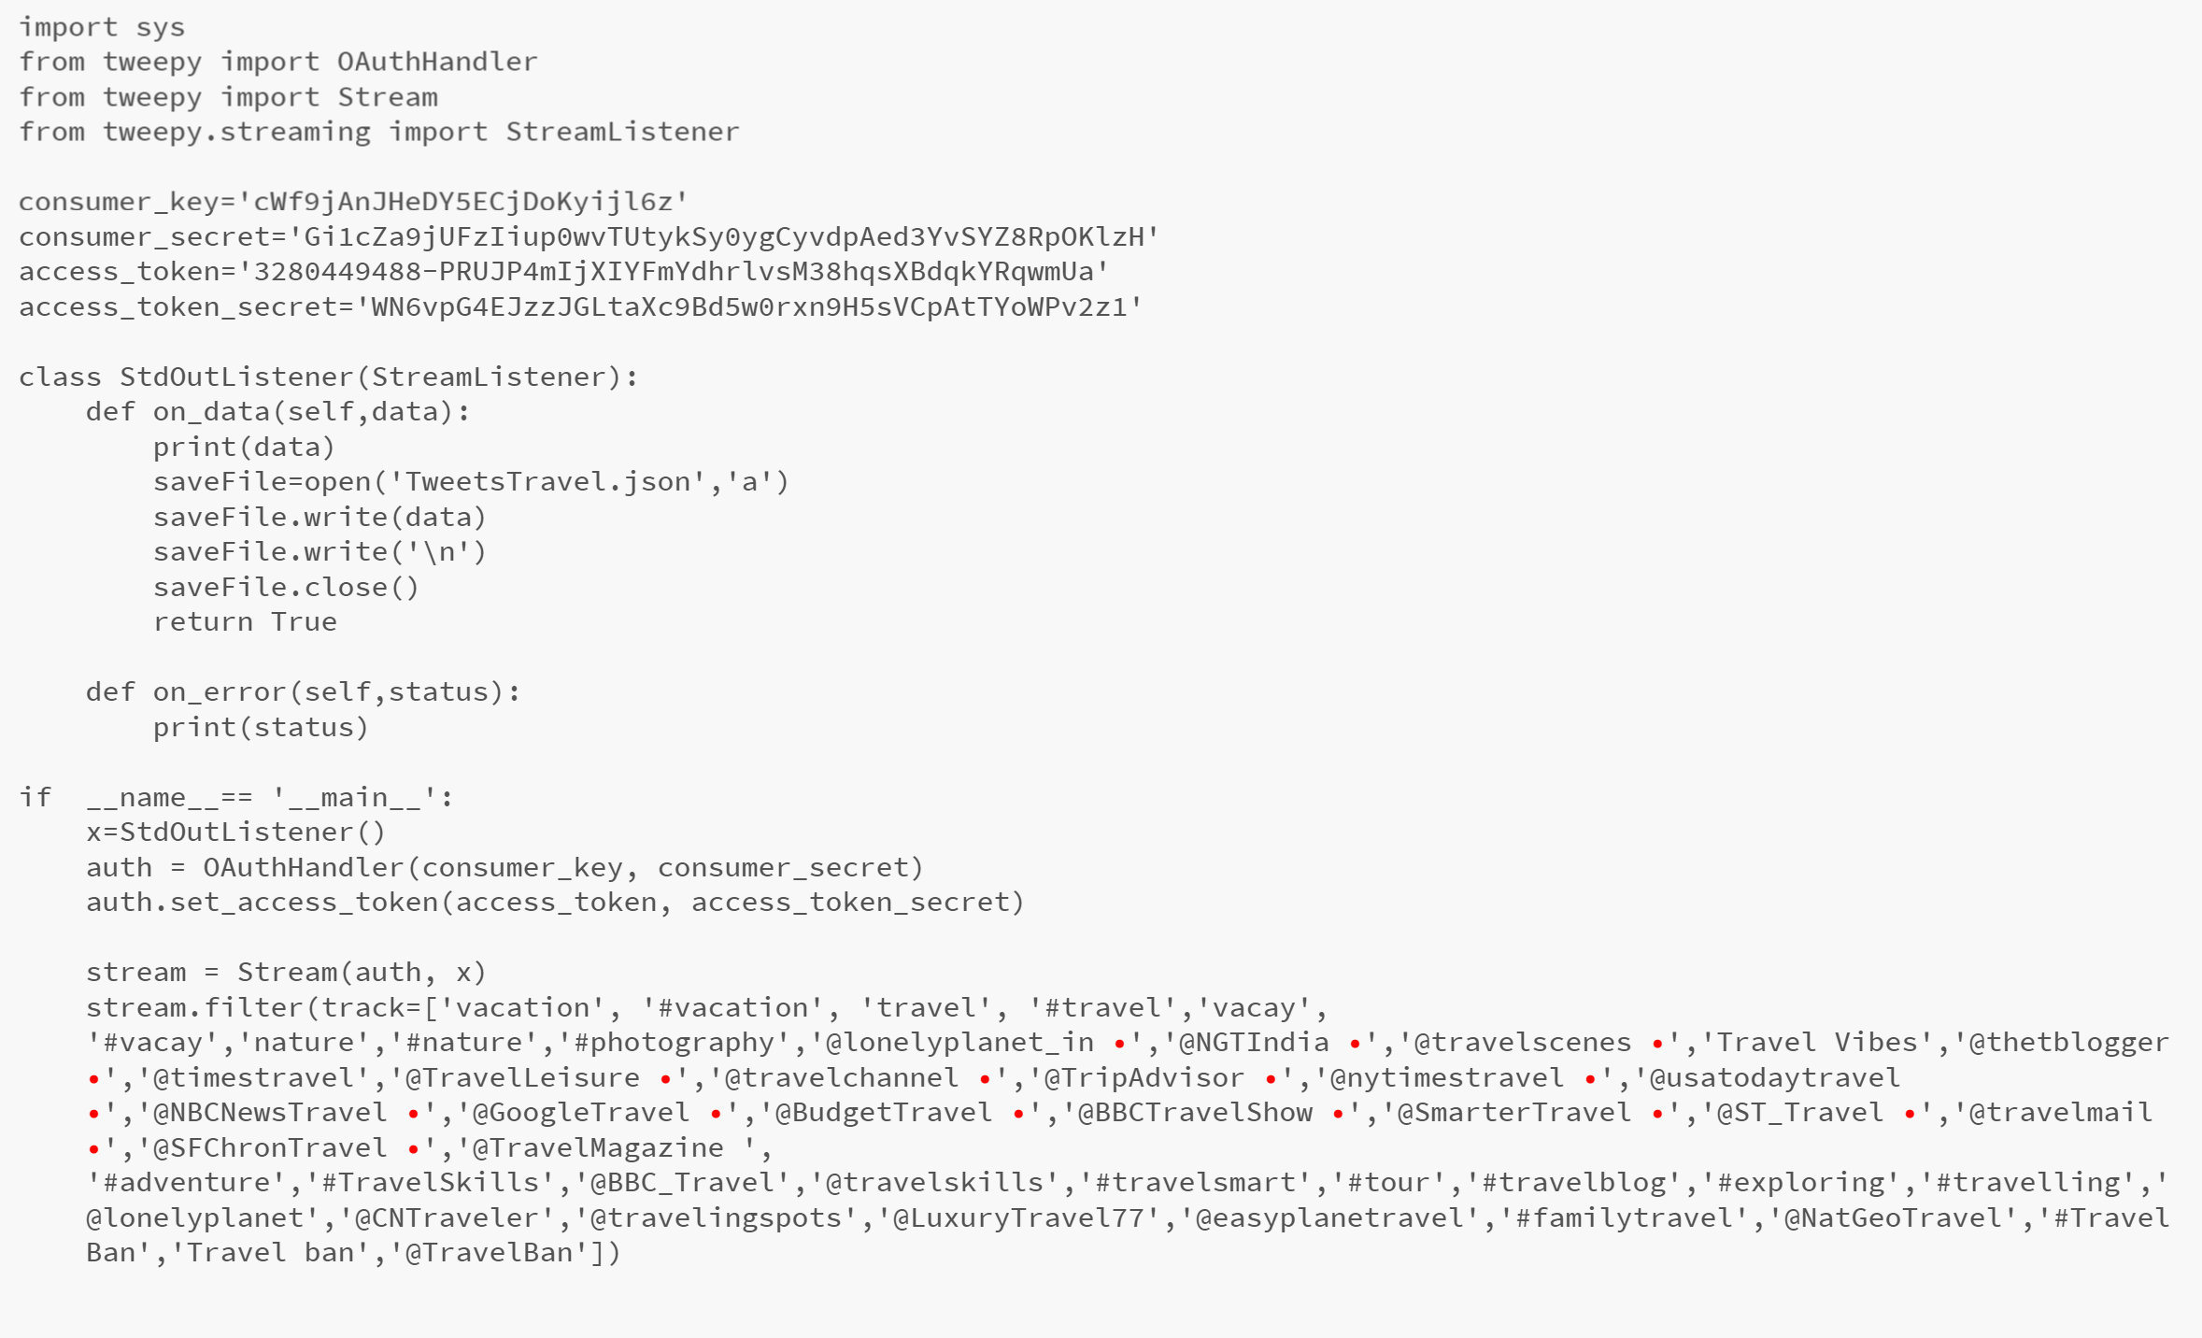
PHASE 1
Collecting Tweets using this Python code

Slide 6
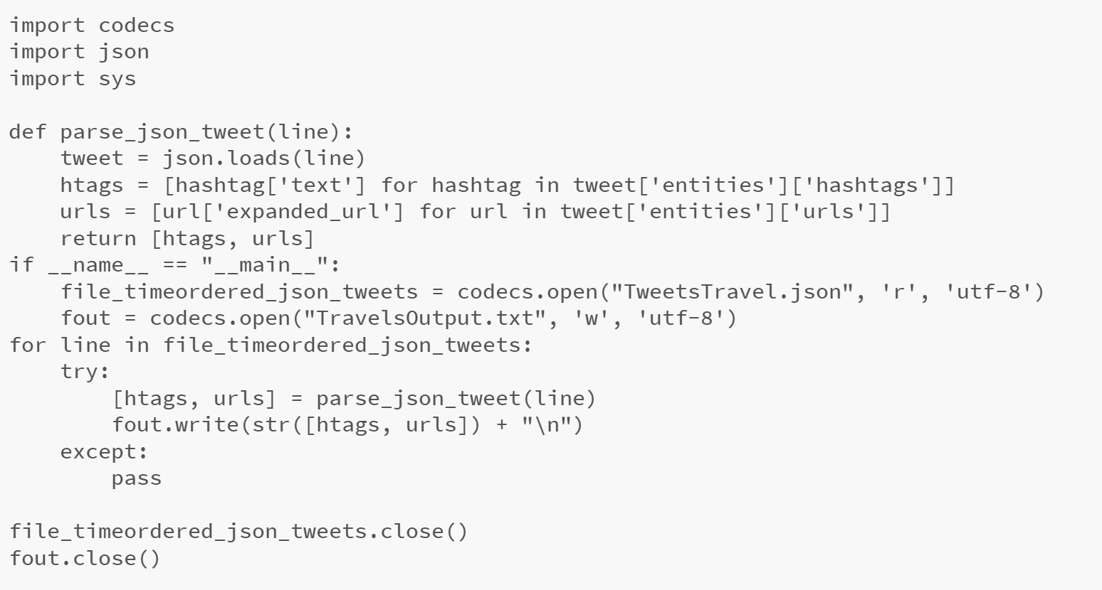
PHASE 1
Extracting Hashtags and URLs from the ‘TweetsTravel’ JSON file using this Python code

Slide 7
PHASE 2
Analytical queries performed on the extracted tweets.
Visualized these queries using Tableau Software.

Slide 8
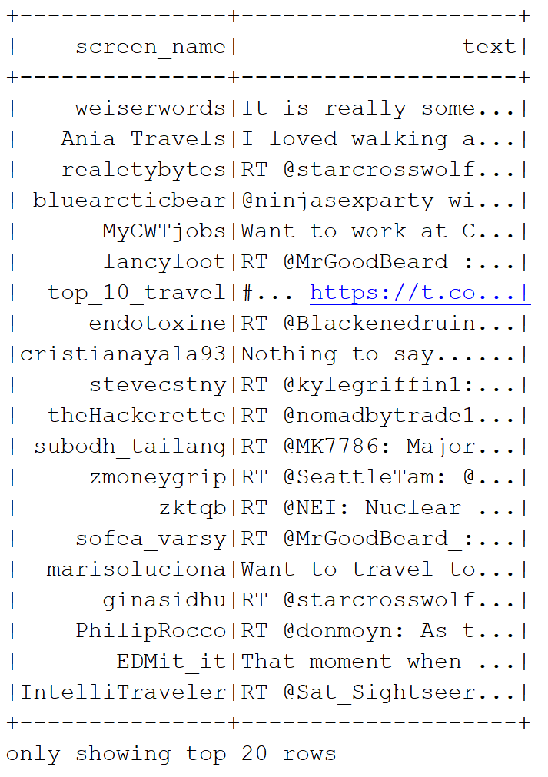
Query 1
Travel passionate people and what they say..
SELECT user.screen_name, text FROM Travel WHERE text LIKE '%travel%’ WHERE user.screen_name IS NOT NULL

Slide 9
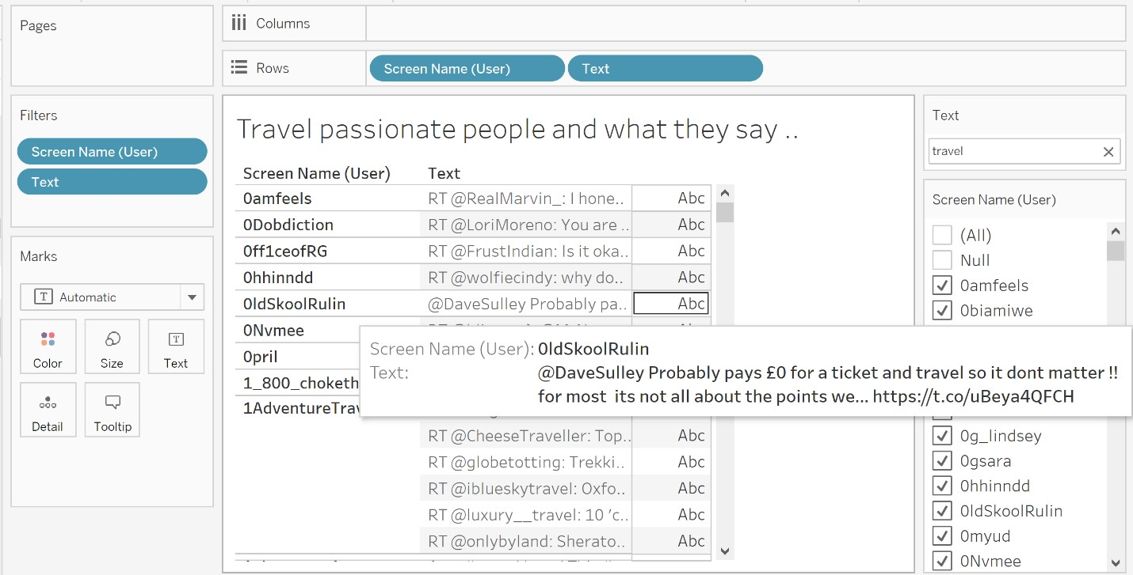
Query 1

Slide 10
Query 2
Most users from USA or UK
SELECT user.name,user.location,text,created_at," + "CASE WHEN user.location like '%USA%' THEN 'USA'" + "WHEN user.location like '%States%' THEN 'USA'" + "WHEN user.location like '%Kingdom%' THEN 'UK'" + "WHEN user.location like '%Scotland%' THEN 'UK'" + "WHEN user.location like '%England%' THEN 'UK'" + "WHEN user.location like '%Ireland%' THEN 'UK'" + "WHEN user.location like '%Wales%' THEN 'UK'" + "WHEN user.location like '%Europe%' THEN 'UK'" + "END AS locationName FROM Travel WHERE user.location is not null
SELECT locationName, count(text) AS loc_count FROM words1 WHERE locationName IS NOT NULL AND text IS NOT NULL GROUP BY locationName,text ORDER BY COUNT(text) DESC

Slide 11
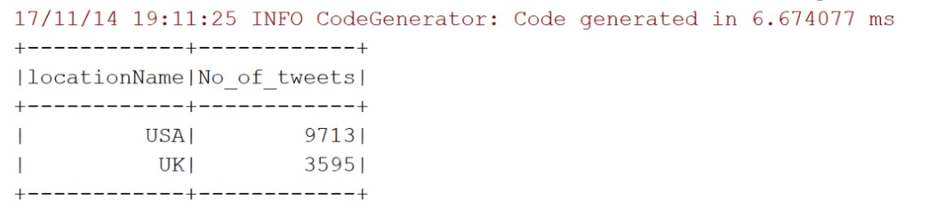
Query 2 (Contd.)
Most users from USA or UK
SELECT locationName, SUM(loc_count) AS No_of_tweets FROM words3 WHERE locationName IS NOT NULL AND loc_count IS NOT NULL GROUP BY locationName ORDER BY SUM(loc_count) DESC

Slide 12
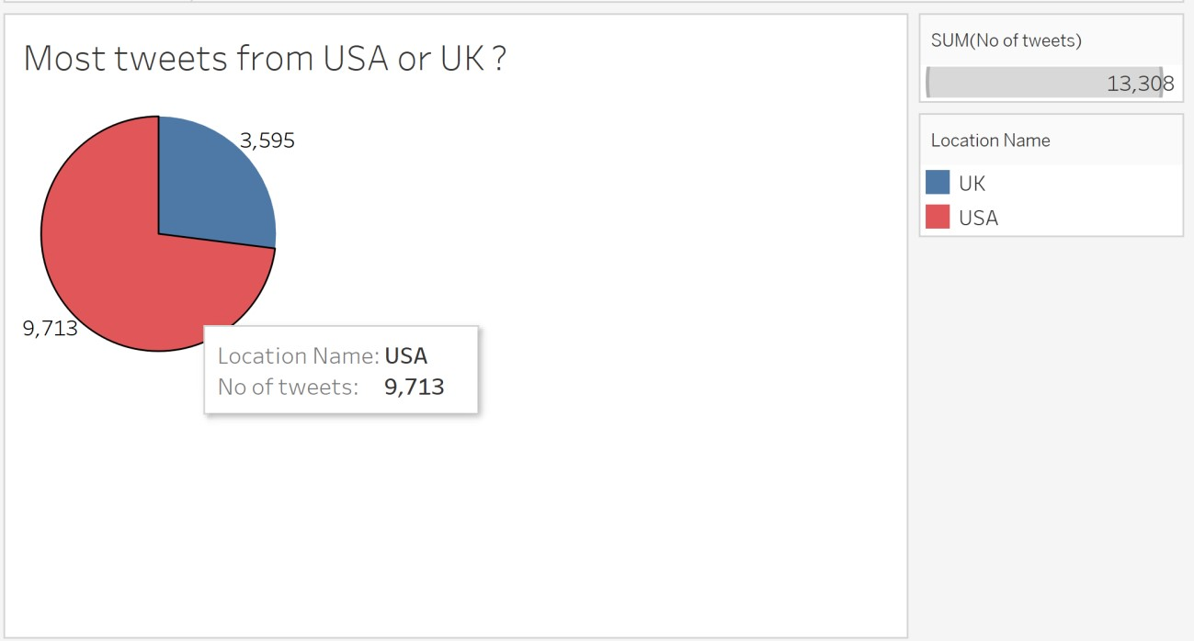
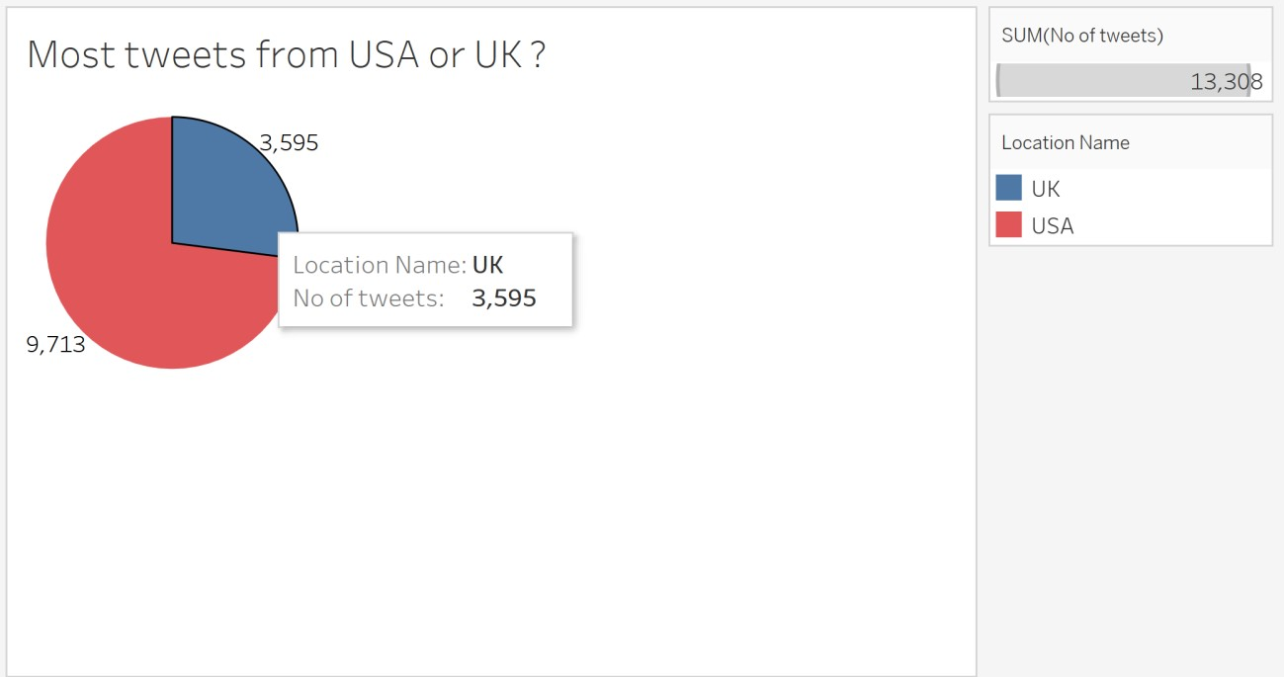
Query 2 (Contd.)

Slide 13
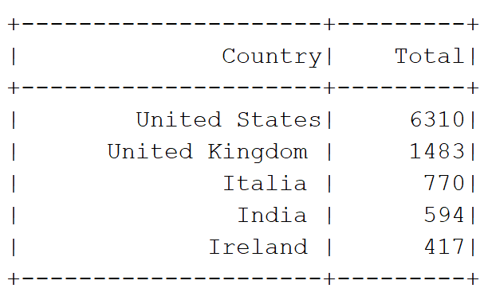
Query 3
Top 5 Countries from where the tweets originate
SELECT place.country AS Country, COUNT(place.country) AS Total FROM Travel WHERE place.country IS NOT NULL GROUP BY Country ORDER BY Total DESC LIMIT 5

Slide 14
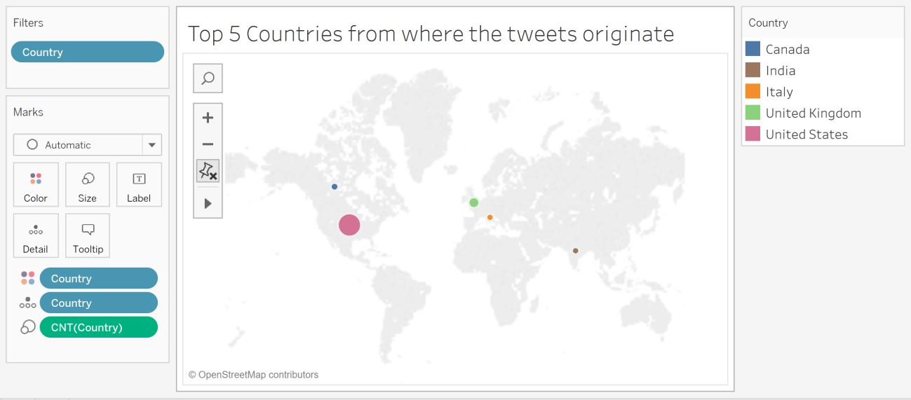
Query 3

Slide 15
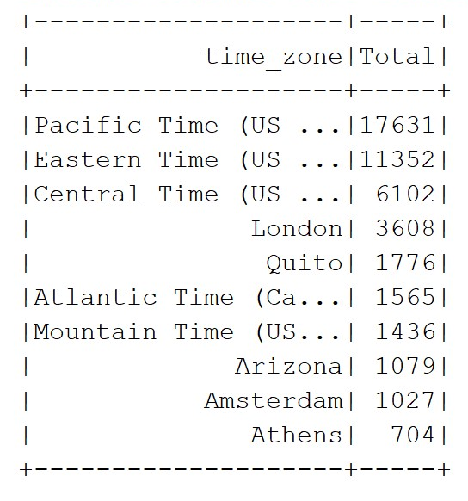
Query 4
Total tweets from different time zones
SELECT user.time_zone,count(text) AS Total FROM Travel WHERE user.time_zone IS NOT NULL GROUP BY user.time_zone ORDER BY Total DESC LIMIT 10

Slide 16
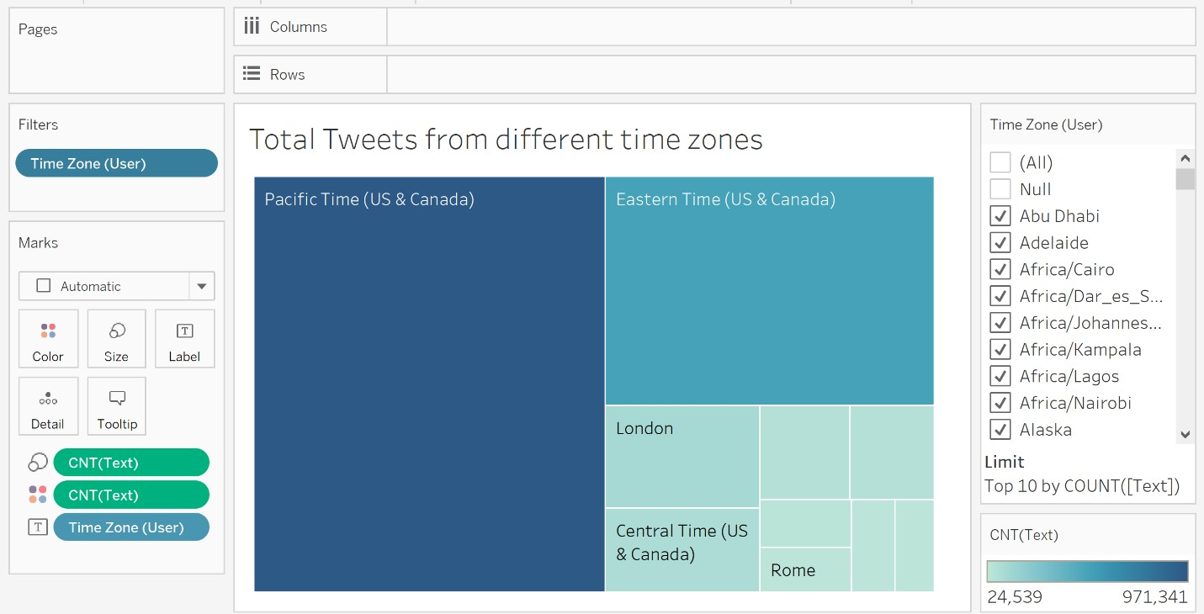
Query 4

Slide 17
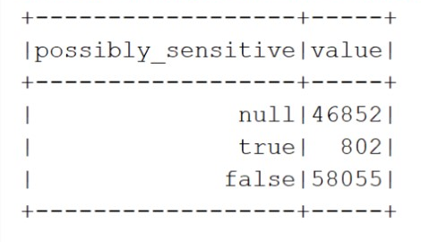
Query 5
Sensitivity of tweets
SELECT possibly_sensitive,count(*) AS value FROM Travel GROUP BY possibly_sensitive

Slide 18
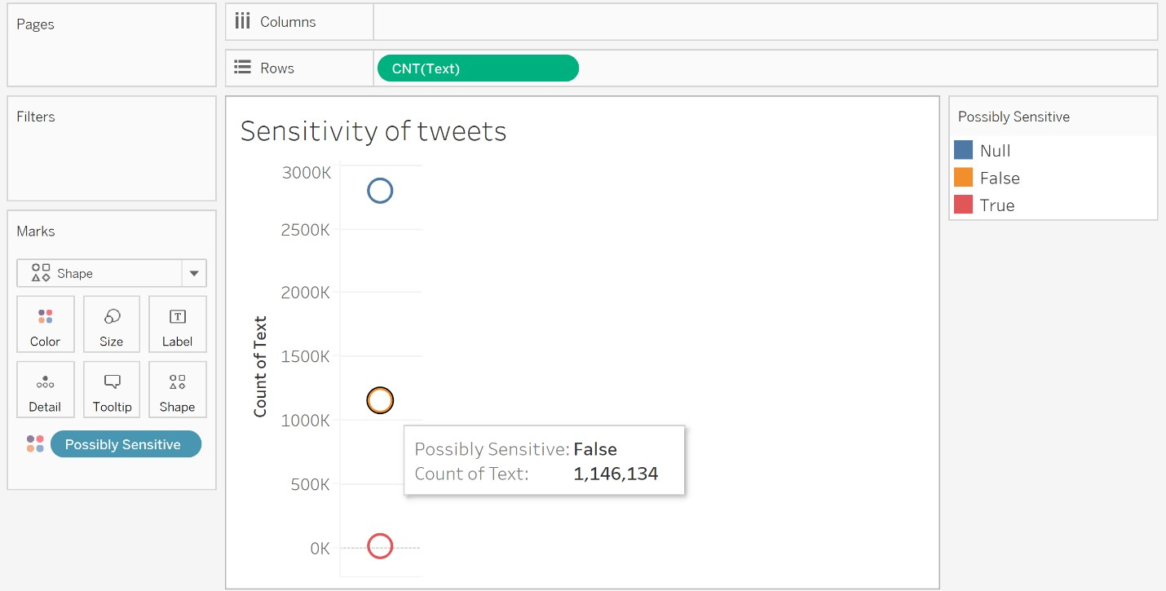
Query 5

Slide 19
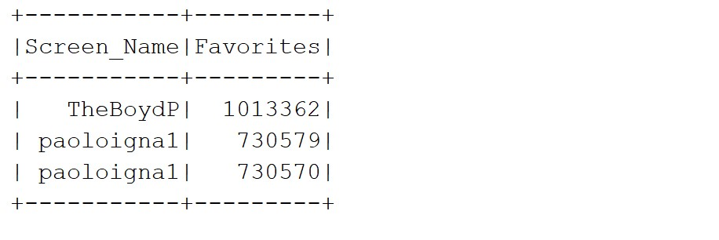
Query 6
Number of tweets user has liked
SELECT user.screen_name AS Screen_Name,user.favourites_count AS Favorites FROM Travel ORDER BY Favorites DESC LIMIT 3

Slide 20
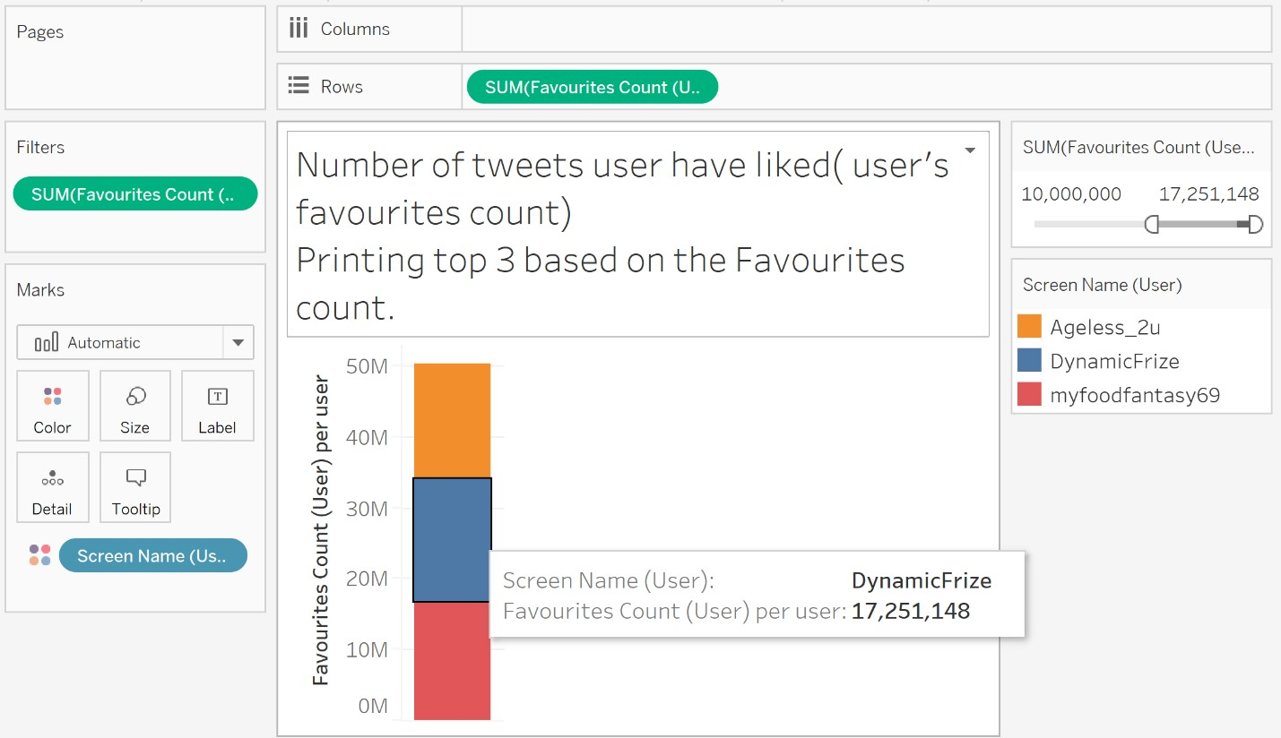
Query 6

Slide 21
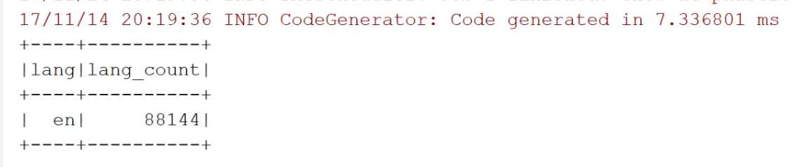
Query 7
Language most used by people
SELECT user.lang,count(*) AS lang_count FROM Travel WHERE user.lang IS NOT NULL GROUP BY user.lang ORDER BY lang_count DESC LIMIT 1

Slide 22
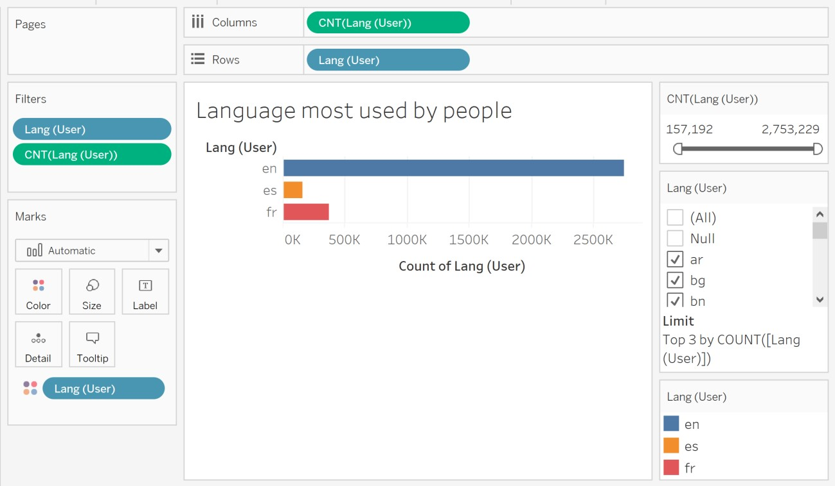
Query 7

Slide 23
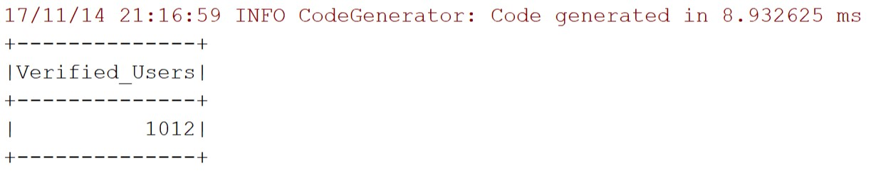
Query 8
Verified Users
SELECT count(user.verified) AS Verified_Users FROM Travel WHERE user.verified=true

Slide 24
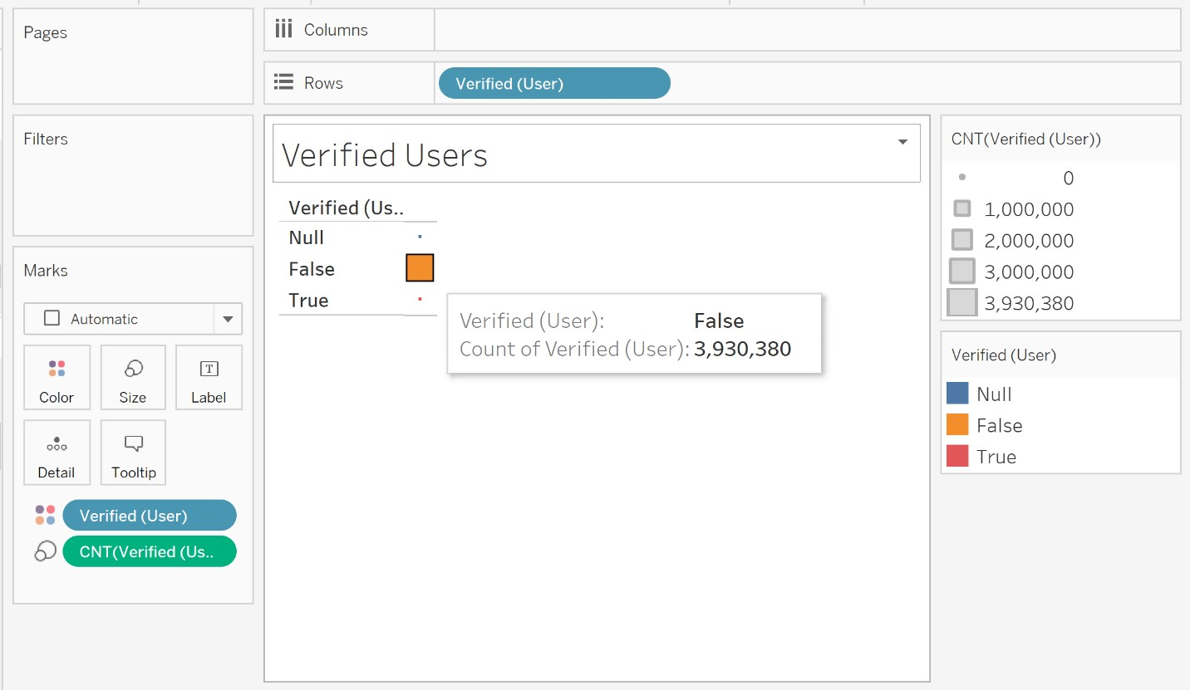
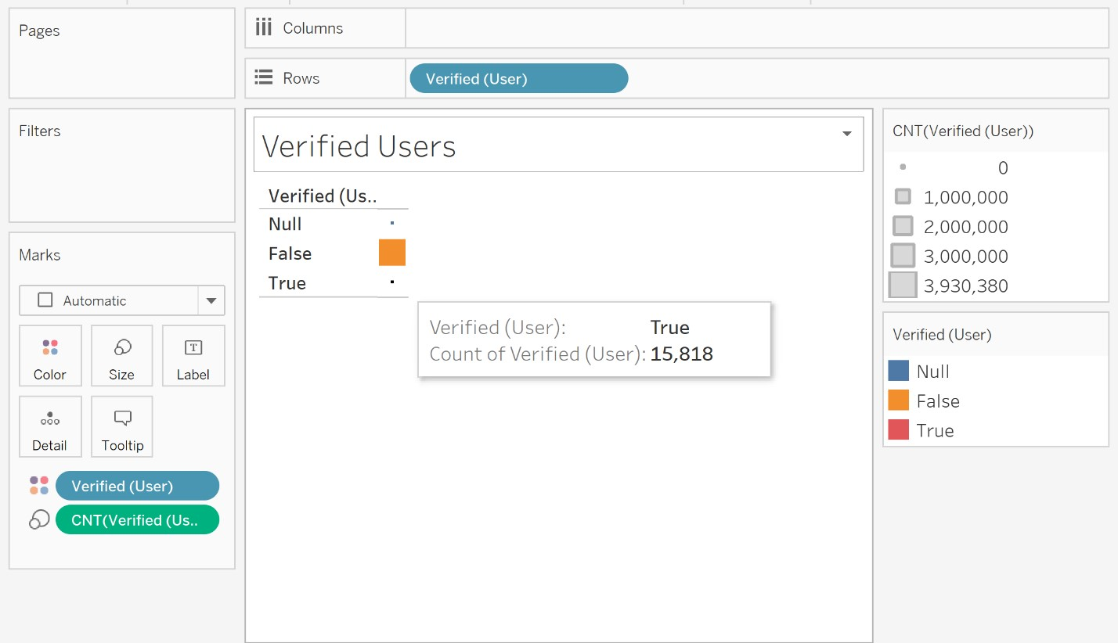
Query 8

Slide 25
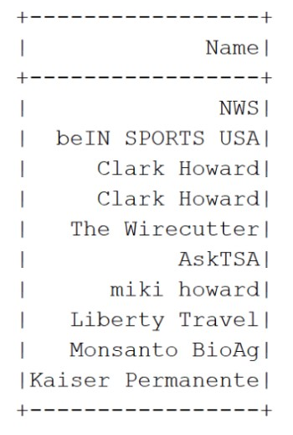
Query 9
Top 10 verified users in United States(based on their followers count)
SELECT user.name AS Name FROM Travel WHERE user.verified=true AND user.location='United States' ORDER BY user.followers_count DESC LIMIT 10

Slide 26
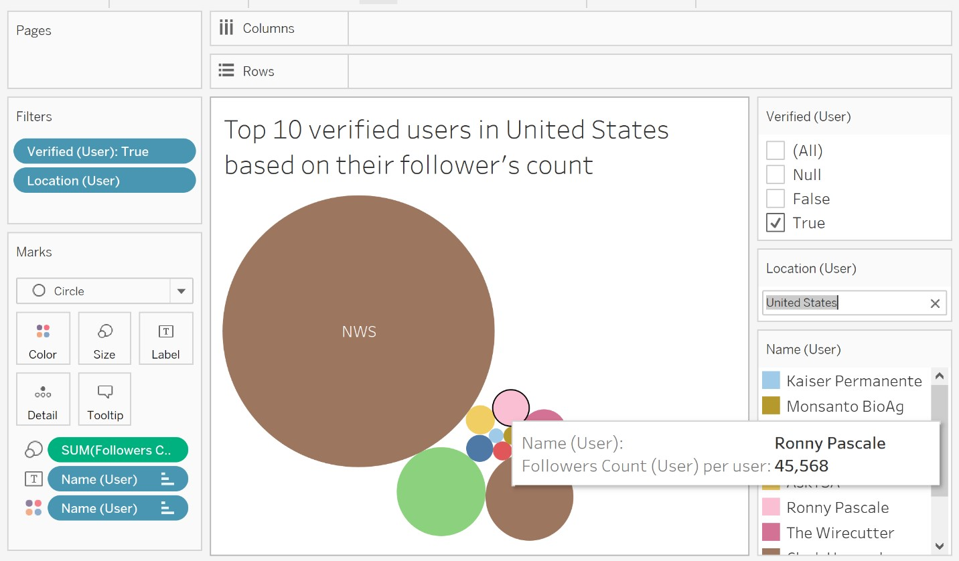
Query 9

Slide 27
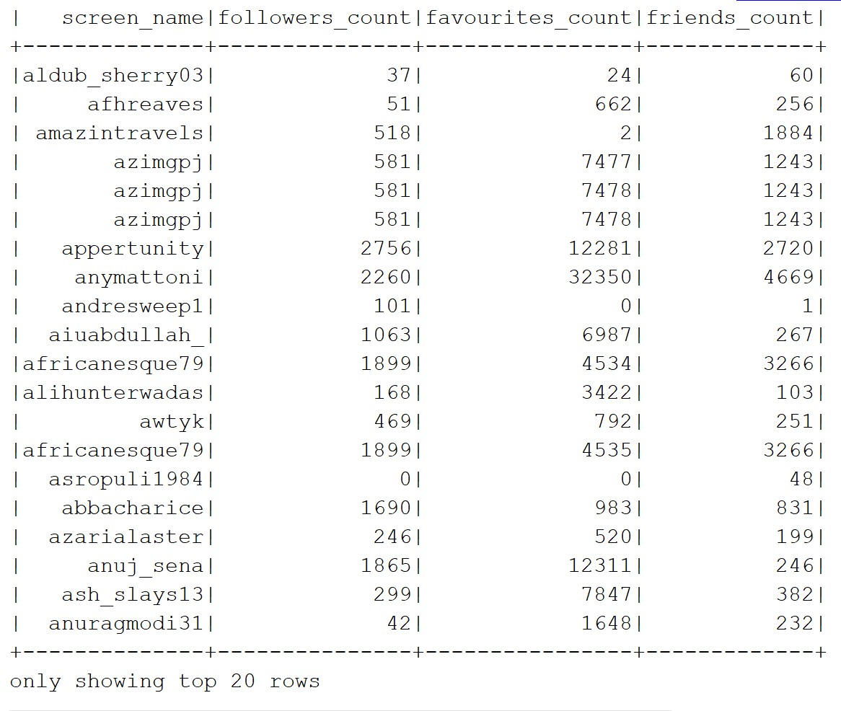
Query 10
List the User’s Screen Name, followers count , friends count and favourites count when it satisfies two conditions : ‘Travel’ in the text and screen name starts with ‘a’.
SELECT user.screen_name, user.followers_count,user.favourites_count, user.friends_count FROM Travel WHERE user.screen_name LIKE 'a%' AND text LIKE '%travel%'

Slide 28
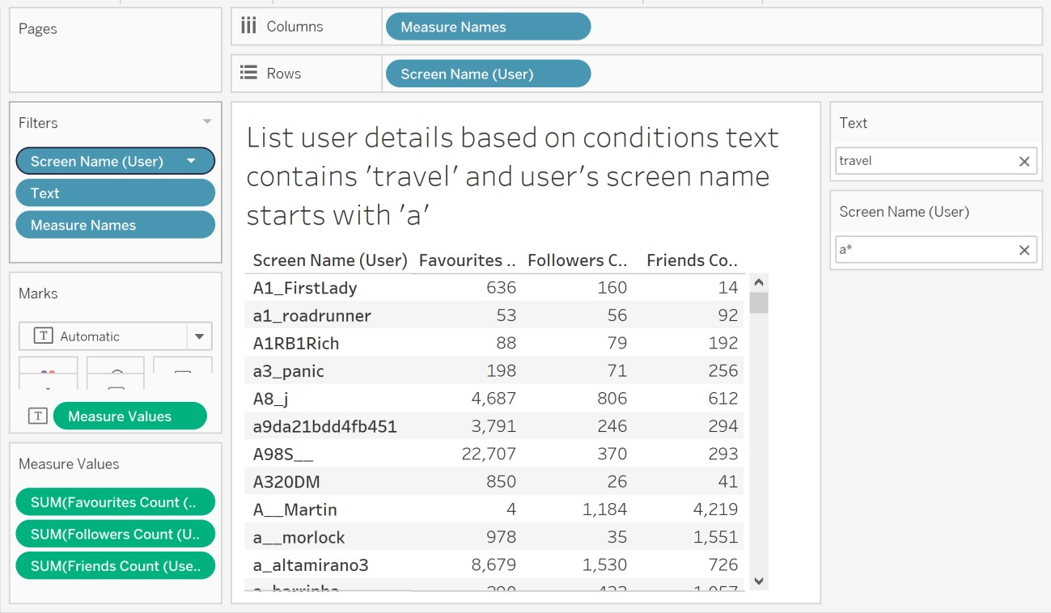
Query 10

Slide 29
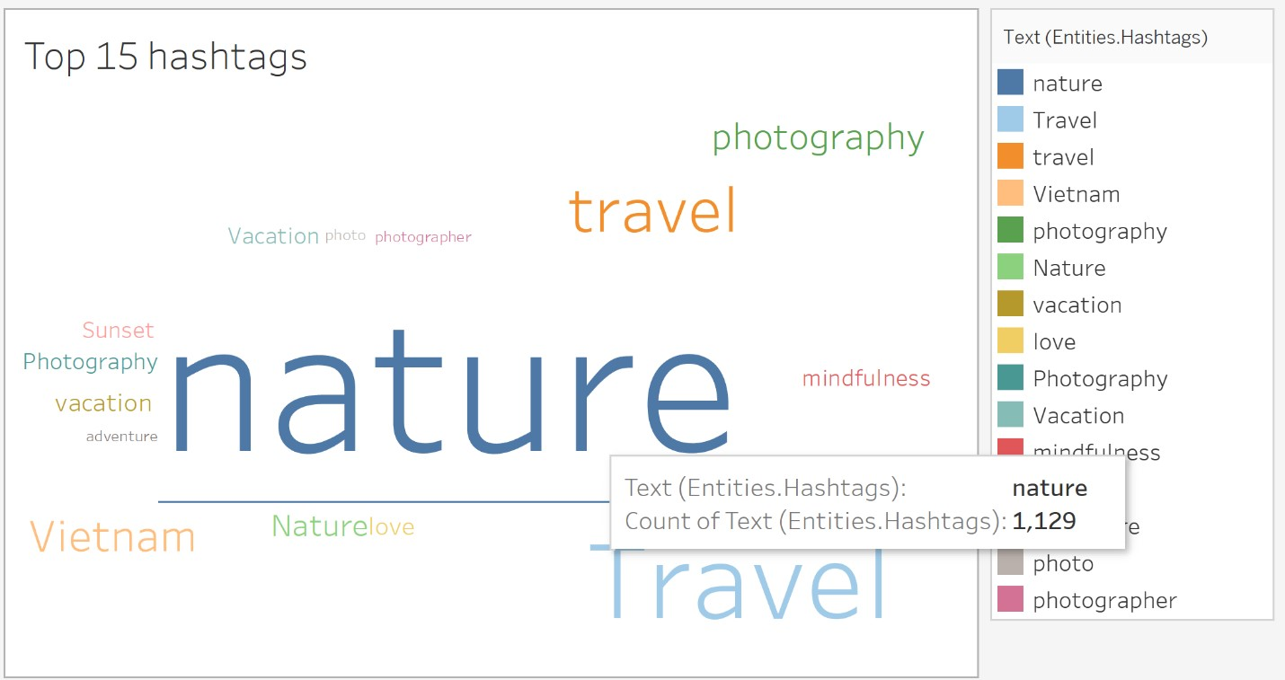
WORD CLOUD BASED ON THE DATA

Slide 30
THANK YOU

