Slide 1



Project Title : Fake Coin Detection Using Divide and Conquer Algorithm
NAME : J.SHREYAA
ROLL.NO : 23ITR151

Slide 2

We are given a collection of identical-looking coins.
One coin is fake, and it is slightly lighter than the rest.
The challenge is to find the fake coin using the least number of weighings.
A balance scale is used for comparisons (not an electronic weighing machine).
The problem is efficiently solved using the Divide-and-Conquer algorithm.
The coins are divided into three groups at each step to minimize comparisons.
The process is repeated on the lighter or unweighed group until the fake coin is found.

Slide 3
Algorithm Design Technique
The algorithm uses the Divide-and-Conquer technique:
Divide the coins into three equal groups.
Compare two of the groups using a balance scale.
Based on the result, discard the heavier group and repeat the process with the lighter group or the remaining one (if balanced).
Repeat until only one coin remains.
3

Slide 4
Appropriate Data Structure
Arrays to represent the set of coins.
Each coin is represented as an object with properties like id and weight.
Arrays are used to simulate groups placed on the left and right pans.
4

Slide 5
Input size and Efficiency Class
Input Size:
The input is the total number of coins (n). It must be at least 3 to ensure proper division into groups of three.
Efficiency class:
The time complexity of the divide-and-conquer approach is approximately O(log₃ n) since the number of coins is divided into thirds at each step.
5

Slide 6
SAMPLE INPUT AND OUTPUT
Input: Number of coins = 9 Randomly selected fake coin = Coin #8
Output (Step-wise simulation):
Step 1: Compare Group1 vs Group2 → Group1 is lighter
Step 2: Compare 3 coins from Group1 → Group1 is lighter
Step 3: Compare individual coins → 🎯 Fake coin found: Coin #4

Slide 7
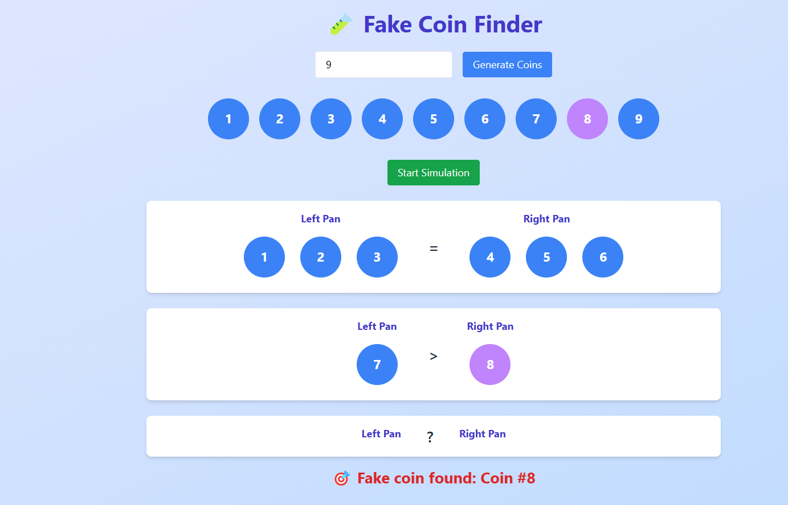
OUTPUT

Slide 8
Thank you!

