Slide 1

DATA VIZUALISATION-Python Project

Slide 2
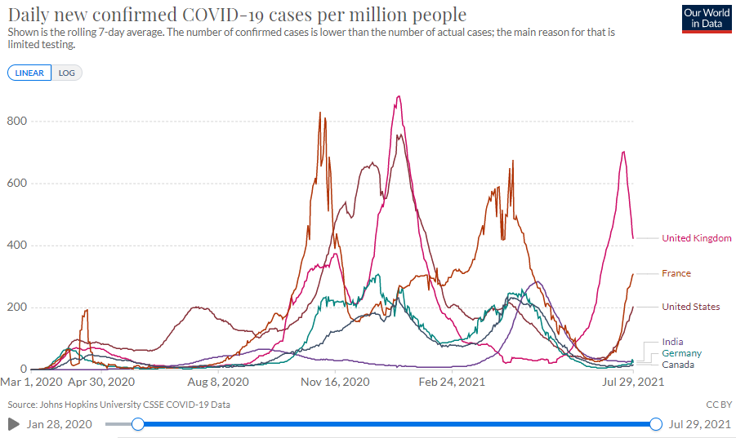
Introduction
We will be going over data on Coronavirus (COVID-19) cases and its impact around the world
Our dataset comprises of 31 columns and 18232 rows
Data types used are int, float and object
Categorical variables are Location and Age
Date Timeline variables are used
Dataset has less than 3% missing values and have either been removed or imputed with means/most frequently occurring values
Note: The data here is sourced from the European Center for Disease Prevention and Control (ECDC), who provide these statistics only

Slide 3
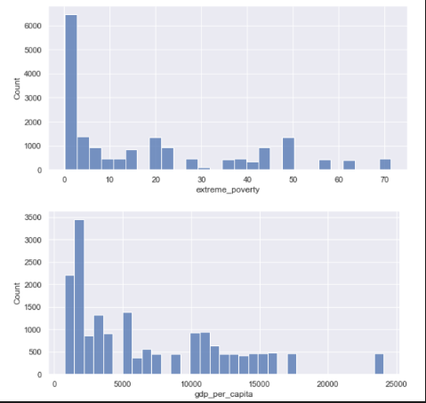
Histogram
Impact of COVID on people in extreme poverty and low GDP per capita
X axis: Extreme poverty & GDP/capita, Y axis: Count
Inference
People with lower income were affected the most
The Dataset is biased towards people with lower GDP per capita
Africa has the highest extreme poverty ratio as per the dataset
We conclude by saying that the exact new case/death per million may not have been registered accurately for those countries with extreme poverty

Slide 4
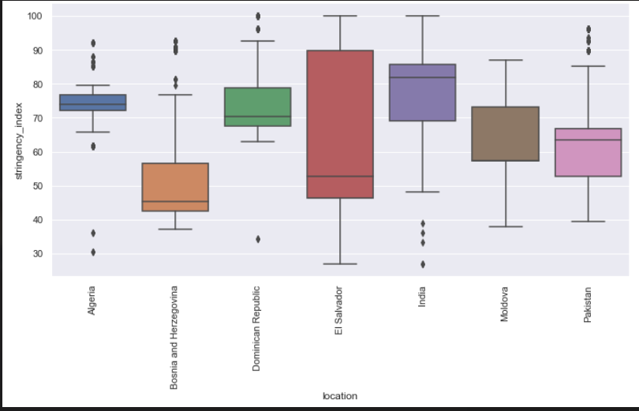
Box Plot
Stringency index across different countries during COVID
X axis: Location, Y axis: Stringency Index
Inference
Bosnia was impacted the most with new case and new deaths/million since they had the lowest range of stringency index (Stringency effects and impacts are captured in the next few slides)
India & El Salvador have the highest stringency index but have been flexible
Algeria has been stringent throughout

Slide 5
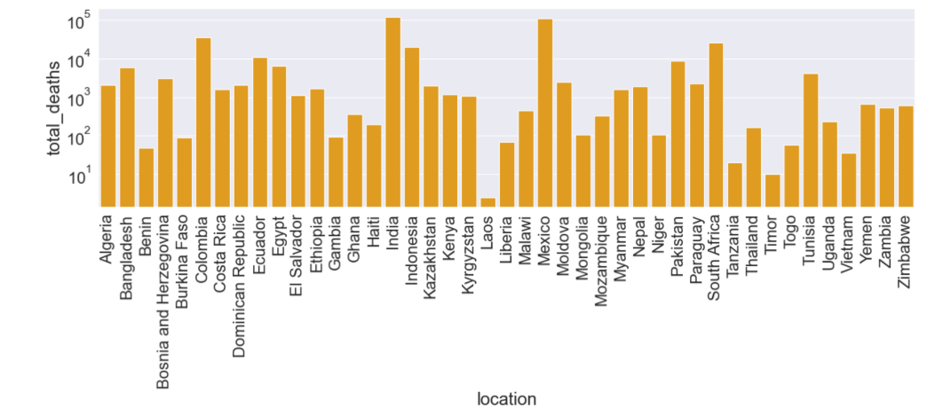
Bar Chart
Total Death counts across all countries
X axis: Location, Y axis: Total Deaths
Inference
India & Mexico have the highest number of death counts
Laos & Timor have the lowest number of death counts
While India and Mexico have the highest death rates it does not mean these two countries also have the highest number of cases/million which is captured in the next few slides

Slide 6
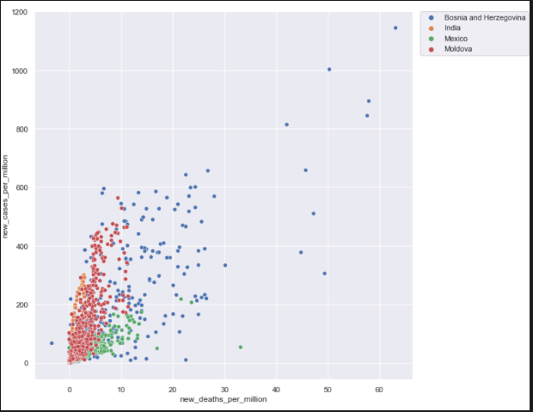
Scatter plot
New deaths/million differed for countries with new cases registered
X axis: New deaths/millions, Y axis: New Cases/million
Inference
Bosnia experienced the most surge in cases and deaths/million
Even though there were few new cases registered as compared to other countries their death rate was still on the higher side
Moldova reported close to 590 new cases/million, however, the death rate never crossed 12/million
In Mexico, the death rate was high in spite of fewer new cases being registered

Slide 7
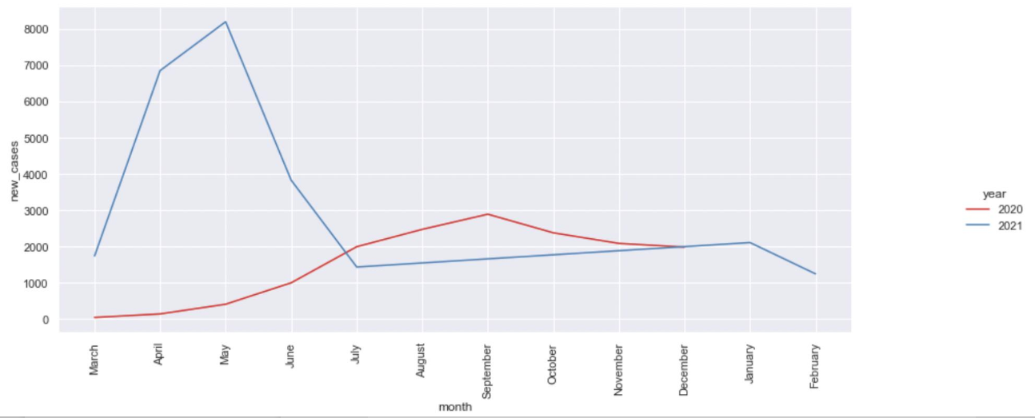
Line Chart
Number of cases through 2020 vs 2021
X axis: Months, Y axis: Total number of new cases registered
Inference:
In 2020, most new cases were registered in the month of September
In 2021, most new cases were registered in the month of May
New cases registered are more in 2021 when compared to 2020

Slide 8
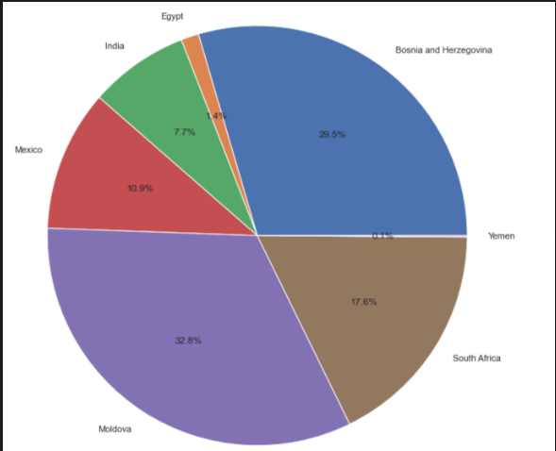
Pie Chart
Total cases/million across India, Egypt, Pakistan, South Africa, Yemen, Moldova, Bosnia & Herzegovina,
Inference
Amongst the countries compared
Yemen has the least number of cases registered/million
Moldova has the most number of cases registered/million
People assume that the most populated countries(ex: India & Mexico) are usually the ones most impacted per million but this pie chart proves the very hypothesis wrong

Slide 9
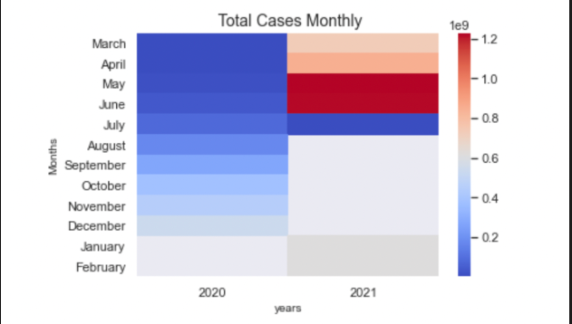
Heat Map
Total COVID Cases registered from January to December in 2020 & 2021
X axis: Years 2020, 2021, Y axis: Months (Jan – Dec)
Inference
May & June in 2021 has the highest number of cases recorded
March & April in 2020 has the lowest number of cases recorded
Total number of cases increased rapidly from March 2020 through June 2021

Slide 10
CONCLUSION
The Dataset is biased towards people with lower GDP per capita
Stats show that Bosnia was impacted the most with new case and new deaths/million since they had the lowest range of stringency index
While India and Mexico have the highest death rates it does not mean these two countries also have the highest number of cases/million which is captured in the next few slides
In 2021, most new cases were registered in the month of May & New cases registered are more in 2021 when compared to 2020
People assume that the most populated countries(ex: India & Mexico) are usually the ones most impacted per million but our pie chart visualization proves the very hypothesis wrong
Total number of cases increased rapidly from March 2020 through June 2021

Slide 11
Recommendations
Better data analysis can be performed if there is availability of vaccinations on the data set.
Information on the number of people tested for covid is not available.
Other factors if present may affect the data set and will help us understand the data set better.
Data on the age group and the gender of the people affected with covid will give us more information.
It will be helpful if we had data on individual level rather than country specific for example : the pre-existing health conditions of certain individuals.
The data on the cause of death is not available.

Slide 12
Appendix
Smoothing data removes random variation and shows trends and cyclic components. Inherent in the collection of data taken over time is some form of random variation. There exist methods for reducing of canceling the effect due to random variation. An often-used technique in industry is "smoothing".
(GDP) is one of the most common indicators used to track the health of a nation's economy. The calculation of a country's GDP takes into consideration a number of different factors about that country's economy, including its consumption and investment.
Stringency Index Government Response Stringency Index: composite measure based on 9 response indicators including school closures, workplace closures, and travel bans, rescaled to a value from 0 to 100 (100 = strictest response)
Handwashing facilities - Share of the population with basic handwashing facilities on premises, most recent year available

