Slide 1
HCI Assignment 4
UI/UX Case Study
Submitted By:
Shreya Banerjee PES1201700198
Rachana B Karennavar PES1201700653
Prerana Sirigeri PES1201701497

Slide 2
Overview :
Have you ever looked for a college for your friend/relative or yourself?
Do you know anyone who is going through this process and having a hard time?
Did you find it difficult to compare different institutions because of lack of information?
We tried to analyse the requirements of a user looking for a good educational institution. Here’s what happened.

Slide 3
Title: College search portal
Statement: ‘Find your college’ app helps the user to find an appropriate college based on a number of factors.

Slide 4
Users & audience:
The users mainly consist of parents and students looking for an appropriate college based on a number of factors.
Roles and Responsibilities:
The team consisted of three members ( Shreya, Prerana and Rachana). We got together and decided who we are making this for, what their motivations will be and what we want to achieve.

Slide 5
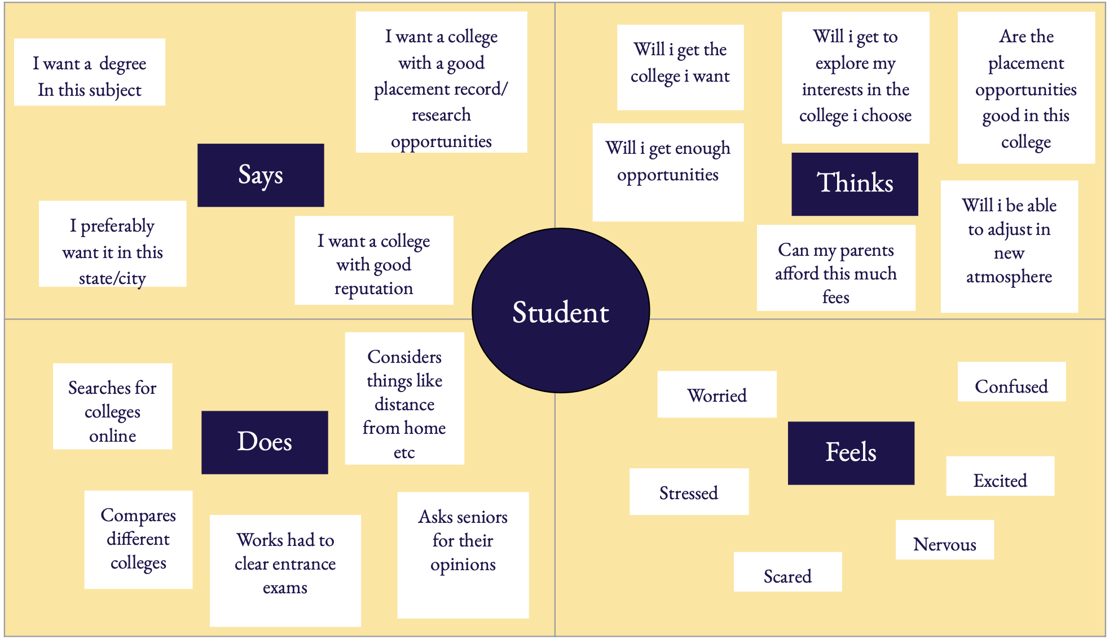
Process and what we did :
The first step was to empathize with the users. For this, we designed empathy maps for parents and students looking for a college.

Slide 6
The empathy map gave us some idea about the user and their needs. We noted the major few requirements:-
Merit
Fees
Location
Need to know about the culture of college from the students itself
Faculty
Future opportunities

Slide 7
Ideate - After identifying the user needs, the next step was to generate ideas for the design.
Brainstorming
We sat down and used a bunch of sticky notes to come up with different kinds of ideas. The notes were discussed ,hierarchically structured and grouped into themes so as they represent a visual map of the best ideas.

Slide 8
b) User flow
The next step was to form a user flow diagram outlining the steps a user has to go through with the product.

Slide 9
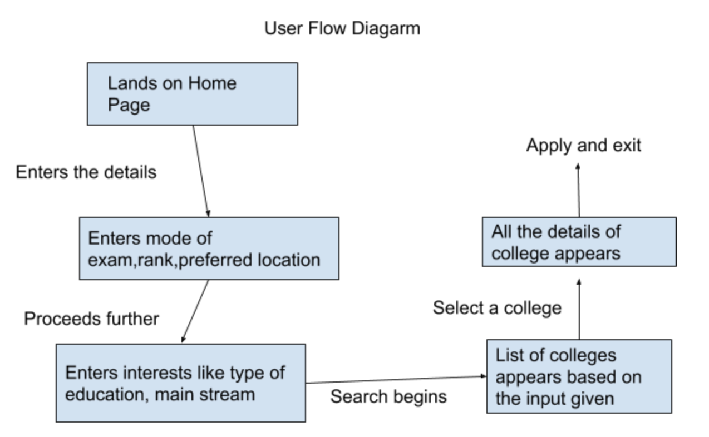

Slide 10
c) Storyboarding
A storyboard is a comic strip, outlining user’s actions and circumstances under which these are performed.We used this concept to not only demonstrate what the user does but also reveal the environment, which might be affecting how or why the user does something.

Slide 11
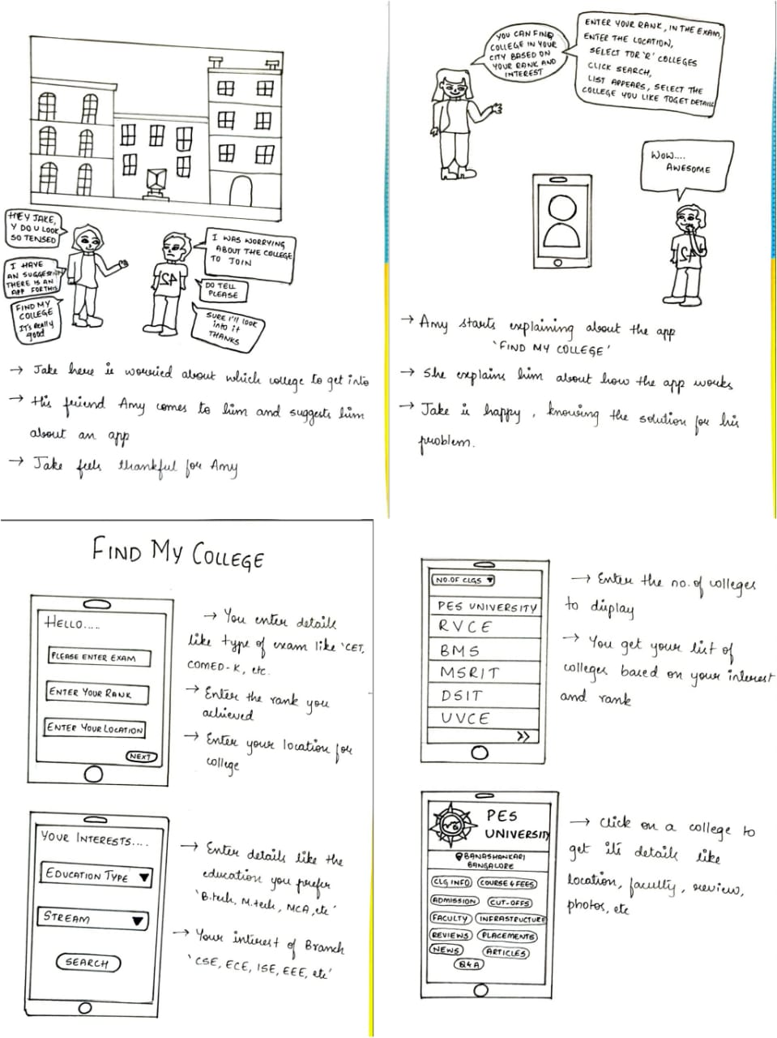

Slide 12
Outcomes & Results :
The UI design is easy to understand for the users.
The first page asks for the rank as input, which covers the merit ambiguity for the user.
Further, the results are filtered on the basis of degree type and stream wanted by the user.
Out of the available colleges, the user can explore each one, get details about the faculty, placements, features in news and read the reviews given by students.
All of this is just a click away.

Slide 13
THANK
YOU

